Slide 1
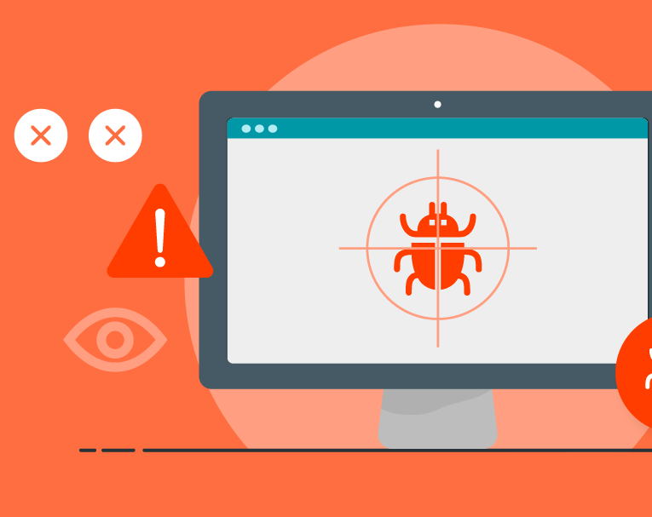
Bug Tracker

Slide 2
Divyashree S
Gouthami S
Manasa S
Vaishnavi I
Tejaswi V
Lakshmi Chandana P
Team Members

Slide 3
Content
Introduction
Modules
Case Study Statement
Class diagram
Software Requirements
Conclusion

Slide 4

Bug Tracker
Bug Tracking System is a web-based application that is designed to help quality assurance and programmers keep track of reported software bugs in there work. Bugs will assigned to a person to a person with a bug Id, bug Description, bug Status.
A bug tracking system is usually a necessary component of a professional software development infrastructure, and consistent use of a bug or issue tracking system is considered one of the "hallmarks of a good software team“.

Slide 5
Purpose of Bug Tracker Application
Bug Tracking System is to test the application for the bugs and report it to the Admin and Employee.
The main intention behind the Bug Tracking System is that to track bugs and report them.
Store the bug information with a unique id in the database.

Slide 6

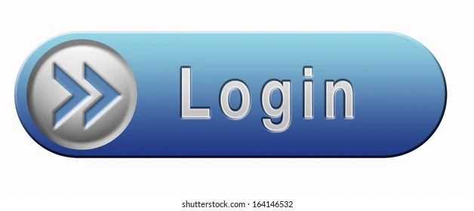
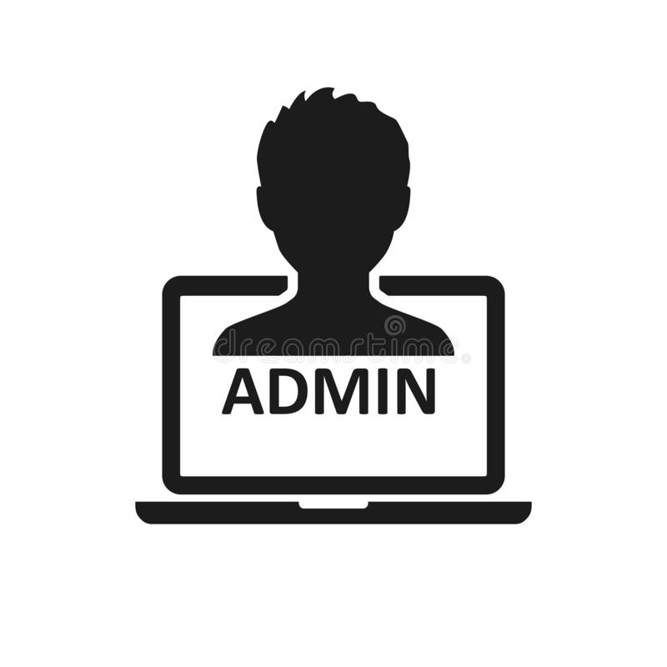





Employee
Modules
User
Address
Bug

Slide 7
Case Study on Bug Tracker
The application has 3 main modules:
Admin
Employee
User
The Admin can log in to the application and enter the details of the project and employees, view the complaints of users, assign tasks to the members, track the bug resolution status and send messages to users.
The Employee can log in to the application to view bug complaints assigned to them and start working on them.
If a member is unable to resolve a bug, they can forward the problem to another member.
As for the users, they can view the progress status of their bug complaints.
The User can also use the ticket number generated during the submission of their compliant and view the solution plan details for the same. In this way, the bug tracking application keeps the process of monitoring and resolving software bugs transparent and seamless.

Slide 8
Sub Modules
Address
Login
Project
Bug
Address - a request is made in the application asking for an issue, change of address, notifying any changes in the role and it will collect the current address of the user.
The Login Module is a module that allows users, admin and employees to type a email/username and password to log in. This module can be placed on any module tab to allow users, admin and employees to log in to the system.
The Project module is to develop a Client / Server based management system that would be mainly based on Client-Server, which provides a great support to Admin, Employee and other development team.
The Bug module keeps track of bugs that the user encountered in any software development or in any project. There are mainly three options out of which user can select the functionality as Create New Bug, Change Status of Bug, Report a Bug or Exit.

Slide 9
Class Diagram
User: Id FirstName LastName
Login: Email Password Role
1
1
Address: Id City State Pincode
Admin: Id Name Contact
Employee: Id FirstName LastName Designation
1
Project: ProjectId ProjectName ProjectType Technology Client
Bug: Id BugStatus Description createdBy createdDate
M
1
1

Slide 10
Software Requirement
Spring tool suite
PostgreSQL
Swagger/Postman
Tomcat server
Junit Testing
Mockito Testing

Slide 11
Conclusion
Bug Tracking System helps to detect and manage the bugs in software products effectively.
This project BTS can be used to track the bugs in the project modules and assist in troubleshooting errors for testing and for development processes.
This project highly avoids all sources of delay in bugs reporting level within the project modules in the software industry. As application is deployed in a company server, it is much more secure.

Slide 12


