Slide 1
A.DIVYASRI
B.Tech-INFORMATION TECHNOLOGY(3RD YEAR)
UNIVERSITY COLLEGE OF ENGINEERING VILLUPURAM.
REGISTER NO:422521205012
MAIL ID:divyasriashok2004@gmail.com

Slide 2
PROJECT TITLE
Chatbot for E-commerce Website

Slide 3
AGENDA
Project Overview
Project Structure
Prerequisites
Installation
Training the Chatbot
Usage
Technologies Used
Result
Conclusion

Slide 4
PROJECT OVERVIEW
The chatbot is a conversational AI designed to engage with customers visiting the e-commerce website. It can answer common questions, provide product details, offer recommendations, and handle customer inquiries related to products, payments, delivery, and more. The chatbot is built using Python and relies on natural language processing techniques to understand and respond to user queries.

Slide 5
PROJECT STRUCTURE
The project consists of the following files and folders:
`train.py`: This script is used to train the chatbot's machine learning model using PyTorch. It reads the intents and responses from `intents.json`, preprocesses the data, and trains the neural network.
`nltk_utils.py`: This file contains utility functions for tokenization, stemming, and creating a bag of words from sentences.
`model.py`: It defines the neural network architecture used for the chatbot.
`intents.json`: This JSON file contains the intents, patterns, and responses used for training the chatbot.

Slide 6
`chat.py`: This script loads the trained model and provides a function to generate responses based on user input.
`app.py`: This is a Flask web application that serves as the interface for the chatbot. It handles user input, sends it to the chatbot, and displays the responses.
`templates`: This folder contains an HTML template (`index.html`) used for rendering the chat interface.
`static`: This folder contains CSS styles.

Slide 7
prerequisites
Before you begin, ensure you have met the following requirements:
- Python (>=3.6) is installed on your system.
- You have access to a terminal or command prompt.

Slide 8
installation
1.Clone the repository to your local machine:
2.Change to the project’s directory:
```bash
cd chatbot-for-ecommerce
```
3.Install the required dependencies by running:
```bash
pip install –r requirements.txt
```

Slide 9
TRAINING THE CHATBOT
To train the chatbot model, follow these steps:
1. Open a terminal and navigate to the project directory if you're not already there.
2. Run the training script:
```bash
python train.py
```

Slide 10
usage
1. Start the Flask web application by running:
```bash
python app.py
```
2. Access the chatbot interface by opening a web browser and navigating to http://localhost:5000.
3. Use the chat interface to interact with the chatbot. Type a message, and the chatbot will provide responses based on the trained model and the content of intents.json.
4. You can ask questions about products, payments, delivery, and more.

Slide 11
Technologies used
Python
PyTorch
Flask
NLTK (Natural Language Toolkit)

Slide 12
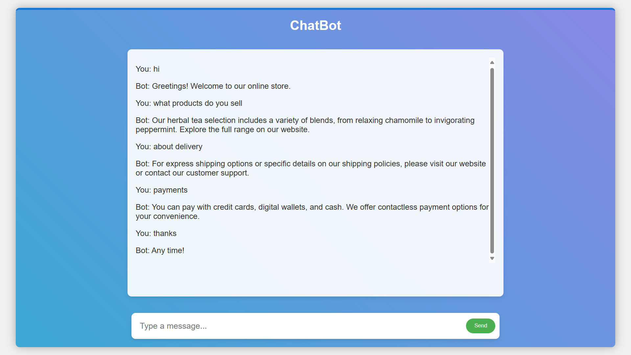
Result

Slide 13
conclusion
Our ecommerce chatbot project aims to enhance customer experience and streamline shopping processes. By providing instant assistance and personalized recommendations, it improves user satisfaction and boosts sales. Through continuous updates and feedback integration, we strive to optimize the chatbot's performance and adapt to evolving customer needs. Ultimately, our goal is to revolutionize online shopping by making it more convenient, efficient, and enjoyable for all users.

Slide 14
Thank you☺

