Slide 1



Hypothesis Testing:
Hypothesis testing is a statistical method used to make decisions about the properties of a population based on a sample of data. It involves formulating two competing hypotheses - the null hypothesis and the alternative hypothesis - and then using statistical analysis to determine which hypothesis is more likely to be true.

Slide 2

Null Hypothesis and Alternative Hypothesis
1
Null Hypothesis (H₀)
2
Alternative Hypothesis (H₁)
3
Significance Level (α)
A statement that there is no significant difference or relationship between the variables being studied.
The maximum acceptable probability of rejecting the null hypothesis when it is true (Type I error).
A statement that there is a significant difference or relationship between the variables being studied.
4
P-value
The probability of obtaining a test statistic at least as extreme as the one observed, assuming the null hypothesis is true. It's used to determine whether the null hypothesis should be rejected.

Slide 3
Z-test
Assumptions
Applications
The population standard deviation is known, and the sample size is large (n > 30).
Quality control, market research, and other scenarios with large sample sizes and known population parameters.
Example
Suppose a company claims that the average weight of its cereal boxes is 12 ounces. To test this claim, a random sample of 50 boxes is taken, and the sample mean is found to be 11.8 ounces with a population standard deviation of 0.5 ounces.

Slide 4
T-test
Assumptions
Example
Types of T-test
The population standard deviation is unknown, and the sample size is small (n < 30).
Evaluating the effectiveness of a new teaching method by comparing the test scores of two small student groups.
One-Sample T-Test
Two Sample T-Test
Paired T-Test

Slide 5


Choosing Between Z-test and T-test
Population Standard Deviation
Sample Size
Known → Z-test, Unknown → T-test
Large (n > 30) → Z-test, Small (n < 30) → T-test

Slide 6
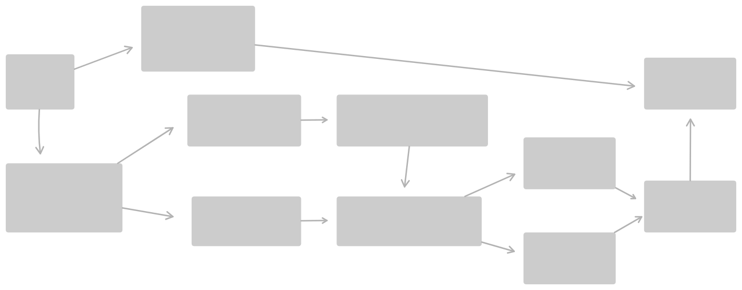
Project Overview
Develop a tool for performing hypothesis tests (Z-Test and T-Test) using Streamlit.
Features:
User-friendly interface for data input.
Option to upload CSV files or enter data manually.
Guidance for choosing the appropriate test using OpenAI.
OpenAI Guidance
Start
End
Upload CSV file
Data Processing
T-Test
perform hypothesis testing
Result Display
Enter data manually
Test Selection
Z-Test

Slide 7
Why
Easy to use for users with minimal statistical knowledge.
Guidance for test selection.
Flexible data input options.

Slide 8
Thank You
Thank you for your time and attention

