Slide 1
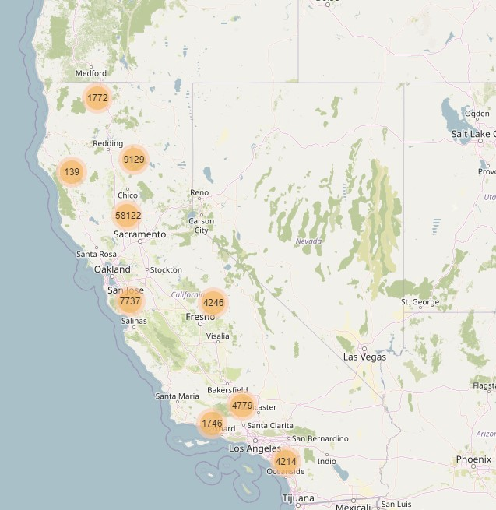
California Wild Fire Analysis:Insurance
BY
Divya vinu

Slide 2
Findings & Summary
Some key findings which we analyzed based on the shared data for California Wildfire Risk areas as below
Age of the Building: Properties Built during the period 1950 to 2000 reported most of the incidents( >50%)
Wildfire Perimeter Risk based on Historic data: more than 35% of the cases reported are within the Risk perimeter
Known Vegetation burn Risk site: above 80% reported are within ½ mile from Vegetation burn site
% of damage reported and the total incidents per category: 45% of the properties are damaged above 50%, more likely to be write-off.
Property Structure Type: Single residence property is most impacted.
Most and Least impacted County’s : Further analysis to be done on County’s which are most reported
Based on these findings, the recommendation should be to consider above factors before making insurance approval decisions.

Slide 3
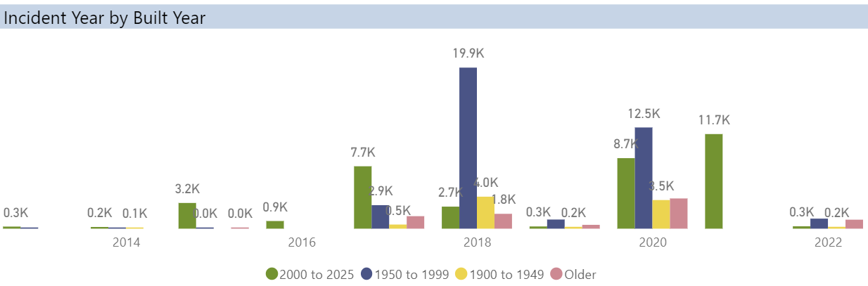
The majority of claims occurred between 2018 and 2020.
A significant portion of the claims came from homes constructed between 1950 and 1999.

Slide 4
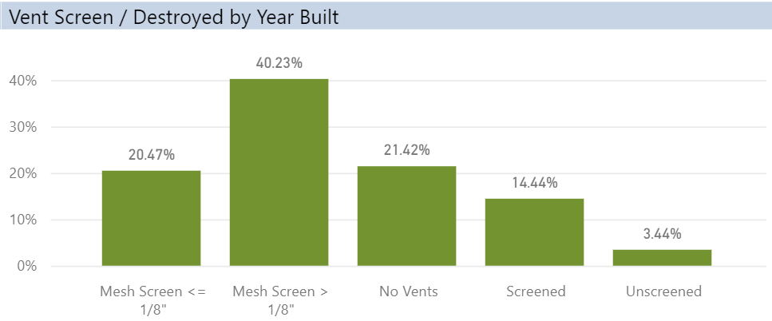
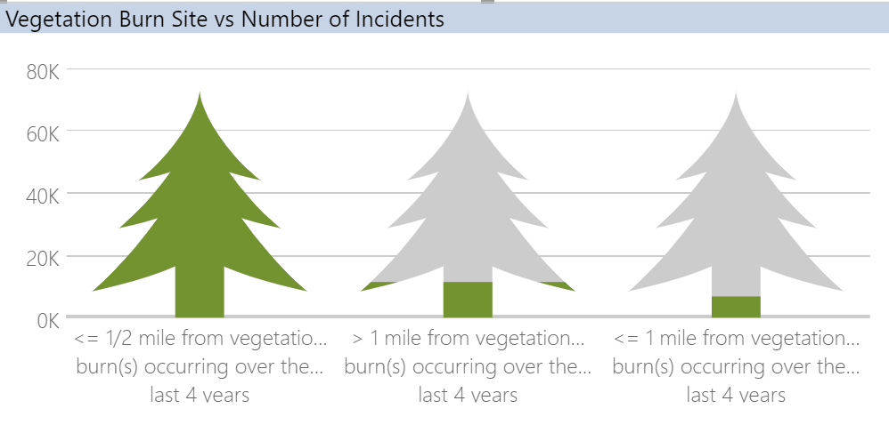
Vent Screen provides validation based on property damage that is more than 50% damaged.
We observe a maximum impact of 40% for the number of homes with mesh screens higher than 1/8".
Based on analysis of vegetation burn sites
Less than 0.5 miles separated the reported
Incidents from the vegetation burn(s) that took place over the previous 4 years.

Slide 5
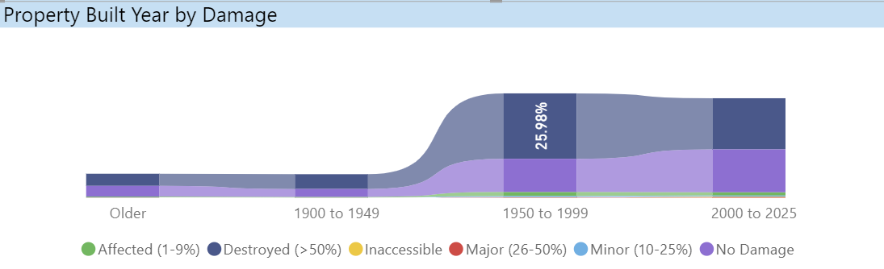
Homes built between the years 1950 and 1999 (41%) and 2000 to 2025 (40%) were the most damaged and had the highest rate of insurance claims related to fire. whereby 26% and 20% of the homes sustained damage of over 50%.

Slide 6
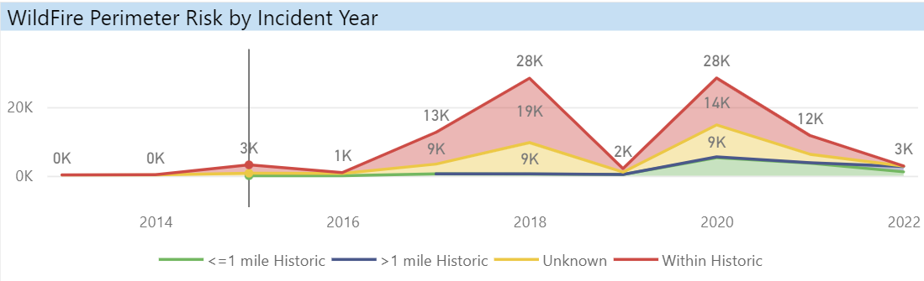
Based on Wildfire Perimeter Risk analysis, Most events that were reported came from the Historic Perimeter Wildfire Risk Area.
From this zone, 40k incidents were reported. In general, one of the factors to consider before issuing insurance is wildfire perimeter.

Slide 7
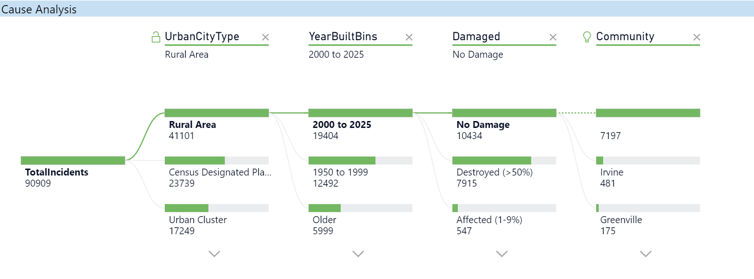
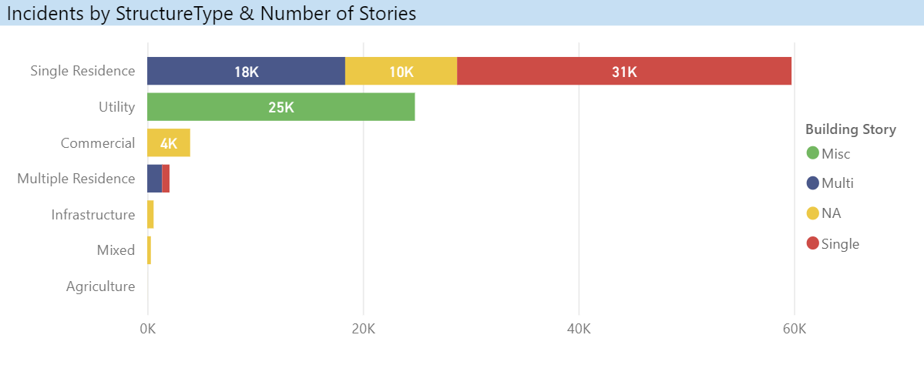
Created to show the split of Total Incidents reported based on
Urban City → Year Built → % Damaged → Community.
Based on the number of story’s and the type of structure, we see the majority of incidents ( 64 %) came from single- residence and 31,000 of those were in one-story structure.

Slide 8
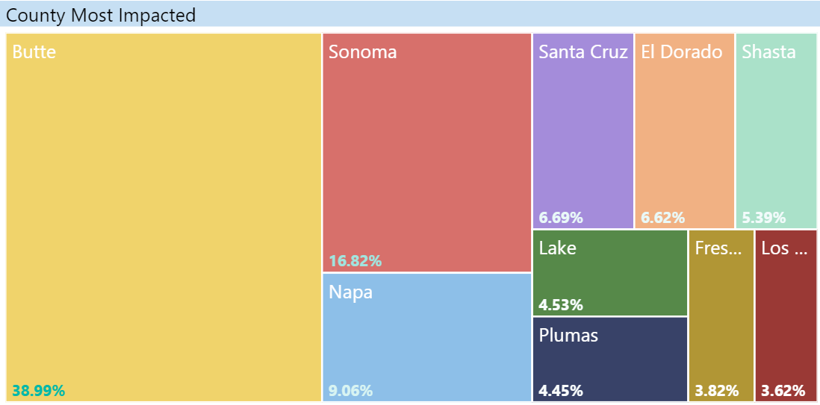
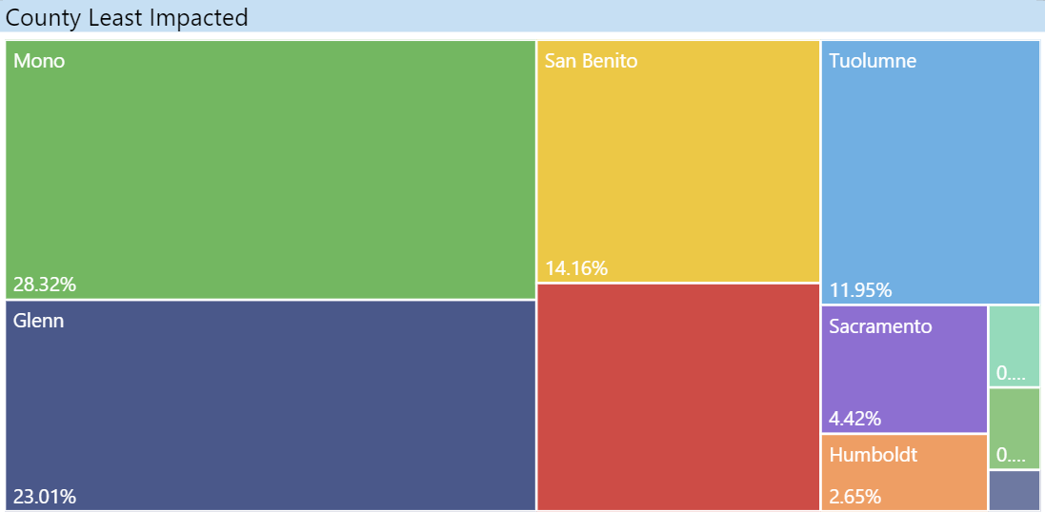
Represents the most affected and least affected county’s:
Most affected County:Butte,Sonoma,Napa
Least Affected County:Mono,Clenn,SanBenito

Slide 9
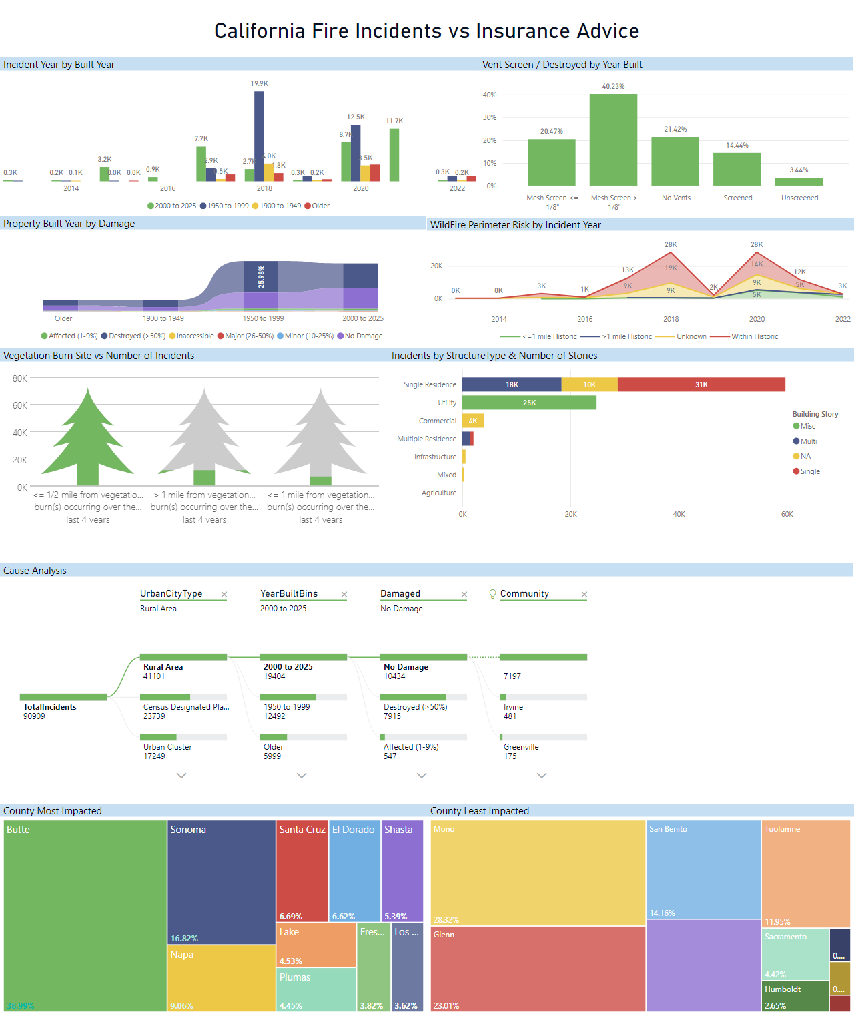

Slide 10

Files
Files:
CSV file with raw data
PBIX file which have the visualizations and methods used – Primary
Jupyter notebook
Powerpoint Presentation

Slide 11
Thank You

