Slide 1
Topic
Presentation on Full Stack Project
Smart Exam Portal
by
G-4
Deepansh Goel: 2310990320
Dilnawaz: 2310990326 Divye Rana: 2310990329
Supervised by: Rahul Sir
Department of Computer Science and Engineering, Chitkara University, Punjab

Slide 2
Table of Contents
Problem Statement
Objective / Purpose
Main Topics / Sections (Depends on your topic)
Future Scope
Conclusion
References (if applicable)
Q&A / Discussion

Slide 3
Problem Statement
Traditional examination systems are inefficient, prone to delays, and lack transparency for both students and administrators. Students face difficulties in accessing exams, submitting answers on time, and reviewing past performance. Administrators struggle with securely creating exams, managing questions, and ensuring fair evaluation. The Smart Exam Portal solves these issues by providing secure JWT-based login, an admin interface for exam and question management, and a student interface to attempt exams within a timed window. , automatic submission on timeout, and a results dashboard for performance tracking. This ensures exams are conducted seamlessly, securely, and transparently for all stakeholders.

Slide 4
Objective / Purpose
Enhance Student Engagement: Integrate interactive exam interfaces, real-time timers, and instant feedback features to keep students focused and motivated throughout their exams.
Expand Accessibility: Ensure the portal is accessible on both desktop and mobile devices, allowing students and administrators to manage and attempt exams anytime, anywhere.
Elevate User Experience: Continuously refine the portal’s interface for intuitive navigation, clear instructions, and seamless interaction, ensuring a smooth and stress-free exam process.
Strengthen Administrative Control: Provide robust tools for administrators to create exams, manage questions, track student performance, and generate detailed reports efficiently.
Overall Goal: Establish the Smart Exam Portal as a reliable, secure, and user-friendly platform for online examinations, offering fairness, transparency, and efficiency for all stakeholders.

Slide 5
Main Topics / Sections
1. User-Centric Design
Responsive Interface: Built with React to provide a seamless experience across desktops, tablets, and mobile devices for both students and administrators.
Enhanced User Experience: Intuitive layouts, fast load times, and smooth navigation ensure stress-free exam participation and efficient admin operations.
2. Efficient Backend Architecture
Scalable and Real-Time Operations: Developed using Node.js/Express.js to handle concurrent exam attempts, autosave requests, and real-time result tracking.
Dynamic Data Management: Efficient handling of exams, questions, student responses, and performance data for timely updates and accurate results.
3. Secure and Scalable Database
Database Integration: Robust database (MongoDB) securely stores student profiles, exams, questions, attempts, and results while maintaining data privacy and scalability.

Slide 6
Main Topics / Sections
4. Advanced Features Implementation
Exam Management: Admins can create, update, and schedule exams; students can attempt exams with timers, autosave, and automatic submission.
Performance Tracking: Students can view past results and performance analytics; admins can generate detailed exam reports.
5. Administrator and Student Collaboration
Admin Panel: Centralized portal for managing exams, questions, student registrations, and results.

Slide 7
Future Scope
Expanded Exam and Question Types
Introduce additional question formats such as coding questions, file uploads, and interactive simulations. Enable real-time updates to exams and questions, ensuring students always access the latest content.
AI-Powered Exam Assistance
Implement AI-driven tools for auto-grading objective questions and providing instant feedback.
Introduce smart recommendations for practice questions, time management tips, and learning resources tailored to each student.
Advanced Analytics and Reporting
Provide administrators with detailed exam analytics, question difficulty insights, and performance trends. Use predictive analytics to improve exam design and optimize student outcomes.
Scalability and Integration
Support integration with third-party tools for notifications, calendar scheduling, and analytics.
Ensure the system remains scalable to handle large numbers of simultaneous users during peak exam periods.

Slide 8
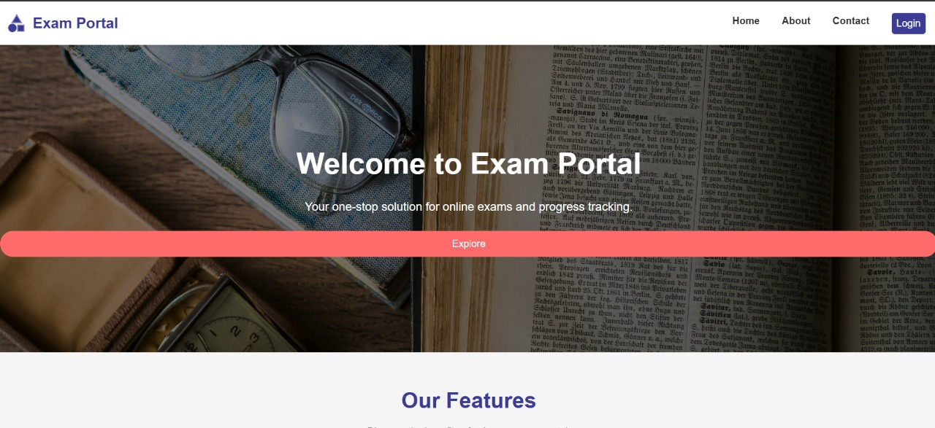
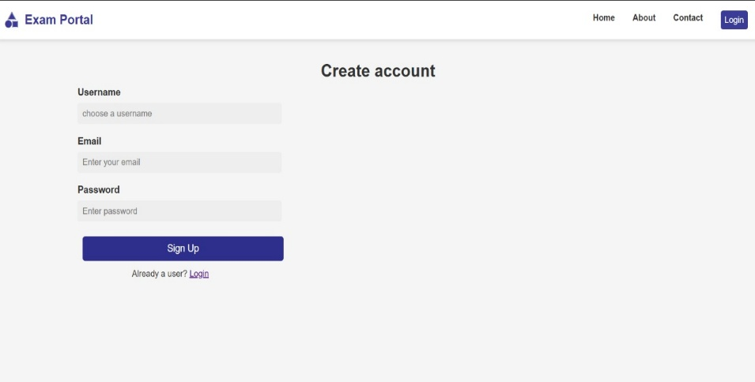
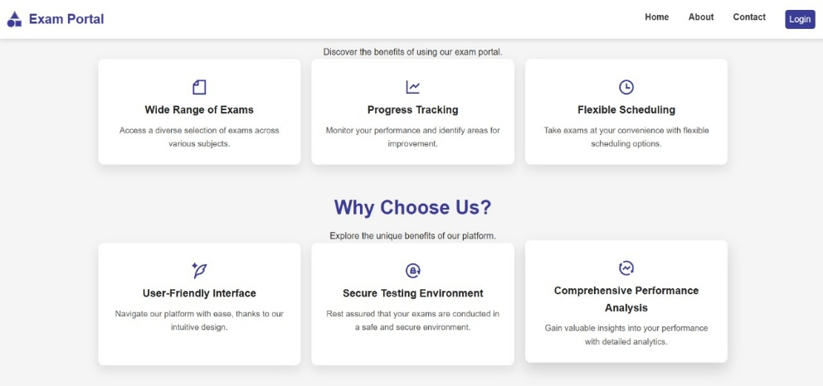
Project Snippets

Slide 9
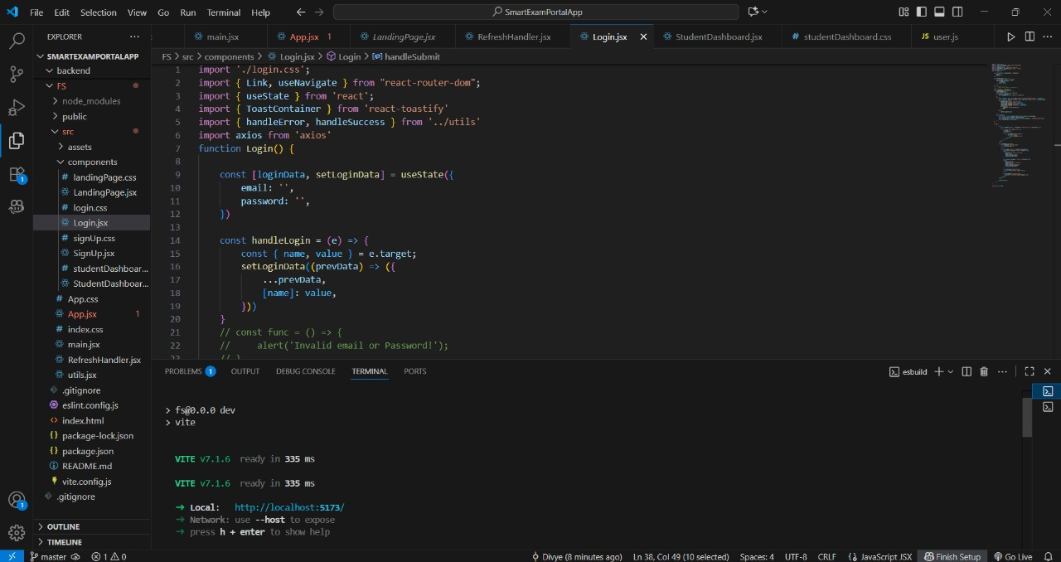
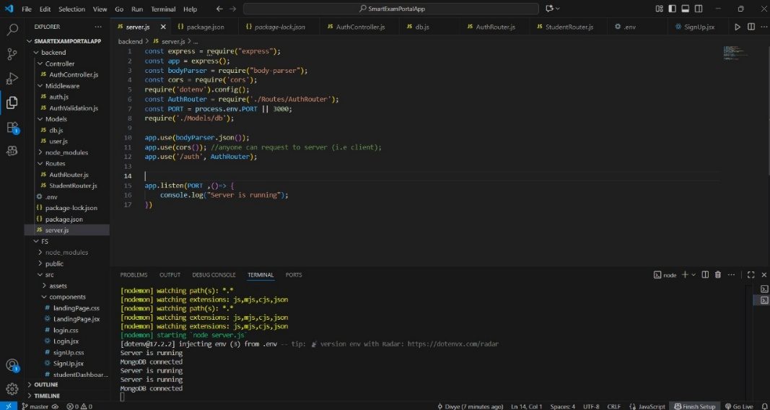
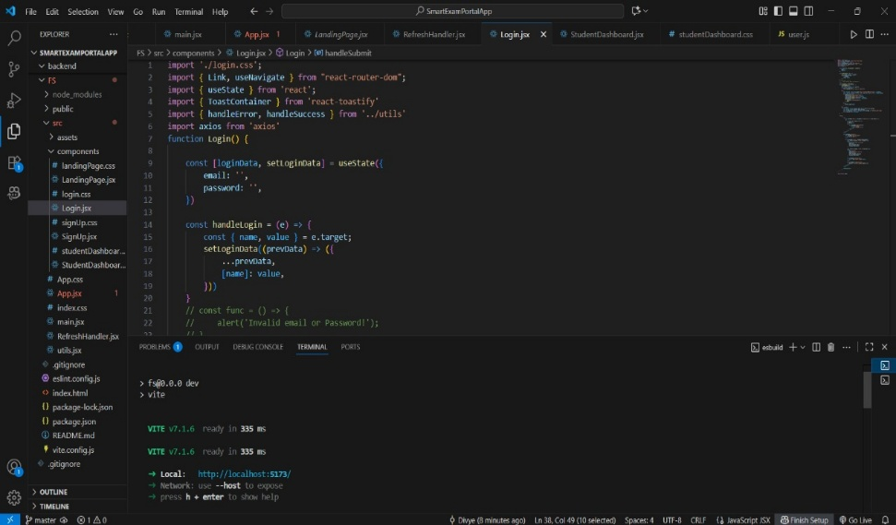
Code Snippets

Slide 10
Conclusion
Seamless User Experience The portal offers a responsive and intuitive interface for both students and administrators, ensuring smooth navigation across desktops and mobile devices for effortless exam participation and management.
Efficient Backend Operations Powered by Node.js/Express, the backend supports scalable, real-time processing of exam attempts, autosave, automatic submissions, and live result tracking for reliability and performance.
Secure and Scalable Database Using MongoDB, the system securely stores student profiles, exams, questions, attempts, and results, ensuring data confidentiality while supporting a growing user base.
Robust Infrastructure Built on a secure and scalable cloud infrastructure, the portal guarantees high availability, reliability, and smooth handling of concurrent exam takers, while allowing future integration of advanced features like analytics and AI-based recommendations for exam preparation.

Slide 11
References
Official Documentation: Documentation for libraries, frameworks, and tools used in the project, as well as APIs or services integrated.
https://www.google.com/
Tutorials and Guides: Online tutorials, guides, blog posts, and educational videos that provided assistance or insights during development.
https://www.geeksforgeeks.org/
Code Repositories: GitHub repositories or other code repositories where code snippets, examples, or inspiration were found.
https://chat.openai.com/
Forums and Communities: Online forums, such as Stack Overflow or Reddit, and developer communities where questions were asked, advice was sought, or discussions were participated in.
Personal Communication: Mentors, peers who provided guidance, feedback, or support during development.

Slide 12
Q&A / Discussion
Ensuring Cross-Device Responsiveness
Challenge: Developing a user interface that works seamlessly across desktops, tablets, and mobile devices for both students and administrators.
Solution: Utilized React’s responsive design principles and thoroughly tested the portal on multiple devices to ensure smooth navigation and accessibility during exams and admin operations.
Dynamic Exam and Result Handling
Challenge: Efficiently fetching and displaying exam questions, student responses, and result data without affecting performance.
Solution: Implemented optimized API endpoints to minimize load times and ensure timely updates for students and administrators.

Slide 13
Q&A / Discussion
Scalability of the Backend
Challenge: Designing a backend capable of handling multiple concurrent exam attempts, and result submissions in real-time.
Solution: Used Node.js/Express for real-time request handling, ensuring smooth exam workflows and scalability as the number of users grows.
Database Optimization
Challenge: Managing and scaling the database to store exams, questions, student attempts, and results while ensuring fast queries and data integrity.
Solution: Created a well-structured schema, implemented indexing strategies, and optimized queries for quick retrieval and seamless exam experience.
Administrator and Student Management
Challenge: Streamlining exam creation, student registrations, and tracking results efficiently.
Solution: Developed a dedicated admin panel for creating exams, scheduling, monitoring student activity, and generating reports, ensuring efficient system management and user support.

