Slide 1
Short-term Prediction of User Motion from Live Tracking Data
CMS-PRO - Research Project
Interactive Media Lab Dresden
Institute of Software and Multimedia Technology
Presenter : Divyendu Dutta
Supervisor : Dr.-Ing. Wolfgang Büschel
May 27, 2024

Slide 2
Contents
Introduction
Background and Related Work
Benchmarking 3D Human Motion Prediction Models
Results
Conclusion

Slide 3
Introduction

Slide 4
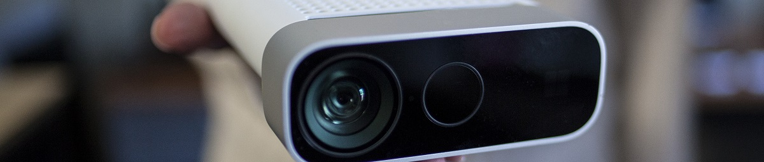
Introduction
Motivation
Live human tracking used in many fields
Virtual Reality (VR)
Augmented Reality (AR)
Robotics
Human-Computer Interaction (HCI)
Delay between tracking and data availability of tracking systems
Impedes analysis and sabotages user experience in real-time applications
Use of 3D human motion prediction to reduce latency
Gap in integration of 3D human motion prediction models with live tracked data
Necessary to carefully explore various aspects of such deep learning models
[1]
Microsoft Kinect

Slide 5
Introduction
Task Description
Comprehensive exploration of the relevant literature and related prior work
Comparison and evaluation of the latency and accuracy of specifically selected 3D human motion prediction models
Selection of the best model with low latency and high accuracy for use in real-time applications
Note
Evaluated using standardized human motion datasets rather than actual live-tracked human motion data
Not all models were evaluated using a common framework

Slide 6
Background and Related Work

Slide 7
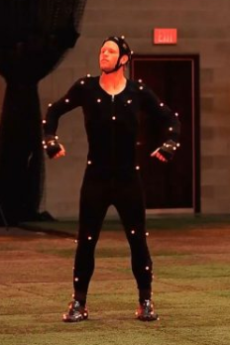

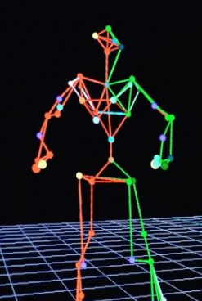
Background and Related Work
Challenges in Real-Time Human Motion Tracking
Tracking systems capture RGBD images and process them to determine human poses
Delay between tracking and data availability of tracking systems
Could include networking delay
Delay
[10]
[10]
Tracking
Visualization

Slide 8
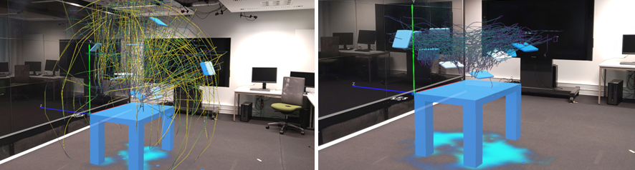
Background and Related Work
Human Computer Interaction (HCI) and Live Human Motion Tracking
Previous works like MIRIA show that 3D position data of rigid bodies analyzed in-situ via AR lead to better spatial interaction analysis [11]
Extended to an entire humanoid avatar
Delay introduced by tracking systems can cause bad user experience and hinder visual analysis
[11]

Slide 9

Background and Related Work
Short-Term Human Motion Prediction
Humans navigate by predicting others' actions; machines use 3D human (user) motion prediction for this
Predicting future movement poses given past motion poses
Seed Sequence
Target Sequence
Short Term
Pose Prediction
Generative Modelling Task
Long Term
(Spatial + Temporal) information

Slide 10
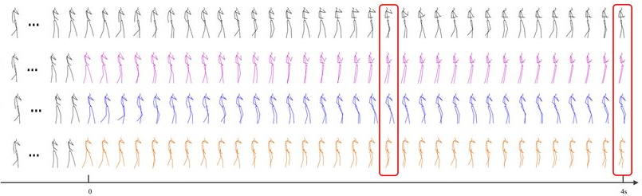
Background and Related Work
Short-Term Human Motion Prediction to Mitigate Latency in Motion Tracking
Predict future poses at a fast enough rate to mitigate introduced delay
Eg, need to predict the future frames faster than 33.3 ms (frame time) to make up for the original delay introduced by the Kinect sensor

Slide 11
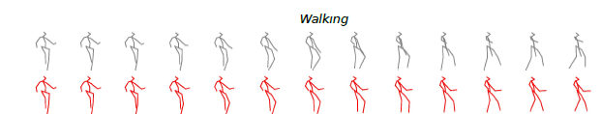
Background and Related Work
Selection of Appropriate Human Motion Prediction Model
Latency and Accuracy
Two major factors:
Latency - Time required by the motion prediction model to predict one frame
Accuracy - How close the predicted frame is to the ground truth?
Ground Truth
Predicted Frame

Slide 12


Background and Related Work
Selection of Appropriate Human Motion Prediction Model
Autoregressive vs Non Autoregressive Models
3D Motion Prediction Models
Autoregressive
Non Autoregressive
Accumulate errors over time
Bad at long term predictions
Hard to parallelize
Predict all frames in parallel
so on…
Less control over the upper limit of the number of frames being predicted

Slide 13
Benchmarking 3D Human Motion Prediction Models

Slide 14
Benchmarking 3D Human Motion Prediction Models
Initial Requirements to Evaluate 3D Human Motion Prediction Models
Substantial amount of work done in the field of 3D human motion prediction
Conducting evaluations on all models would not only be impractical but also infeasible
Availability of Code:
Training and evaluation code publicly available
Papers With Code - Human Pose Forecasting utilized [26]
Open Source Compliance:
Followed open source policies to ensure their availability for use in future research endeavors
Availability of Pre-trained Models:
Utilized pre-trained models to complete within allotted time

Slide 15
Benchmarking 3D Human Motion Prediction Models
Hardware And Software Specification Used for Benchmarking
Operating System - Windows 11 Pro 64-bit
CPU - Intel Core i9-14900K (32 CPUs) 3.2GHz
RAM - 64GB
GPU - NVidia GeForce RTX 4090
WSL 2 - Ubuntu 22.04 LTS

Slide 16

Benchmarking 3D Human Motion Prediction Models
UnPOSed: A Framework to Test and Benchmark 3D Human Motion Prediction Models
Open-source framework written in Pytorch
Supports various human pose datasets
[23]
Streamlines training and evaluation processes within its
framework

Slide 17
Benchmarking 3D Human Motion Prediction Models
Brief Overview of Models Evaluated via UnPOSed
Zero Velocity:
Simple baseline model
Uses the last pose of the seed sequence as the prediction of all the future poses
STS GCN:
Models the human pose dynamics using a graph convolutional network (GCN)
Smaller model in terms of the number of parameter allowing it to train in a short period of time
ST Trans:
Transformer-based model that utilizes the attention mechanism to capture both spatial and temporal dependencies in human poses
PV LSTM:
Sequence-to-sequence LSTM model that takes as input the velocities and positions of the joints of the human and outputs the predicted velocities of the joints in future poses
Non Autoregressive Models

Slide 18
Benchmarking 3D Human Motion Prediction Models
Training and Evaluation Dataset Used For UnPosed
No availability of pre-trained models of the supported human pose prediction models
Not possible to use the pre-trained models provided by the original research work within UnPosed
Trained for 10 frames of seed sequence and 25 frames of target sequence
Also, trained for 15 epochs and the best model selected
Archive of Motion Capture As Surface Shapes (AMASS) dataset used [27]

Slide 19
Benchmarking 3D Human Motion Prediction Models
Spatio-Temporal Autoregressive Transformer Model
Autoregressive model proposed by Aksan et. al. [22]
Provided pre-trained model uses seed sequence of 120 frames
Input: Joint orientations as rotation matrices; Output: Future joint orientations
Trained on AMASS dataset
Diffusion-Based Model
Diffusion model proposed by Saadatnejad et. al. [23]
Can refine inputs and outputs of any 3D human motion prediction model, as pre- or post-processing
Provided pre-trained model uses seed sequence of 50 frames and target sequence of 25 frames
Input: Joint positions; Output: Joint positions
Trained on Human3.6M dataset

Slide 20
Benchmarking 3D Human Motion Prediction Models
Latency Measurement
Inference script modified to time autoregressive (1 frame) and non-autoregressive (25 frames) model predictions
Inference time measure in milliseconds
Measured latency includes CPU-GPU data transfer time
Latency for Spatio-Temporal autoregressive transformer model measured on GPU and CPU
Accuracy Measurement
Modified evaluation scripts measured displacement error for upto 25 frames. Measured in millimeters
Displacement Error: Averaged distance between predicted and actual joint positions per frame
Due to dataset and hardware limits, for Spatio-Temporal model accuracy taken from the original paper
Paper reports the average displacement error over 6, 12, 18 and 24 frames

Slide 21
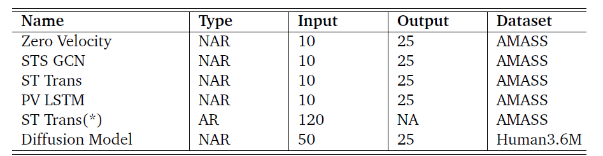
Benchmarking 3D Human Motion Prediction Models
Overview of Model Comparisons
AR: Autoregressive, NAR: Non autoregressive
ST Trans(*): Spatio Temporal Autoregressive Transformer Model
Input: Seed sequence length, Output: Target sequence length

Slide 22
Results

Slide 23
Results
Latency Results
Evaluate 3D human motion prediction models' latency with following three values, averaged over 5 runs, in milliseconds
Average time excluding first run
Average latency of the model not including the first run
Main latency metric
Average time including first run
Average latency of the model including the first run
Time for first run
Time needed to complete inference during the first run
Throwaway time
Difference between first run and others due to warm up period of deep learning models
In practice, we don’t use results from first run but from subsequent runs

Slide 24
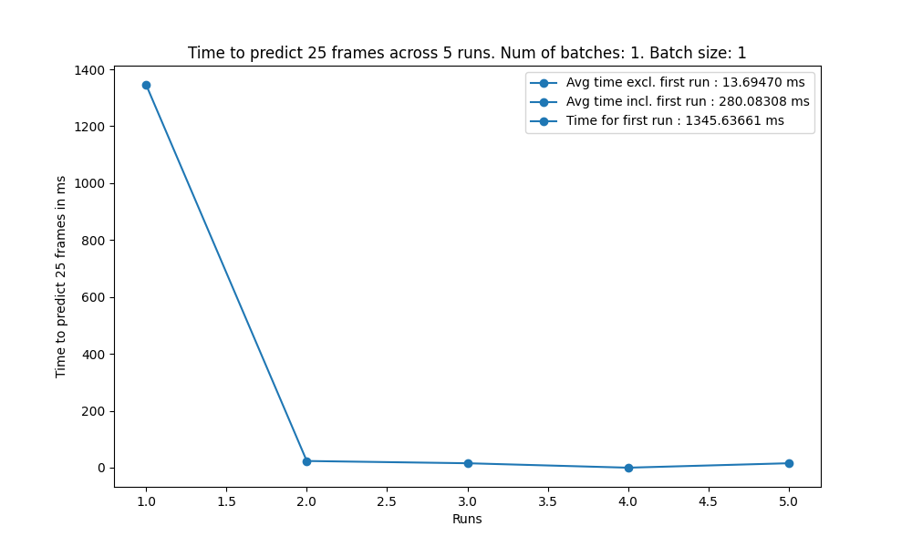
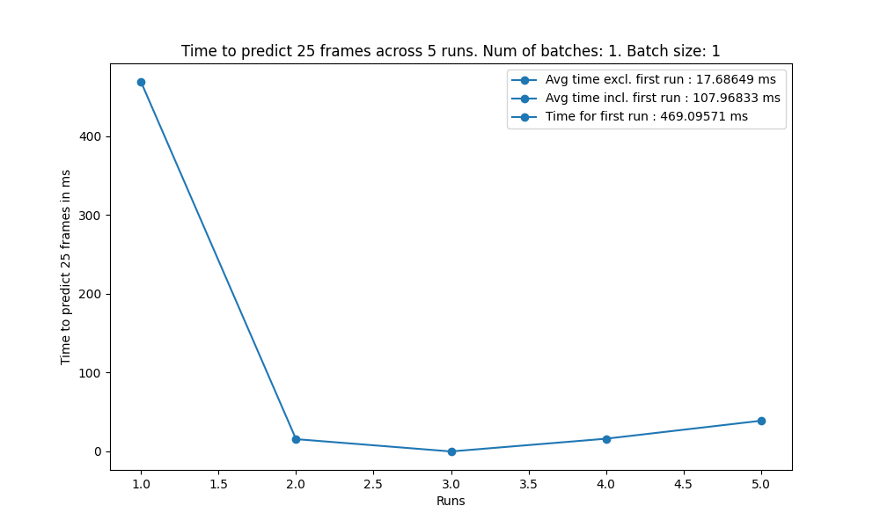
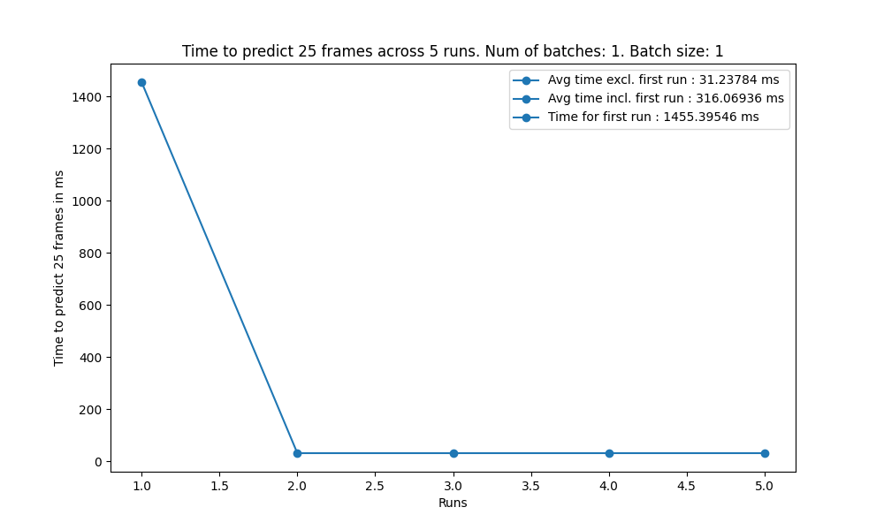
Results
Latency of Models Evaluated as Part of UnPOSed
STS GCN
PV LSTM
ST Trans

Slide 25



Results
Latency of Models Evaluated as Part of UnPOSed
STS GCN model fastest at ~13.7ms, followed by PV LSTM at ~17.7ms. ST Trans slowest at ~31.2ms
All non autoregressive models, hence all 25 frames available after each model’s time
Initial STS GCN inference takes about 1.3 seconds
STS GCN
PV LSTM
ST Trans

Slide 26
Results
Latency of the Spatio-Temporal Autoregressive Transformer Model
Challenge Faced
Model tested on Nvidia RTX 4090 with highest support/compatibility for CUDA version 11.0
Model written using Tensorflow 1.12.0 compatible with upto CUDA version 9.0
Used Nvidia-tensorflow - Nvidia maintained version of Tensorflow that is compatible with CUDA 11.0
No support for Nvidia-tensorflow on Windows but only for the Linux
Decision to use Windows Subsystem for Linux (WSL) 2 with Ubuntu
Latency of this model evaluated on:
The GPU via ubuntu/WSL 2 - Ubuntu-GPU via WSL2
The CPU via ubuntu/WSL 2 - Ubuntu-CPU via WSL2
The CPU via windows - Windows-CPU

Slide 27
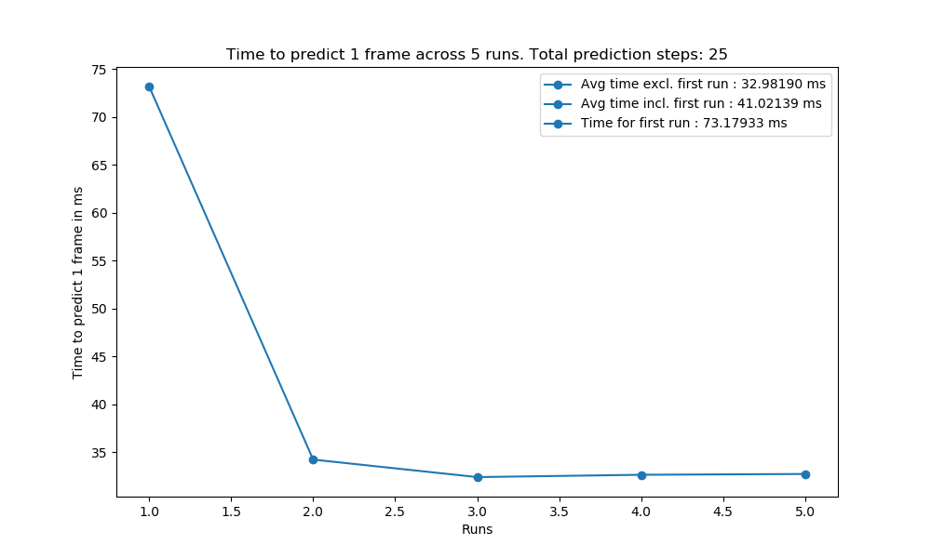
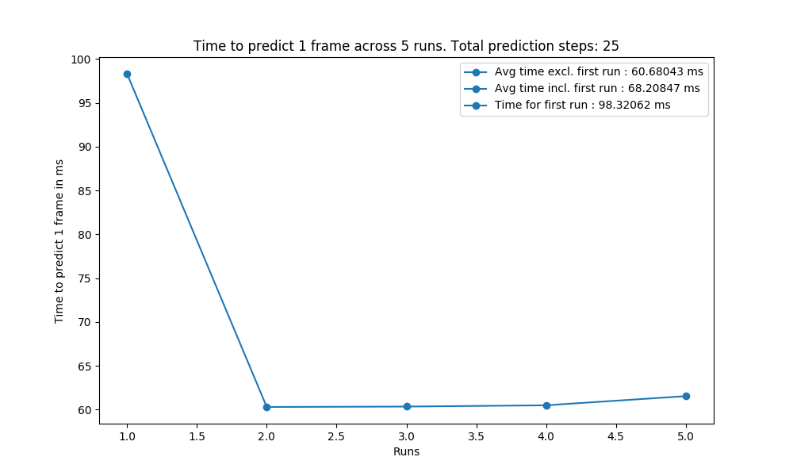
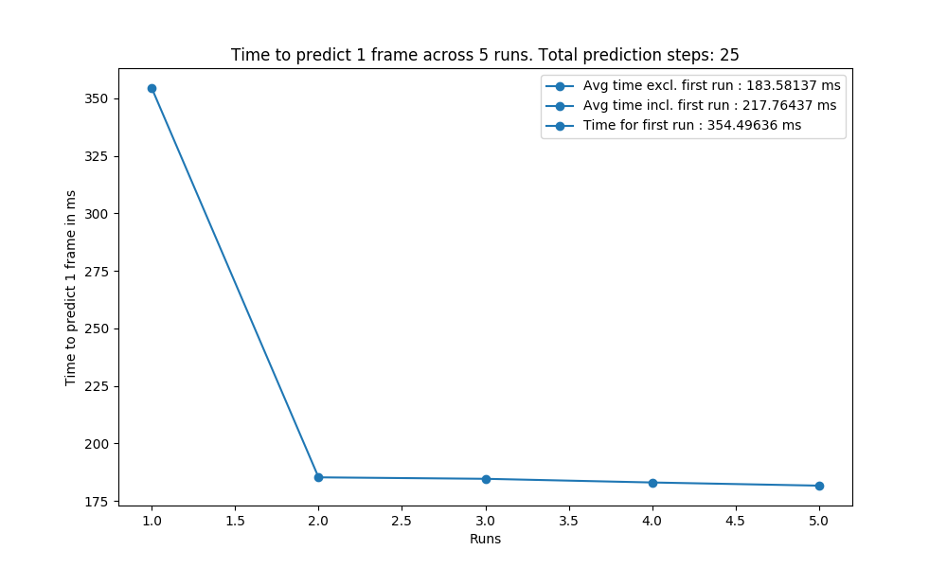
Results
Latency of the Spatio-Temporal Autoregressive Transformer Model
Windows-CPU
Ubuntu-CPU via WSL2
Ubuntu-GPU via WSL2

Slide 28



Results
Latency of the Spatio-Temporal Autoregressive Transformer Model
Windows-CPU fastest at ~33ms, followed by Ubuntu-CPU via WSL 2 at ~60.7ms. Ubuntu-GPU via WSL 2 slowest at ~183.6ms
GPU latency is higher due to memory overhead from CPU-GPU data transfers in autoregressive models
Autoregressive models, hence only 1 frame available after the time period
Windows-CPU
Ubuntu-CPU via WSL2
Ubuntu-GPU via WSL2

Slide 29
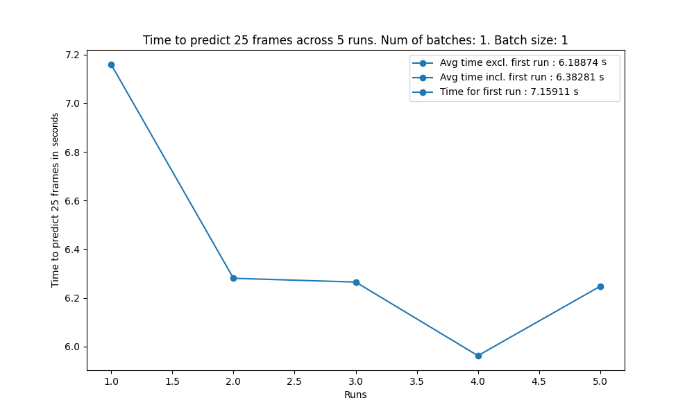

Results
Latency of the Diffusion-Based Model
"Avg. time excl. first run" is ~6.2s
"Time for first run" is ~7.2s.
Latency significantly higher compared to all the other models
Diffusion model's complexity requires further work to improve runtime without losing accuracy

Slide 30
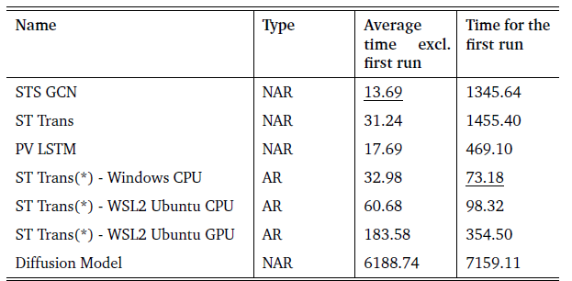
Results
Overview of Latency of all Evaluated Models
Latency metrics are in the range of milliseconds. The least value is underlined
AR: Autoregressive, NAR: Non autoregressive
ST Trans(*): Spatio Temporal Autoregressive Transformer model

Slide 31
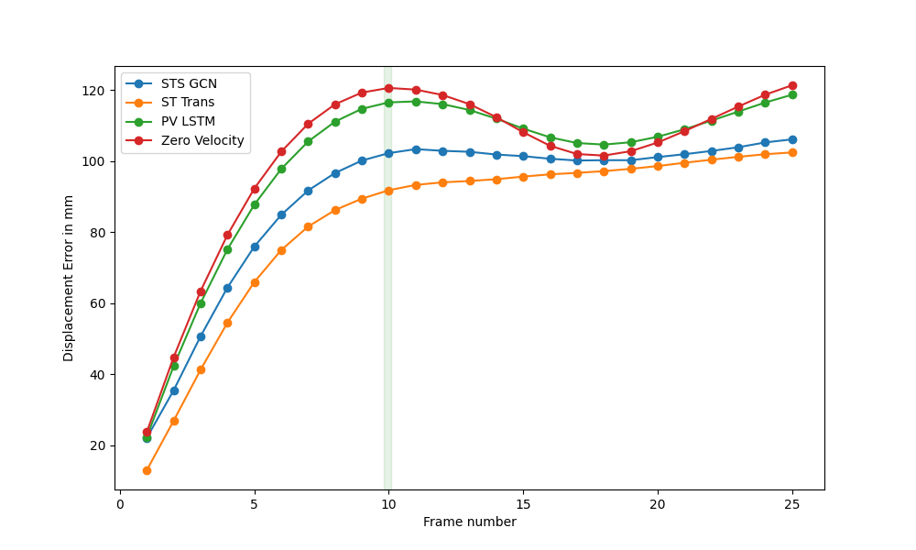
Results
Accuracy Results
Displacement error per frame up to 25 frames
ST Trans best, followed by STS GCN
PV LSTM as good as Zero Velocity baseline model
Shows an error dip at frame 17, notably in Zero Velocity and PV LSTM models, likely due to test dataset characteristics
Accuracy comparison of the 4 UnPosed models

Slide 32
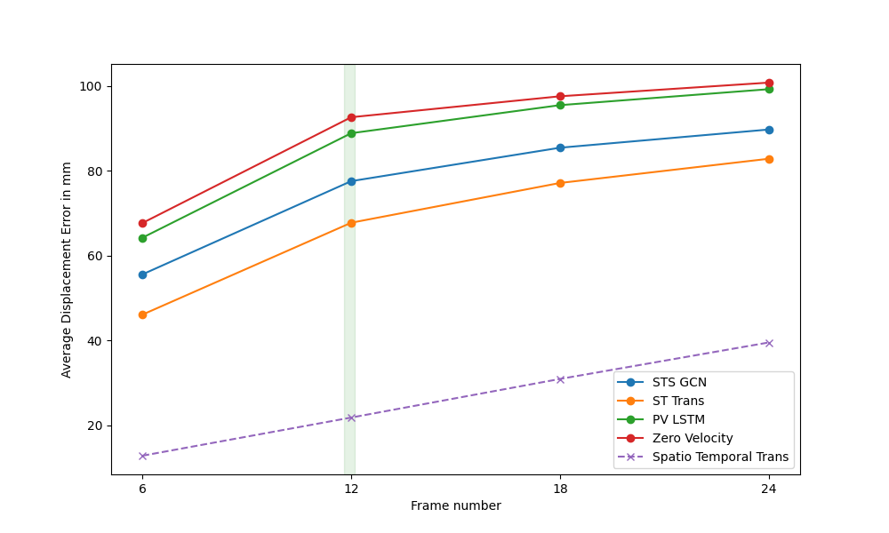
Results
Accuracy Results
Spatio-Temporal transformer model significantly better
Spatio-Temporal transformer model trained for more epochs
Spatio-Temporal transformer model utilized a longer seed sequence length
Accuracy of diffusion based model ignored due to significantly worse latency
Accuracy comparison of the Spatio-Temporal autoregressive model with the 4 UnPosed models

Slide 33
Conclusion

Slide 34
Conclusion
Selection of a Top Performing Model for Real-Time Applications
STS GCN model demonstrated the quickest inference time, at ~13.69ms
STS GCN model had slightly lower accuracy as compared to ST Trans model
STS GCN model most promising for real-time pose prediction with live-tracked human data
Spatio-Temporal autoregressive transformer model had good accuracy but poor latency performance
The diffusion-based model, though good at noise reduction, had the worst latency, taking over 6 seconds

Slide 35
Conclusion
Future Work
Training the Spatio-Temporal autoregressive transformer with a shorter seed sequence might reduce latency without impacting accuracy
Inference of the Spatio-Temporal autoregressive transformer model could be implemented in specialized low latency inference libraries to improve latency
Evaluated diffusion model uses short-term and long-term cascaded diffusion. Assessing just the short-term's latency and accuracy might be interesting

Slide 36
Thank You Questions and Answers

Slide 37
References
[1] https://learn.microsoft.com/en-us/azure/kinect-dk/about-azure-kinect-dk
[2] Katsu Yamane and Jessica K. Hodgins. Simultaneous tracking and balancing of humanoid robots for imitating human motion capture data. 2009
IEEE/RSJ International Conference on Intelligent Robots and Systems, 2009, pp. 2510–2517
[3] Ilana Rapp. Motion Capture Actors: Body Movement Tells the Story. 2014. URL: https : / / web . archive . org / web / 20140703113656 / http : / /
www.nycastings.com/dmxreadyv2/blogmanager/v3_blogmanager.asp?post=motioncaptureactors
[4] Kamiar Aminian and Bijan Najafi. Capturing human motion using body-fixed sensors: outdoor measurement and clinical applications. Computer
Animation and Virtual Worlds, 2004, pp. 79–94
[5] Xudong Zhu and Kin Fun Li. Real-Time Motion Capture: An Overview. 2016 10th International Conference on Complex, Intelligent, and Software
Intensive Systems (CISIS), 2016, pp. 522–525
[6] Edouard Auvinet, Franck Multon, and Jean Meunier. Lower limb movement asymmetry measurement with a depth camera. Annual International
Conference of the IEEE Engineering in Medicine and Biology Society
[7] Brook Galna, Gillian Barry, Dan Jackson, et al. Accuracy of the Microsoft Kinect sensor for measuring movement in people with Parkinson’s
disease. Vol. 39. 4. Gait and Posture, 2014, pp. 1062–1068
[8] YanbinWang, Rohit Dubey, Nadia Magnenat-Thalmann, and Daniel Thalmann. An immersive multi-agent system for interactive applications. Vol.
29. The Visual Computer, 2013
[9] Fernando Cassola, Leonel Morgado, Fausto de Carvalho, et al. Online-Gym: A 3D Virtual Gymnasium Using Kinect Interaction. Vol. 13. Procedia
Technology, 2014, pp. 130–138
[10] https://proyectoidis.org/motion-capture
[11] Wolfgang Büschel, Anke Lehmann, and Raimund Dachselt. MIRIA: A Mixed Reality Toolkit for the In-Situ Visualization and Analysis of Spatio-
Temporal Interaction Data. Proceedings of the 2021 CHI Conference on Human Factors in Computing Systems, 2021
[12] https://robotics.dei.unipd.it/reid/index.php/8-dataset/2-overview-biwi

Slide 38
References
[13] Abdenour Amamra and Nabil Aouf. Real-Time Robust Tracking of Moving Robots with Multiple RGBD Consumer Cameras. URL:
https://arxiv.org/ftp/arxiv/papers/2110/2110.15815.pdf
[14] Chris Torkar, Saeed Yahyanejad, Horst Pichler, Michael W. Hofbaur, and Bernhard Rinner. RNN-based Human Pose Prediction for Human-Robot
Interaction. Proceedings of the Joint ARW & OAGM Workshop, May 2019, pp. 76–80
[15] Emre Aksan, Manuel Kaufmann, and Otmar Hilliges. Structured Prediction Helps 3D Human Motion Modelling. The IEEE International Conference
on Computer Vision (ICCV), Oct. 2019
[16] Dario Pavllo, David Grangier, and Michael Auli. QuaterNet: A Quaternion based Recurrent Model for Human Motion. May 2018
[17] Julieta Martinez, Michael J. Black, and Javier Romero. On human motion prediction using recurrent neural networks. Proceedings IEEE
Conference on Computer Vision and Pattern Recognition (CVPR) 2017, July 2017, pp. 4674–4683
[18] Wei Mao, Miaomiao Liu, Mathieu Salzmann, and Hongdong Li. Learning Trajectory Dependencies for Human Motion Prediction. Proceedings of
the IEEE/CVF International Conference on Computer Vision (ICCV), Oct. 2019
[19] Theodoros Sofianos, Alessio Sampieri, Luca Franco, and Fabio Galasso. Space-Time-Separable Graph Convolutional Network for Pose
Forecasting. Proceedings of the IEEE/CVF International Conference on Computer Vision (ICCV), 2021
[20] Lingwei Dang, Yongwei Nie, Chengjiang Long, Qing Zhang, and Guiqing Li. MSR-GCN: Multi-Scale Residual Graph Convolution Networks for
Human Motion Prediction. Proceedings of the IEEE/CVF International Conference on Computer Vision (ICCV), Oct. 2021, pp. 11467–11476
[21] T. Ma, Y. Nie, C. Long, Q. Zhang, and G. Li. Progressively Generating Better Initial Guesses Towards Next Stages for High-Quality Human Motion
Prediction. 2022 IEEE/CVF Conference on Computer Vision and Pattern Recognition (CVPR), June 2022, pp. 6427–6436
[22] Emre Aksan, Manuel Kaufmann, Peng Cao, and Otmar Hilliges. A Spatiotemporal Transformer for 3D Human Motion Prediction. 2021
International Conference on 3D Vision (3DV), Dec. 2021, pp. 565–574
[23] Saeed Saadatnejad, Mehrshad Mirmohammadi, Matin Daghyani, et al. Toward Reliable Human Pose Forecasting with Uncertainty. 2023

Slide 39
References
[24] Angel Martínez-González, Michael Villamizar, and Jean-Marc Odobez. Pose Transformers (POTR): Human Motion Prediction With Non-
Autoregressive Transformers. Proceedings of the IEEE/CVF International Conference on Computer Vision (ICCV) Workshops, Oct. 2021, pp. 2276–
2284
[25] Saeed Saadatnejad, Ali Rasekh, Mohammadreza Mofayezi, et al. A generic diffusion-based approach for 3D human pose prediction in the wild.
International Conference on Robotics and Automation (ICRA), 2023
[26] Papers With Code - Human Pose Forecasting. URL: https://paperswithcode.com/task/human-pose-forecasting
[27] Naureen Mahmood, Nima Ghorbani, Nikolaus F. Troje, Gerard Pons-Moll, and Michael J. Black. “AMASS: Archive of Motion Capture as Surface
Shapes”. In: International Conference on Computer Vision. Oct. 2019, pp. 5442–5451

Slide 40
Appendix

Slide 41
Appendix
Motion Capture (MoCap) in the Context of Live Human Motion Tracking
MoCap is surveillance and recording of the movement of humans and objects using different technologies
Mocap used in
Robotics [2]
Computer Animation [3]
Medicine [4]
Many Other fields…
Capture motion of humans in real time called “Live Human Motion Tracking”
Needs to “respond in a reasonable time or before a deadline, in a reliable manner” [5]

Slide 42
Appendix
Live Human Tracking using Microsoft Kinect
Analyzing human movement such as walking [6]
Test the accuracy of the Kinect to measure motion in Parkinson’s disease [7]
Training and evaluation of emergency evacuations and other real-time applications of crowd simulation [8]
Sports and fitness -> Online-Gym -> allows users to interact using a Kinect and participate in online gymnastics sessions [9]
And more …

Slide 43
Appendix
Overview of Various Human Motion Prediction Models
Traditionally recurrent neural networks (RNNs) preferred for human motion prediction, due to their capability to capture temporal dependencies in sequential data [14, 15, 16]
Graph convolutional network (GCN) used for human motion prediction [18, 19, 20]
Transformer architecture used for human motion prediction [22, 23, 24]
Diffusion model that frames the prediction of future human poses as a de-noising problem [25]

Slide 44
Appendix
More Overview of Various Human Motion Prediction Models
Traditionally recurrent neural networks (RNNs) preferred for human motion prediction, due to their capability to capture temporal dependencies in sequential data [14, 15, 16]
Martinez et. al. show that existing RNNs have difficulty obtaining good performance for long-term and short-term predictions [17]
Graph convolutional network (GCN) used for human motion prediction [18, 19, 20]
Ma et. al. propose a two-network system comprising of, a spatial dense GCN and a temporal dense GCN which operate alternatively [21]
Transformer architecture used for human motion prediction [22, 23, 24]
Diffusion model that frames the prediction of future human poses as a de-noising problem [25]

Slide 45
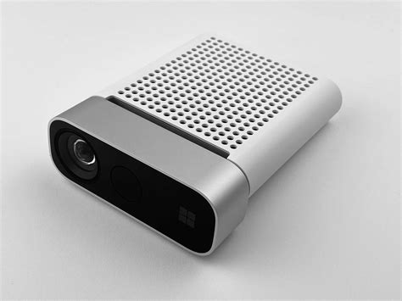
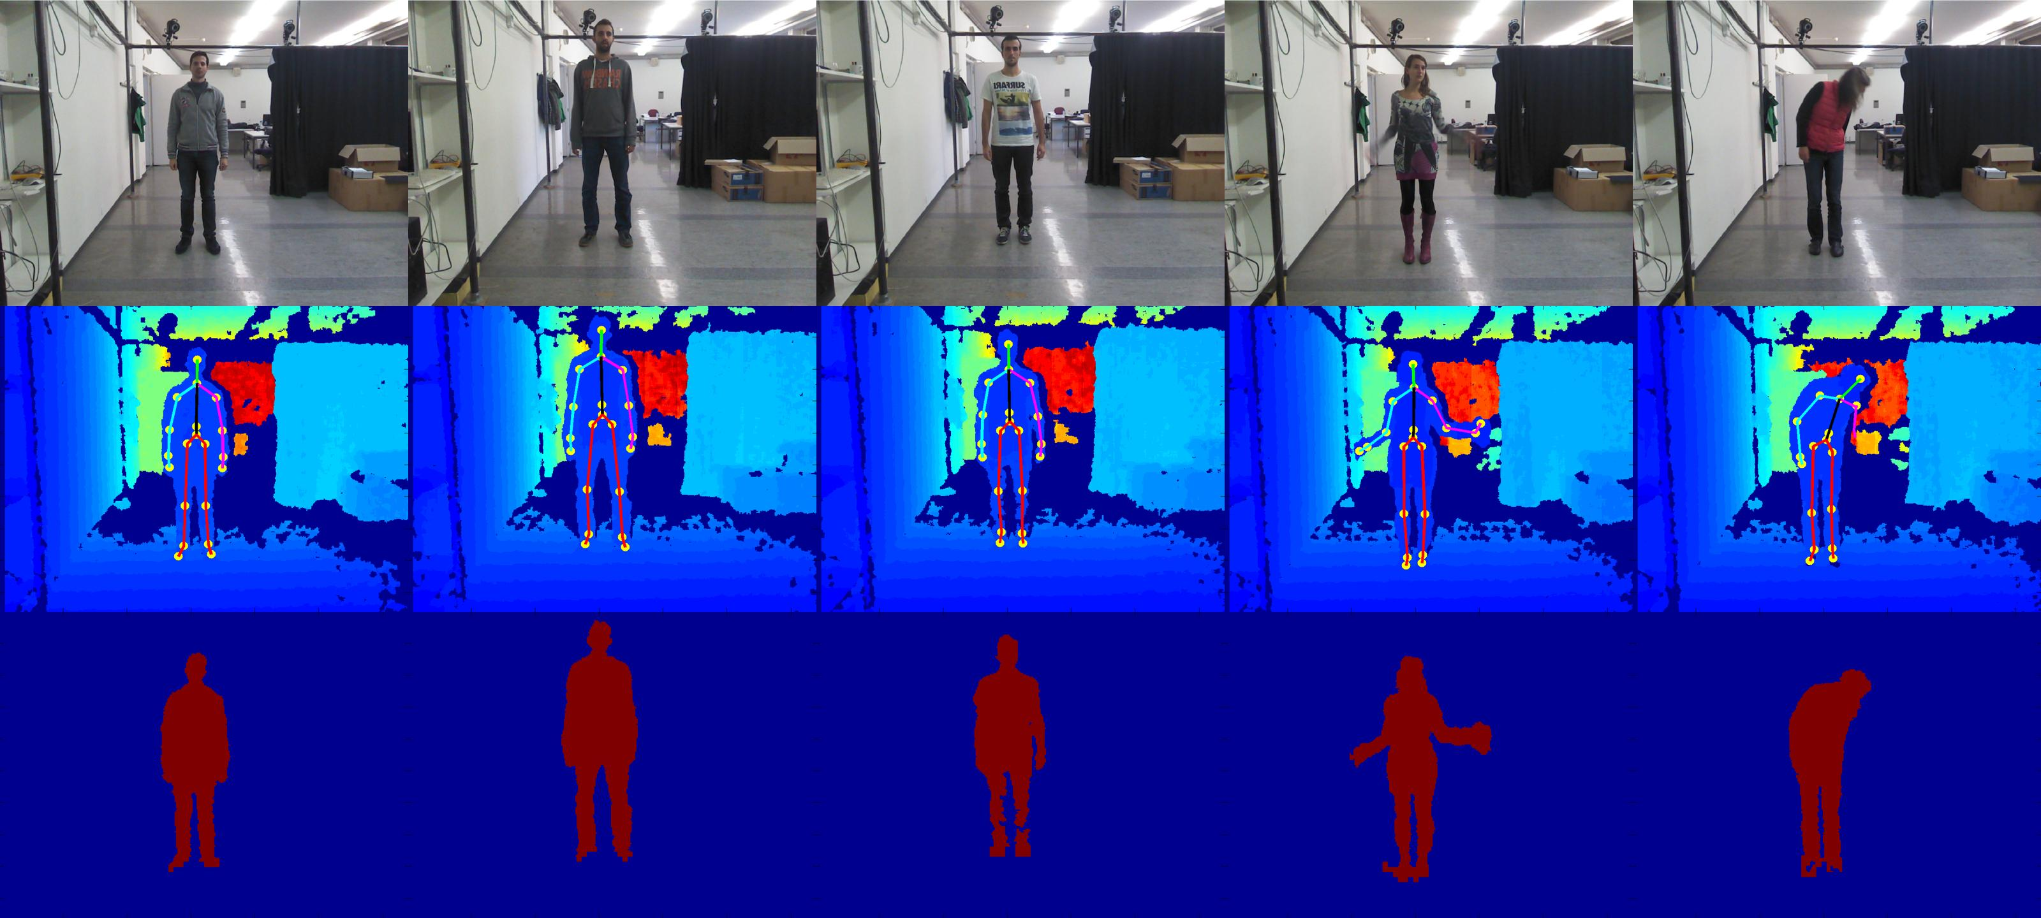
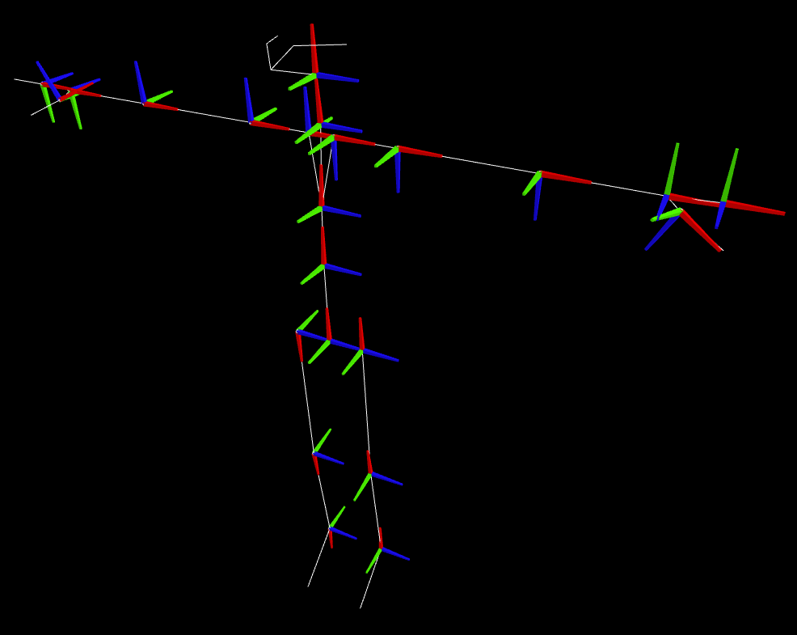
Appendix
Potential Solutions to Mitigate Latency in Motion Tracking
Extract raw Kinect data, process orientations and positions on GPU
Proposed by Amamra et. al. [13]
Complex custom solutions and involve a lot of steps
No longer able to use the Kinect Body Tracking SDK which integrates easily with popular game engines such as Unity
Networking delay still present
Kinect
[12]
[1]
Raw RGBD Data
Human Pose

