Slide 1
👁
RetinaPredict
Deep Learning Based Diabetic Retinopathy Detection
Major Project — B.E. Computer Engineering
GROUP 7
Rajveer Rai (B830) • Jeetkumar Rathod (B832)
Harshal Satam (B837) • Divyesh Shinde (B843)
Python
TensorFlow
Guided by: Naina Kaushik
Streamlit

Slide 2
Agenda
Presentation structure overview
01
Introduction & Problem Statement
06
Model: Hybrid InceptionResNetV2 + LSTM
02
Literature Review
07
Implementation & Tech Stack
03
Existing System & Proposed Solution
08
Application Demo
04
System Architecture & Methodology
09
Results & Evaluation
05
Dataset & Preprocessing
10
Challenges, Future Work & Conclusion

Slide 3
What is Diabetic Retinopathy?
Introduction & Clinical Background
Overview
People with diabetes globally (2021)
Diabetic patients develop DR
537 M
~35%
Diabetic Retinopathy (DR) is a microvascular complication of diabetes mellitus affecting the retina
Leading cause of preventable blindness in the working-age population worldwide
Early stages present with NO visible symptoms — detection requires fundus imaging
Untreated DR progresses through 5 severity stages up to complete blindness
Timely screening and intervention can prevent up to 95% of vision loss cases
IDF Atlas 10th Ed.
Yau et al., Meta-analysis
Projected diabetics by 2045
DR cases go undetected early
783 M
1 in 3
IDF Atlas 10th Ed.
WHO Global Report
5 DR Severity Stages
No DR
Mild
Moderate
Severe
Proliferative
0
1
2
3
4
Sources: IDF Diabetes Atlas 10th Ed. (2021) | WHO Global Report on Diabetes | Wilkinson et al. (2003)

Slide 4
Problem Statement
Diabetic Retinopathy leaves no symptoms in its early stages. By the time a patient notices vision degradation, significant irreversible damage has already occurred. Manual screening by ophthalmologists is time-consuming, expensive, and inaccessible in resource-limited settings.
Scarce Specialists
Manual & Slow
India has <1 ophthalmologist per 100,000 population in rural areas [NPCB India, 2019]
Expert grading of a single fundus image takes 3-5 min; mass screening is infeasible [Abramoff et al., 2016]
High Subjectivity
Late Diagnosis
Inter-observer variability in DR grading can reach 20-30% between clinicians [Wilkinson et al., 2003]
Over 50% of DR cases in developing countries detected only at moderate-to-severe stage [Bellemo et al., 2019]

Slide 5
Literature Review
Recent work (2021-2025) in deep learning-based DR detection
Study | Year | Method / Contribution | Result | Gap / Limitation
★ Das et al. [Base Paper] | 2022 | DRFEC: CNN models (InceptionResNetV2, MobileNetV2, DenseNet, ResNet, EfficientNets) for DR feature extraction | Compared 18+ CNN architectures on fundus images | No hybrid temporal model; no web deployment
Kalyani et al. | 2021 | Capsule Networks for DR stage classification | 97.98% | Single dataset; resource-heavy; no segmentation
Rajarajeshwari & Selvi | 2023 | Comprehensive AI/CNN review for DR detection via teleophthalmology | Survey | No new model; poor explainability noted
Vohra et al. | 2025 | Low-cost AI (ESP32-CAM + CNN) for DR and glaucoma detection at edge | ~95.5% | No multi-center validation; no explainable AI
Asif et al. | 2025 | Systematic review: traditional vs AI-driven DR diagnosis; federated learning | Survey | High bias in studies; limited real-world deployment

Slide 6
Existing System — Limitations
Manual Screening
Not Scalable
Trained ophthalmologists required; 3-5 min per image [Abramoff et al., 2016]
Mass screening infeasible without automation [Bellemo et al., 2019]
Human Variability
Resource Constraints
Inter-observer disagreement up to 20-30% [Wilkinson et al., 2003]
Specialist shortage in rural/low-income regions [NPCB India, 2019]
Basic AI Methods
No Explainability
Earlier ML models lack clinical-grade accuracy [Revathy et al., 2020]
Existing AI systems give no visual explanation for decisions [Rajarajeshwari, 2023]

Slide 7
Proposed Solution — RetinaPredict
An automated, explainable DR detection and grading system
System Capabilities
Workflow
Accepts retinal fundus images (PNG/JPG) as input
Preprocesses: resize to 224×224, normalize, augment
Classifies into 5 DR severity stages (0–4)
Generates per-class confidence scores via Softmax
Grad-CAM heatmaps for interpretable AI decisions
Downloadable PDF diagnostic report per patient
Web-based interface (Streamlit) — no installation needed
Admin panel: train, evaluate, compare models
1. Fundus Image Upload
2. Preprocessing & Augmentation
3. InceptionResNetV2 Feature Extraction
4. LSTM Sequence Learning
5. Softmax Classification (5 classes)
6. Diagnosis + Grad-CAM + Report

Slide 8
Dataset — APTOS 2019
Asia Pacific Tele-Ophthalmology Society Blindness Detection Dataset
Total Images
DR Classes
Train/Test Split
Input Resolution
6,841
5
80/20
224×224
Dataset Details
Source: APTOS 2019 Kaggle Challenge
Images: Color fundus photographs
Format: PNG / JPEG
Class imbalance addressed via class weights
Augmentation: flip, shear, rescale, rotation
Preprocessing: resize → normalize → enhance contrast
Train: 5,472 | Validation: 1,369 images
Class Distribution

Slide 9
System Architecture
End-to-end deep learning pipeline
📷
⚙️
🔄
🧠
🔗
📊
✅
Input
Fundus Image
Data
Preprocessing
Data
Augmentation
InceptionResNetV2
Feature Extraction
LSTM
Sequence Layer
Softmax
Classifier
DR Stage
+ Report
Output Classes
Stage 0
No DR
Stage 1
Mild
Stage 2
Moderate
Stage 3
Severe
Stage 4
Proliferative
Post-processing & Deployment
• Grad-CAM heatmap for visual explainability
• Confidence scores per class shown in bar chart
• Automated PDF diagnostic report generated
• Streamlit web app deployed locally / cloud

Slide 10
Hybrid Model: InceptionResNetV2 + LSTM
Combining spatial feature extraction with sequence learning
InceptionResNetV2 (CNN Backbone)
LSTM Layer (Sequence Learner)
169 layers deep; 55.1M total parameters
Fuses Inception modules (multi-scale) with Residual connections (skip connections)
Alleviates vanishing gradient via skip connections
Pre-trained on ImageNet — transfer learning applied
Fine-tuned backbone with class weights for imbalance
Input size: 224×224×3
128 LSTM hidden units capture feature inter-dependencies
853,125 trainable parameters (fine-tuned)
Models temporal patterns in extracted feature maps
Dropout layer to prevent overfitting
Global Average Pooling before LSTM input
Final Dense + Softmax → 5-class output

Slide 11
Models Explored & Compared
Six CNN architectures + our proposed hybrid model
AlexNet
DenseNet121
ResNet18
Pioneer CNN; first to use ReLU activation & GPU acceleration
Dense connectivity; strong gradient flow; reduced overfitting
Residual skip connections; enables very deep network training
VGG19
MobileNetV2
InceptionResNetV2
Uniform 3x3 filters; excellent transfer learning capability
Depthwise separable convolutions; mobile-optimized design
Multi-scale inception + residual blocks — our backbone
Hybrid (IRV2+LSTM)
★ Proposed — spatial + sequence learning; best overall performance

Slide 12
Implementation — Tech Stack
Core ML
Visualization
Python 3.12
TensorFlow 2.x
Keras
NumPy
Pandas
Matplotlib
Seaborn
Plotly
Grad-CAM (custom)
Web App
Hardware Used
Streamlit (frontend)
Role-based auth (Admin/User)
PDF report generation
AMD Ryzen 5 processor
8 GB RAM
CPU (no dedicated GPU)
512 GB storage (system)

Slide 13
System Requirements
Hardware Requirements
Software Requirements
Processor: AMD Ryzen 5 or equivalent
RAM: 8 GB minimum
Storage: 512 GB system storage
Display: 1920x1080 resolution recommended
CPU-based inference (no GPU required for deployment)
Internet: Required for initial setup & library install
OS: Windows 10/11, Ubuntu 20.04+, or macOS
Python 3.12 with pip/conda
TensorFlow 2.x + Keras
Libraries: NumPy, Pandas, Pillow, Matplotlib
Streamlit for web interface
IDE: VS Code or PyCharm
Browser: Chrome / Edge (latest)

Slide 14
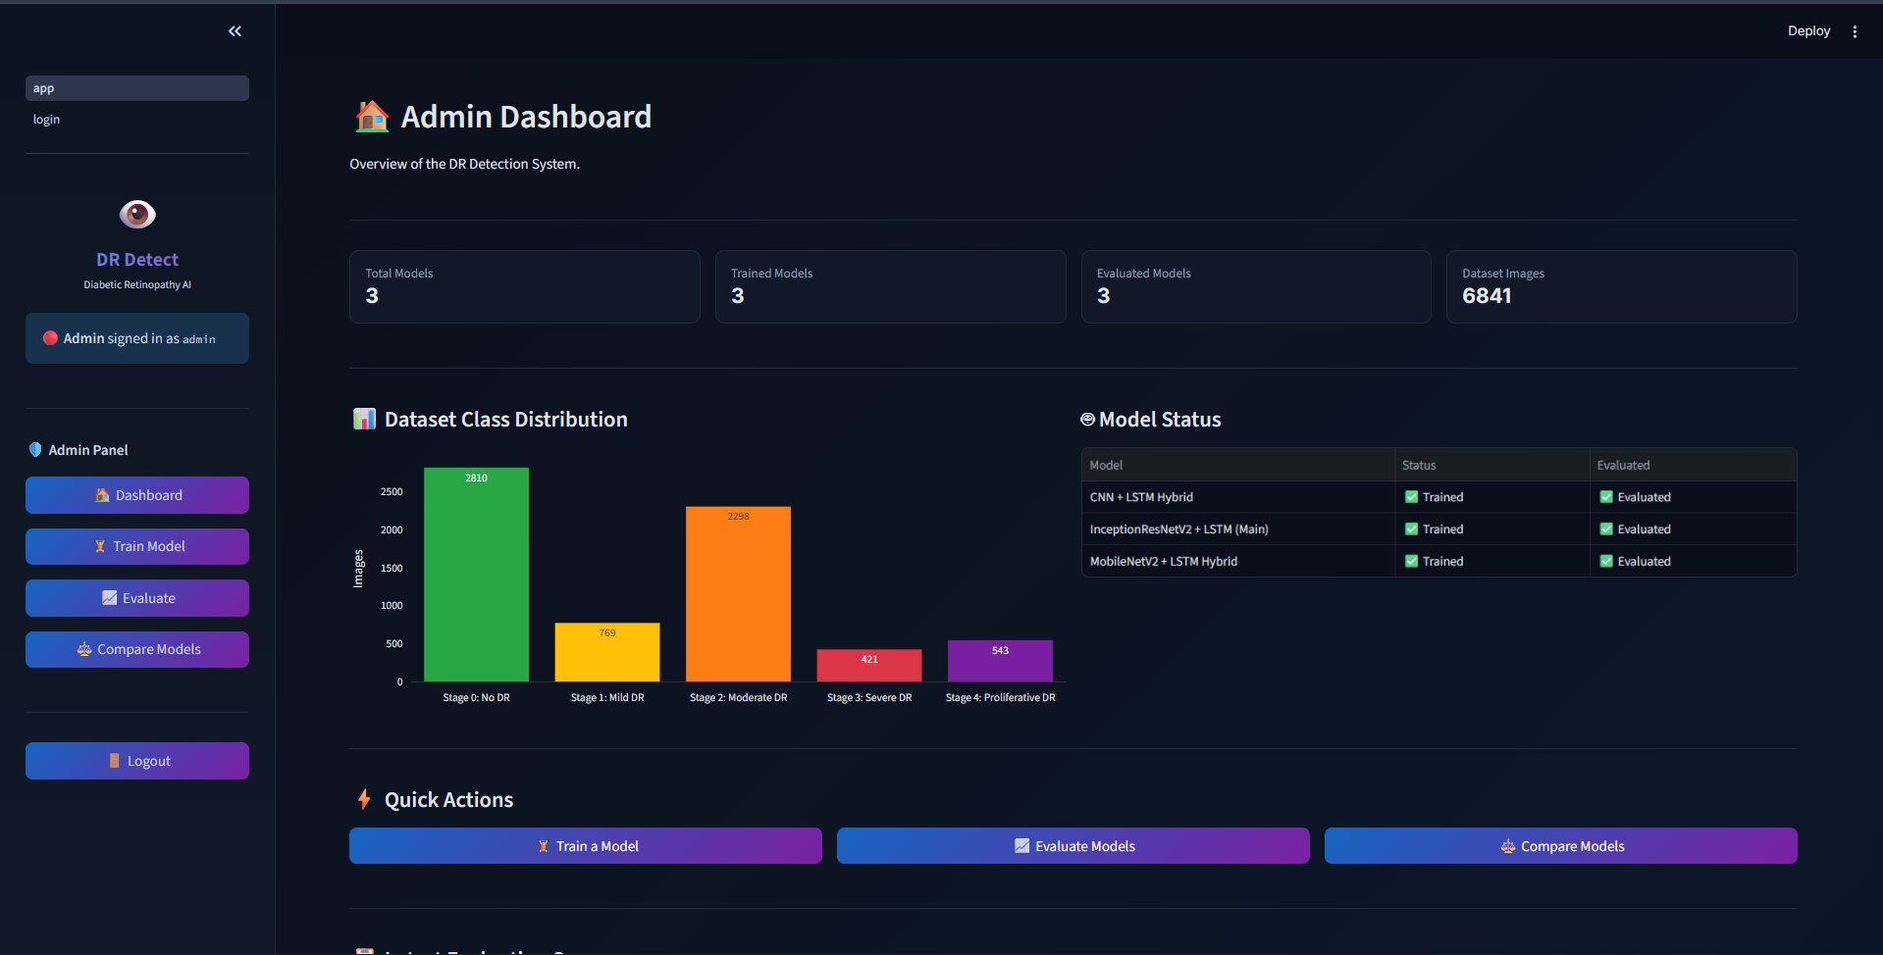
Application Demo — Admin Dashboard
DR Detect Web App | Built with Streamlit
Key Features
3 models trained & evaluated
6,841 dataset images
Class distribution chart
Model status table
Quick action buttons
Latest evaluation summary

Slide 15
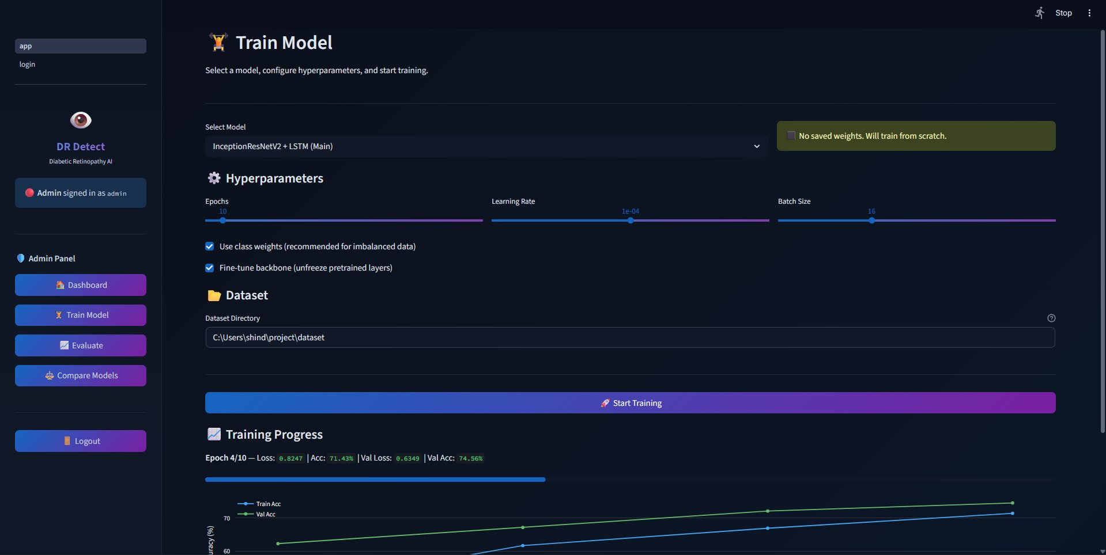
Application Demo — Model Training
Configurable hyperparameter training interface
Training Options
Model selection dropdown
Epoch / LR / Batch sliders
Class weights toggle
Fine-tune backbone option
Real-time training progress
Live acc/loss graph

Slide 16
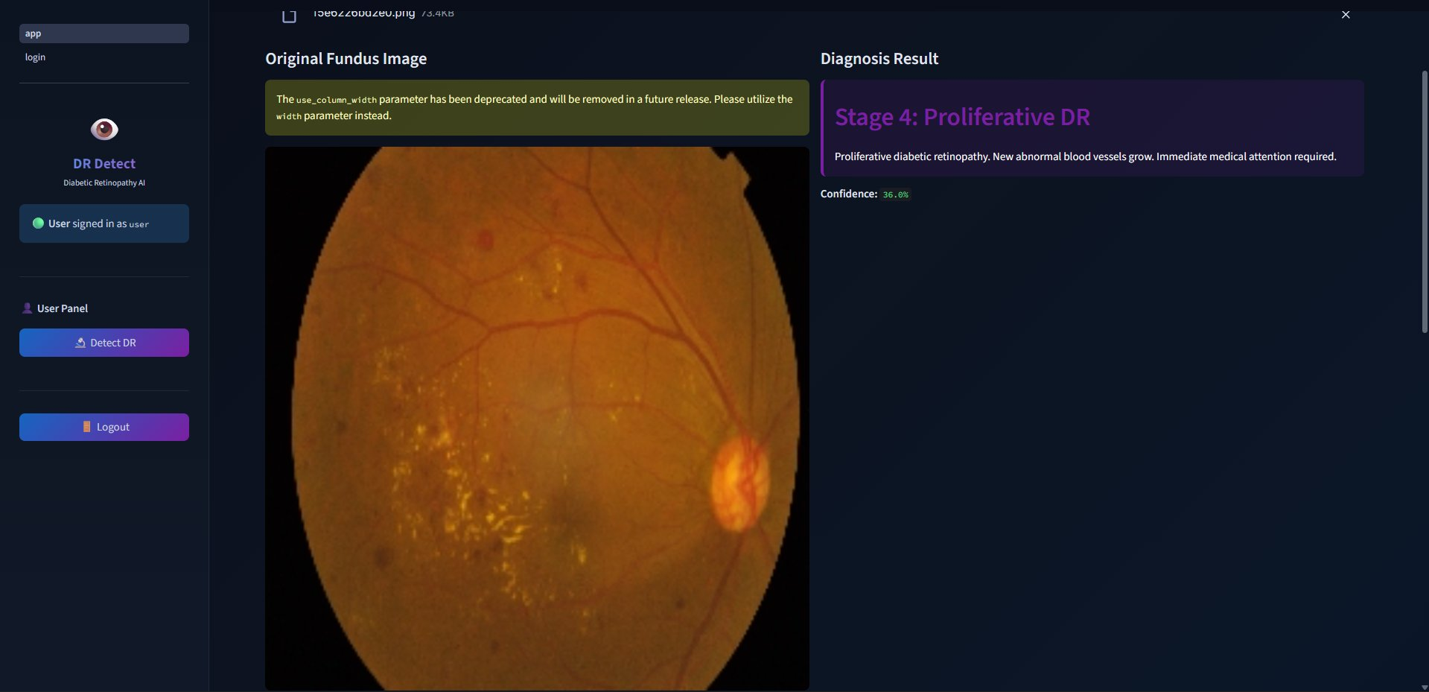
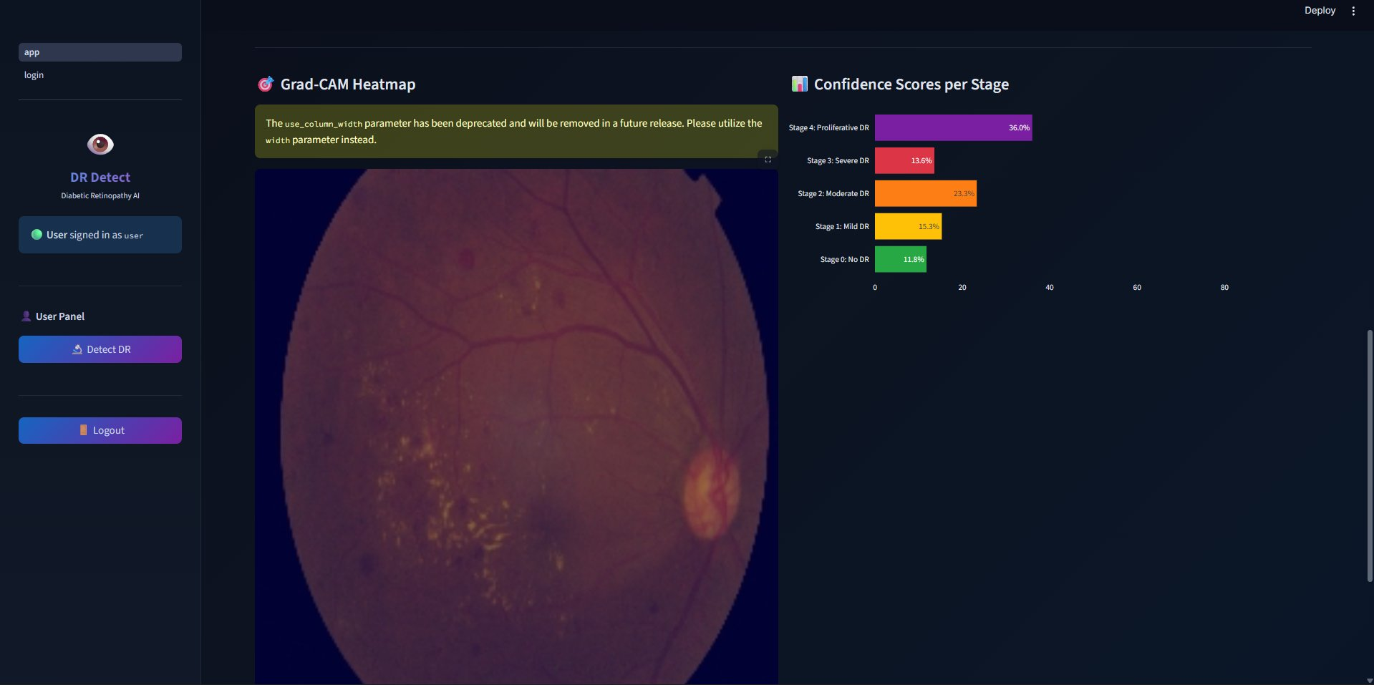
Application Demo — Fundus Image Analysis
User-facing DR detection with confidence scores
Left: Diagnosis Result showing Stage 4 — Proliferative DR | Right: Grad-CAM heatmap highlighting lesion regions

Slide 17
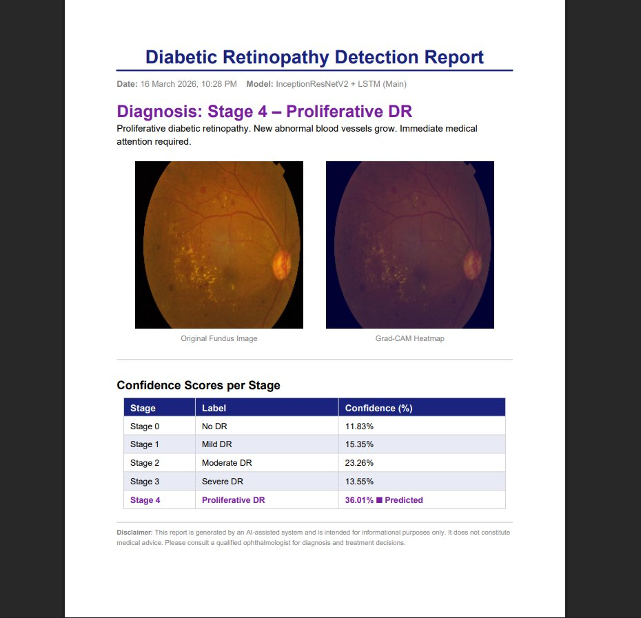
Application Demo — Auto-Generated Report
Downloadable PDF diagnostic report per patient scan
Report Contents
Date, time & model used for prediction
Diagnosed DR stage with clinical description
Original fundus image + Grad-CAM heatmap
Confidence scores for all 5 classes
Disclaimer: AI-assisted, not a medical certificate
Export as PDF for patient records

Slide 18
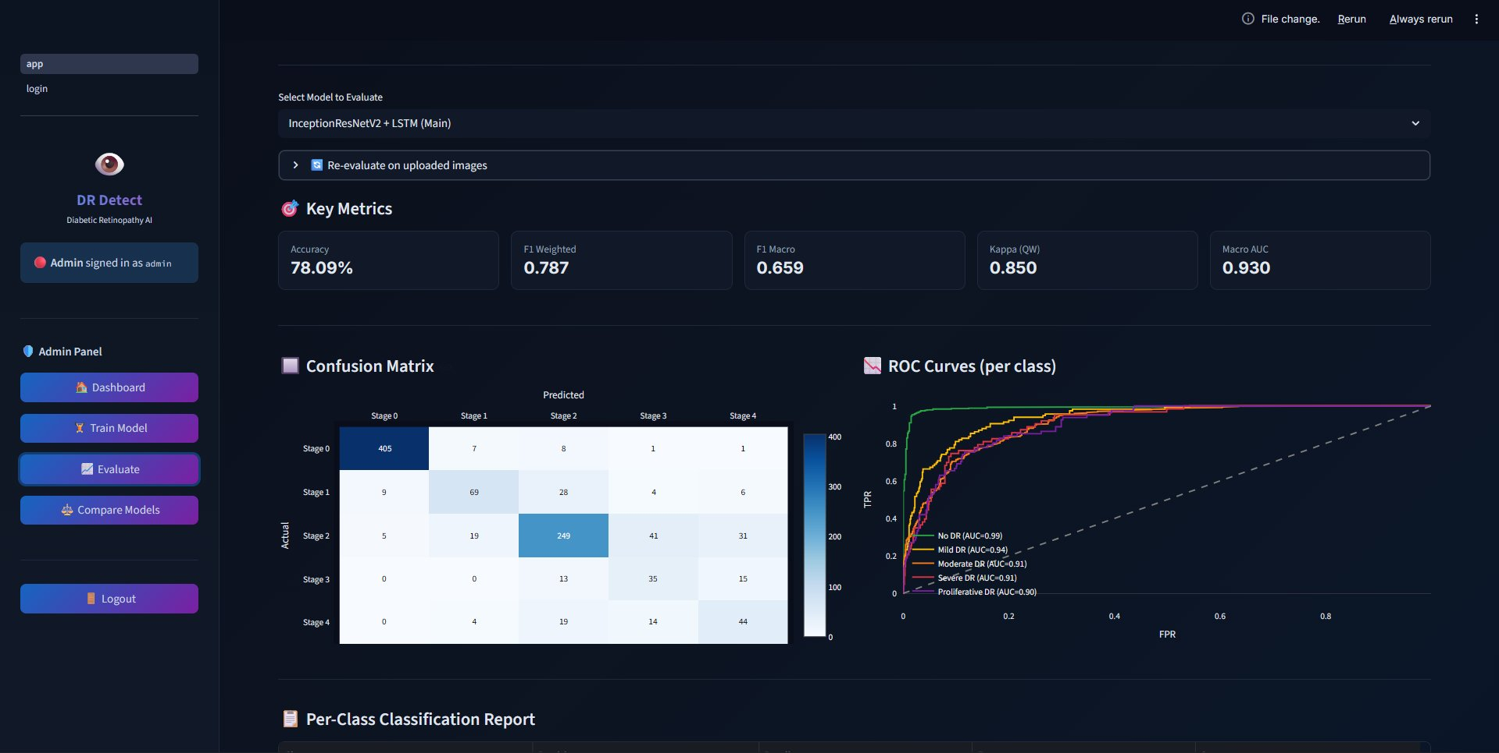
Key Results — InceptionResNetV2 + LSTM
Best performing model on APTOS 2019 test set
Accuracy
F1 Weighted
Kappa (QW)
Macro AUC
78.09%
0.787
0.850
0.930
Per-Class F1
Class | F1
No DR | 0.963
Mild | 0.642
Moderate | 0.752
Severe | 0.443
Prolif. | 0.494

Slide 19
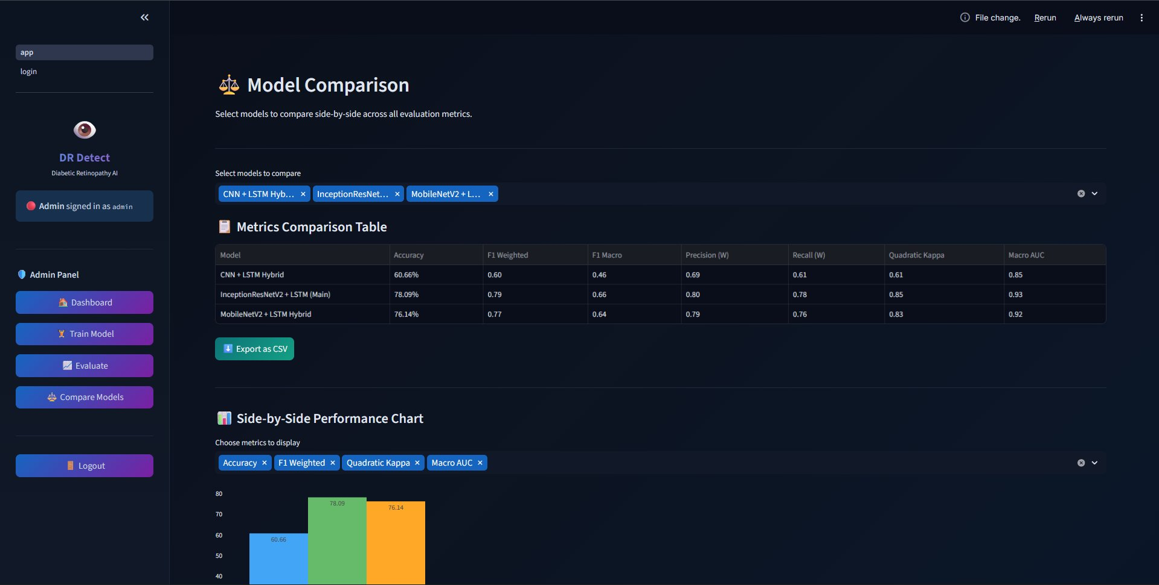
Model Comparison — 3 Hybrid Architectures
Side-by-side evaluation from the app dashboard

Slide 20
Confusion Matrix & ROC Curves
InceptionResNetV2 + LSTM on test set (1,027 images)
No DR: AUC=0.99 | Mild: AUC=0.94 | Moderate: AUC=0.91 | Severe: AUC=0.91 | Proliferative: AUC=0.90

Slide 21
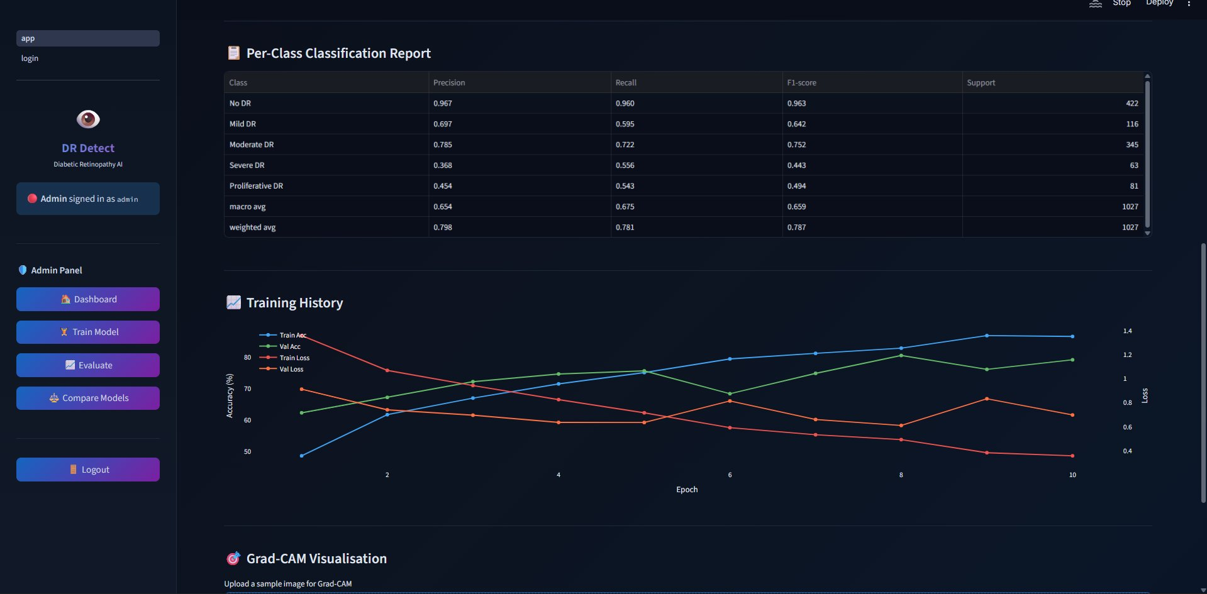
Per-Class Classification Report & Training History

Slide 22
Challenges Faced
Class Imbalance
Overfitting
Stage 0 (No DR) had 2,810 samples vs only 421 for Stage 3 (Severe DR). Addressed via class weights and oversampling in augmentation pipeline.
Despite Image Augmentation and Dropout, early training runs showed train-val accuracy gap. Resolved via aggressive augmentation, early stopping, and fine-tuning schedule.
Image Quality Variations
Computational Resources
Real fundus images had lighting artifacts, blur, and eyelash occlusions affecting feature extraction. Contrast enhancement and normalization applied as preprocessing.
Training InceptionResNetV2+LSTM (55M parameters) on 50 epochs is GPU-intensive. Training done on local GPU; inference served via CPU for web app.
Low Accuracy on Severe DR
LSTM Integration
Classes 3 & 4 (Severe + Proliferative) had fewest samples and lowest per-class F1. Further dataset expansion and synthetic augmentation needed.
Flattening CNN feature maps correctly for LSTM input without spatial loss required careful architecture design and multiple iterations.

Slide 23
Future Work & Roadmap
Phase 1
Dataset Expansion
Integrate multi-center datasets (Messidor-2, EyePACS) to improve generalization across diverse patient populations and imaging equipment.
Phase 2
Hyperparameter Optimization
Systematic grid/Bayesian search for optimal LR, batch size, and architecture depth. Implement learning rate scheduling and warmup strategies.
Phase 3
Clinical Validation
Conduct prospective clinical trial with ophthalmologists at partner hospitals. Measure sensitivity/specificity against expert grading as ground truth.
Phase 4
Cloud Deployment
Deploy RetinaPredict on AWS/GCP with HIPAA-compliant storage for real-world telemedicine integration in rural screening camps.

Slide 24
Conclusion
RetinaPredict demonstrates that a Hybrid InceptionResNetV2 + LSTM model can effectively classify diabetic retinopathy into 5 severity stages from retinal fundus images, achieving 78.09% accuracy, 0.850 Quadratic Kappa, and 0.930 Macro AUC on the APTOS 2019 dataset — outperforming standalone CNN baselines across key metrics.
Model Performance:
Hybrid IRV2+LSTM achieves best Kappa (0.850) and AUC (0.930) — clinically significant discrimination between severity levels
Interpretability:
Grad-CAM heatmaps provide visual explanations doctors can trust, highlighting hemorrhages and microaneurysms automatically
Usability:
Full-featured Streamlit web app with Admin & User roles, model training, evaluation, comparison, and PDF report generation
Clinical Relevance:
System reduces screening time from 3–5 min per image to seconds, enabling scalable mass screening programs
Limitations:
Severe (Stage 3) and Proliferative (Stage 4) DR classes showed lower F1 scores due to class imbalance — addressed in future work

Slide 25
Thank You
RetinaPredict — Deep Learning Based Diabetic Retinopathy Detection

