Slide 1

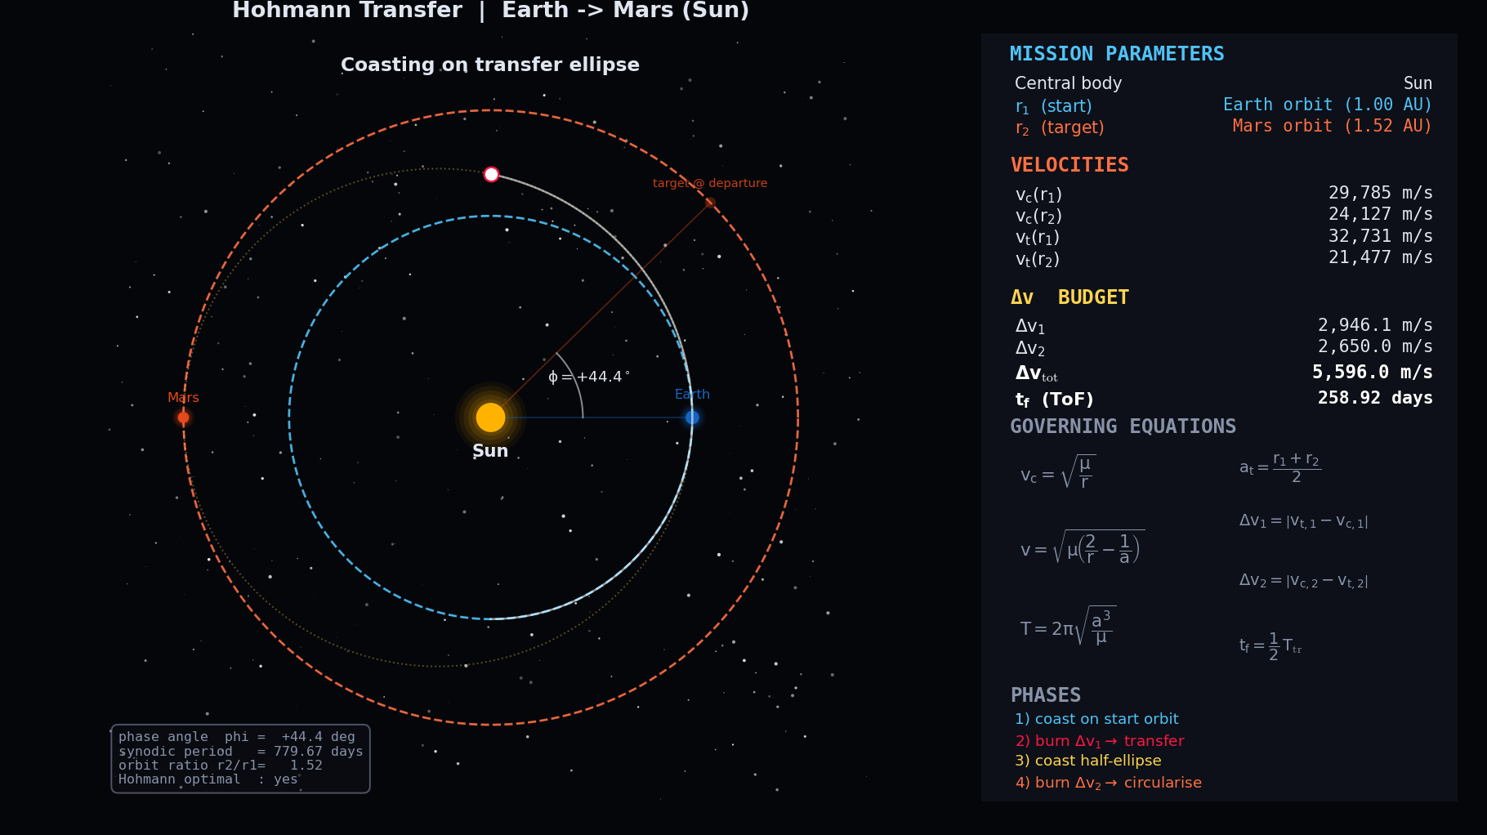
Reaching Other Worlds on a Fuel Budget
An Orbital Mechanics Simulator for Hohmann Transfers
Divyesh Bansal 4th year BTech Computer Science and Engineering , IIT Roorkee

Slide 2
The Big Question: Changing Orbits
How do we get a spacecraft from one orbit to another using the least fuel possible?
In space there is no "straight line to Mars."
Every kilogram of fuel must be launched off Earth at enormous cost.
The path you choose decides whether a mission is possible at all.

Slide 3
Why Fuel Is Everything in Space
A rocket can only carry a fixed amount of propellant.
Once it's gone, you cannot refuel, there are no gas stations in orbit.
Mission designers measure everything in delta-v (Δv): the total change in velocity a spacecraft can produce.
Δv is the real "budget" of a space mission. Spend it wisely or the mission fails.

Slide 4
What Keeps a Satellite in Orbit?
An orbit is a balance between gravity pulling inward and sideways speed carrying you forward.
Go fast enough sideways and you keep "falling around" the planet instead of into it.
Different altitudes need different speeds:
Low orbit (400 km): ~7.7 km/s
Geostationary (35,786 km): ~3.1 km/s
To change orbit, you must change speed and that costs Δv.

Slide 5
The Problem with Changing Orbits
You cannot simply "drive" from a low orbit to a high one.
Firing your engine doesn't move you outward instantly , it reshapes your entire orbit.
A single push stretches a circle into an ellipse.
The challenge: how do you connect two circular orbits efficiently?

Slide 6
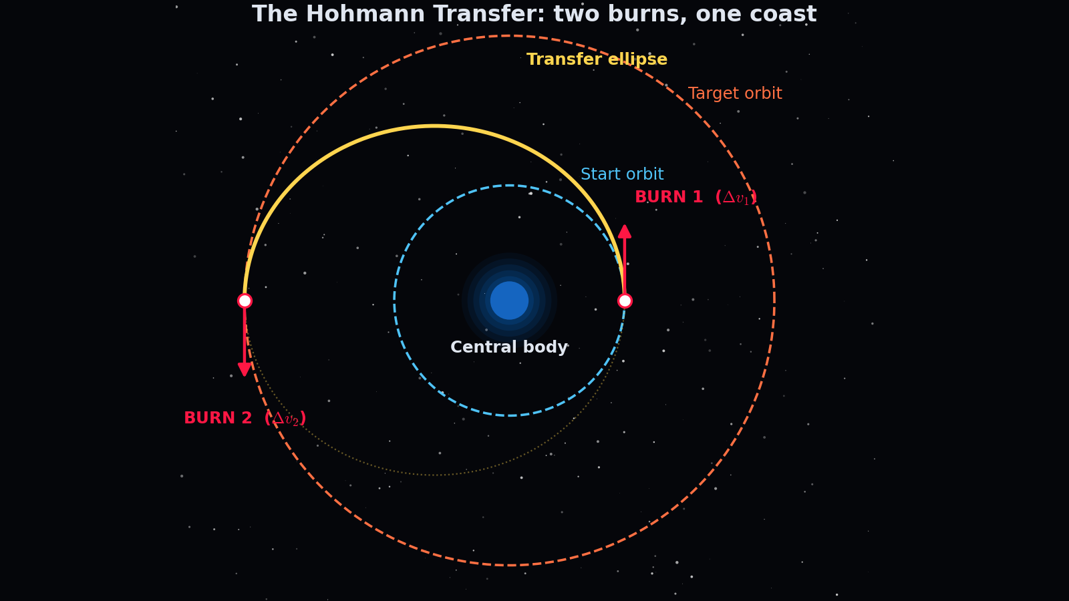
The Elegant Answer: Hohmann Transfer
Proposed by Walter Hohmann in 1925 decades before spaceflight existed.
It uses just two engine burns and one long coast.
It is the most fuel-efficient way to move between two circular orbits in the same plane.
Still the backbone of real mission design 100 years later.

Slide 7
How It Works: The Transfer Ellipse
Burn once to stretch your circular orbit into an ellipse.
The low point of the ellipse touches your start orbit.
The high point touches your target orbit.
You coast halfway around this ellipse , engines off , letting gravity do the work.

Slide 8
Burn 1: Climbing
At the starting orbit you fire prograde (in the direction of motion).
This raises the far side of your orbit out to the target altitude.
You are now on the transfer ellipse, coasting upward and slowing down as you climb.

Slide 9
The Coast
During the coast, the engine is off.
Gravity trades your speed for altitude on the way up.
This coast can take hours (satellites) or years (outer planets).
No fuel is spent , only patience.

Slide 10
Burn 2: Arriving
At the high point you are moving too slowly to stay there you'd fall back.
A second prograde burn speeds you up to circularize at the new orbit.
Mission complete: you've moved between two orbits with minimal fuel.

Slide 11

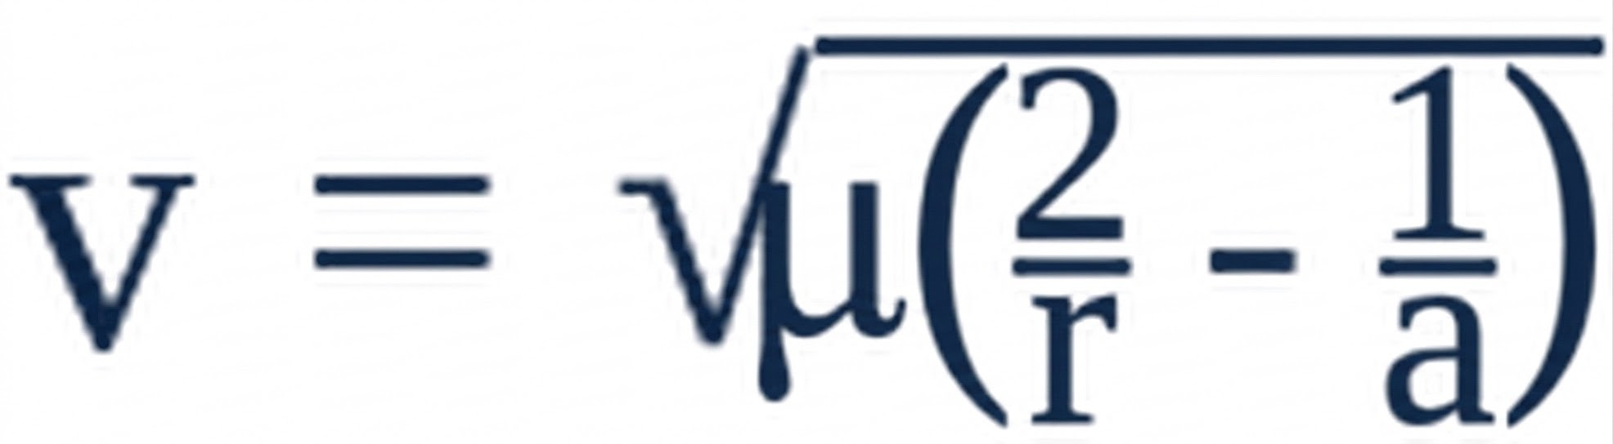
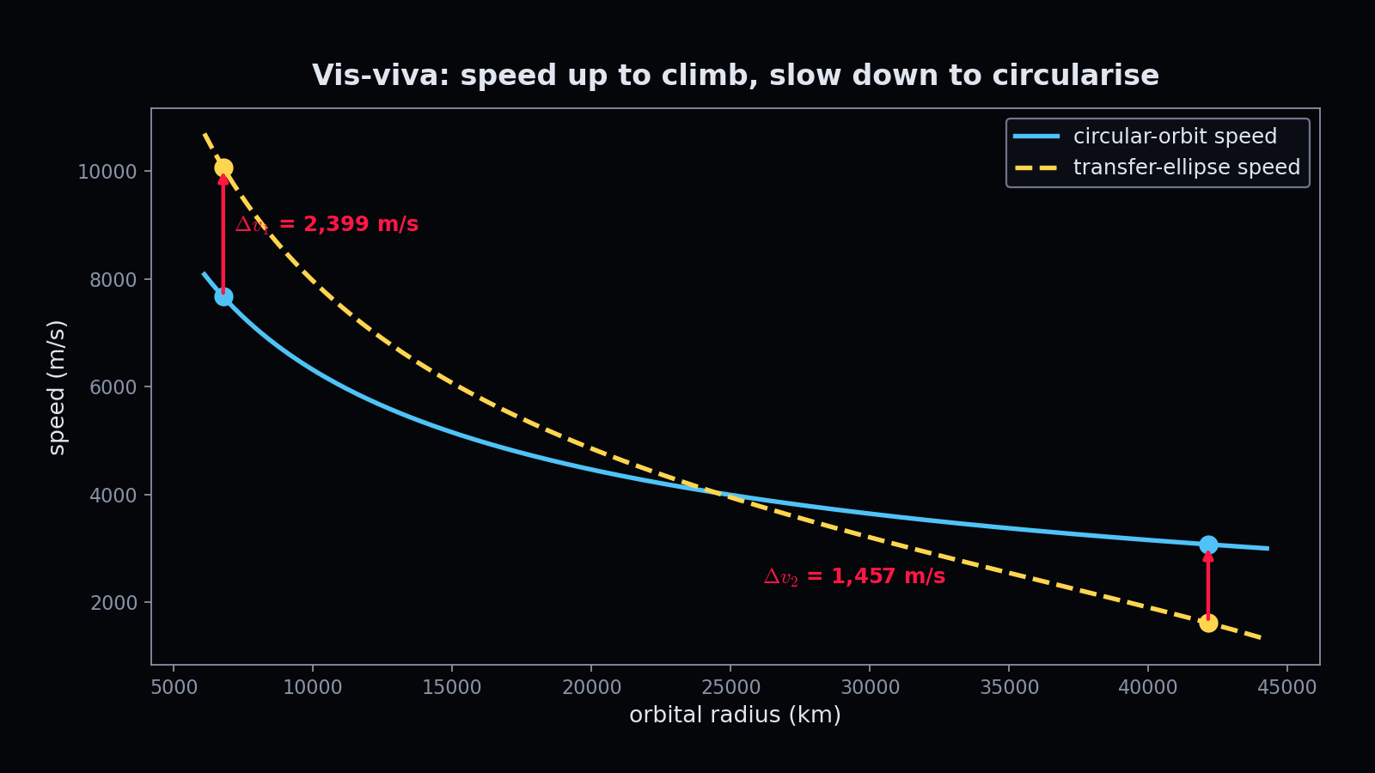
Physics: Vis-Viva Equation
The master equation of orbital speed:
μ = gravitational parameter of the central body
r = current distance from the center
a = semi-major axis (size) of the orbit
This single equation gives the speed at any point on any orbit — circular or elliptical.

Slide 12

Physics: Circular & Transfer Speeds
Circular orbit speed:
On the transfer ellipse you move faster than circular at the bottom, slower at the top.
The two burns simply bridge those speed gaps:
Δv₁ = speed needed to jump onto the ellipse
Δv₂ = speed needed to circularize at the top

Slide 13


Physics: Kepler's Third Law
Orbital period:
The transfer takes exactly half of the ellipse's period.
This is why distance dramatically increases travel time:
To GEO: about 5 hours
To Mars: about 8.5 months
To Jupiter: about 2.7 years

Slide 14
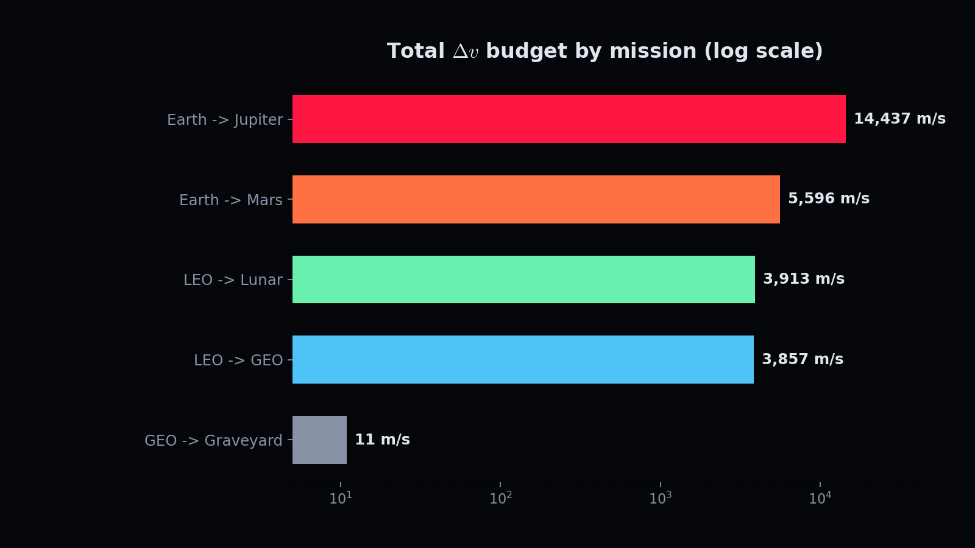
Delta-v: The Currency of Spaceflight
Total Transfer Δv= Δv₁ + Δv₂.
Every maneuver "spends" from a fixed Δv budget set at launch.
More Δv = more fuel = bigger, more expensive rocket.
Minimizing Δv is the difference between a feasible mission and an impossible one.

Slide 15


Why Δv Means Fuel: Rocket Equation
Tsiolkovsky's rocket equation:
Fuel mass grows exponentially with required Δv.
A small Δv saving can mean tons less propellant.
This is exactly why the fuel-optimal Hohmann transfer matters so much.

Slide 16
Why Hohmann Is (Usually) Optimal
Among all two-burn transfers between circular orbits, Hohmann uses the least Δv.
It puts both burns where they are most effective.
For nearly every practical mission, it is the efficient default.
But there is a fascinating exception...

Slide 17
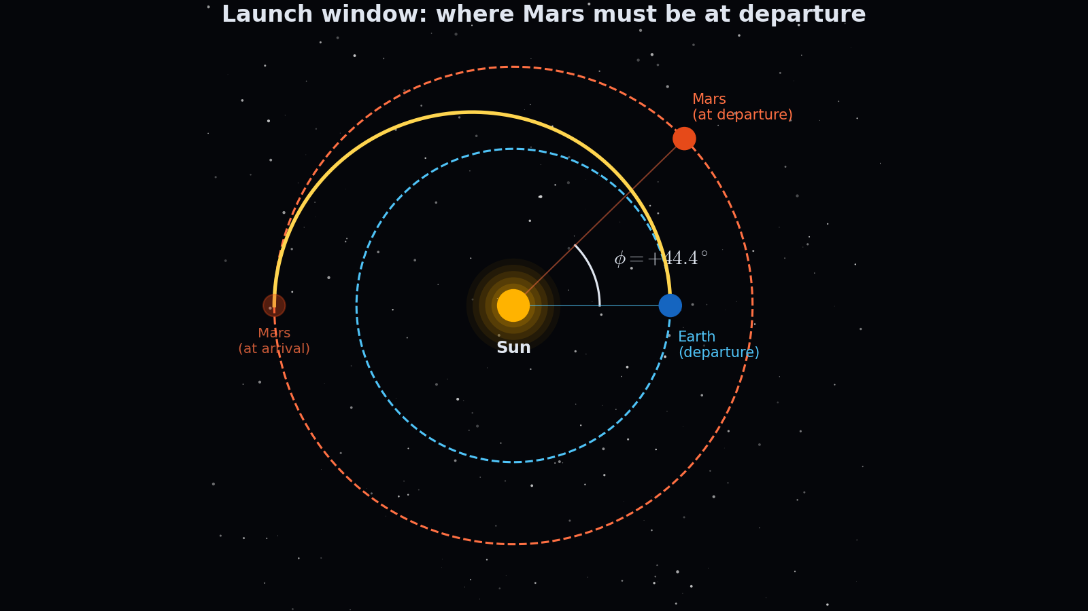
Launch Windows: Wait For Alignment
For interplanetary trips, the destination is a moving target.
The planet must be at the right place so you both arrive at the same point.
This sets a required phase angle between departure and target at launch.
For Earth to Mars, Mars must lead Earth by about 44°.

Slide 18
The Synodic Period
After a missed window, you must wait for the geometry to repeat.
Earth–Mars alignment repeats only about every 780 days (~26 months).
This is why real Mars missions launch in tight, widely spaced windows.
My simulator computes this automatically for any pair of orbits.

Slide 19
When Hohmann Isn't Best
Bi-Elliptic Transfers
For very large orbit changes, a clever three-burn path can beat Hohmann.
It swings far beyond the target, then drops back saving Δv.
The trade: it takes far longer.
A real example of the elegant trade-offs in mission design.

Slide 20
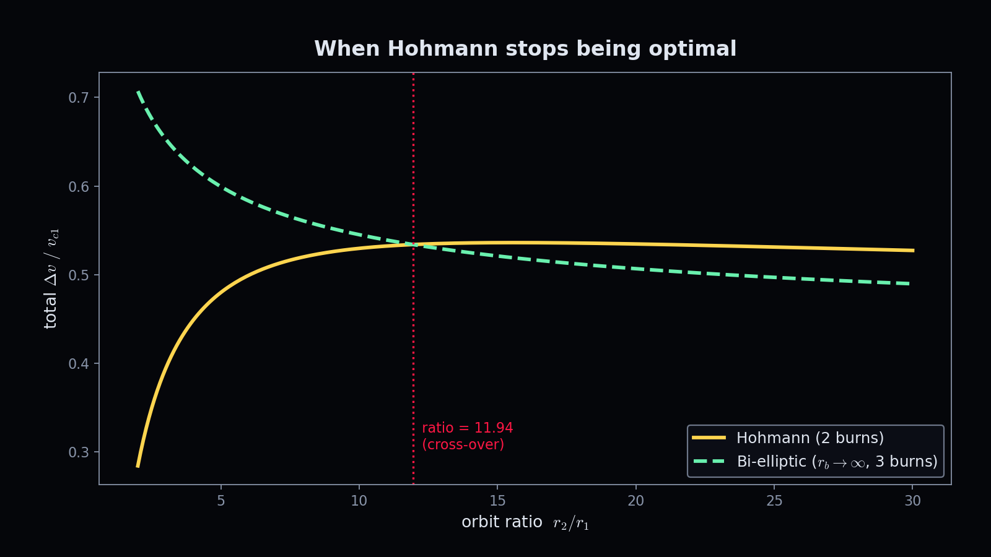
The 11.94 Cross-Over
Mathematics shows the exact tipping point: orbit ratio r₂/r₁ ≈ 11.94.
Below it: Hohmann wins. Above it: bi-elliptic can win.
My LEO to Lunar scenario (ratio ≈ 57) is flagged as a bi-elliptic-favorable case.

Slide 21
My Project: Interactive Simulator
A from-scratch physics engine + animated visualizer.
Computes Δv, travel time, phase angle, and synodic period for any transfer.
Renders the spacecraft, orbits, burns, and live data as an animation.
Built and validated against textbook and real-mission numbers.

Slide 22
Mission 1: LEO → GEO (Comms)
Moves satellites from a low parking orbit up to geostationary altitude.
Δv ≈ 3,857 m/s
Travel time ≈ 5.3 hours
This is the exact maneuver used to place TV, weather, and comms satellites.

Slide 23
Mission 2: Earth → Mars
The classic heliocentric Hohmann transfer to the Red Planet.
Δv ≈ 5,596 m/s
Travel time ≈ 259 days
The same physics that sends rovers like Perseverance to Mars.

Slide 24
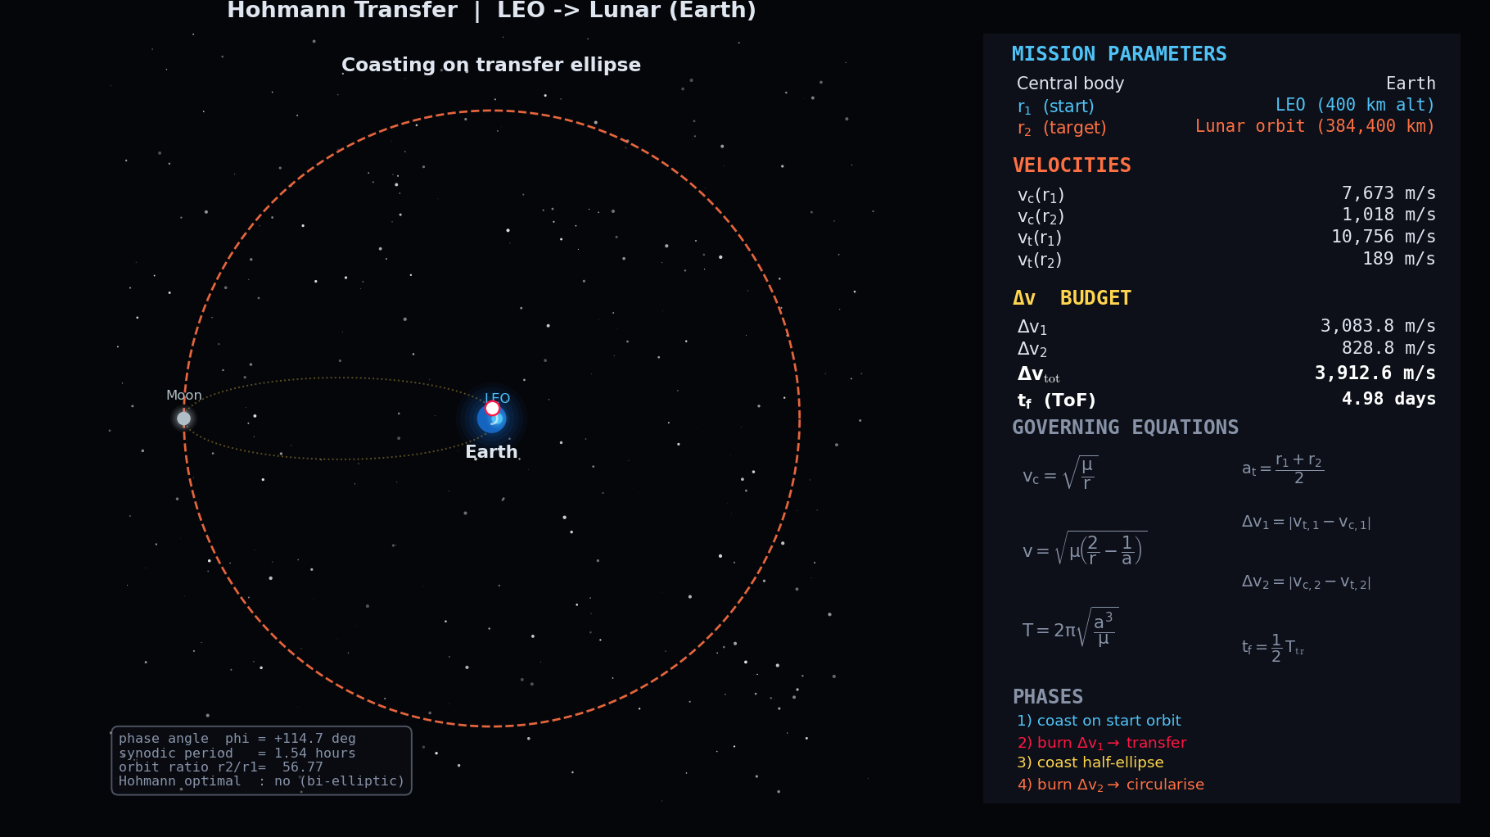
Mission 3: LEO → Lunar Distance
Sends a spacecraft from low Earth orbit out to the Moon's distance.
Δv ≈ 3,913 m/s
Travel time ≈ 5 days
The translunar injection that carried Apollo astronauts to the Moon.

Slide 25
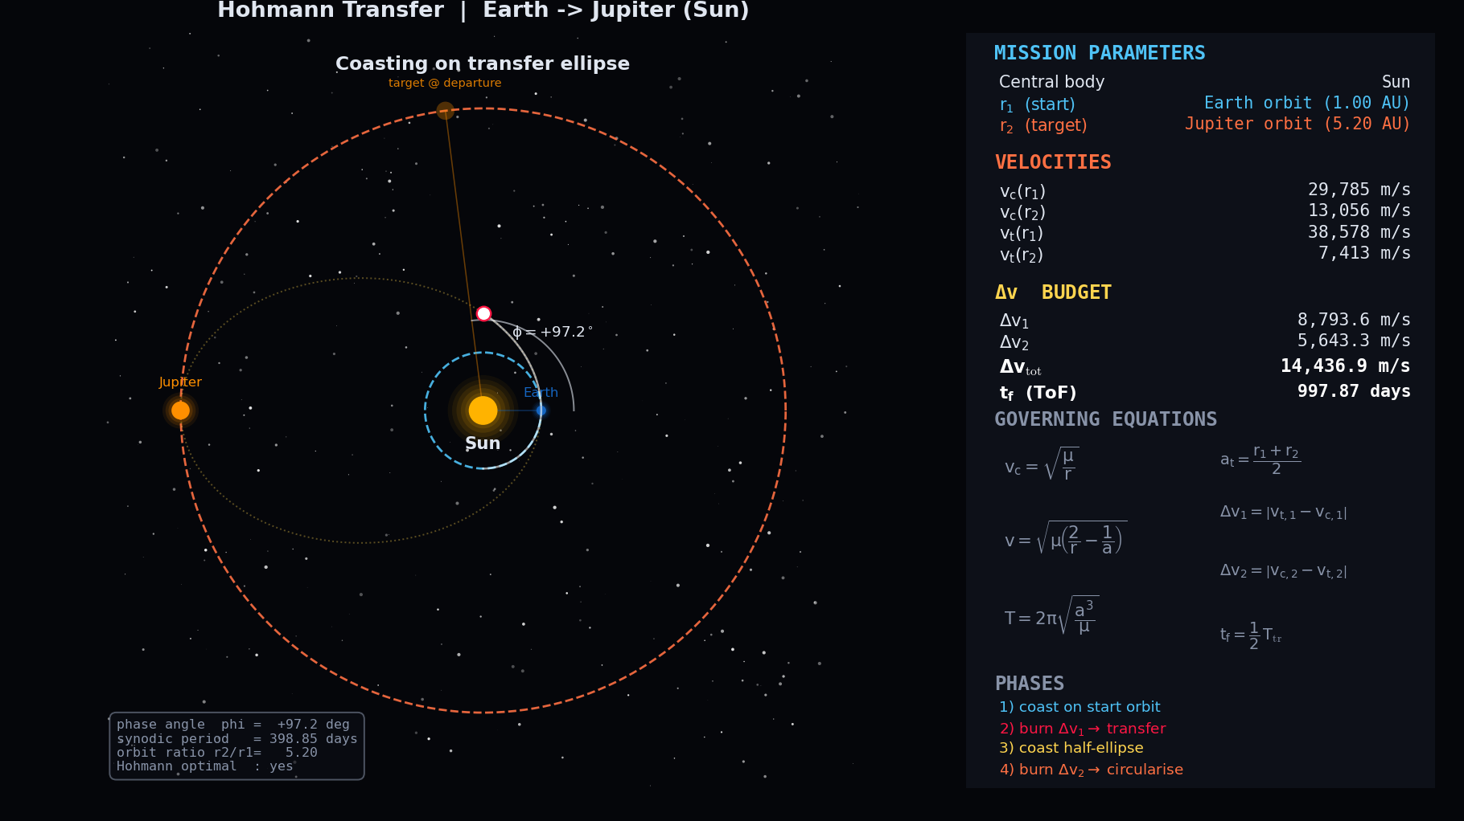
Mission 4: Earth → Jupiter
A transfer all the way to the outer solar system.
Δv ≈ 14,437 m/s
Travel time ≈ 2.7 years
Shows how steeply cost and time grow with distance and why real probes use gravity assists.

Slide 26
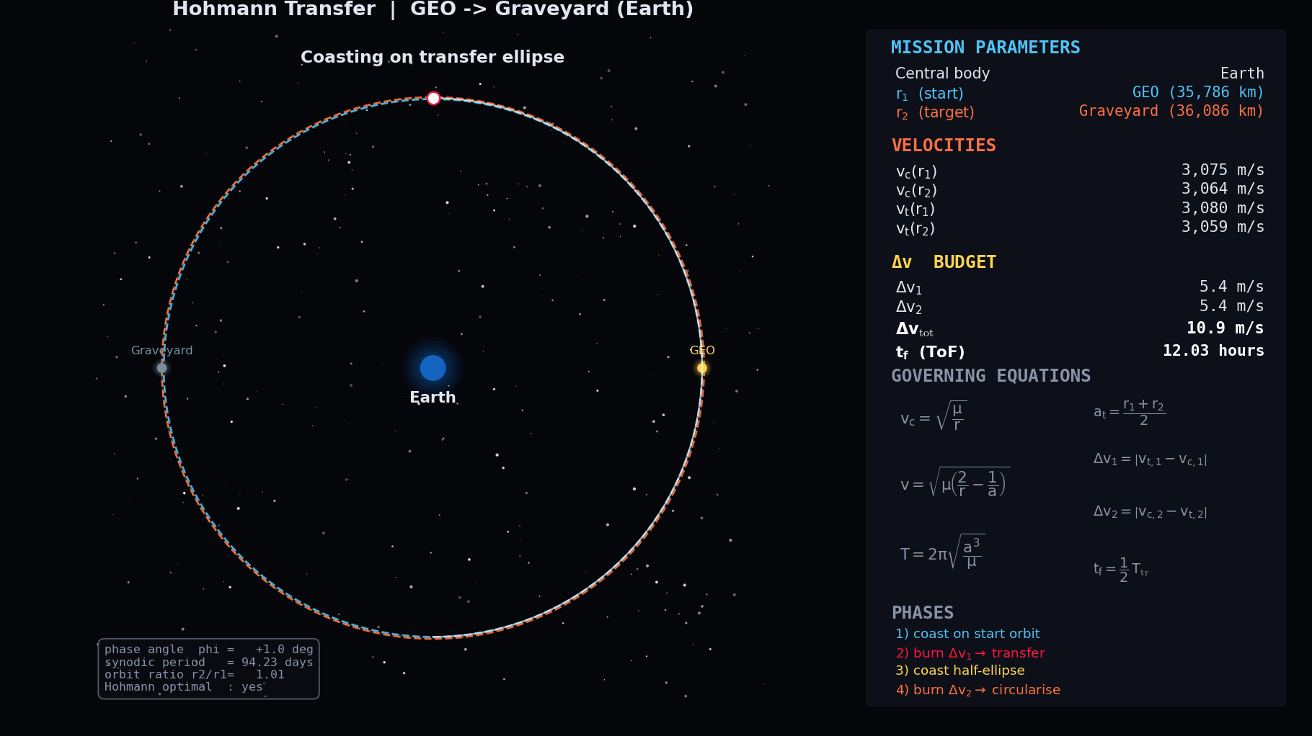
Mission 5: GEO → Graveyard
Retired satellites are nudged ~300 km above GEO into a "graveyard" orbit.
Δv ≈ 11 m/s
Travel time ≈ 12 hours
A tiny burn that protects valuable orbital slots real-world debris mitigation.

Slide 27
Results & Validation
Mission | Δv | Travel time | Checks against
LEO → GEO | 3,857 m/s | 5.3 h | textbook ~3.9 km/s
Earth → Mars | 5,596 m/s | 259 d | ~8.5 months
LEO → Lunar | 3,913 m/s | 5.0 d | Apollo-class
Earth → Jupiter | 14,437 m/s | 2.7 yr | published values
GEO → Graveyard | 11 m/s | 12 h | debris guidelines
Geostationary period computes to 86,164 s = one sidereal day (exact).
Earth–Mars synodic period: 779.7 days vs. accepted 779.9 days.
31 automated tests confirm the physics.

Slide 28
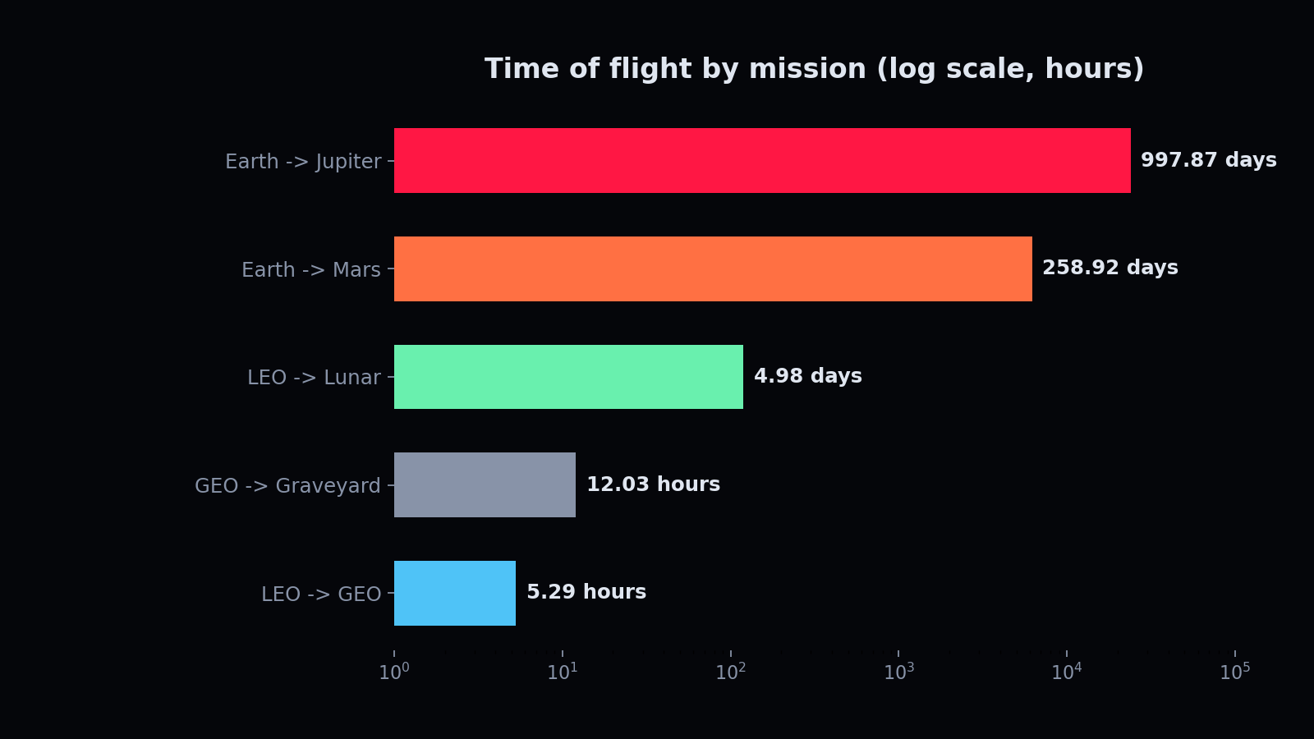
Travel Time Across Missions
The same fuel-optimal strategy spans 5 hours to nearly 3 years.
Distance is the dominant driver a direct result of Kepler's third law.
Mission designers must balance fuel, time, and launch opportunities.

Slide 29
Why This Matters in the Real World
Communications & weather satellites: reach geostationary orbit via Hohmann.
Mars rovers & probes: launched on Hohmann-class interplanetary transfers.
Crewed lunar missions: translunar injection is the same principle.
Space sustainability: graveyard disposal keeps orbits usable for the future.

Slide 30
Honest Science: Limits & Assumptions
Burns are treated as instantaneous; real engines burn over time.
Orbits assumed circular and in one plane (no inclination change).
Interplanetary Δv is the heliocentric transfer value, not full mission Δv.
No drag, oblateness, or third-body effects.
Stating limits clearly is part of doing real science and shows where the model could grow.

Slide 31
What I Learned
How a single equation (vis-viva) unlocks all of orbital motion.
Why fuel, time, and launch timing are deeply connected trade-offs.
That a 100-year-old idea still governs modern spaceflight.
How to validate a physics model against real-world data.

Slide 32

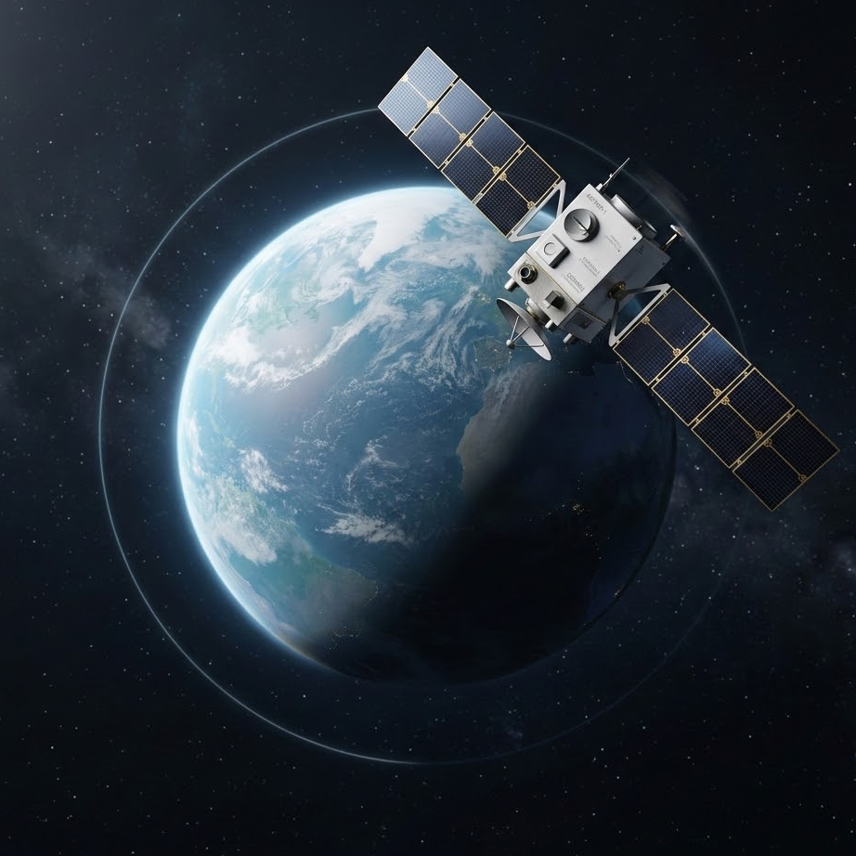
Thank You
l

