Slide 1
IBM University Engagement Project Submission
“Exploring the Power of Agentic AI with IBM Granite and watsonx Orchestrate”

Slide 2

Project Tile – Smart Business Idea Generator Agent
Domain of Project – E-Commerce
Student Name | Recent Passport Photo | Email ID | Mobile number [WhatsApp]
Divyesh Manoj Sud |  | divyeshsud98@gmail.com | 9619565165

Slide 3
Problem Statement - Smart Business Idea Generator Agent
Problem Statement : Smart Business Idea Generator Agent
The Challenge
Many aspiring entrepreneurs struggle to identify business opportunities that match their skills, interests, budget, and market demand. Business advice is often generic, making it difficult to find ideas that are practical and achievable.
The Objective
Build an AI-powered Smart Business Idea Generator Agent that:
• Collects user skills, interests, budget, experience, and goals.
• Generates personalized business ideas.
• Evaluates feasibility, startup costs, and revenue potential.
• Suggests target customers and business models.
• Creates launch roadmaps and validation strategies.
• Provides market trend insights and opportunity analysis.

Slide 4
Proposed Solution - Smart Business Idea Generator Agent
Proposed Solution: Smart Business Idea Generator Agent
The solution is an AI-powered business ideation assistant built using IBM watsonx Orchestrate and IBM Granite models.
The agent interacts with users to understand:
• Skills and experience
• Areas of interest
• Available budget
• Time commitment
• Risk tolerance
• Business goals
Using this information, the system generates personalized business ideas, evaluates feasibility, estimates startup costs, identifies revenue models, and recommends implementation roadmaps.
The agent also provides:
• Market opportunity analysis
• Customer targeting suggestions
• Growth strategies
• Risk assessment
• MVP recommendations
The result is a practical assistant that helps aspiring entrepreneurs discover and validate business opportunities quickly.

Slide 5
Technology Used
IBM watsonx Orchestrate – Agent orchestration and workflow automation
IBM Granite Models – Business reasoning, idea generation, summarization, and recommendations
IBM Cloud – Secure and scalable deployment infrastructure
IBM watsonx.ai – Foundation model access and AI governance
RAG (Optional Enhancement) – Retrieval of market reports, startup trends, and industry insights
Vector Database (Optional) – Storage and retrieval of business knowledge and trend data

Slide 6
IBM watsonx Orchestrate Components Used -
1) User Input Component – Collects skills, interests, budget, and goals
2) IBM watsonx Orchestrate Agent – Coordinates business idea generation workflow
3) IBM Granite Model – Generates personalized business recommendations
4) Business Evaluation Module – Assesses feasibility, cost, and scalability
5) Recommendation Output – Presents ranked business ideas and launch roadmap
6) Market Insights Module – Provides trend and opportunity analysis

Slide 7
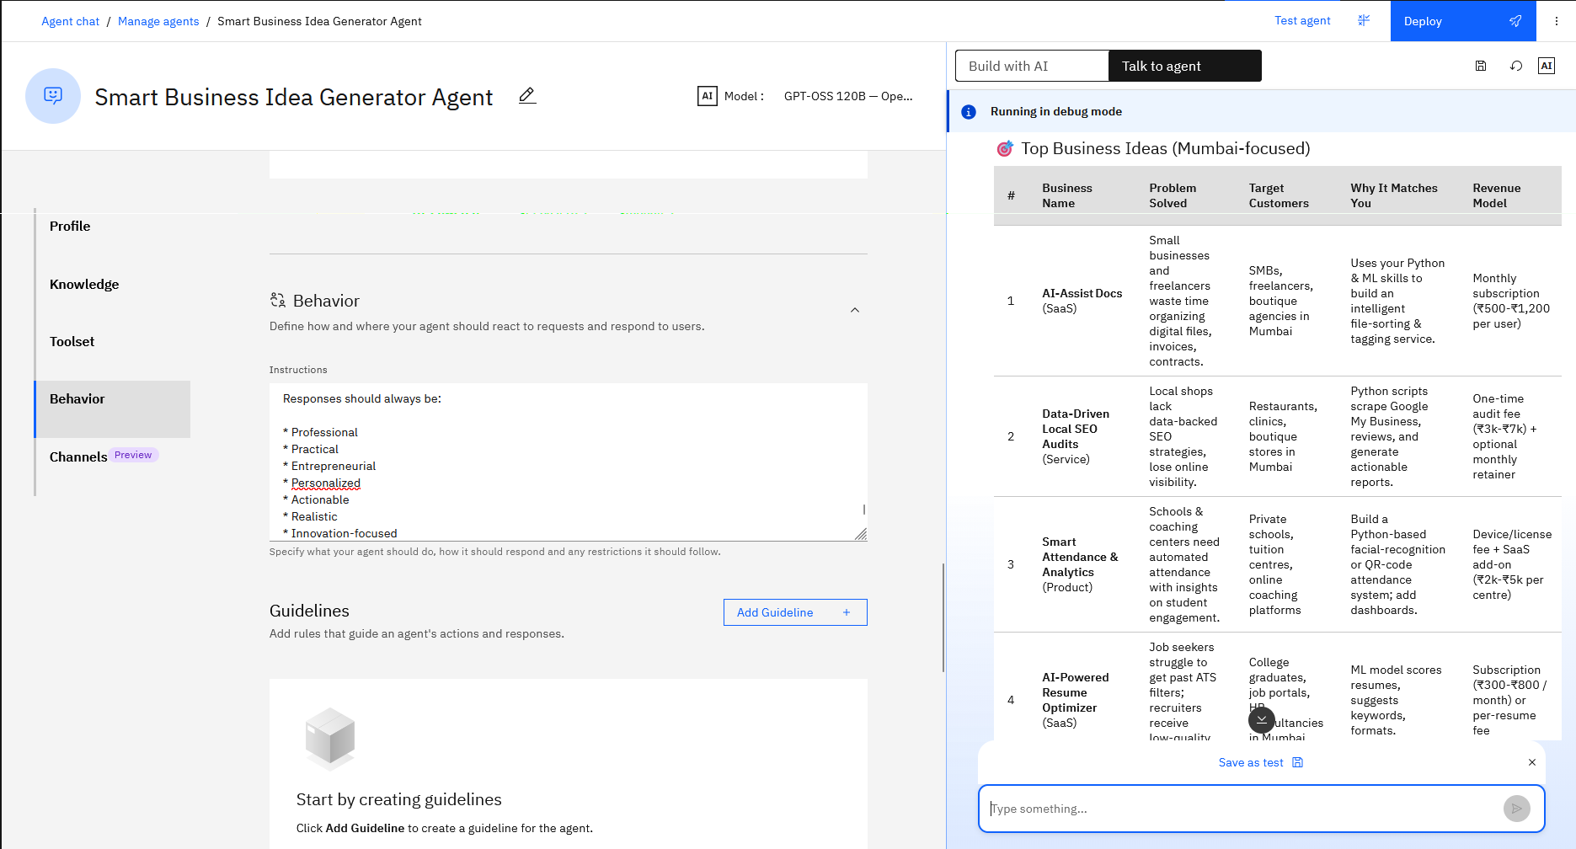
watson x orchestrate -

Slide 8
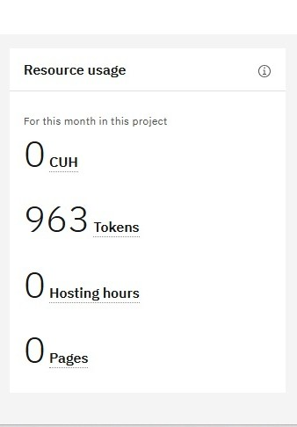
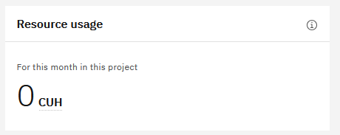
Tokens before and after

Slide 9

Role of Agentic AI in the solution
Role of Agentic AI in the Solution
Agentic AI enables the Smart Business Idea Generator to act as an intelligent business consultant rather than a simple chatbot.
The agent gathers user information, analyzes constraints and opportunities, evaluates multiple business paths, and generates personalized recommendations.
It can:
• Understand user goals and resources
• Generate and compare multiple business ideas
• Assess feasibility and risks
• Recommend revenue models
• Suggest implementation roadmaps
This creates a proactive and personalized experience that helps users discover realistic business opportunities.

Slide 10
Novelty and Uniqueness
The proposed Smart Business Idea Generator Agent stands out through:
• Personalized Recommendations based on skills, interests, and budget
• Agentic Decision-Making rather than static responses
• Business Feasibility Analysis for each idea
• Market Opportunity Assessment using current trends
• Startup Cost and Revenue Estimation
• Launch Roadmap Generation
• Scalable Architecture powered by IBM Granite and watsonx technologies
The solution acts as a virtual business mentor that helps users move from ideas to execution.

Slide 11
Git Hub Link
Please create public github repository (Enable Add README button while creating repository) with format –
Please test and Paste the working Github URL – https://github.com/Divyesh-Sud/Smart-Business-Idea-Generator-Agent.git
·
·
·

Slide 12
Future Scope
1. Integration with Real-Time Market Data
Connect with market intelligence platforms to provide dynamic business opportunities and trend analysis.
2. Advanced Business Planning
Generate Lean Canvas, SWOT analysis, marketing plans, and financial projections automatically.
3. Industry-Specific Agents
Dedicated agents for technology, agriculture, healthcare, education, retail, and service industries.
4. Multilingual Support
Enable business idea generation and consulting in multiple languages.
·
·
·

Slide 13
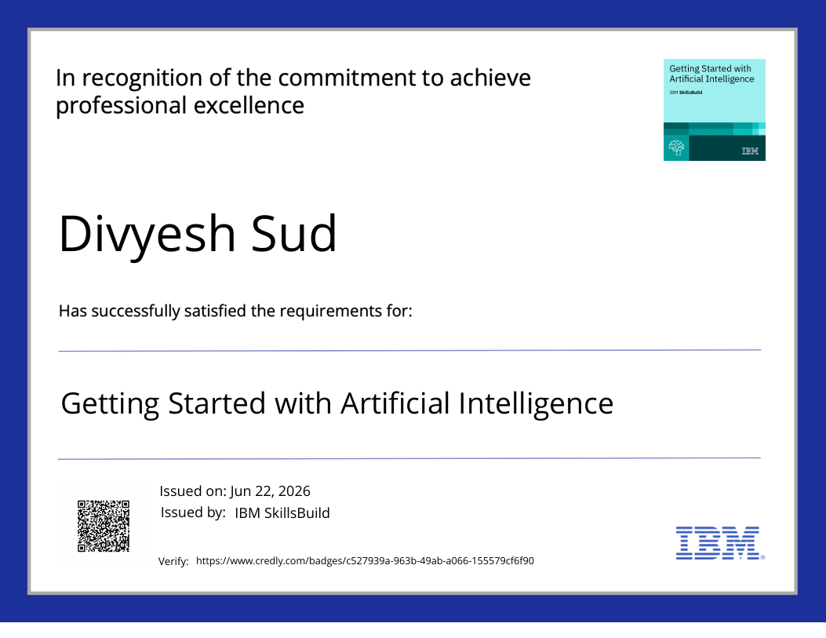
Certificates Earned:
Please add your credly certificate

Slide 14
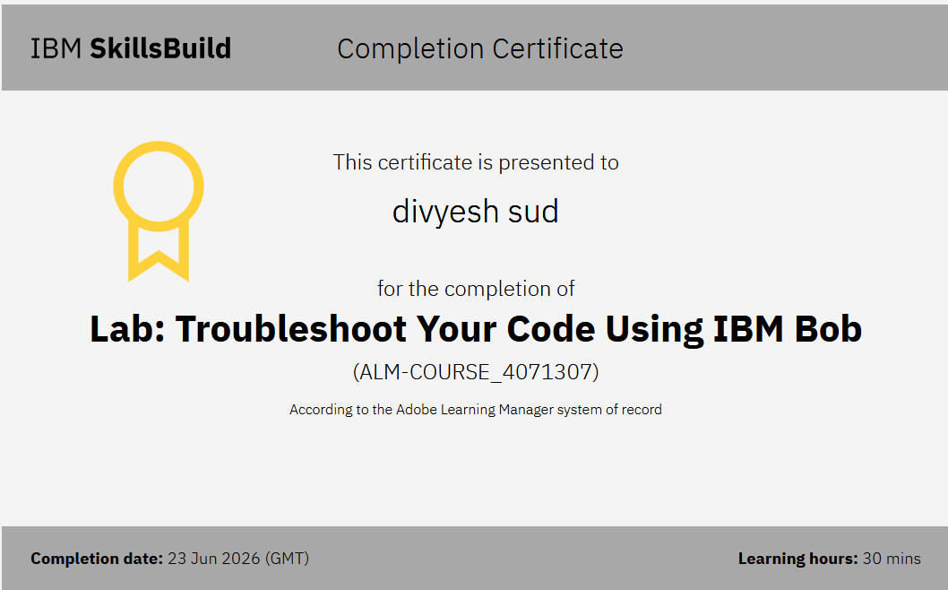
Certificates Earned:​
Add your IBM BOB Certificate

Slide 15


