Slide 1





Project Overview
Vehicle Maintenance App
The Vehicle Maintenance App is a comprehensive solution designed to help individuals and organizations efficiently track and manage vehicle information, including mileage, maintenance records, and servicing history. The application aims to replace traditional paper-based record-keeping with a digital solution that provides real-time updates and easy access to vehicle data.
Purpose
Target Users
Key Value
Simplify everyday vehicle management through an intuitive interface and real-time data updates.
Individual vehicle owners, small businesses with company cars, and fleet managers.
Centralized vehicle information reduces administrative work and improves maintenance accuracy.

Slide 2













Development Approach
Methodology
Technology Stack
Agile Development
with two-week sprints allowing for regular stakeholder feedback and incremental feature delivery
Backend:
Frontend:
React Native
Node.js with Express
Continuous Integration
ensuring code quality and stability throughout development
Database:
MongoDB
Authentication:
JWT
Cross-functional Teams
with developers, QA, and UX specialists working collaboratively
Cloud Services:
AWS
CI/CD:
GitHub Actions
Feature Prioritization
based on user needs and technical dependencies
Iterative Improvement
with regular retrospectives and process refinement

Slide 3









Development Challenges & Solutions
Data Synchronization
Performance Optimization
Challenge:
Challenge:
Ensuring data consistency between offline storage and cloud database when users operate in areas with poor connectivity.
The app experienced performance issues when handling large datasets, particularly for users with multiple vehicles and extensive maintenance histories.
Solution:
Solution:
Stores changes locally when offline
Automatically syncs when connectivity is restored
Implemented pagination for data retrieval
Resolves conflicts using timestamp-based resolution
Added data indexing in MongoDB
Provides visual indicators of sync status to users
Optimized React Native components to minimize re-renders
Implemented data caching strategies
Cross-Platform Consistency
Battery Consumption
Challenge:
Challenge:
Maintaining consistent behavior and appearance across iOS and Android platforms.
Initial versions of the app consumed excessive battery due to background processes.
Solution:
Solution:
Created a platform-agnostic component library
Optimized background sync frequency
Implemented platform-specific code only where necessary
Implemented more efficient location tracking
Established comprehensive testing protocols for both platforms
Added user-configurable settings for background activities
Used React Native's platform-specific extensions for critical differences
Used push notifications instead of polling where possible

Slide 4



















Integration Work
The Vehicle Maintenance App integrates with multiple third-party systems and services to provide a comprehensive solution for vehicle management.
Vehicle Information Databases
Service Provider Integration
Fuel Price APIs
National vehicle databases for VIN-based specifications
API connections to major service chains
Real-time fuel price data integration
Secure data exchange protocols
Geolocation-based price comparisons
Manufacturer databases for maintenance schedules
OAuth-based authentication for service providers
Historical price tracking for cost analysis
Standardized error handling for API failures
Payment Processing
Cloud Services Integration
Location Services
Stripe integration for subscription management
AWS S3 for document and image storage
Google Maps API for service location finding
AWS Lambda for serverless background processing
Apple Pay and Google Pay for in-app purchases
Geocoding for address-based searches
CloudWatch for monitoring and alerting
Route optimization for service planning
PCI DSS compliance implementation

Slide 5





Technical Challenges Overcome
Security Implementation
Database Schema Evolution
Challenge:
Challenge:
Ensuring robust security for sensitive vehicle and user data.
Evolving the database schema without disrupting existing users.
Solution:
Solution:
Implemented end-to-end encryption for data transmission
Designed a versioned migration system
Added biometric authentication options
Implemented backward compatibility layers
Created role-based access control for shared vehicles
Created data transformation utilities
Conducted regular security audits and penetration testing
Developed rollback mechanisms for failed migrations
Push Notification Reliability
Analytics Implementation
Challenge:
Challenge:
Inconsistent delivery of maintenance reminder notifications across devices.
Balancing comprehensive usage analytics with privacy concerns.
Solution:
Solution:
Created an opt-in analytics system
Implemented a multi-channel notification strategy
Implemented data anonymization
Added delivery confirmation tracking
Developed clear privacy controls for users
Created a notification retry mechanism
Created aggregated reporting to avoid individual tracking
Implemented time-zone aware scheduling

Slide 6









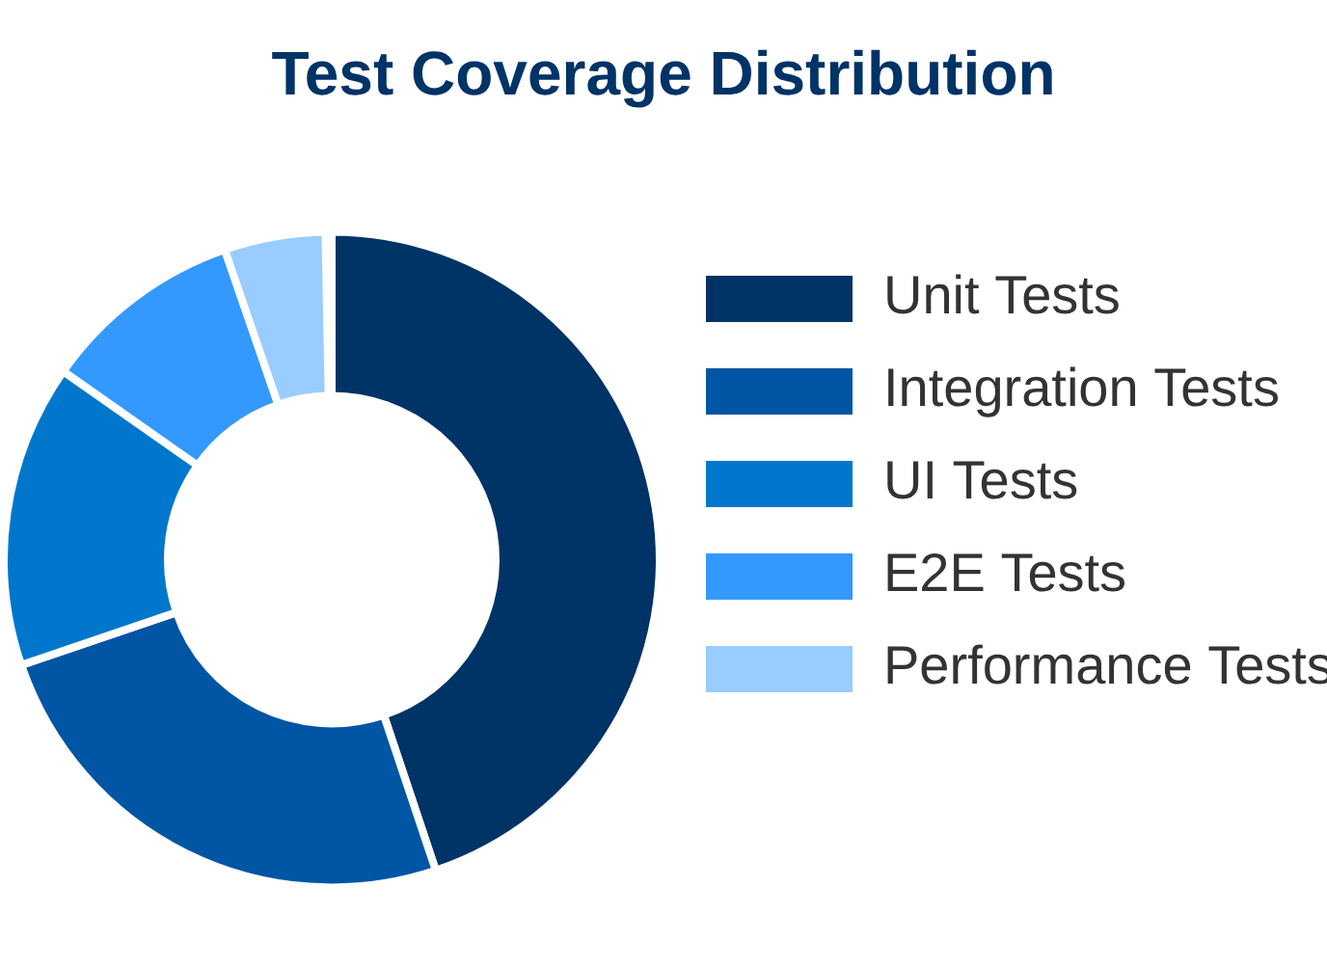
Testing Strategy
Automated Testing
Manual Testing
Beta Testing Program
Unit tests for core business logic (Jest)
Exploratory testing sessions
Phased rollout to beta testers
Integration tests for API endpoints (Supertest)
Usability testing with target user groups
Structured feedback collection
Accessibility compliance testing
Bug bounty program
UI component tests (React Testing Library)
Cross-device compatibility testing
Feature prioritization based on beta feedback
End-to-end tests (Detox)
Edge case scenario testing
Performance benchmarking tests
Continuous improvement cycle

Slide 7









Deployment & DevOps
CI/CD Pipeline
Monitoring & Support
1
Code Commit
Performance Monitoring
Error Tracking
Developers push code to GitHub repository, triggering the CI/CD workflow
Sentry captures and reports runtime errors with detailed context
New Relic tracks app performance metrics and identifies bottlenecks
2
Automated Testing
GitHub Actions runs unit, integration, and UI tests to verify code quality
User Analytics
Customer Support
Mixpanel tracks user behavior and feature usage patterns
Zendesk integration for streamlined user support and issue tracking
3
Staging Deployment
Successful builds are automatically deployed to staging environment for verification
Crash Reporting
Alerting System
Automated crash reports with device and OS information
PagerDuty alerts for critical issues requiring immediate attention
4
Production Approval
Team lead reviews changes and approves deployment to production
5
Production Deployment
Approved changes are deployed to production with automated version management

Slide 8












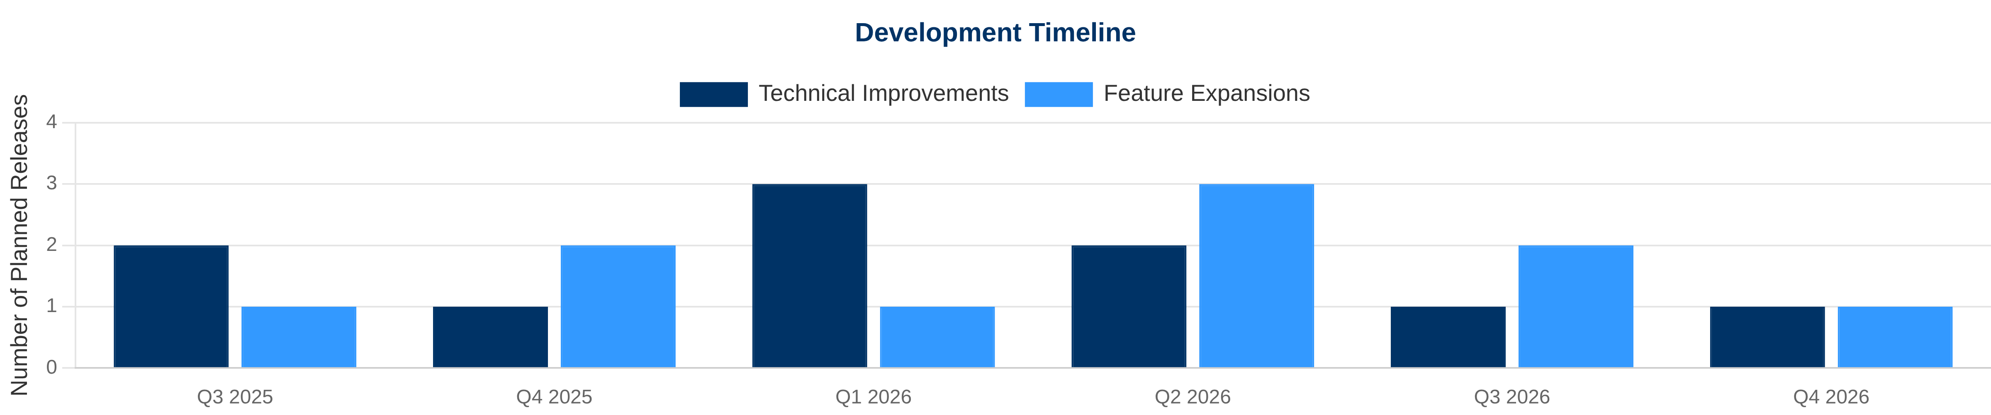
Future Development Roadmap
Our development roadmap outlines planned technical improvements and feature expansions to enhance the Vehicle Maintenance App's capabilities and user experience.
Technical Improvements
Feature Expansion
GraphQL Implementation
OBD-II Integration
Migration to GraphQL for more efficient data fetching and reduced network overhead
Direct connection with vehicle diagnostic systems for real-time data
React Native New Architecture
Fleet Management
Adoption of React Native's new architecture for improved performance and native capabilities
Advanced tools for businesses managing multiple vehicles
Expense Tracking
Enhanced Offline Capabilities
Comprehensive expense monitoring with reporting and tax categorization
Improved offline functionality with conflict resolution and background synchronization
Maintenance Marketplace
Machine Learning Integration
Platform for connecting with service providers and parts suppliers
Predictive maintenance recommendations based on vehicle usage patterns
Gamification
Blockchain for Service Verification
Achievement system to encourage regular maintenance and safe driving
Immutable service records using blockchain technology for verification

Slide 9













Lessons Learned
Technical Insights
Process Improvements
Early performance optimization is crucial
for mobile applications to prevent major refactoring later in development.
More frequent user testing would have identified UX issues earlier
, reducing the need for significant interface changes.
Cross-platform frameworks require platform-specific testing
Better documentation of API contracts would have streamlined integration
to ensure consistent behavior across iOS and Android.
between frontend and backend teams.
Data synchronization requires careful conflict resolution planning
to handle offline usage scenarios effectively.
More comprehensive device testing matrix would have reduced platform-specific bugs
discovered after initial release.
Third-party API dependencies need robust fallback mechanisms
to maintain app functionality during service disruptions.
Earlier performance profiling would have prevented later refactoring
of core components to meet performance targets.
User privacy must be considered at every development stage
, not just as a compliance checkbox at the end.
More granular feature flagging would have enabled safer production releases
with better control over feature rollout.

Slide 10





Conclusion
The Vehicle Maintenance App successfully addresses the need for a comprehensive, user-friendly solution for tracking and managing vehicle maintenance. Despite facing significant technical challenges during development, the team implemented robust solutions that resulted in a reliable, performant application that meets user needs.
Cross-platform solution with consistent experience across iOS and Android
Reliable offline functionality with seamless data synchronization
Secure, privacy-focused design with robust data protection
The project demonstrates the effectiveness of modern mobile development practices, including cross-platform development, cloud integration, and agile methodology. The lessons learned provide valuable insights for future mobile application development projects.
For more information: vehiclemaintenance@example.com

