Slide 1
University Recommendation System
With KNN Algorithm
Divyesh Patel

Slide 2





Content Title
Visualization
System Flow Chart
Insights
Proposed System
Inference

Slide 3
Proposed System
This is the system in which client will insert their choice according to the feature menu.
There would be some training data generated by pandas itself
Basic analysis is also performed to see what kind of data it is.
With the help of KNN Algorithm, machine will learn patterns from previous data, by seeing the similar patterns of nearest neighbour of new data the prediction is formed.
After some post-processing 10 recommended universities are shown on the basis of features

Slide 4
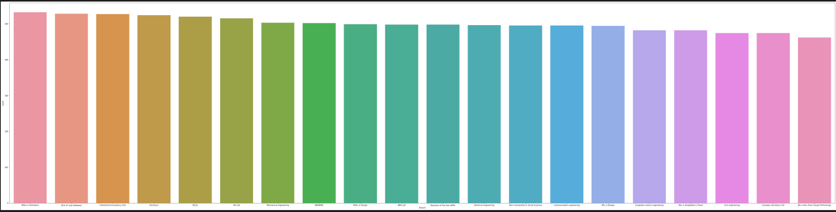

Visualization
This are the branches that a university offers
This graph shows that which branch is repeated the most in the sorted way

Slide 5
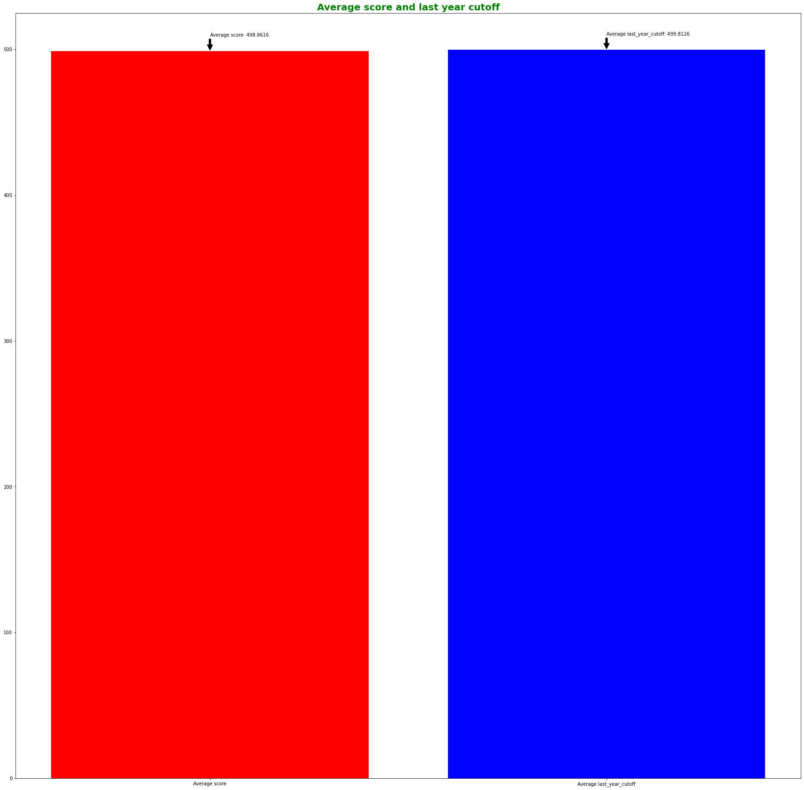
Chart
This is a graph showing the average cutoff and average score which we can observe is nearly same

Slide 6
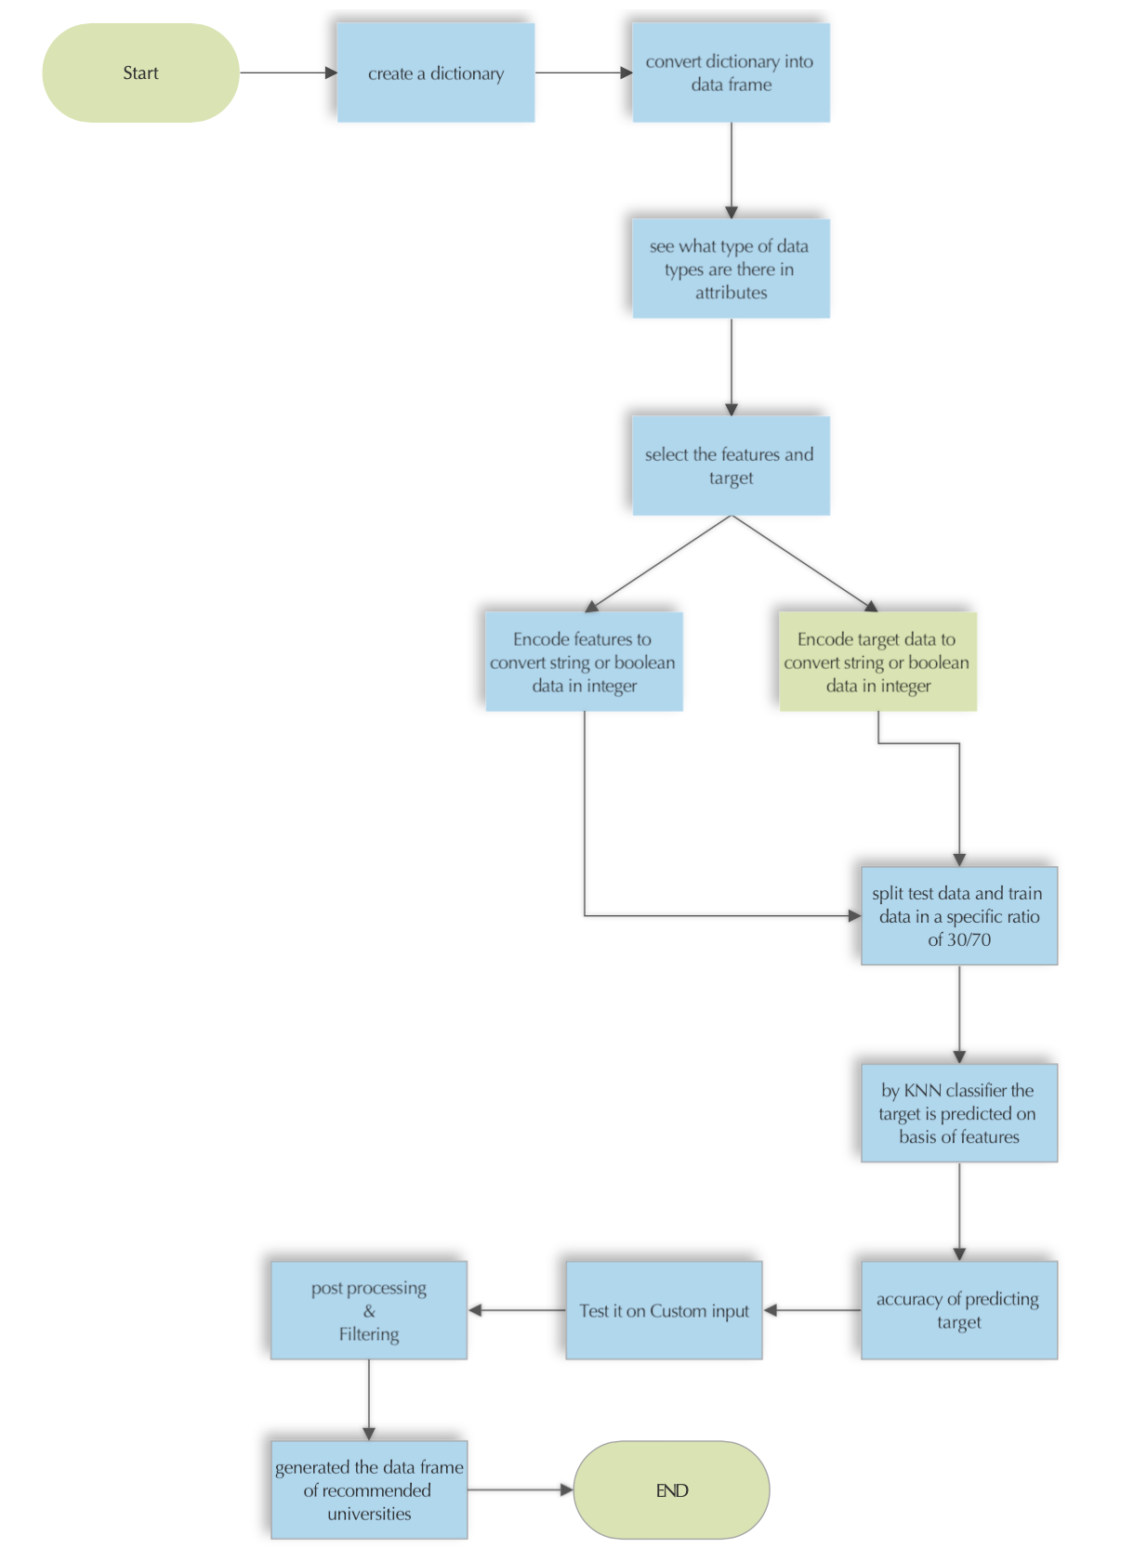
Flow Chart
Click the flow chart to see the complete flow

Slide 7
Features & Target
Features
Target
The selection of the features is done on the basis of how does the data correlate in suggesting an university.
There are two main feature last_year_cutoff and score if this two are predicted properly than we can recommend the college having similar features
The selection of target function is done on the basis of what we want to predict from our data.
The target function in our case is selection column.

Slide 8
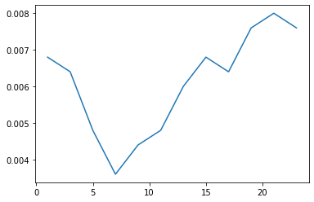
Elbow Method
This graph shows us the best value of n_neighbour
Which nearly lies in between 5 to 10

Slide 9
Insights & Inference
Inference
Insights
The process of machine learning with KNN Algorithm needs more memory and computational power.
In this we are first finding the value of k by elbow method to get best out of this algorithm after that we select the feature and target attributes and split them into training and testing data in 75%/25% ratio respectively.
By KNN classifier we predict the output.
Then on the basis of test and prediction we can find the accuracy, classification report and confusion matrix
There was a major insight found in custom test which was the main pattern learned by the KNN algorithm was the logic whether the student will get the admission or not.
The chances of not getting admission were more if the score was below 500

Slide 10
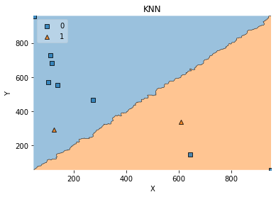
KNN classification graph
This shows that how the prediction
looks like and at what region it lies
0:- admission can be done
1:- admission cannot be done
Accuracy to recommend an University is 99.52 %

Slide 11
Classification Report
 | precision | recall | F-1 score | support
0 | 1.00 | 1.00 | 1.00 | 1256
1 | 1.00 | 1.00 | 1.00 | 1244
Accuracy |  |  | 1.00 | 2500
Macro avg | 1.00 | 1.00 | 1.00 | 2500
Weighted avg | 1.00 | 1.00 | 1.00 | 2500

Slide 12
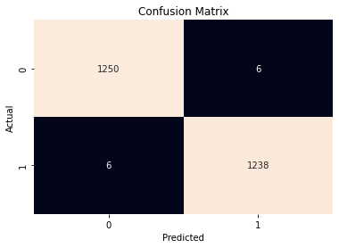
Confusion Matrix
Here is the confusion matrix which has the report
That how much the condition is predicted and true

Slide 13
“Have courage to follow your heart and intuitions.” - Steve Jobs

Slide 14
Thank you

