Slide 1
Java -Interface
BY
Dhivya S

Slide 2
Contents
→ What is Interface?
→ Syntax for Declaring Interface
→ Why is an Interface required?
→ Difference between Class and Interface
→ When to use Interface and Abstract Class?
→Must know facts about Interface

Slide 3
What is Interface ?
It’s a blue print of a class
Set of rules or contract
It’s used to achieve abstraction
Supports functionality of multiple inheritance
Achieve loose coupling
Notes:
1.specify what a class must do and not how. It is the blueprint of the class.
2.An Abstraction is a process of exposing all the necessary details and hiding the rest. In Java, Data Abstraction is defined as the process of reducing the object to its essence so that only the necessary characteristics are exposed to the users.
3.The degree of dependency of one class over the other.

Slide 4
Syntax for Declaring Interface
Interface interfacename(user defined name)
{
void abstract1method();//methods – abstract,
double abstract2method();//no method body
default int methodname(){ //default method
// statements to be executed
}
Static void methodname(){ //static method
// statements to be executed
}

Slide 5
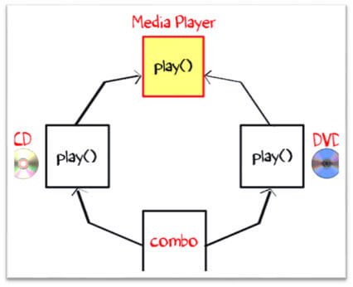
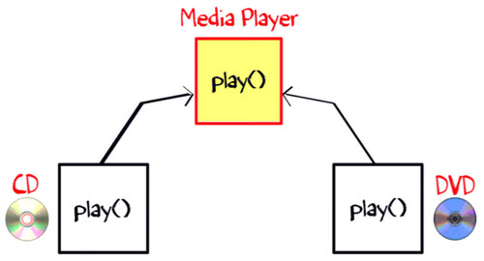
To understand the use of interface in Java better, let see a Java interface example. The class “Media Player” has two subclasses: CD player and DVD player. Each having its unique interface implementation in Java method to play music. Another class “Combo drive” is inheriting both CD and DVD (see image below). Which play method should it inherit? This may cause serious design issues. And hence, Java does not allow multiple inheritance.

Slide 6
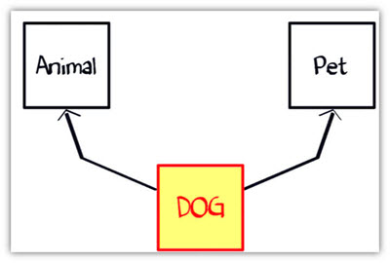
Now let’s take another example of Dog. Suppose you have a requirement where class “dog” inheriting class “animal” and “Pet” (see image). But you cannot extend two classes in Java. So what would you do? The solution is Interface.

Slide 7
Differences between a Class and an Interface:
Class | Interface
The keyword used to create a class is “class” | The keyword used to create an interface is “interface”
A class can be instantiated i.e, objects of a class can be created. | An Interface cannot be instantiated i.e, objects cannot be created.
Classes does not support multiple inheritance. | Interface supports multiple inheritance.
It can be inherit another class. | It cannot inherit a class.
It can be inherited by another class using the keyword ‘extends’. | It can be inherited by a class by using the keyword ‘implements’ and it can be inherited by an interface using the keyword ‘extends’.
It can contain constructors. | It cannot contain constructors.
It cannot contain abstract methods. | It contains abstract methods only before java8, now it has default and static methods too.
Variables and methods in a class can be declared using any access specifier(public, private, default, protected) | All variables and methods in a interface are declared as public.
Variables in a class can be static, final or neither. | All variables are static and final.

Slide 8
why default methods were included in the Java 8?
In a typical design based on abstractions, where an interface has one or multiple implementations, if one or more methods are added to the interface, all the implementations will be forced to implement them too. Otherwise, the design will just break down.
Default interface methods are an efficient way to deal with this issue. They allow us to add new methods to an interface that are automatically available in the implementations. Thus, there's no need to modify the implementing classes.
When a class implements an interface that contains default methods, it can:
Do nothing: inherit the default methods from the super interface.
Re-declare the default methods as abstract – causing its subclasses to implement them.
Override the default methods with new implementation

Slide 9
Must know facts about Interface
A Java class can implement multiple Java Interfaces. It is necessary that the class must implement all the methods declared in the interfaces.
Class should override all the abstract methods declared in the interface
Class needs to provide functionality for the methods declared in the interface.
All methods in an interface are implicitly public and abstract
The overriding methods cannot have more restrict access specifiers
Non-abstract classes must override all methods declared in the super interfaces
Abstract classes are not forced to override all methods from their super interfaces. The first concrete class in the inheritance tree must override all methods:
An interface cannot be instantiated
An interface can extend from one or many interfaces. Class can extend only one class but implement any number of interfaces
An interface cannot implement another Interface. It has to extend another interface if needed.
The class cannot implement two interfaces in java that have methods with same name but different return type.
An interface reference can point to objects of its implementing classes
i.e.: If you implement an interface and provide body to its methods from a class. You can hold object of the that class using the reference variable of the interface i.e. cast an object reference to an interface reference.
Notes:
Example abstract,
example5,
example

Slide 10
1) To achieve security - hide certain details and only show the important details of an object (interface). 2) If the functionality we are creating will be useful across a wide range of disparate objects, use an interface
public interface Actor {
void perform();
}
public interface Producer {
void invest();
}
Nowadays most of the actors are rich enough to produce their own movie. If we are using interfaces rather than abstract classes, we can implement both Actor and Producer. Also, we can define a new ActorProducer interface that extends both.
public interface ActorProducer extends Actor, Producer{
// some statements
}

Slide 11
Functional Interface
A functional interface has only one abstract method but it can have multiple default methods.
The reason it's called a "functional interface" is because it effectively acts as a function. Since you can pass interfaces as parameters, it means that functions are now "first-class citizens" like in functional programming languages. This has many benefits, and you'll see them quite a lot when using the Stream API.
@FunctionalInterface annotation is used to ensure an interface can’t have more than one abstract method. The use of this annotation is optional.
@FunctionalInterface
interface Square
{
int calculate(int x);
}

Slide 12
Marker Interface in Java
An interface that does not contain methods, fields, and constants is known as marker interface. In other words, an empty interface is known as marker interface or tag interface.
The declaration of marker interface is the same as interface in Java but the interface must be empty.
For example:
public interface Serializable
{
}

Slide 13

Uses of Marker Interface
Marker interface is used as a tag that inform the Java compiler by a message so that it can add some special behavior to the class implementing it.
Java marker interface are useful if we have information about the class and that information never changes, in such cases, we use marker interface represent to represent the same.
Implementing an empty interface tells the compiler to do some operations.
It is used to logically divide the code and a good way to categorize code. It is more useful for developing API and in frameworks like Spring.

Slide 14
Nested or Inner interfaces in Java
An interface which is declared inside another interface or class is called nested interface.
They are also known as inner interface. Since nested interface cannot be accessed directly, we can only call the nested interface by using outer class or outer interface name followed by dot( . ), followed by the interface name.

Slide 15
interface MyInterfaceA{
void display();
interface MyInterfaceB{ //nested inner interface
void myMethod();
}
}
class NestedInterfaceDemo1 implements MyInterfaceA.MyInterfaceB
{ //implementing by superinterfacename.interfacename
public void myMethod(){
System.out.println("Nested interface method");
}
public static void main(String args[]){
MyInterfaceA.MyInterfaceB obj= new NestedInterfaceDemo1();
obj.myMethod();
}
}
Notes:
Nested interfaces are static by default. You don’t have to mark them static explicitly as it would be redundant.
Nested interfaces declared inside class can take any access modifier, however nested interface declared inside interface is public implicitly.

Slide 16
Example 2: Nested interface declared inside a class
class MyClass{
interface MyInterfaceB{
void myMethod();
}
}
class NestedInterfaceDemo2 implements MyClass.MyInterfaceB{
public void myMethod(){
System.out.println("Nested interface method");
}
public static void main(String args[]){
MyClass.MyInterfaceB obj= new NestedInterfaceDemo2();
obj.myMethod();
}
}
Notes:
Demointerface in →interface -folder
Newinterface file in → src path

Slide 17

Questions ?
Suppose A is an interface. Can we create an object using new A()?
Ans: No, we cannot create an object of interface using new operator. But we can create a reference of interface type and interface reference refers to objects of its implementation classes.
Suppose A is an interface. Can we declare a reference variable a with type A like this:
A a;
Ans: Yes.

Slide 18
Why an Interface method cannot be declared as final in Java? Or, Can a method within an interface be marked as final?
Ans: Not possible. Doing so will result the compilation error problem. This is because a final method cannot be overridden in java. But an interface method should be implemented by another class.
So, the interface method cannot be declared as final. The modifiers such as public and abstract are only applicable for method declaration in an interface.

Slide 19

Can an interface be final?
Ans: No. Doing so will result compilation error problem.
Can we re-assign a value to a variable of interface?
Ans: No, variables defined inside the interface are static and final by default. They are just like constants. We can’t change their value once they got.
What is a Marker Interface in Java?
Ans: An Interface that doesn’t have any data members or methods is called marker interface in java. For example, Serializable, Cloneable, Remote, etc.

Slide 20

Can we define an interface inside a method as local member?
Ans: No, we can’t define an interface as local member of a method like local inner class.
Why we Cannot use constructor in interface?
An Interface in Java doesn't have a constructor because all data members in interfaces are public static final by default, they are constants (assign the values at the time of declaration). There are no data members in an interface to initialize them through the constructor.

Slide 21
Something to think about
At a conceptual level, it may help you choose between making something a class versus making it an interface
if you think of a class as defining what an object is, whereas an interface defines what an object acts like.
Thus, if you want to declare a variable or parameter as storing objects that are a certain type of thing, create a class to use in these declarations. On the other hand, if you only need to say that a variable or parameter stores objects that act in certain ways (i.e., by handling certain messages), without concern for what they really are, create an interface to use in the declarations.
For example, if Fish is a class, and Swimmer is an interface, then the declaration
Fish f;
conceptually says that f is a fish,
Swimmer s;
says that s merely acts like something that swims -- perhaps by handling a swim message.
The object stored in s could really be any kind of thing that acts in this way -- it could be a fish, it could be a boat, it could be a human athlete, etc.
Notes:
Apart from theoretical, what is really a class and interface?
What you want to create?
Why u create?

Slide 22

Thank you .

