Slide 1
BASIC RELATIONSHIP BETWEEN PIXELS

Slide 2
What is a pixel?
In digital imaging, a pixel, pel, or picture element is a physical point in a raster image, or the smallest addressable element in an all points addressable display device; so it is the smallest controllable element of a picture represented on the screen.
Each pixel is a sample of an original image; more samples typically provide more accurate representations of the original. The intensity of each pixel is variable. In color imaging systems, a color is typically represented by three or four component intensities such as red, green, and blue, or cyan, magenta, yellow, and black.

Slide 3
BASIC RELATIONSHIP BETWEEN PIXELS
Neighborhood
Adjacency
Connectivity
Paths
Regions & Boundaries
Distance Measures

Slide 4
Neighbors of a pixel
There are three kinds of neighbors of a pixel-
N4(p) 4-neighbors:
The set of horizontal and vertical neighbors.
ND(p) diagonal neighbors:
The set of 4 diagonal neighbors.
N8(p) 8-neighbors:
Union of 4-neighbors and diagonal neighbors.

Slide 5
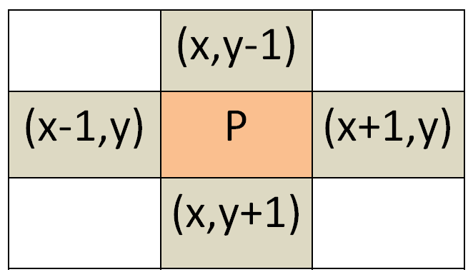
4-Neighbour
Any pixel p(x, y) has two vertical and two horizontal neighbors, given by
(x-1, y), (x+1, y), (x,y-1), and (x, y+1)
This set of pixels are called the 4-neighbors of P, and is denoted by N4 (P).
Each of them are at a unit distance from P.

Slide 6
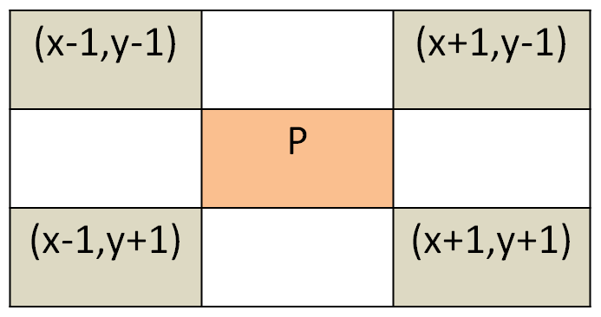
Diagonal neighbor
The four diagonal neighbors of p(x, y) are given by
(x-1, y-1), (x+1, y+1), (x+1,y-1), and (x-1, y+1).
This set is denoted by ND (P).
Each of them are at Euclidean distance of 1.414 from P.

Slide 7
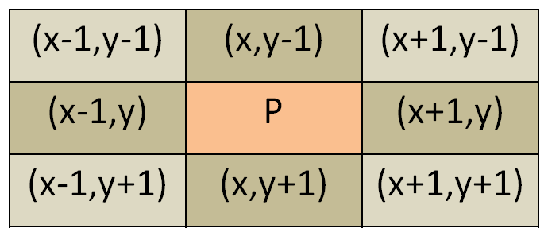
8 - neighbor
The points ND(P) and N4(P) are together known as 8-neighbors of the point P, denoted by N8(P).
N8(p) = N4(p) U ND(p)
Some of the points in the N4, ND and N8 may fall outside image when P lies on the border of image.

Slide 8
adjacency
In a binary (black and white) image, two neighboring pixels are connected if their values are the same, i.e., both equal to 0 (black) or 255 (white).
In a gray level image, two neighboring pixels are connected if their values are close to each other, i.e., they both belong to the same subset of similar gray levels: and , where is a subset of all gray levels in the image.
For example, in a binary image two pixels are connected if they are 4-neighbors and have same value (0/1).

Slide 9
Types of adjacency
4-adjacency:
Two pixels p and q with values from V are 4-adjacent if q is in the set N4(p).
8-adjacency:
Two pixels p and q with values from V are 8-adjacent if q is in the set N8(p).
m-adjacency (mixed adjacency):
Two pixels p and q with values from V are m-adjacent iff
q is in N4(p), or
q is in ND(p) and the set N4(p) N4(q) has no pixels whose values are from V.
V: The set of gray-level values used to define adjacency
∩

Slide 10



Examples of adjacency
4 adjacent, if V = {0,1}
8 adjacent, if V = {1,2}
m adjacent, if V = {1}

Slide 11
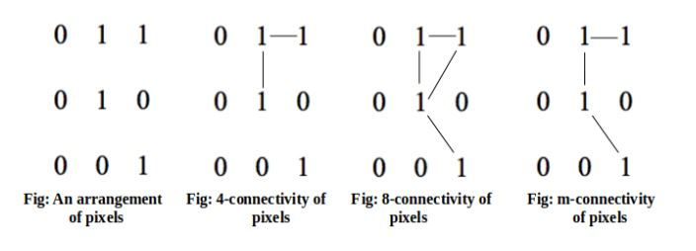
Connectivity
Connectivity is used to determine whether the pixels are adjacent in some sense or not.
Let V be the set of gray-level values used to define connectivity; then Two pixels p, q that have values from the set V are:
4-connected, if q is in the set N4(p).
8-connected, if q is in the set N8(p).
m-connected, if
q is in N4(p) or
q is in ND(p) and the set N4(p) ∩ ND(p) is empty.

Slide 12
PATHS
A path from pixel p with coordinates (x, y) to pixel q with coordinates (s, t) is a sequence of distinct pixels with coordinates:
(x0, y0), (x1, y1), (x2, y2) … (xn, yn),
where (x0, y0)=(x, y) and (xn, yn)=(s, t);
(xi, yi) is adjacent to (xi-1, yi-1) 1 ≤ i ≤ n.
Here n is the length of the path.
If (x₀, y₀) = (x_{n}, y_{n}), the path is closed path.
We can define 4-path, 8-path, and m-path based on type of adjacency used.

Slide 13
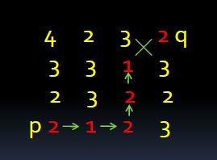
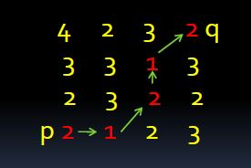
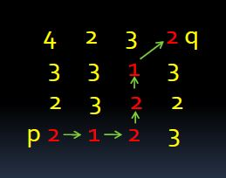
Examples of path
4 path does not exist.
So, shortest-8 path = 4
So, shortest-m path = 5

Slide 14
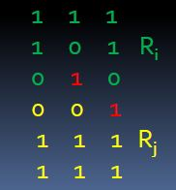

REGIONS & BOUNDARIES
A subset R of pixels in an image is called a Region of the image if R is a connected set.
The boundary of the region R is the set of pixels in the region that have one or more neighbors that are not in R.

Slide 15
Distance Measures
Given pixels p, q and z with coordinates (x, y), (s, t), (u, v) respectively, the distance function D has following properties:
D(p, q) 0 [D(p, q) = 0, if p = q]
D(p, q) = D(q, p)
D(p, z) D(p, q) + D(q, z)

Slide 16
Types of distance measures
Euclidean Distance :
De(p, q) = [(x-s)2 + (y-t)2]
City Block Distance:
D4(p, q) = |x-s| + |y-t|
Chess Board Distance:
D8(p, q) = max(|x-s|, |y-t|)

Slide 17
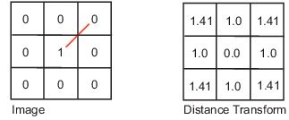
Euclidean Distance
For this distance measure, the pixels having a distance less than or equal to some value r from (x,y) are the points contained in a disk of radius r centered at (x,y).

Slide 18
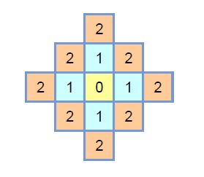
CITY BLOCK DISTANCE
Pixels with D4(p) = 1 is 4-neighbors of p.
The City Block distance metric measures the path between the pixels based on a 4-connected neighborhood.
Pixels whose edges touch are 1 unit apart; pixels diagonally touching are 2 units apart.

Slide 19
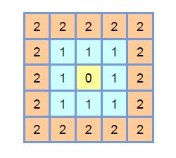
CHESSBOARD DISTANCE
The Chessboard distance metric measures the path between the pixels based on an 8-connected neighborhood.
Pixels whose edges or corners touch are 1 unit apart.

Slide 20
THANK YOU

