Slide 1
IBM
CLOUD

Slide 2
What is IBM Cloud?
IBM Cloud® is an enterprise grade, full stack platform, purpose built for data-intensive AI workloads and cloud-native application suites, delivered on software definable infrastructure.
It offers the most open and secure public cloud for business, a next-generation hybrid multicloud platform, advanced data and AI capabilities, and deep enterprise expertise across 20 industries.

Slide 3
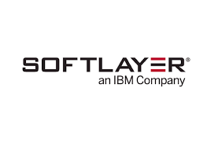
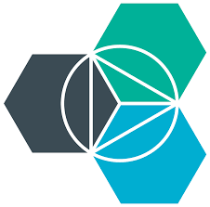
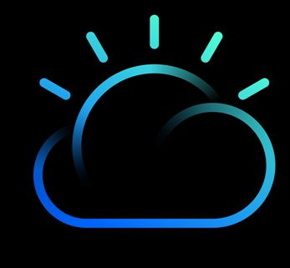
Evolution of IBM Cloud
In 2013, IBM acquired SoftLayer, a public cloud platform, to serve as the foundation for its IaaS offering.
In 2014, IBM introduced Bluemix as PaaS offering.
In October 2016, IBM rolled the SoftLayer brand under its Bluemix brand of PaaS offerings, giving users access to both IaaS and PaaS resources from a single console.
In October 2017, IBM then rebranded their entire portfolio as IBM Cloud.

Slide 4
IBM Cloud Architectures Overview
IBM's architectures provide practices for building apps on the cloud.
The reference architectures define the basic pattern, while implementations provide specific technology, practices, and tool choices to build and deploy that pattern.
The Cloud Architecture Center provides practices for building apps on the cloud, across multiple clouds, and in hybrid environments where your cloud app links to your on-premises application.
Start with your business problem, then select the best architecture to address your unique application, data, and workload requirements.
IBM’s platform, based on open technologies, such as Linux and Kubernetes, enables you to securely deploy, run, and manage on the cloud of your choice.

Slide 5

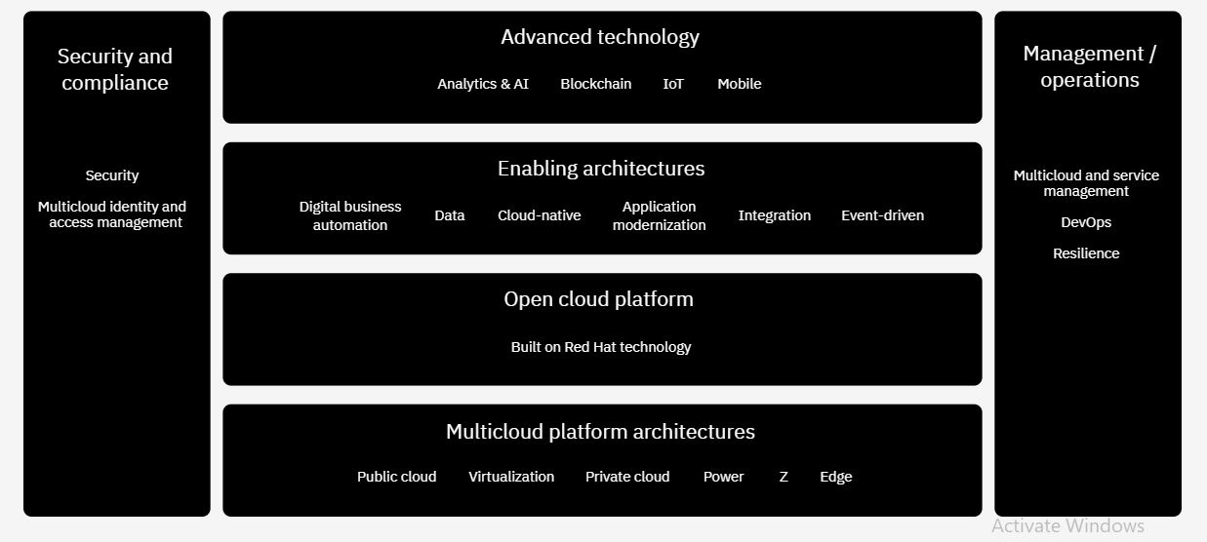
IBM Cloud Architecture

Slide 6
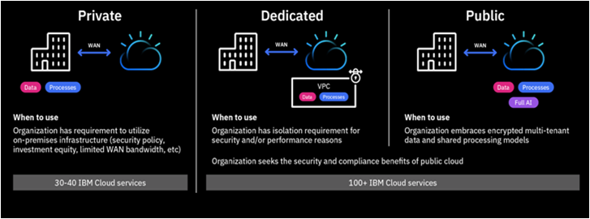
Types of IBM Cloud Deployment

Slide 7
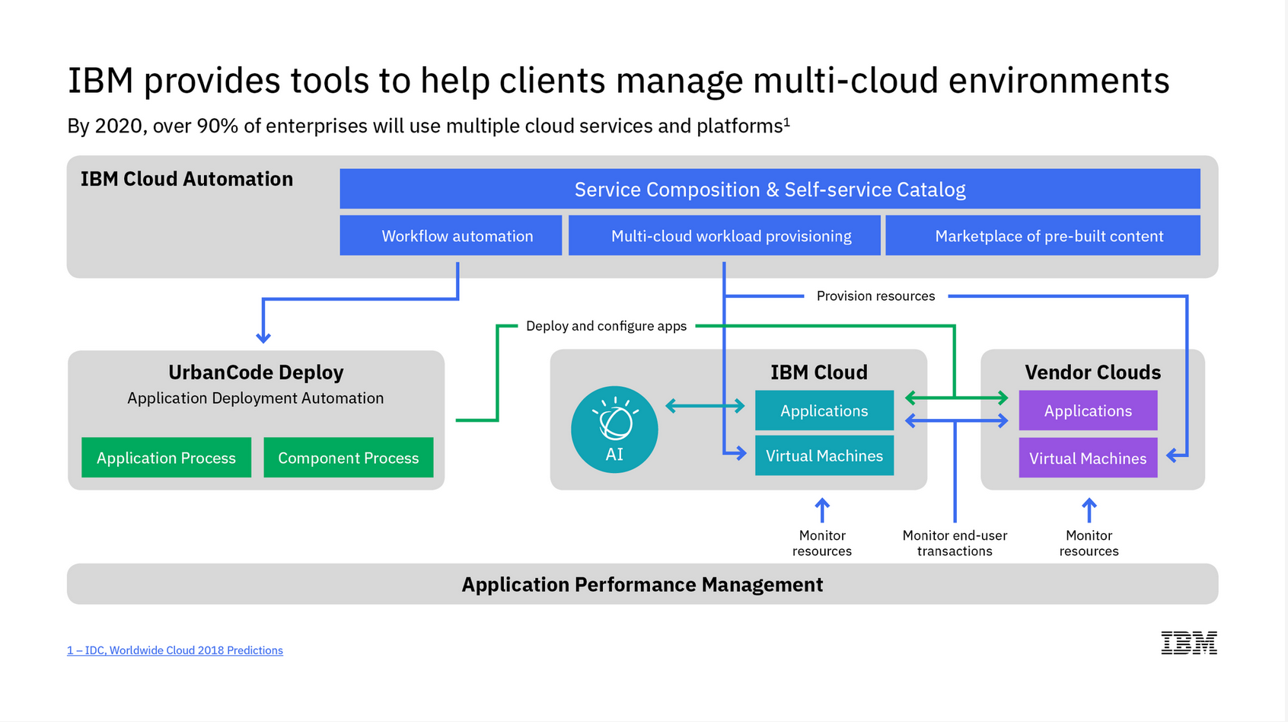
^{IBM Cloud Automation Manager}

Slide 8
^{IBM Cloud Automation Manager}
IBM Cloud® Automation Manager is a multicloud self-service management platform running on IBM Cloud Private that empowers developers and administrators to meet business demands. This platform allows you to efficiently manage and deliver services through end-to-end automation while enabling developers to build applications aligned with enterprise policies.
Key features
Accelerated innovation and agility
Enriched cloud automation
Multi-cloud operations
Open source technology
Integration with your existing data center
IBM Cloud Private
Benefits of IBM CAM>>
Self Service
Provide self-service access for developers and the ability to automate the application lifecycle using prebuilt automation packs.
Automated Provisioning
Deploy and configure infrastructure and applications across any cloud environment with workflow orchestration.
Governance and Control
Maintain control through effective, enforceable governance and intelligent insights for a security-rich and complaint IT environment.

Slide 9
IBM Cloud Technologies
Data
Tools to prepare data for cognitive
Ingestion
Storage
Analytics
Deployment
Governance
AI
Cognitive building blocks for developers
Conversation
Discovery
Compare & Comply
DLaaS
Tone Analyzer
Personal Insight
API
API
API
API
API
API
API
Visual Recognition
API
Speech
API
Document Conversion
API
Nat Language Understanding
API
Nat Language Classifier
API
Knowledge Query
Cloud infrastructure
A highly scalable, security enabled infrastructure
Cloud Integration
Cognitive Micro-services
DevOps Tooling
Networking
Security
Core Enterprise Infrastructure
Cognitive
Systems
Virtual Servers
Object Storage
File Storage
Applications, solutions & services
Targeted solutions for enterprise businesses
Watson
Oncology
Watson
Cyber Security
Weather
IBM Services & Ind. Solutions
Watson
Virtual Agent
Watson Explore & Discover
IBM Risk & Compliance
Asset Mgmt. (Maximo)

Slide 10
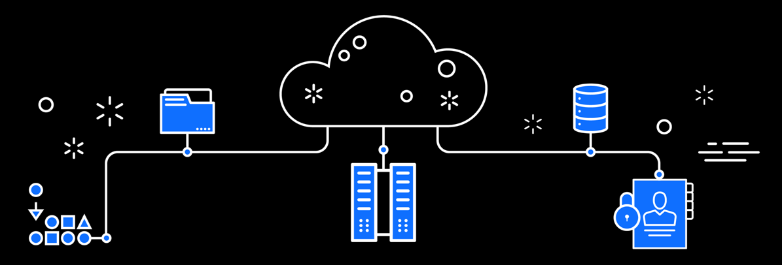
Why IBM is the Cloud for Smarter Business?
Create innovative
Cloud-native apps using AI
IoT
Blockchain
High performance computing and other disruptive technologies .
Exploit unmatched choice and industry expertise.
Deploy it where you need to on a secure network, without sacrificing quality and compliance.
AI READY
BUILT FOR ALL YOUR APPLICATIONS
SECURE TO THE CORE

Slide 11
IBM Private Cloud IBM Native Cloud
IBM Cloud Private delivers a customer-managed container solution for enterprises.
It is also available in a community edition, IBM® Cloud Private-CE, which provides a limited offering that is available at no charge and ideal for test environments.
IBM Cloud Private is a private container as a service (CaaS), platform as a service (PaaS), and infrastructure as a service (IaaS) cloud platform.
Enterprises use the platform for three main use cases:
Developing and running production cloud native applications in a private cloud.
Securely integrating and using data and services from sources external to the private cloud.
Refactoring and modernizing heritage enterprise applications.
Cloud computing environments are dynamic, with on-demand allocation and release of resources from a virtualized, shared pool.
These elastic environments enable more flexible scaling options when compared to the up-front resource allocation that is typically used in traditional on-premises data centers.
Cloud-native systems have the following attributes:
Applications or processes are run in software containers as isolated units.
Processes are managed by central orchestration processes to improve resource usage and reduce maintenance costs.
Applications or services (microservices) are loosely coupled with explicitly described dependencies.

Slide 12




Reasons IBM Cloud Private brings Cloud Native to the Enterprise
Rapid Innovation
Hybrid Integration
Investment Leverage
Management & Compliance
Open Kubernetes-based container platform
Cloud Foundry for app dev and deployment
DevOps toolchain integration
Integration capabilities to unlock and connect
Secure access to public cloud services (AI, Blockchain)
Consistent experience across private/public
Containerized versions of IBM Middleware
Prescriptive guidance to optimize workloads
Work with existing apps, data, skills, infrastructure
Core operational services including logging, monitoring, security
Flexibility to integrate with existing tools and processes

Slide 13
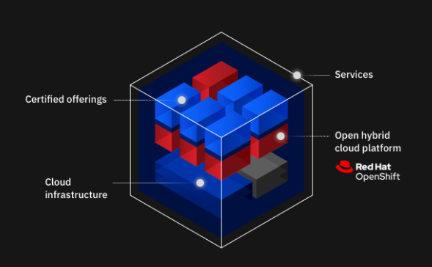
IBM Cloud Hybrid Model
The new generation of hybrid cloud enables you to build and manage across any cloud with a common platform, allowing you to skill once, build once and manage from a single pane of glass.
At IBM, the foundation of this approach is Red Hat® OpenShift®, the market-leading hybrid cloud container platform. With Red Hat OpenShift, you can develop and consume cloud services anywhere and from any cloud.
Benefits of Hybrid Cloud
Build and run anywhere
Industry expertise
Leverage innovations
Security and compliance
Automate and modernize
Benefits of Hybrid Cloud
Build and run anywhere
Industry expertise
Leverage innovations
Security and compliance
Automate and modernize

Slide 14
Reasons many clients are choosing a IBM Cloud hybrid model to address evolving needs
Predict Outcomes
Automate at scale
AI for business
Modernize with ease
Secure Everything

Slide 15





Types of tools, compute options for any workload, across global infrastructure
PERFORMANCE & CONTROL
PORTABILITY
DEVELOPMENT SPEED
Bare Metal
Maximum performance and control
Virtual Server
Leverage existing languages and tools
Containers
Maximum portability
Platform as a Service
Extensive runtime options
Serverless
Maximum speed with serverless apps

Slide 16
Key reasons why enterprises choose to move their Oracle applications to IBM Cloud
Built for your applications:
Support for Oracle and Non-Oracle workloads
60+
Data centers and network points of presence worldwide
97%* satisfaction with IBM managed cloud services – higher than other vendors
DBs supported:
IBM DB2®, Oracle, Sybase, MS SQL, SAP HANA, IBM DB2 BLU®
Secure to the core
We treat your data as our own
Standardized worldwide delivery
High-speed and low-cost optimized data transfer among data centers
Enterprise-class SLAs: Different levels based on your requirements
AI ready
Extensions to IBM Watson®, IoT, blockchain
3
Virtualization on VMware and Oracle Virtualization Manager (OVM) e-commerce on Hybris and ATG Web Commerce
Multiple operating systems
IBM AIX®, Redhat, Microsoft Windows, Oracle Enterprise, Linux Solaris
Service options:
Managed OS
Managed DB
Managed apps

Slide 17
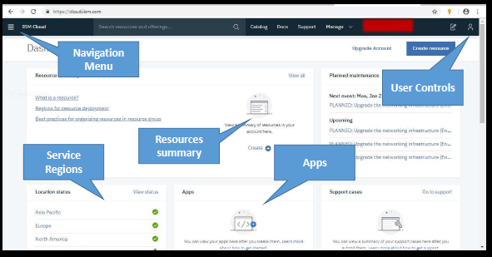
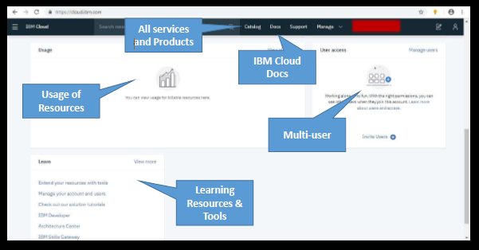
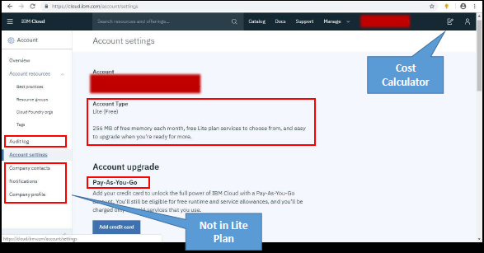
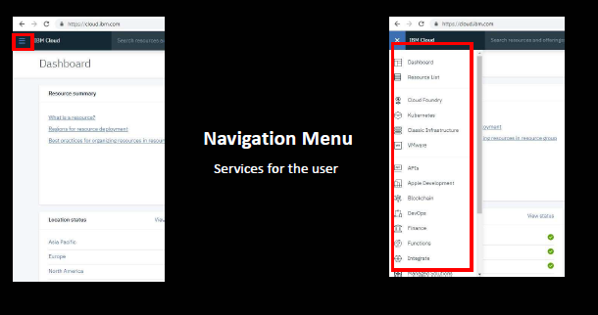
Dashboard of IBM Cloud after logging in with an IBMid
Benefits of Hybrid Cloud
Build and run anywhere
Industry expertise
Leverage innovations
Security and compliance
Automate and modernize

Slide 18

THANK YOU

