Slide 1
OAUTH 2.0

Slide 2
What is OAuth 2.0?
¢OAuth is an open authorization protocol, which allows accessing the resources of the resource owner by enabling the client applications on HTTP services such as Facebook, GitHub, etc. It allows sharing of resources stored on one site to another site without using their credentials. It uses username and password tokens instead.
¢OAuth 2.0 is developed by the IETF OAuth Working Group, published in October 2012.

Slide 3
History
Created and strongly supported from the start by Twitter, Google and other companies, OAuth was released as an open standard in 2010 as RFC 5849, and quickly became widely adopted.
Over the next two years, it underwent substantial revision, and version 2.0 of OAuth, was released in 2012 as RFC 6749.
Today, you can add Amazon, Facebook, Instagram, LinkedIn, Microsoft, Netflix, Paypal and a list of other internet who’s-whos as adopters.

Slide 4
Roles
Resource owner
An entity capable of granting access to a protected resource. When the resource owner is a person, it is referred to as an end-user.
Resource server
The server hosting the protected resources, capable of accepting and responding to protected resource requests using access tokens.
Client
An application making protected resource requests on behalf of the resource owner and with its authorization. The term "client" does not imply any particular implementation characteristics (e.g., whether the application executes on a server, a desktop, or other devices).
Authorization server
The server issuing access tokens to the client after successfully authenticating the resource owner and obtaining authorization.

Slide 5
Oauth 2.0 Scenario
Authorization Server
Google
Google
Bob
Bob
Resource Owner
Client
Resource Server
Print - Fast
Pisaca
Print - Fast
Pisaca
David
Google
Authorization Server
Bob
Client
Resource Server
Print - Fast
Pisaca

Slide 6
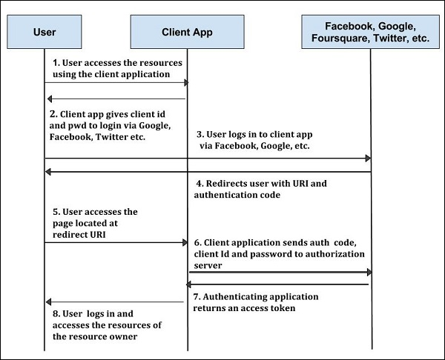
ARCHITECTURE

Slide 7
OAuth Flows/Grant Types
Authorization Code Grant
Implicit Grant
Resource Owner Password Credentials Grant
Client Credentials Grant

Slide 8
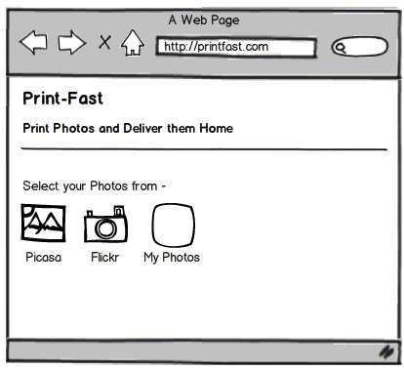
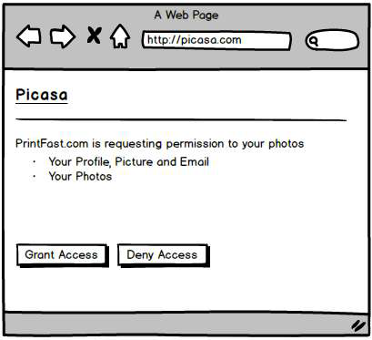
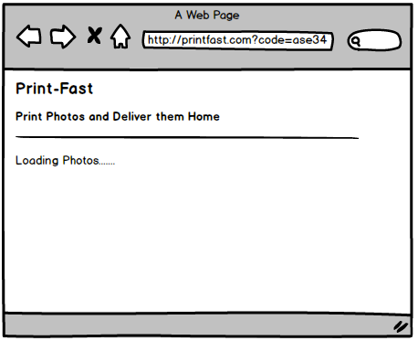
Get Authorization Grant
Authorization Request
Authorization Response
Authorization Grant
Code = ase34
URL used is:
http://picasa.com/?client_id=photo-fast&scope=profile,email,photos&redirect_uri=http://print-fast.com&response_type=code

Slide 9
Client
Authorization Request
Client_Id=print-fast Redirect_url = http://print-fast.com Scope=profile,email,photos
Resource Owner
Authorization Grant
code = ase34
David
Authorization Server
Print Fast
Resource Server

Slide 10
Exchange for Access Token
Client
Resource Owner
David
Authorization Grant
code = ase34
Client_Id=print-fast
Client_Secret=xxx
Google
Authorization Server
Print Fast
Access Token
access_token= x3e4
Resource Server

Slide 11
Access Protected Resources
Client
Resource Owner
David
Authorization Server
Google
Print Fast
Access Token
access_token = x3e4
Pisaca
Resource Server
Protected Resource
[“http://…/DSC34.jpg”,“http://…/DSC44.jpg”,
“http://…/DSC56.jpg”,“http://…/DSC98.jpg”]

Slide 12
Complete Flow at Once
Client
Authorization Request
Resource Owner
Authorization Grant
Authorization Grant
Authorization Server
Access Token
Access Token
Resource Server
Protected Resource

Slide 13
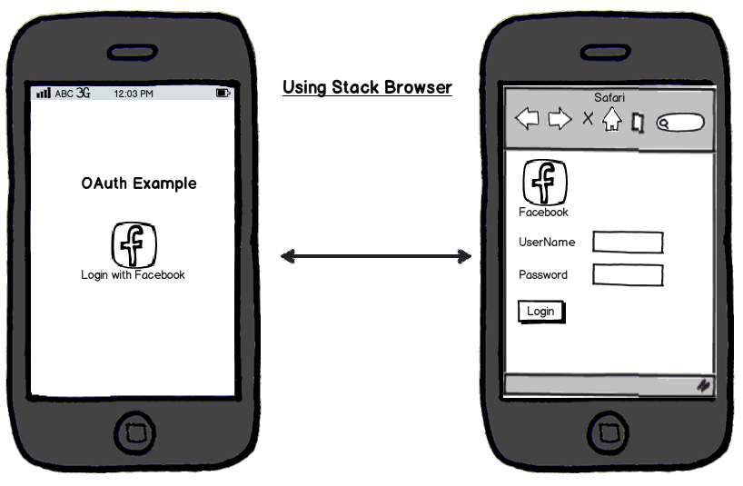
OAuth from Mobile Device

Slide 14
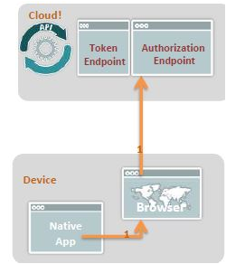
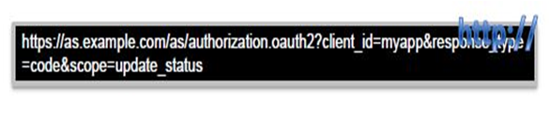
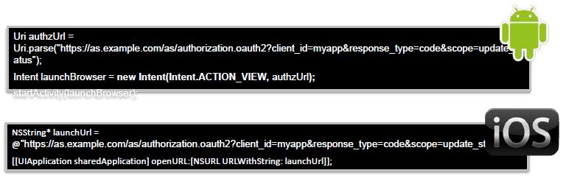
Request Authorization
¢When user first needs to access some protected resource, client opens a browser and sends user to the authorization endpoint.

Slide 15
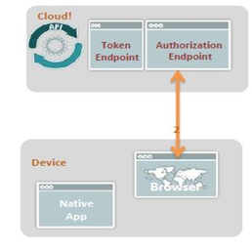
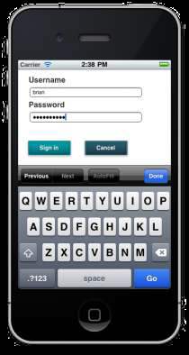
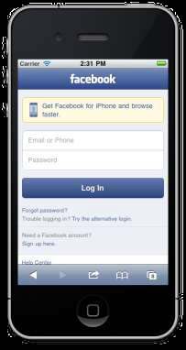
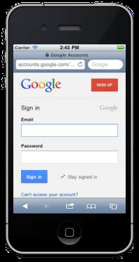
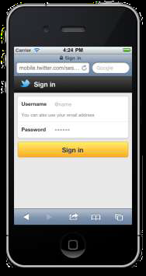
Authenticate
¢The AS authenticates the user:
¢Directly
¢Indirectly via Facebook, Twitter, Google, Yahoo, etc.

Slide 16
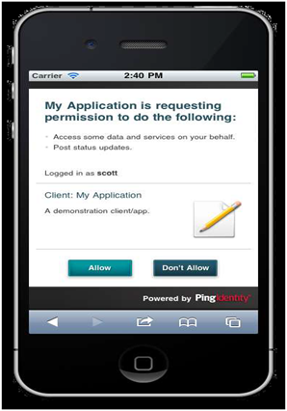
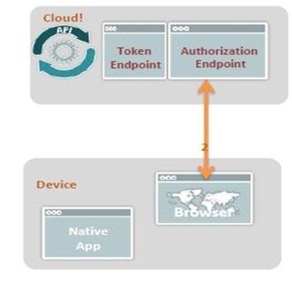
Approve
¢User approves the requested access.

Slide 17
Features
¢OAuth 2.0 is a simple protocol that allows to access resources of the user without sharing passwords.
¢It provides user agent flows for running clients application using a scripting language, such as JavaScript. Typically, a browser is a user agent.
¢It accesses the data using tokens instead of using their credentials and stores data in online file system of the user such as Google Docs or Dropbox account.

Slide 18
Advantages Disadvantages
¢OAuth 2.0 is a very flexible protocol that relies on SSL (Secure Sockets Layer that ensures data between the web server and browsers remain private) to save user access token.
¢OAuth 2.0 relies on SSL which is used to ensure cryptography industry protocols and are being used to keep the data safe.
¢It allows limited access to the user's data and allows accessing when authorization tokens expire.
¢It has ability to share data for users without having to release personal information.
¢It is easier to implement and provides stronger authentication.
¢If you are adding more extension at the ends in the specification, it will produce a wide range of non-interoperable implementations, which means you have to write separate pieces of code for Facebook, Google, etc.
¢If your favorite sites are connected to the central hub and the central account is hacked, then it will lead to serious effects across several sites instead of just one.

Slide 19
THANK YOU

