Slide 1
Inferential Statistics

Slide 2
What is Inferential Statistics??
Inferential statistics allows you to make predictions (“inferences”) from the data. With inferential statistics, you take data from samples and make generalizations about a population.
For example, you might stand in a mall and ask a sample of 100 people if they like shopping at Sears. You could use your research (and inferential statistics) to reason that around 75-80% of the population (all shoppers in all malls) like shopping at Sears.

Slide 3
Importance Areas Used
Making conclusions from a sample about the population.
To conclude if a sample selected is statistically significant to the whole population or not.
Comparing two models to find which one is more statistically significant as compared to the other.
In feature selection, whether adding or removing a variable helps in improving the model or not.
There are two main areas of Inferential Statistics:
Calculating Expected Parameters (Mean and Standard Deviation).
This means taking a statistic from your sample data (for example the sample mean) and using it to say something about a population parameter (i.e. the population mean).
Estimating population parameters (Point Estimate, Sampling Distribution, Confidence Interval).

Slide 4
Mean Standard Deviation
The mean is the average or the most common value in a collection of numbers. In statistics, it is a measure of central tendency of a probability distribution along median and mode. It is also referred to as an expected value.
This means taking a statistic from your sample data (the sample mean) and using it to say something about a population parameter (i.e. the population mean).
Standard Deviation is a measure of spread in Statistics. It is used to quantify the measure of spread, variation of a set of data values. It is very much similar to variance, gives the measure of deviation whereas variance provides the squared value.
Standard deviation is a number that describes how spread out the values are. A low standard deviation means that most of the numbers are close to the mean (average) value. A high standard deviation means that the values are spread out over a wider range.

Slide 5
Formula
Suppose random sample of size n are drawn from a population with mean µ and standard deviation σ. The mean µx and standard deviation σx of the sample mean X satisfy
µx=µ and σx=σ/√n

Slide 6
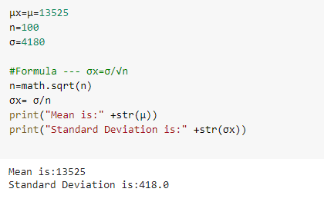
Example & Output
The mean and standard deviation of the tax value of all vehicles registered in a certain state are μ=13,525 & σ=4,180. Suppose random samples of size 100 are drawn from the population of vehicles. What are the mean μX and standard deviation σX of the sample mean X?

Slide 7
Point Estimate
A point estimate is an estimate of a population parameter based on sample data.
We use point estimates to estimate population means, variances, and other statistics.
To obtain these estimates, we simply apply the function that we wish to measure for our population to a sample of the data.

Slide 8
Example 1
Let's suppose that in a company of 10,000 people, our employees are 20% white, 10% black, 10% Hispanic, 30% Asian, and 30% identify as other. We will take a sample of 1,000 employees and see if their race proportions are similar.
employee_races represents our employee population. For example, in our company of 10,000 people, 2,000 people are white (20%) and 3,000 people are Asian (30%). Let's take a random sample of 1,000 people, as shown:

Slide 9
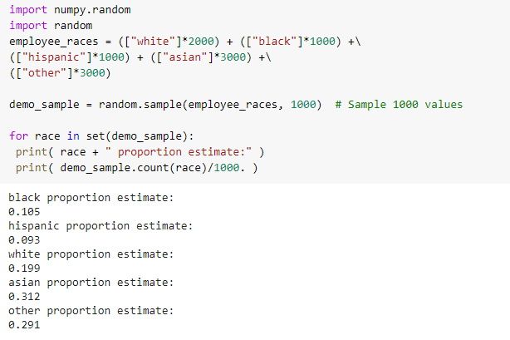
Output

Slide 10
Example 2
For example, suppose there is a company of 9,000 employees and we are interested in ascertaining the average length of breaks taken by employees in a single day. As we probably cannot ask every single person, we will take a sample of the 9,000 people and take a mean of the sample. This sample mean will be our point estimate.
Get the data distribution using a poisson random variable and find the point estimate sample mean for a longer break taken by 3000 employees. Get the data distribution using a poisson random variable and find the point estimate sample mean for a shorter break taken by 6000 employees. Combine the entire population of 9000 employees with longer breaks and shorter breaks and find the population mean estimate, that is the average break time taken by the company employees. Simulate the result for a random sample of size 100 and find the difference in sample mean and population mean.

Slide 11
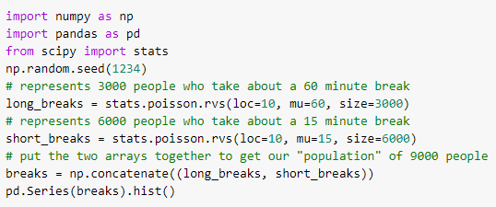
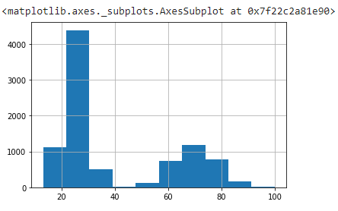
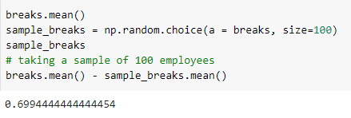

Output

Slide 12
Sampling Distribution
A sampling distribution is a probability distribution of a statistic obtained from a larger number of samples drawn from a specific population. The sampling distribution of a given population is the distribution of frequencies of a range of different outcomes that could possibly occur for a statistic of a population.
First off, we will need to utilize what is known as a sampling distribution, which is a distribution of point estimates of several samples of the same size. Our procedure for creating a sampling distribution will be the following:

Slide 13
Example
For example, suppose there is a company of 9,000 employees and we are interested in ascertaining the average length of breaks taken by employees in a single day.
1. Take 500 different samples of the break times of size 100 each.
2. Take a histogram of these 500 different point estimates (revealing their distribution).
The number of elements in the sample (100) was arbitrary, but large enough to be a representative sample of the population. The number of samples I took (500) was also arbitrary, but large enough to ensure that our data would converge to a normal distribution:
Visualize the data of both loger breaks and shorter breaks that are calculated in the previous example into a single plot, explain the plot and check for the type of distribution. If the data distribution is not in normal form, get it into normal form using the more number of samples, say 500. Plot the average break time (Sample mean) taken by company employees with the help of histogram for these 500 samples. Calculate the difference of sample mean of sample with size 100 and sample with size 500 and state the conclusion.

Slide 14
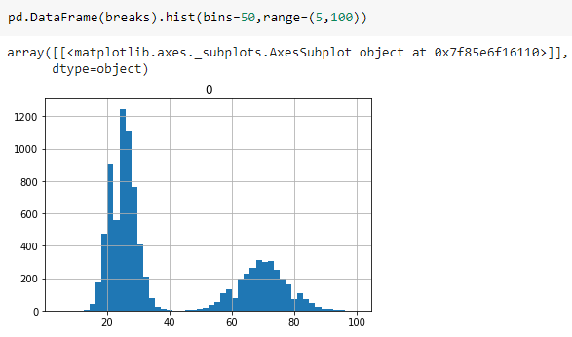
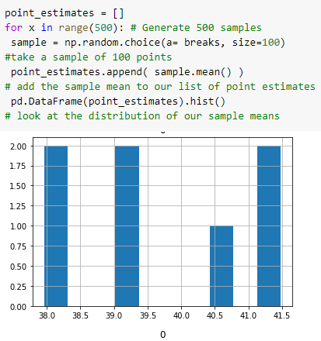

Output

Slide 15
Confidence Interval
A confidence interval is a range of values based on a point estimate that contains the true population parameter at some confidence level.
Confidence is an important concept in advanced statistics. Its meaning is sometimes misconstrued. Informally, a confidence level does not represent a "probability of being correct"; instead, it represents the frequency that the obtained answer will be accurate. For example, if you want to have a 95% chance of capturing the true population parameter using only a single point estimate, we would have to set our confidence level to 95%.

Slide 16
Example
For example, suppose there is a company of 9,000 employees and we are interested in ascertaining the average length of breaks taken by employees in a single day. Find margin of error of point estimate sample mean that is range values of confidence, by calculating the confidence interval with confidence level .95. Compare the population parameter and population mean. Get 10000 different confidence intervals and check the existence population parameter (Population mean) into it. Also get the total count of getting the population parameter in the range of confidence interval. Demonstrate the statement, “ The sizeof confidence interval changes as we change the confidence level”.

Slide 17
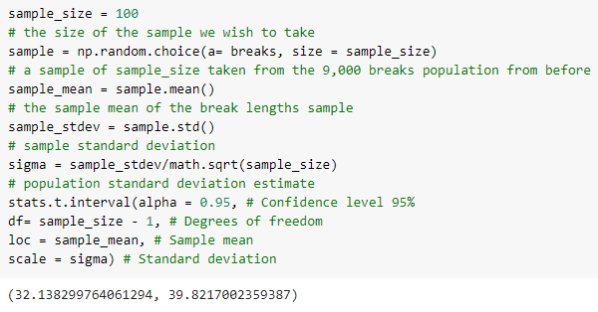
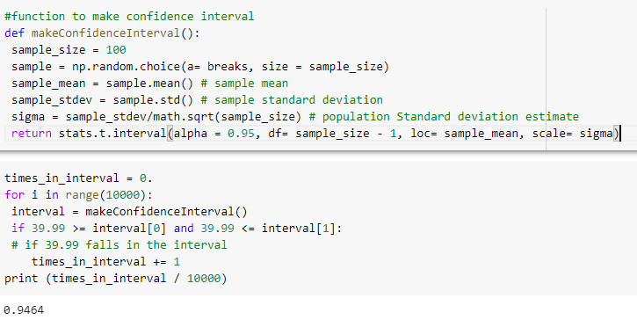
Output

Slide 18
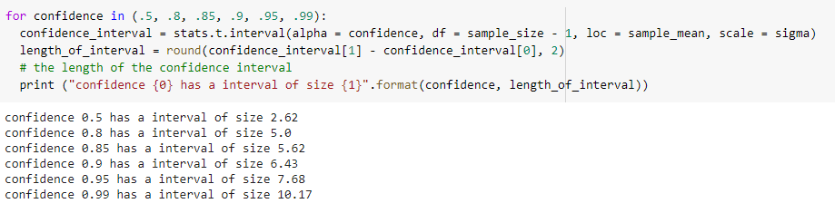
Output

Slide 19
THANK YOU

