Slide 1


“ORIGIN: A PROJECT GAP AND SIMILARITY FINDER”
Program: BIT
Semester: IV
Submitted By:
Sandesh Dotel [Roll No.]
Bhumika Karki [Roll No.]
Diwakar Ray Yadav [Roll No.]
Submitted To:
Department of Science and Technology
Purbanchal University

Slide 2
Table Of Content
Introduction and problem statement
Objectives and scope
Feasibility and literature review
SDLC model and system architecture
System flow, use case and data flow diagrams
ER diagram
Hardware and software requirements
Outcome
References

Slide 3
Introduction
BIT groups choose a project idea every semester, and the same ideas keep coming back: library, attendance, hospital and hotel systems.
Origin checks an idea at proposal time against past projects and this semester's locked ideas, and explains every score.
A Syllabus Map of 41 topics reacts as you type, and the Ideas page suggests real problems built from topics nobody has used.
Past projects load themselves from files dropped into a folder. Built with Java Servlets and JSP on Tomcat and MySQL.

Slide 4
Problem Statement
Repeated ideas are found late: at the proposal defense or the mid-term, after weeks of work.
Renaming hides an old idea ("Library System" becomes "Book Depot Portal"), and buzzwords like "AI" make it look new.
Tools such as Turnitin check finished text, not ideas, and none shows which areas are still unexplored.

Slide 5
General and Specific Objectives
General Objective:
  To build a web application that loads past projects from files, checks an idea against them and current projects, shows untouched syllabus topics and suggests real problems to build.
Specific Objectives:
  Study how BIT ideas repeat and review existing originality tools.
  Design a layered architecture and a self-updating MySQL schema.
  Build an explainable similarity engine that resists renaming and buzzwords.
  Build the Syllabus Map and the idea suggester.
  Implement Class Radar, supervisor review, semester archiving and the DB folder.
  Test for correctness, security and performance.

Slide 6
Scope of Project
Idea check against the past-project corpus and this semester's locked ideas, with a score split into tags, words and type, told as a story.
Class Radar: one locked idea per group per semester; clashes between groups shown to both.
Syllabus Map and ranked idea suggestions; DB-folder import of CSV only; supervisor review and semester archiving.
Not included: PDF files, checking finished reports or code for copied text, mobile app, multi-college use.

Slide 7
Feasibility Analysis
Technical: Java, Servlets, JSP, JDBC and MySQL are all in the 4th-semester syllabus and are free.
Operational: students enter what they already write in a proposal; no training needed.
Economic: all tools are free; no paid service is needed.
Schedule: five increments from February to October 2026.

Slide 8
Literature Review
System | What it checks | What it cannot do
Turnitin, iThenticate | Finished writing | Judge an idea before it is written
MOSS, JPlag | Finished source code | Say anything about the idea itself
DSpace repository | Stores past reports | Score similarity or show gaps
Google Scholar | Published research | See a college's own student projects
Supervisor memory | Common repeats | Scale, or catch same-week clashes
Origin (this project) | The idea, at proposal time | Replace a check of finished text

Slide 9
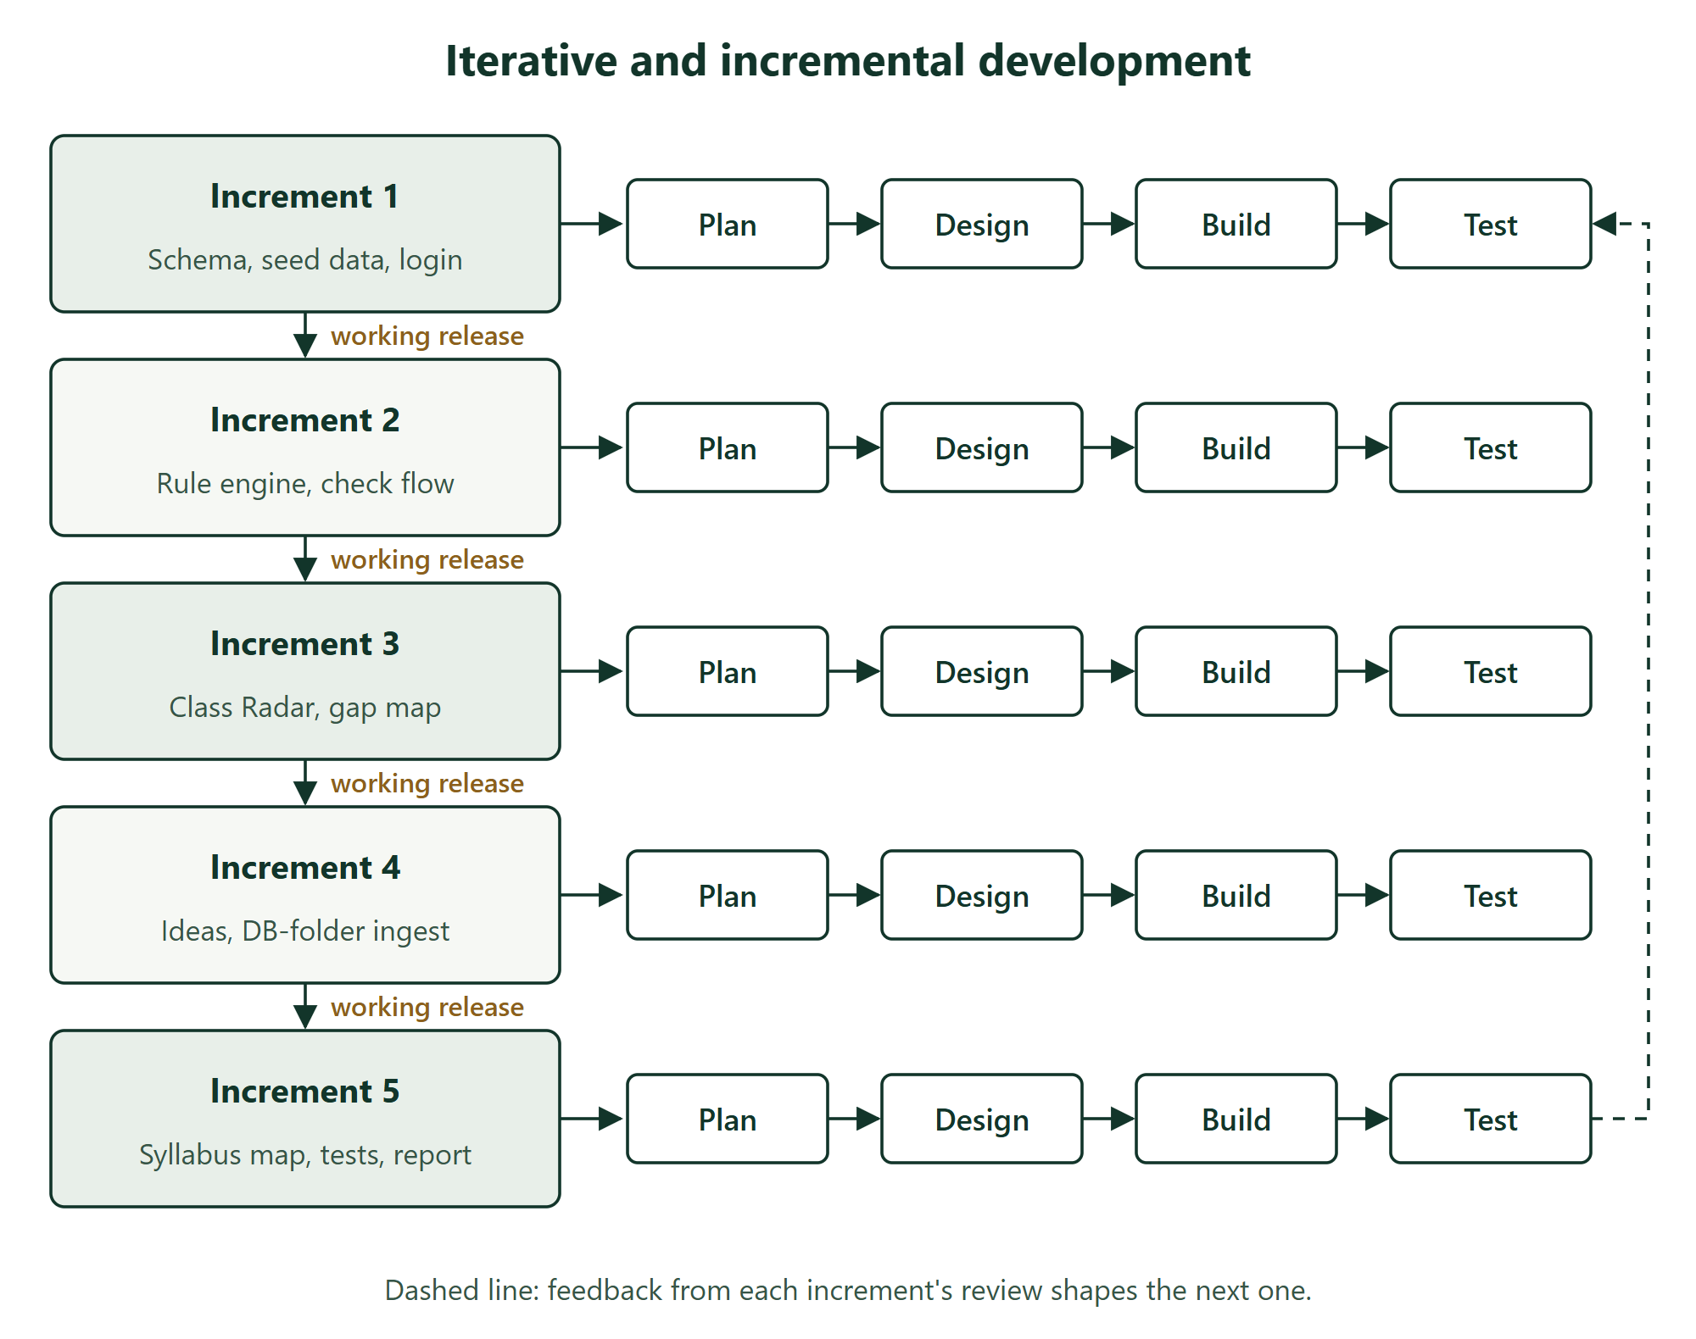
“Used SDLC Model”

Slide 10
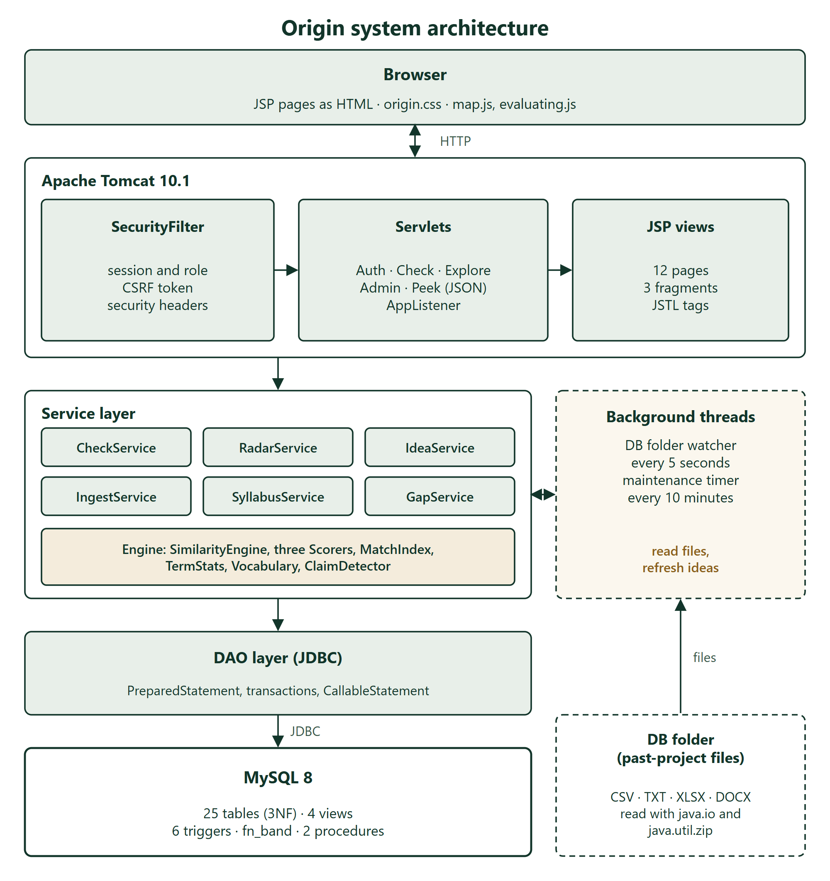
System-Architecture

Slide 11
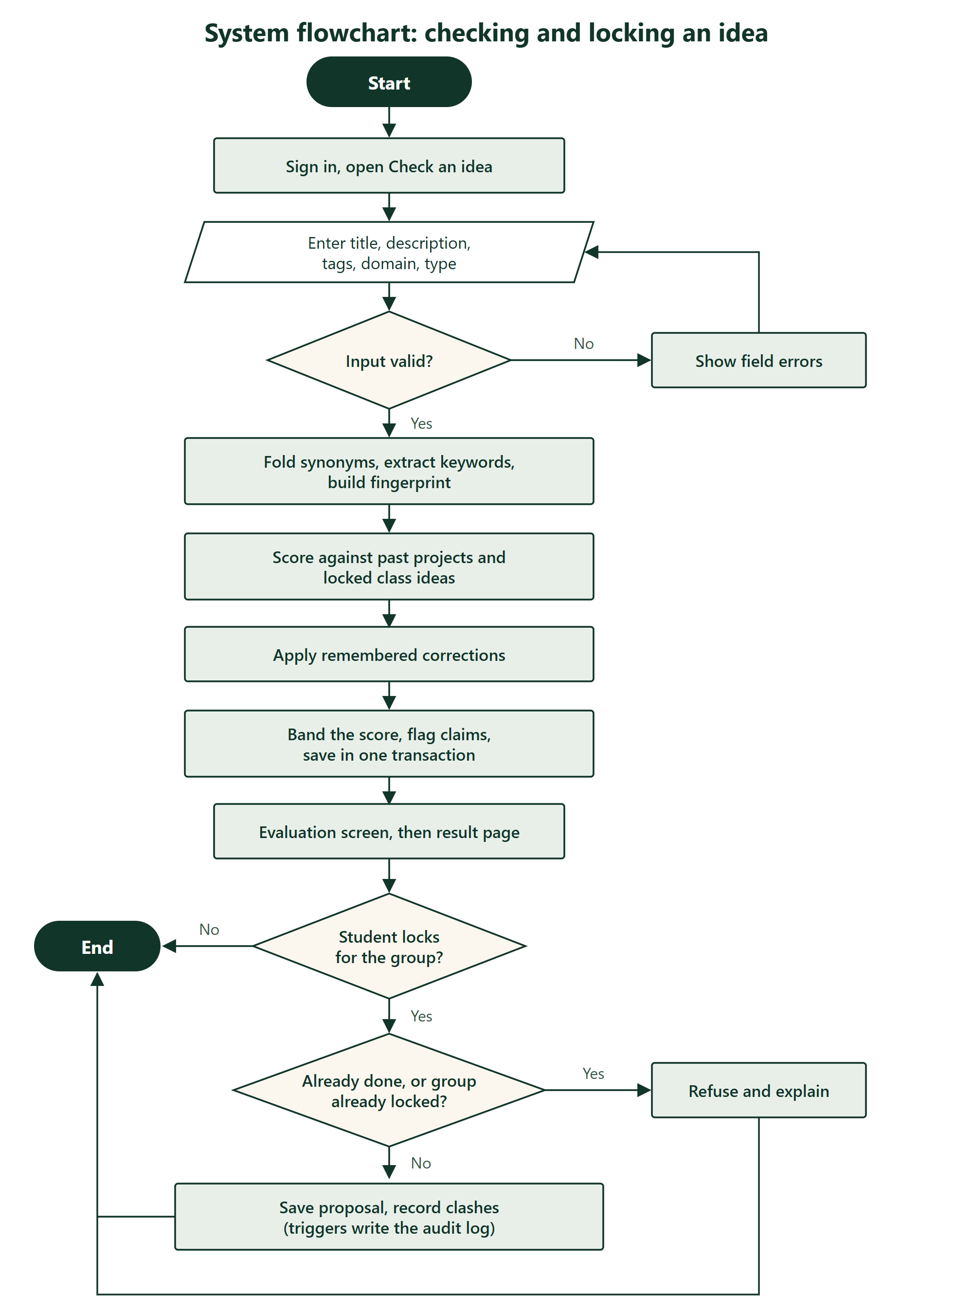
System Flow Diagram

Slide 12
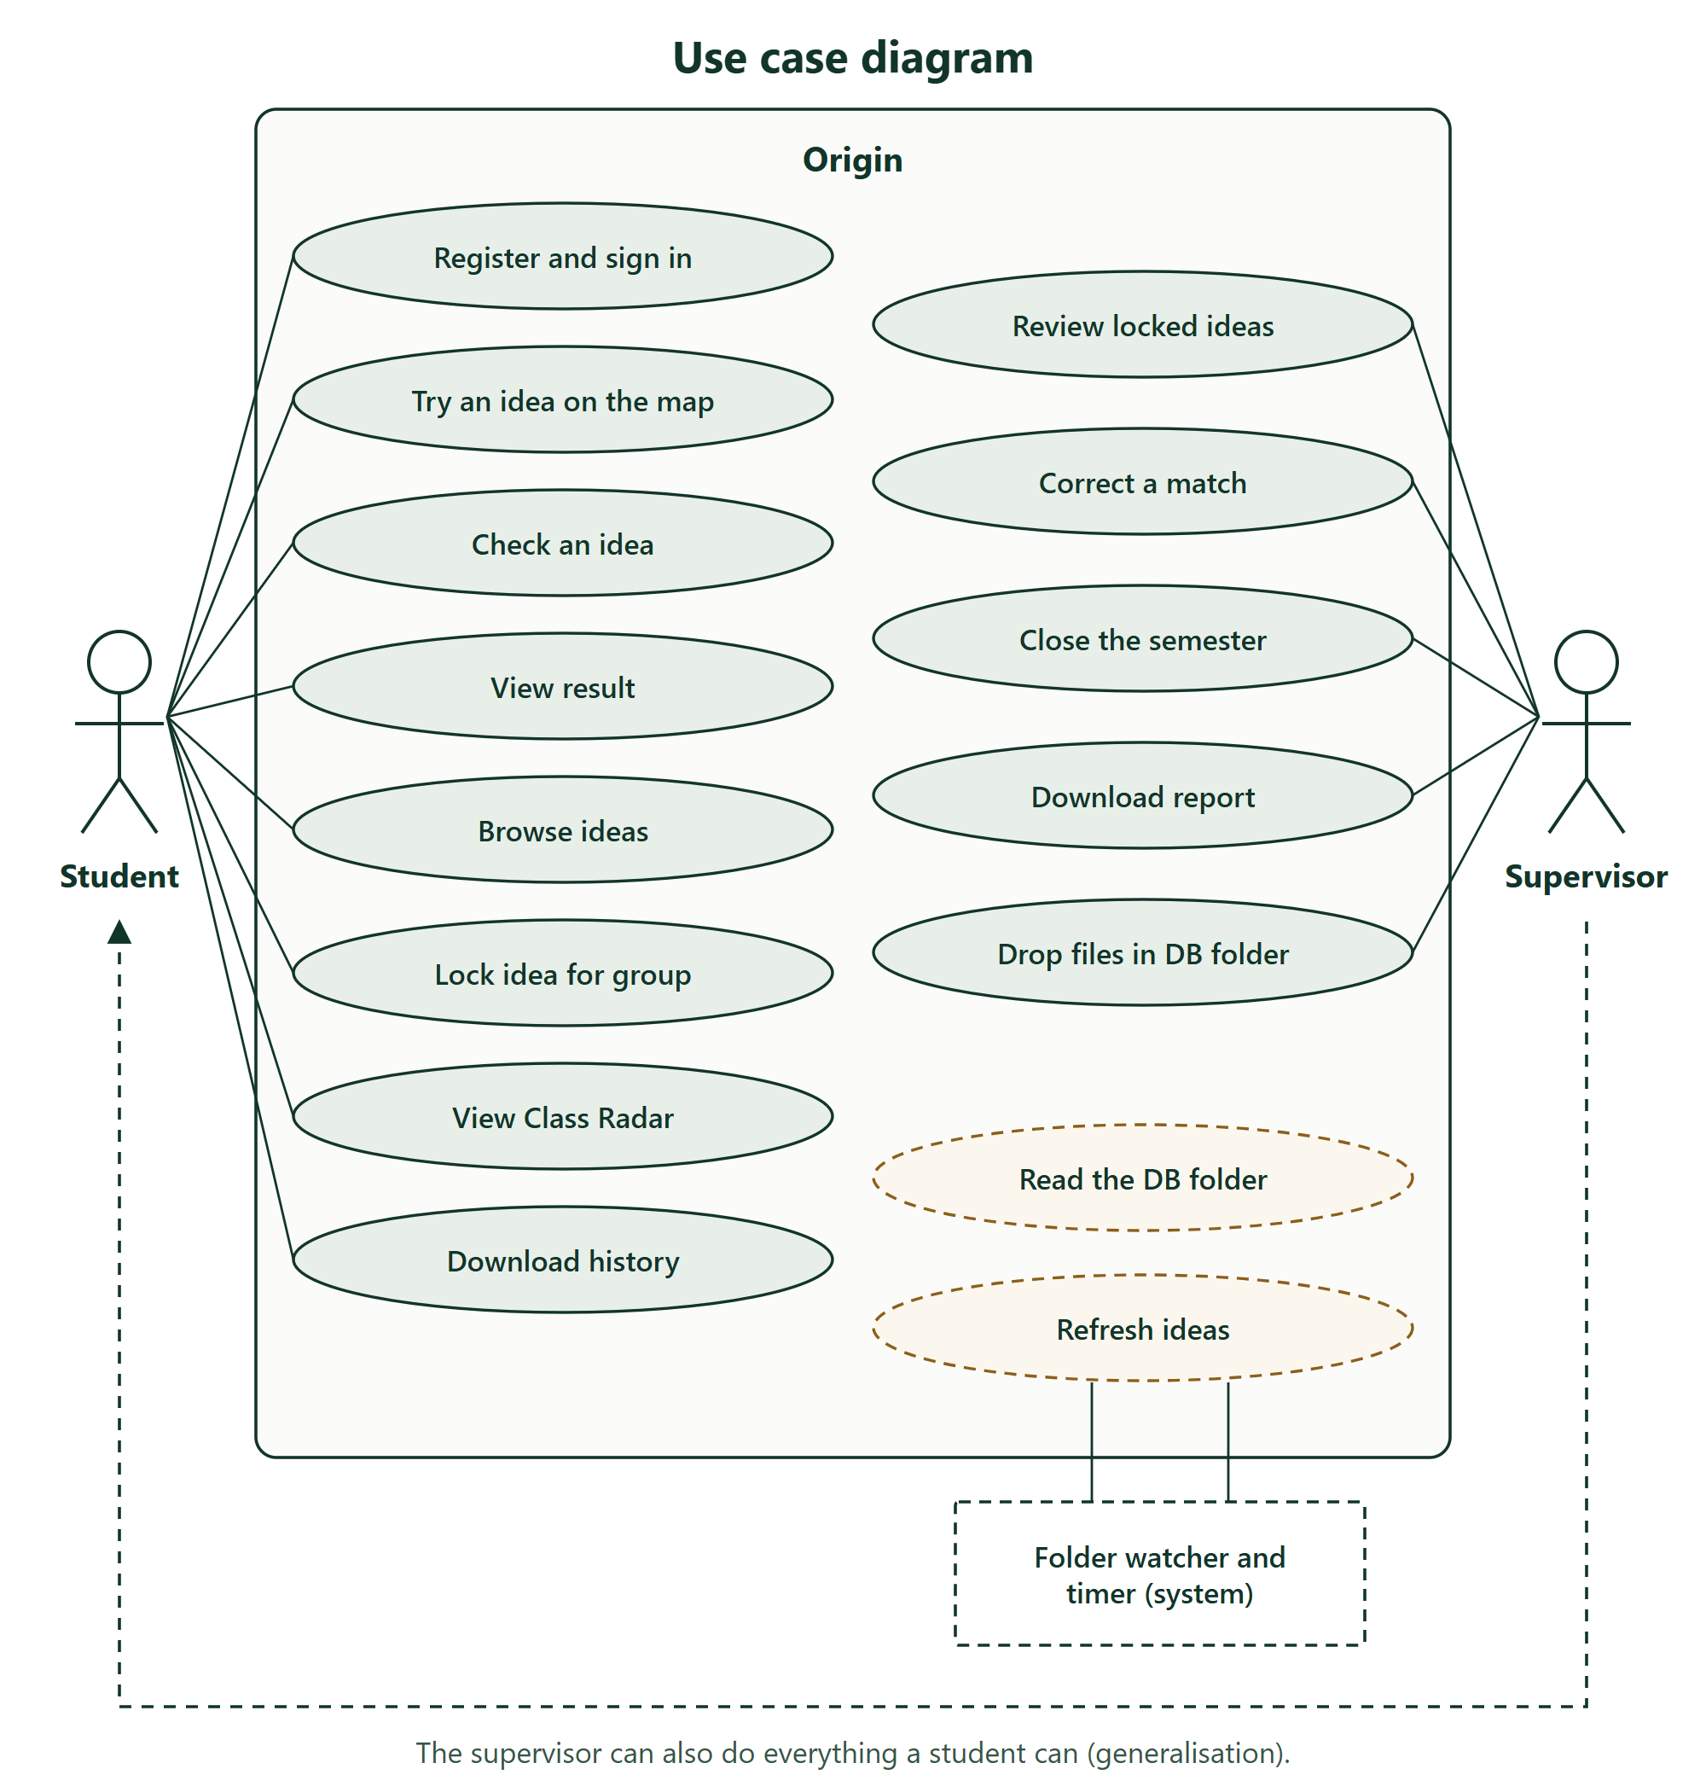
Use Case Diagram

Slide 13
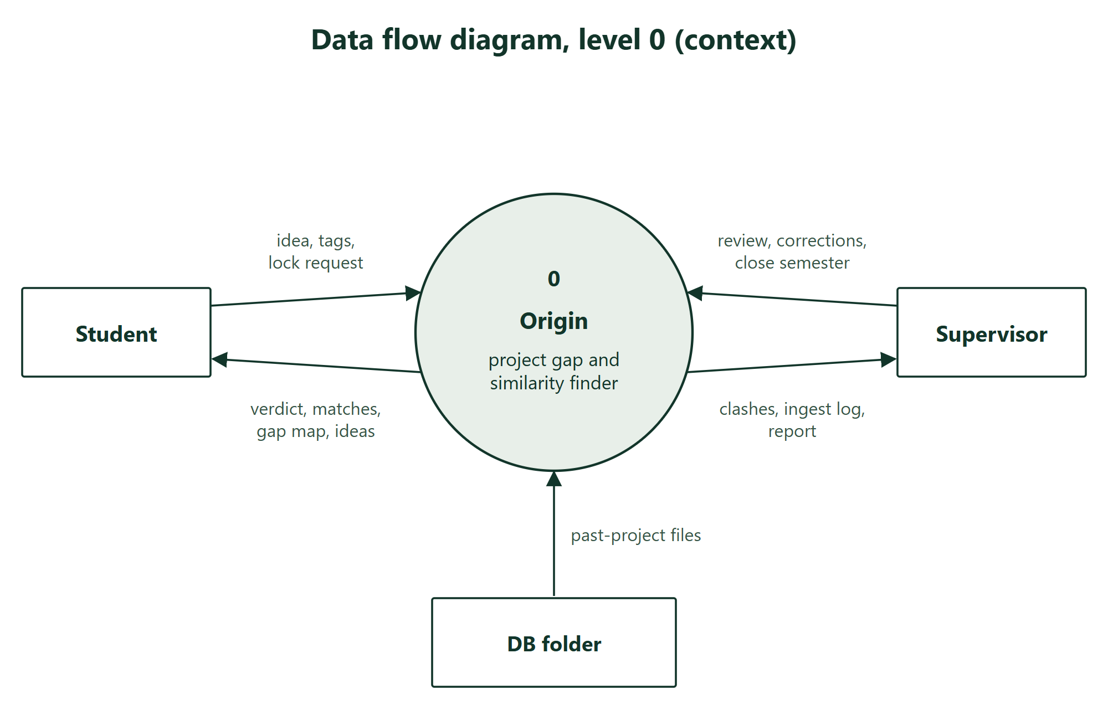
DFD-0 Context Diagram

Slide 14
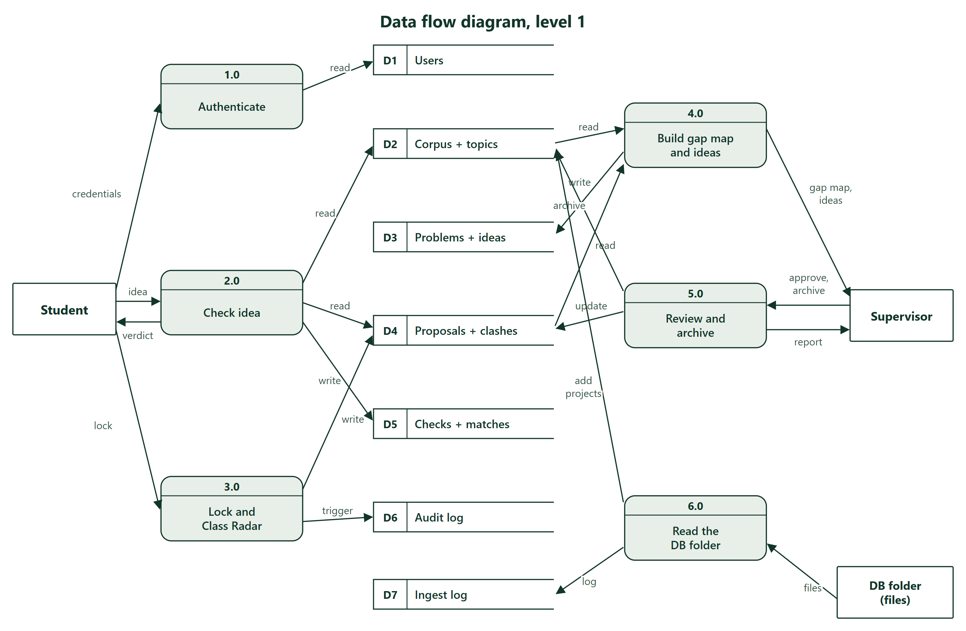
DFD-1

Slide 15
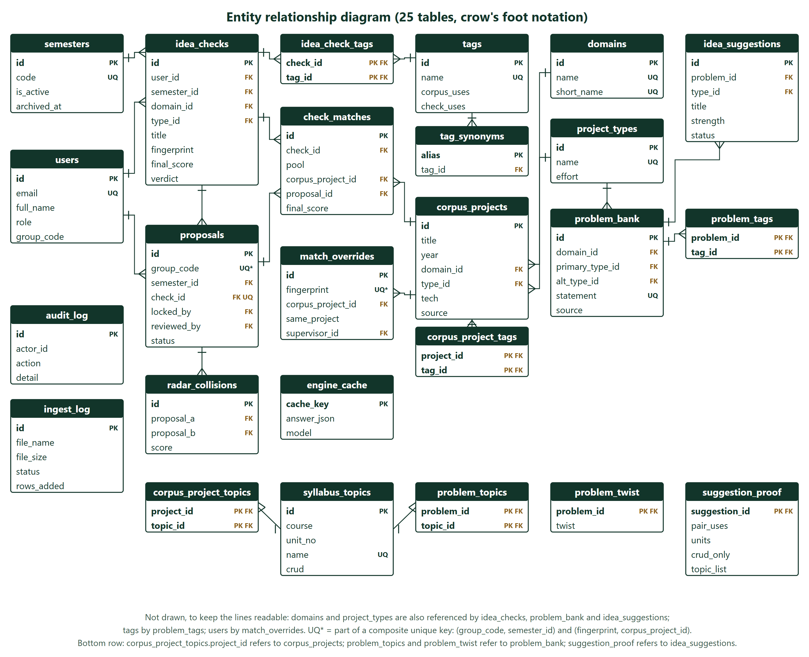
ER-Diagram

Slide 16
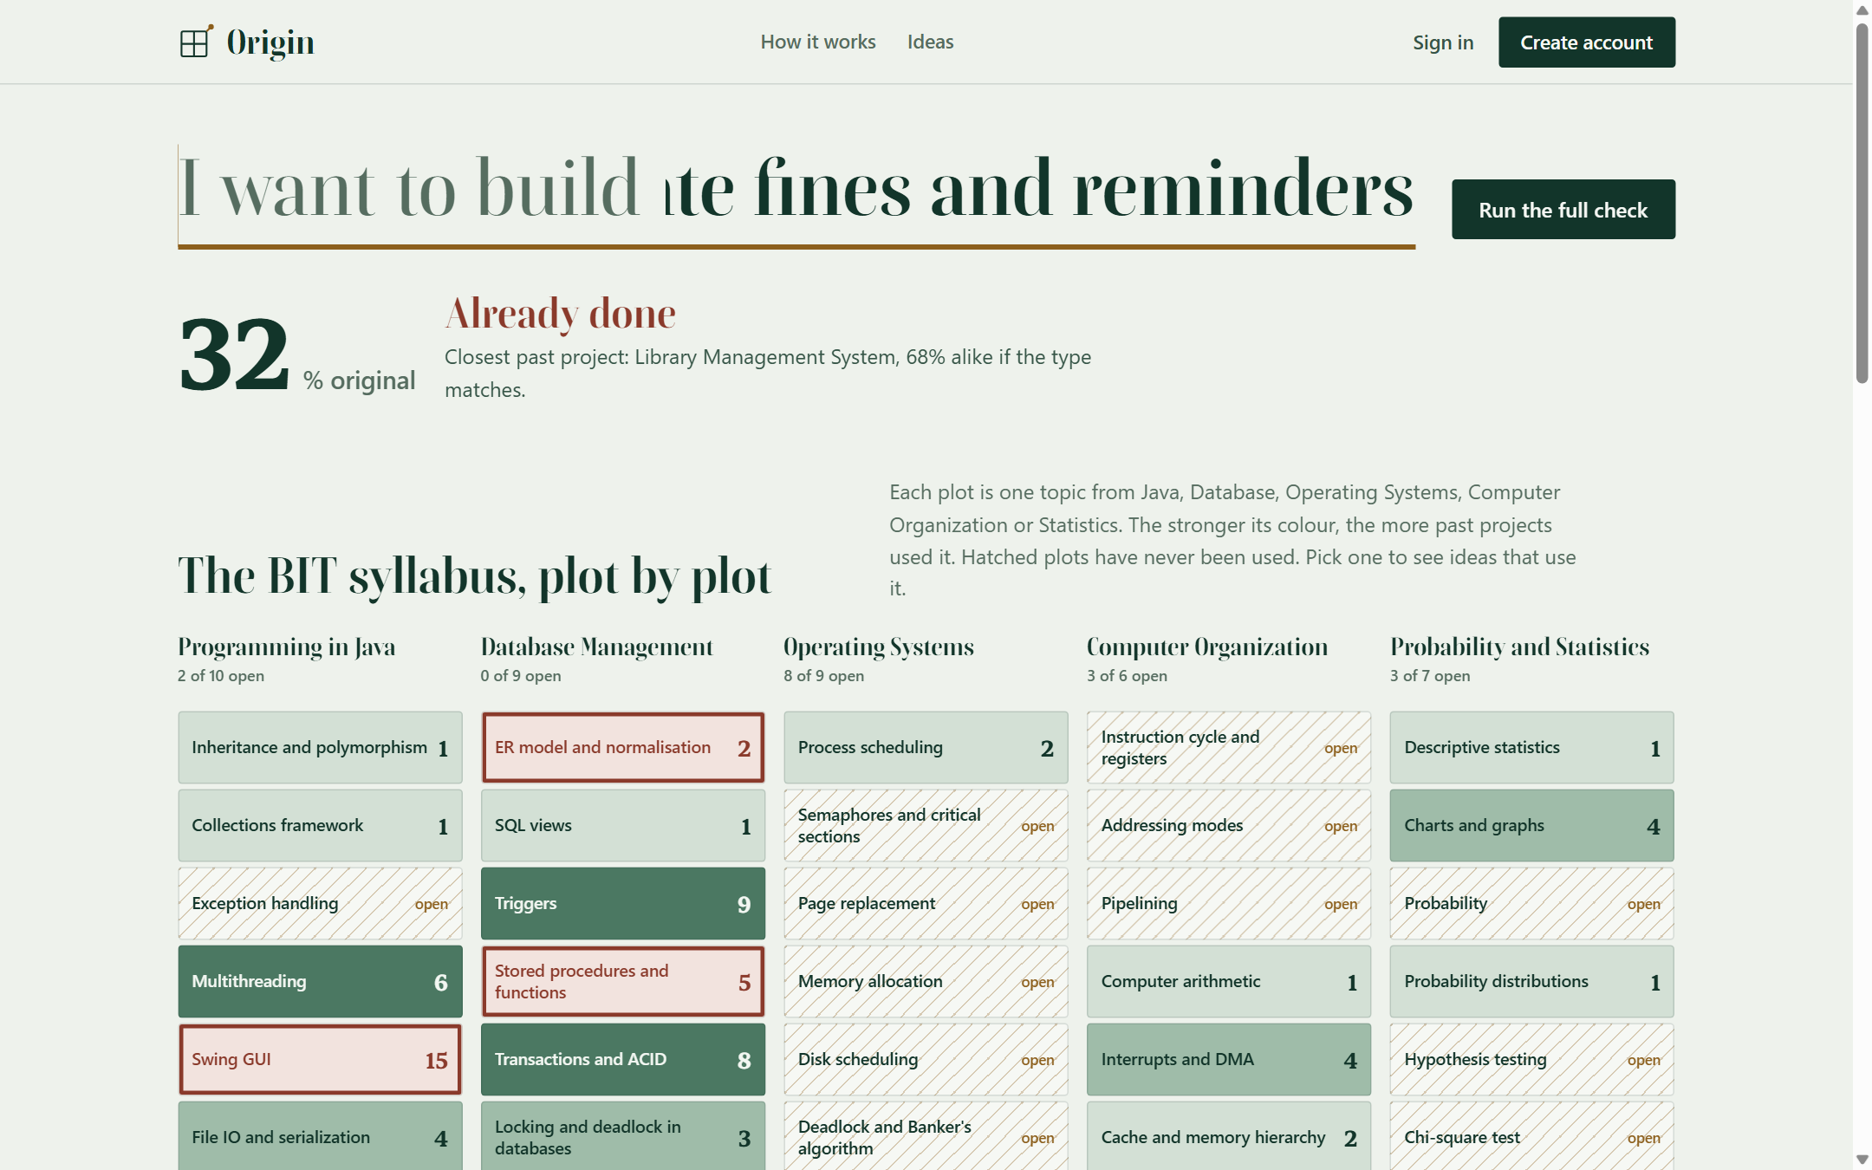
Syllabus Map

Slide 17
Hardware and Software Requirements
Component | Specification
Processor / RAM | Intel Core i3 or better, 4 GB RAM (8 GB recommended)
Operating system | Windows 10/11 or Ubuntu 20.04+
Language and container | Java 17+, Apache Tomcat 10.1 (Servlets 6.0, JSP 3.1, JSTL)
Database | MySQL 8.4 through JDBC (Connector/J)
Build and test | Maven 3.9, JUnit 5, Chrome DevTools driver (Node)
Tools | IntelliJ IDEA / VS Code, Git and GitHub, Chrome
File reading | java.io for CSV files: comma, pipe, tab and semicolon delimiters, quoted cells, byte-order mark (no extra library)

Slide 18
Expected Outcome
Working system: Syllabus Map, idea check, ideas with proof, Class Radar, DB-folder import and supervisor desk.
Renamed library idea caught at 62%; the formula agrees with human labels on 22 of 25 pairs, as often as the old one.
DB folder: real CSV files were read in 8 seconds and the pages updated on their own.
84 suggestions from 42 real problems, each with proof; 7 taken by locked groups; 25 tables, 6 triggers, 4 views, 2 procedures.
81 automated tests pass; every page answers in under 0.4 s.

Slide 19
Reference
[1] Turnitin, LLC, "Turnitin Similarity." [Online]. Available: https://www.turnitin.com
[2] S. Schleimer, D. S. Wilkerson, and A. Aiken, "Winnowing: Local algorithms for document fingerprinting," in Proc. ACM SIGMOD, 2003, pp. 76-85.
[3] P. Jaccard, "The distribution of the flora in the alpine zone," New Phytologist, vol. 11, no. 2, pp. 37-50, 1912.
[4] A. Silberschatz, H. F. Korth, and S. Sudarshan, Database System Concepts, 7th ed. McGraw-Hill, 2019.
[5] Eclipse Foundation, "Jakarta Servlet Specification, Version 6.0." [Online]. Available: https://jakarta.ee
[6] C. D. Manning, P. Raghavan, and H. Schutze, Introduction to Information Retrieval. Cambridge Univ. Press, 2008.
[7] I. Sommerville, Software Engineering, 10th ed. Pearson, 2016.
[8] H. Schildt, Java: The Complete Reference, 12th ed. McGraw-Hill, 2021.

Slide 20
Thank You

