Slide 1

Dr. Asha
A medical-report chatbot that asks before it answers
FastAPI · Groq openai/gpt-oss-120b · FAISS + local FastEmbed · SSE streaming · Render
Project walkthrough · live demo: document-chatbot-kambaa.vercel.app
Notes:
Hook: most health chatbots give textbook answers. Dr. Asha reads YOUR report and asks about YOU first. Built end-to-end: backend, intake engine, UI, model benchmark, deployment.

Slide 2
THE PROBLEM
Generic health bots answer everyone the same way
Textbook answers
Average-patient advice that ignores age, meds, diet and history.
GENERIC BOT
“Tiredness has many causes. It is advisable to consult a physician.”
No memory of you
Every message starts from zero — you re-explain yourself forever.
DR. ASHA
One-shot guesses
Never asks the two details that would change the whole answer.
“Because you’re 45, on metformin, and your HbA1c is 8.4%, this fatigue may also trace back to the anemia in your report (Hb 11.8). Three things to ask your doctor…”
02
Notes:
The gap is personalization. Same question, two answers — one is forgettable, one is about the person sitting there.

Slide 3
HOW IT THINKS
Every question runs a two-stage pipeline
QUICK-REPLY CHIPS
“Vegetarian or non-veg?” · “Any allergies?” · “Since when?” — answered in two clicks
STAGE 1 · INTAKE
One fast JSON call: extracts durable facts into a session profile, then decides — answer now, or ask first?
ask
Your question
answer
STAGE 2 · ANSWER
Retrieval over your reports + your profile + what you clarified → streamed live in the Dr. Asha persona
Profile updates silently every turn — age, diet, medications, allergies, preferences.
03
Notes:
Stage 1 is the differentiator: a cheap JSON call that decides whether missing details would materially change the answer. Round-capped at 2 so it never loops.

Slide 4
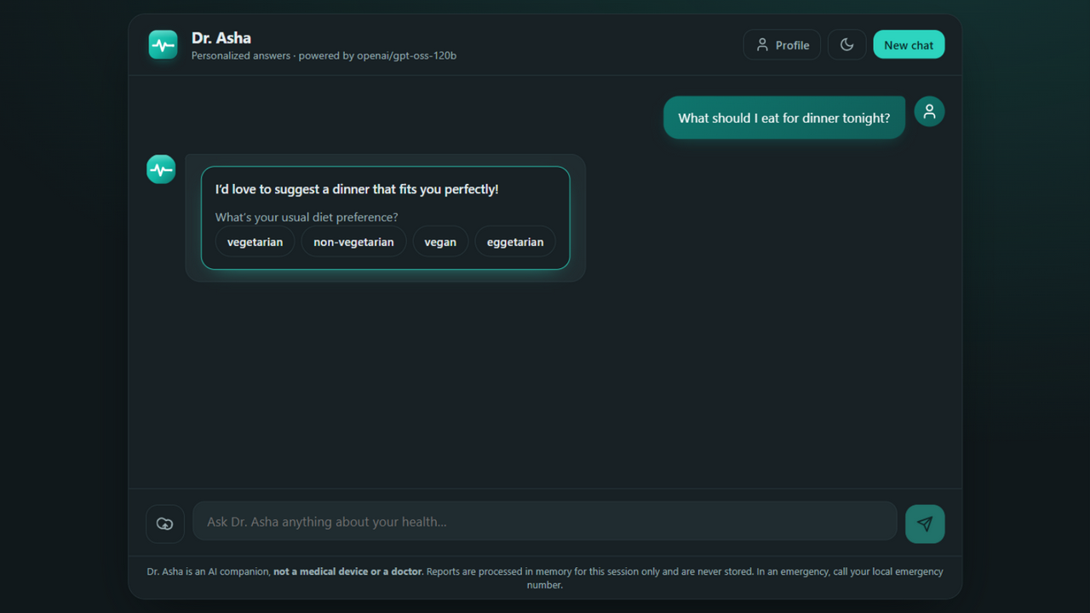
PERSONALIZATION
It asks, then it tailors — a real session
1
Ask naturally
“What can I eat for lunch today?”
2
It asks what matters
Diet preference · allergies · cuisine — as clickable chips
3
The answer is yours
Peanut-free Indian vegetarian plan, tied to the anemia and glucose values in the report
Live session — the bot collected diet and cuisine before recommending anything.
04
Notes:
This is the exact flow the user asked for: input first, personalized output second. Screenshot from the running app.

Slide 5
REPORT INTELLIGENCE
Upload a report — it reads it before you ask
1
Parse anything — PDF · DOCX · TXT · CSV · XLSX — tables included
414 tok/s
2
Chunk smartly — 1,200 characters, 200 overlap, recursive splitting
answer streaming on gpt-oss-120b — first words in ~1s
3
Embed locally — FastEmbed ONNX — no API key, no third party
5
8
4
Index per session — FAISS with MMR retrieval, isolated per chat
formats parsed
reports per session
5
Orient instantly — A warm plain-language summary the moment it lands
05
Notes:
Numbers measured during live testing: ~414 tokens/s streaming, 5 file formats, 8-report session cap. Reports accumulate — question 2 can cite report 1.

Slide 6
MODEL SELECTION
We benchmarked four models — then picked the smart one
Why we switched
gpt-oss-20b writes beautifully (640 tok/s) — but Groq’s strict JSON validator rejects its intake output ~40% of the time, silently breaking clarification.
gpt-oss-120b: 5/5 valid JSON, equally fast in practice. It’s the default.
Source: tools/eval_groq_models.py — 5 intake scenarios + scored RAG answers per model, Groq API, Nov 2026.
06
Notes:
Honest engineering: the user's first pick (20b) failed the pipeline's JSON contract. The benchmark script ships with the repo so the choice is reproducible.

Slide 7
SAFETY
A doctor’s bedside manner, with guardrails
Grounded, never invented
Quotes exact values with units and reference ranges from your report.
6/6
Never diagnoses
Explains associations, then points to your doctor for any conclusion.
automated quality checks passed by the default model
Red flags escalate
Chest pain, breathlessness, sudden weakness → seek urgent care now.
Speaks human
checks: uses your name · quotes real values · no definitive diagnosis · disclaimer present · next steps · personalized opening
Every medical term defined in plain words on first use.
Always discloses
The AI-not-a-doctor disclaimer closes every single answer.
07
Notes:
The 6/6 is the scored answer task in the benchmark script — automatic checks, not vibes.

Slide 8
ARCHITECTURE
Modern stack, honest about every hop
FASTAPI BACKEND
Intake + answer LLM calls · FAISS vector store (MMR) · in-memory sessions with TTL · SSE StreamingResponse
BROWSER
Vanilla JS + CSS · SSE stream reader · quick-reply chips · DOMPurify-safe markdown · profile drawer
GROQ LPU
openai/gpt-oss-120b — the only hop report text ever takes
SSE
chat API
FASTEMBED (ONNX, local)
embeddings computed on your own machine
RENDER BLUEPRINT
one Python service + one static site, infra as code
08
Notes:
Zero build step on the frontend; the backend serves the UI too, so one command runs everything locally.

Slide 9
PRIVACY & HARDENING
Medical data deserves restraint
Embeddings never leave the machine
0 bytes
Local ONNX inference — no embedding API sees your report.
One egress point, on purpose
persisted to disk — reports, profiles and chats live in memory only, evicted after 3 hours idle
Report text reaches only the Groq LLM endpoint. Nowhere else.
Uploads are fenced
10 MB cap · 8 files per session · duplicates rejected by content hash.
Output is sanitized
DOMPurify-clean markdown — a hostile document can’t inject scripts.
09
Notes:
Deliberate trade-off: memory-only sessions keep the demo honest about privacy, at the cost of persistence. Auth + rate limiting are the next hardening step.

Slide 10
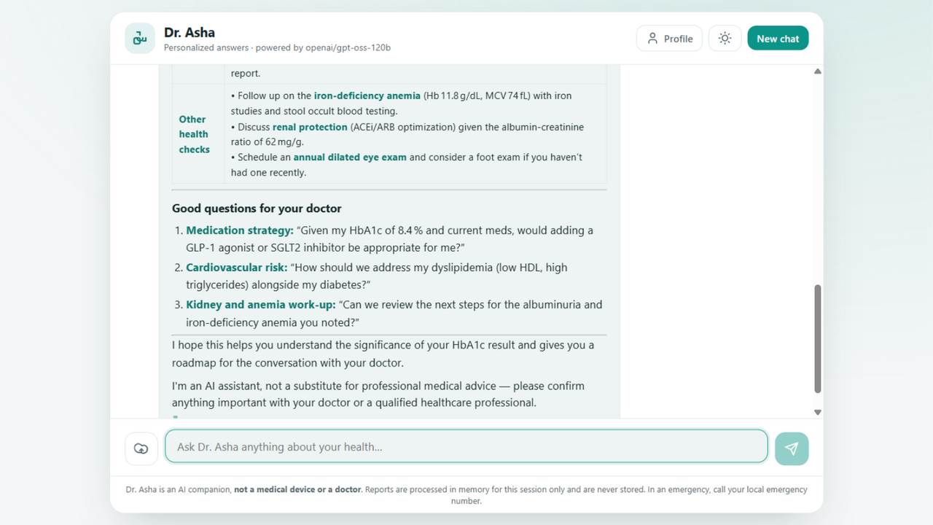
VERIFICATION
Proven against complex hospital reports
Metabolic_CBC_Lipid_Panel_Report.docx
45-year-old with T2DM — CMP, CBC, lipids, urinalysis, impression
Thyroid_VitaminD_Iron_Panel_Report.docx
32-year-old fatigue workup — thyroid, vitamin D, iron, hormones
Lab_Trends_Workbook.xlsx
Four sheets of two-year HbA1c, lipid, BP and lifestyle trends
All three are synthetic and generated by tools/generate_test_reports.py — complex, flagged, realistic.
Browser-verified: upload → summary → clarify chips → streamed, report-grounded answer.
10
Notes:
Testing discipline: synthetic fixtures mean no real PHI, and the generator script is committed so anyone can regenerate.

Slide 11
Ask it something personal.
Running now: http://127.0.0.1:8000 · deployed: render.yaml + one GROQ_API_KEY
ON THE ROADMAP
Multi-file drop
Auth + rate limits
Scanned-PDF OCR
upload all reports at once
before real patients, not after
image-only reports welcome
Dr. Asha · an AI companion, not a substitute for professional medical advice
Notes:
Close on the demo. The roadmap is ranked by what stands between the demo and real patients.

