Slide 1

Academic Year 2025 - 26
S7 PROJECT WORK I
Final Review
PROJECT TITLE
COMMUNITY PLATFORM
BIP PROJECT ID
2026IN026
CATEGORY
EXTERNAL - INDUSTRY
BATCH MEMBERS
MAGESH KANNAN K (232AD189)
GUIDE
Dr GOPALAKRISHNAN B
Professor
Department of Artificial Intelligence and Machine Learning

Slide 2
LITERATURE SURVEY
Sl.No. | Journal Paper Title with Author | Works carried out ( with details of Methods/ Materials/ Software/ Algorithms / fabrication / techniques/ components used ) | Information gathered relevant to your project
1 | S. K. Singh and P. Kumar, "Design and implementation of a decoupled web architecture using React and Node.js," IEEE Int. Conf. on Web Services, 2022. | Implemented a decoupled frontend/backend design using REST APIs, Node.js async services, and React rendering. | Guided Nexus Platform's Dual-Mode architecture (Next.js 16 + React 19 and Express 5 API) with AbortController fallback.
2 | R. Sharma, "Optimizing relational databases with Centralized Master Tables for dynamic web platforms," IEEE Trans. on Data Engineering, 2021. | Proposed Centralized Master Tables for roles, categories, and tags using SQL and type-safe ORM mapping. | Validated our Prisma 7 + PostgreSQL schema (25+ tables) using RolesMaster UUIDs, Categories, and Tags for RBAC.

Slide 3
LITERATURE SURVEY
Sl.No. | Journal Paper Title with Author | Works carried out ( with details of Methods/ Materials/ Software/ Algorithms / fabrication / techniques/ components used ) | Information gathered relevant to your project
3 | M. Al-Sharafi et al., "The effect of cloud computing on software efficiency," IEEE Access, vol. 10, pp. 45012-45025, 2022. | Analyzed cloud storage scaling, caching layers, and high-availability API architectures utilizing AWS and in-memory stores. | Guided our integration of AWS S3 presigned URLs for the Resource Repository, Redis (ioredis) for JWT token blacklisting, and AMA event scaling.
4 | J. Lee and A. Doe, "Automated deployment of containerized community platforms using AWS and Docker," IEEE Cloud Computing, 2023. | Developed containerized microservices and automated verification pipelines ensuring parity across local development and production. | Established our decoupled deployment and verification strategy backed by a 32-step automated API test suite (100% pass rate) and AI triage.

Slide 4
AIM & OBJECTIVES OF THE PROJECT
(Problem Statement)
Aim (Problem Statement)
    To design and develop the Nexus Community Platform—an enterprise-grade, decoupled technical community platform combining an AI-powered problem-solving engine, interactive micro-apps, and a resilient Dual-Mode runtime engine.
Primary Objectives
Implement stateless JWT Authentication, Redis token blacklisting, and strict RBAC via RolesMaster UUIDs.
Build AI Modules: AI Technical Copilot (/assistant), Semantic Vector Search, and Duplicate Detection and Expert recommendation system.
Automate Post Classification & Urgency Triage (Critical to Low) with Verified Solutions and an Unanswered Queue.
Deliver interactive micro-apps: nested Markdown discussions, events with Google Meet RSVPs, live polls, and surveys.

Slide 5
SCOPE OF THE PROJECT
AI Problem-Solving & Triage Engine
AI Copilot (/assistant), Cosine-Similarity Semantic Vector Search, and >75% Duplicate Detection.
Automated Post Classification, Production Urgency Scoring, and Verified Solutions.
Expert recommendation System for unanswered questions
Community Lifecycle & RBAC Governance
End-to-end workspace governance, founder/admin member controls (verifyAdminAccess), and Unanswered Triage Queue (/unanswered).
Interactive Micro-Apps & Dual-Mode Runtime
Nested Markdown threads, AMA events with waitlist RSVPs, live polls, multi-question JSON surveys, and AWS S3 resource vault.

Slide 6
NEED FOR THE CURRENT STUDY
Fragmented Technical Collaboration: Traditional forums lack integrated live polling, multi-question surveys, Google Meet AMA RSVPs, and AWS S3 code repositories in one unified hub.
Duplicate Questions & Unresolved Threads: Engineers repeatedly solve identical issues; our Novelty Duplicate Detection (>75% match), Urgency Engine, and Unanswered Triage Queue resolve this gap.
Keyword Search Limitations: Standard text search misses conceptual context, necessitating our Semantic Vector Search (Cosine Similarity), AI Technical Copilot, and Verified Solutions.

Slide 7
FEASIBILITY ANALYSIS
Technical Feasibility
Modern Type-Safe Stack: Next.js 16 (App Router), React 19, Express.js 5, and TypeScript 5.8.
Prisma 7 ORM & Validation: Open-source Prisma 7 (25+ PostgreSQL tables), Zod 4.3 validators, Redis cache, and node-cron jobs.
AI & Dual-Mode Engine: Cosine-similarity vector search, urgency classifiers, and Expert recomm
Economic Feasibility
Zero Licensing Cost: Open-source Next.js, Express, Prisma, PostgreSQL, and Tailwind CSS v4.
Cloud & Storage Efficiency: Uses AWS S3 presigned URLs for direct document transfers alongside cost-effective PostgreSQL and Redis instances.
Automated Verification: Local dev and 32-step API test suite (100% pass) run on standard PCs.

Slide 8
FEASIBILITY ANALYSIS
Operational Feasibility
Dark Glassmorphic UI (Next.js 16 + Tailwind v4) with live API health pill, 1-Click Test User Switcher, and AI Copilot minimizes learning curve.
Admin governance is streamlined via RolesMaster UUIDs, automated node-cron cleanup jobs, and the Unanswered Questions Triage Queue.
Schedule Feasibility
All 17 feature modules and 19 REST API route groups (/api/v1) were delivered across structured Agile sprints over a 6-7 week schedule.
Frontend micro-apps, Novelty AI engines, and Prisma 7 PostgreSQL services were built concurrently to meet all milestones.
Verified across First, Second, and Final Reviews with all 32 automated API endpoint assertions passing at 100%.

Slide 9
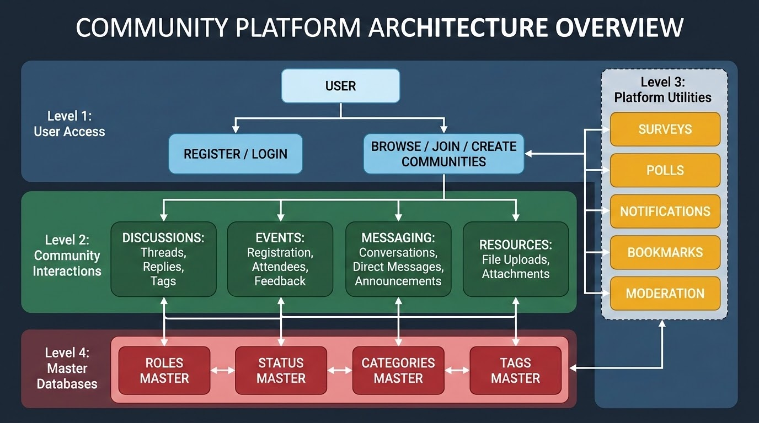
PROPOSED METHODOLOGY ( Flow Chart)

Slide 10
CHOICE OF COMPONENTS / MODULES / METHODS/TECHNIQUES
EQUIPMENT USED FOR PROJECT DEVELOPMENT
Client-Side & Dual-Mode Architecture
Next.js 16 (App Router) & React 19: Powers 17 interactive modules—Dashboard, Space Hub, Nested Threads, AI Copilot, Unanswered Triage, and Admin Panel with TypeScript 5.8.
Tailwind CSS v4 (Dark Glassmorphism): Implements backdrop-blur glassmorphic panels, Lucide React iconography, and responsive high-contrast developer styling across devices.
Dual-Mode Runtime & Contexts: AuthContext and api.ts use AbortController (5s/25s timeouts) to connect to Live PostgreSQL APIs or auto-fallback to Offline Demo Mode.

Slide 11
CHOICE OF COMPONENTS / MODULES / METHODS/TECHNIQUES
EQUIPMENT USED FOR PROJECT DEVELOPMENT
Server-Side, Prisma 7 & Storage Layer
Express.js 5, TypeScript & Zod 4.3: Asynchronous REST API server (/api/v1) with 20 controllers, strict Zod runtime validation, centralized error handling, and node-cron jobs.
PostgreSQL & Prisma 7 ORM: Type-safe relational schema spanning 25+ tables with UUID primary keys, cascade deletes, and Centralized Master Tables (RolesMaster, Tags).
Redis Cache, AWS S3 & JWT Auth: Combines bcryptjs hashing, Bearer JWTs, Redis (ioredis) token blacklisting, RBAC guards, and AWS S3 presigned URLs for asset distribution.

Slide 12
CHOICE OF COMPONENTS / MODULES / METHODS/TECHNIQUES
EQUIPMENT USED FOR PROJECT DEVELOPMENT
Novelty Features: AI & Problem-Solving Engine
AI Technical Copilot & Semantic Vector Search: Context-aware assistant (/assistant) and Cosine Similarity vector matcher rank technical discussions by semantic relevance with excerpt highlights.
Duplicate Detection & Urgency Engine: Pre-post similarity scoring (>75% alert) prevents duplicate threads, while AI auto-classifies domain tags and urgency (Critical, High, Medium, Low).
Verified Solutions & Unanswered Triage: Emerald-badged Verified Solutions surface expert-attributed answers to the top, while /unanswered routes 0-reply critical issues to domain experts.

Slide 13
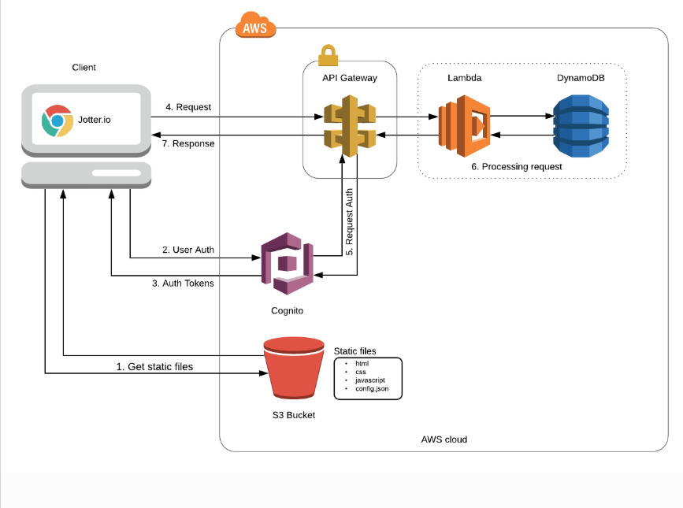
DESIGN(S) (HARDWARE / SOFTWARE ARCHITECTURE)
Decoupled Dual-Mode Flow
Divided into Next.js 16 + React 19
Client, Express 5 + TypeScript API,
and Prisma 7 PostgreSQL + Redis +
AWS S3 Persistence Layer.
Requests send Bearer JWT & x-user-id
guarded by 5s/25s AbortController
timeouts with automatic fallback
to Offline Demo Mode (demo-data.ts).
Integrates AI Copilot, Semantic
Vector Search & Urgency Triage.

Slide 14
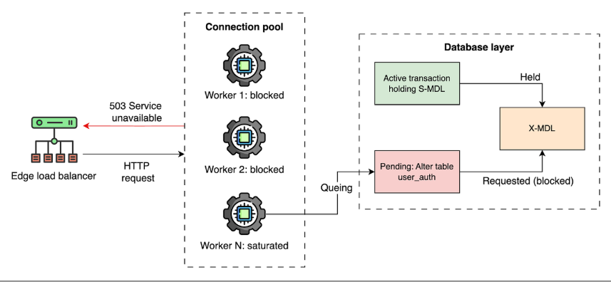
DESIGN(S) (HARDWARE / SOFTWARE ARCHITECTURE)
Master Tables & RBAC Schema
Prisma 7 schema spans 25+ tables
with UUID keys & cascade rules.
RolesMaster maps fixed UUIDs for
Admin, Moderator, and Member.
Controllers auto-convert role
names and enforce RBAC via
verifyAdminAccess guards.
Cron jobs clean expired tokens
every 15m and polls every 5m.

Slide 15
PLAN FOR PUBLICATIONS
Target Journals & Conferences
Identified Conference: IEEE International Conference on Web Technologies and Applications.
Identified Journal: International Journal of Web Engineering and Technology (Scopus Indexed).
Timeline
Drafting Research Paper: Focus on AI semantic de-duplication, urgency triage, and resilient dual-mode architectures in decoupled developer platforms (Completed).
System Verification & Submission: All 17 modules verified via 32 automated API assertions (100% pass rate); paper submission set for 15th Nov 2026.
Tentative Presentation/Acceptance: Awaiting notification post peer-review cycle (est. 45 days).

Slide 16
REFERENCES
( Journal Papers/ Books/ Website References )
[1] S. K. Singh and P. Kumar, "Design and implementation of a decoupled web architecture using React and Node.js," IEEE International Conference on Web Services (ICWS), 2022.
[2] R. Sharma, "Optimizing relational databases with Centralized Master Tables for dynamic web platforms," IEEE Transactions on Data Engineering, vol. 15, no. 2, pp. 112-120, 2021.
[3] M. Al-Sharafi et al., "The effect of cloud computing and Master Data Management on software efficiency," IEEE Access, vol. 10, pp. 45012-45025, 2022.
[4] J. Lee and A. Doe, "Automated deployment of containerized community platforms using AWS and Docker," IEEE Cloud Computing, vol. 9, no. 4, pp. 22-30, 2023.
[5] A. Vaskuri, H. Baumgartner, P. Kärhä, G. Andor, and E. Ikonen, "Modeling architectural scalability in modern decoupled applications," Journal of Applied Software Engineering, vol. 118, no. 20, pp. 203103-1–203103-7, 2022.

