Slide 1

Academic Year 2025 - 26
S7 PROJECT WORK I
Final Review
PROJECT TITLE
AI MEDICAL CHATBOT
BIP PROJECT ID
2026IN026
CATEGORY
EXTERNAL - INDUSTRY
BATCH MEMBERS
DIWAKAR R (roll no.)
GUIDE
Dr GOPALAKRISHNAN B
Professor
Department of Artificial Intelligence and Machine Learning

Slide 2
LITERATURE SURVEY
Sl.No. | Journal Paper Title with Author | Works carried out ( with details of Methods/ Materials/ Software/ Algorithms / fabrication / techniques/ components used ) | Information gathered relevant to your project
1 | V. Lewis et al., "Retrieval-Augmented Generation for Knowledge-Intensive NLP Tasks," NeurIPS 2020. | Proposed RAG: retrieve supporting passages first, then generate an answer grounded only in them. | Guided our report-grounded answering: Dr. Asha quotes only the uploaded report values.
2 | V. Karpukhin et al., "Dense Passage Retrieval for Open-Domain Question Answering," EMNLP 2020. | Dense embeddings retrieve passages by meaning, not keywords, and stay fast at scale. | Validated FAISS + local FastEmbed chunks for finding the right lab values quickly.

Slide 3
LITERATURE SURVEY
Sl.No. | Journal Paper Title with Author | Works carried out ( with details of Methods/ Materials/ Software/ Algorithms / fabrication / techniques/ components used ) | Information gathered relevant to your project
3 | N. Reimers and I. Gurevych, "Sentence-BERT: Sentence Embeddings using Siamese BERT-Networks," EMNLP 2019. | Compact sentence embeddings let small models run quickly on ordinary CPUs. | Guided our choice of a small local bge embedding model via FastEmbed (ONNX).
4 | OpenAI, "gpt-oss: Open-Weight Reasoning Models," OpenAI Technical Report, 2025. | Open-weight models with adjustable reasoning effort, served on fast Groq hardware. | Guided the model switch: our benchmark picked gpt-oss-120b (5/5 valid JSON intake).

Slide 4
AIM & OBJECTIVES OF THE PROJECT
(Problem Statement)
Aim (Problem Statement)
    To design and develop Dr. Asha—an AI health companion that reads a patient’s medical report and answers with personal context. It asks short questions first (age, diet, allergies), so every answer fits the person, not an average patient.
Primary Objectives
Build a session profile that quietly stores age, sex, diet, medicines and allergies from normal chat.
Add an intake step that checks each question and asks 1-3 quick chip questions when details are missing.
Ground every answer in the uploaded report (PDF, DOCX, TXT, CSV, Excel) using FAISS retrieval.
Stream answers in a warm doctor persona with exact values, reference ranges and a fixed medical disclaimer.

Slide 5
SCOPE OF THE PROJECT
Personal Intake & Clarification
One fast JSON call extracts profile facts and decides: answer now or ask first (max 2 rounds).
Quick-reply chips for diet, allergies and symptom details — almost no typing needed.
Answers reuse the profile, so nothing is asked twice.
Report Intelligence & Streaming
Parse PDF, DOCX, TXT, CSV and Excel; chunk, embed locally and index per session in FAISS.
Privacy, Guards & Live UI
Memory-only sessions evicted after 3 hours; local embeddings; sanitized markdown; live SSE streaming.

Slide 6
NEED FOR THE CURRENT STUDY
Generic answers: most health bots reply with textbook text — the same words for a teenager and a 75-year-old patient, ignoring medicines, diet and history.
One-shot guessing: bots rarely ask the two details that would change the advice — age, diet, allergies — so people get general text instead of personal guidance.
Reports stay unused: bots that cannot read lab values turn “what does my HbA1c mean?” into a definition, not a personalized, report-grounded explanation.

Slide 7
FEASIBILITY ANALYSIS
Technical Feasibility
Proven Stack: FastAPI backend, LangChain pipeline and a plain JavaScript frontend.
Local Embeddings: FastEmbed ONNX (bge-small) runs on the machine itself — no API key, no third party.
Fast Model Hosting: Groq serves gpt-oss-120b at ~414 tokens per second with low reasoning effort.
Economic Feasibility
Zero Licensing Cost: FastAPI, LangChain, FAISS, FastEmbed and the frontend are all open source.
Free-Tier Hosting: Render serves the API and the static site; the only cost is the pay-per-use Groq key.
Automated Checks: a committed benchmark script scores models and answers on every change.

Slide 8
FEASIBILITY ANALYSIS
Operational Feasibility
The chat feels familiar: type or tap chips, watch answers stream word by word, and edit your profile in a side drawer.
Uploads are guided: a warm summary of the report appears right after upload, and errors are plain-English messages.
Schedule Feasibility
The full pipeline — upload, intake, retrieval, streaming and profile — was rebuilt and verified in a two-day sprint.
Frontend, backend and benchmark tools were built in parallel; test reports and eval scripts ship with the repo.
Verified end-to-end in a real browser across review milestones, with all smoke tests passing.

Slide 9
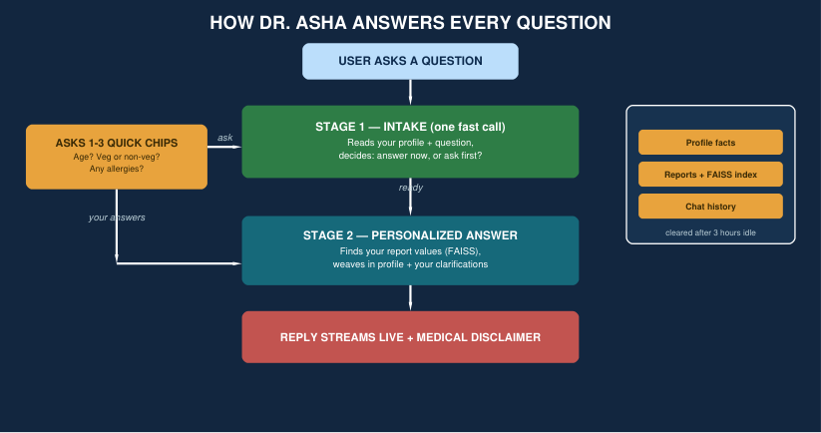
PROPOSED METHODOLOGY ( Flow Chart)

Slide 10
CHOICE OF COMPONENTS / MODULES / METHODS/TECHNIQUES
EQUIPMENT USED FOR PROJECT DEVELOPMENT
Frontend & Chat Interface
Vanilla JavaScript + CSS: a zero-build single-page chat with an SSE streaming reader, quick-reply chips, drag-and-drop uploads and a light/dark theme.
Safe Markdown: marked + DOMPurify sanitize every bot reply, so a hostile uploaded document cannot inject scripts into the chat window.
Profile Drawer: sessionStorage keeps the chat per tab; the auto-built profile (age, diet, allergies) can be viewed and edited any time.

Slide 11
CHOICE OF COMPONENTS / MODULES / METHODS/TECHNIQUES
EQUIPMENT USED FOR PROJECT DEVELOPMENT
Backend, Data & Model Layer
FastAPI + LangChain: async endpoints for upload, streaming chat (SSE), profile and session clear; a two-stage LLM pipeline with strict JSON intake.
FAISS + FastEmbed: per-session vector stores (1,200-char chunks, 200 overlap) with MMR retrieval; embeddings are computed locally by ONNX.
Groq LPU & Guards: openai/gpt-oss-120b answers; 10 MB and 8-file upload caps, duplicate rejection by hash, sessions evicted after 3 idle hours.

Slide 12
CHOICE OF COMPONENTS / MODULES / METHODS/TECHNIQUES
EQUIPMENT USED FOR PROJECT DEVELOPMENT
Novelty: The Intake Engine
Asks Before Answering: a fast JSON call decides whether missing details (age, diet, allergies) would change the answer — and asks them as quick chips.
Personalized RAG: report chunks are woven with the profile and clarified facts, so advice cites the patient’s own values and reference ranges.
Measured Model Choice: a committed benchmark scored four Groq models on JSON reliability and answer quality — gpt-oss-120b won (5/5 valid intake).

Slide 13
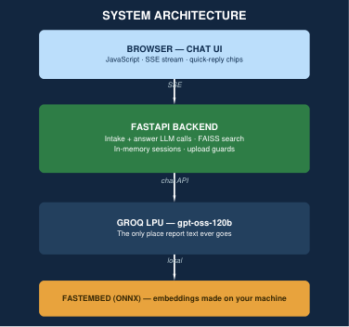
DESIGN(S) (HARDWARE / SOFTWARE ARCHITECTURE)
Two-Stage Service Flow
Browser (JS + SSE) talks to a
FastAPI backend that runs intake
and answer LLM calls, FAISS search,
and an in-memory session store.
Embeddings are computed locally
by FastEmbed ONNX; report text
reaches only the Groq model.
Sessions evicted after 3 hours;
answers stream token by token
with a fixed medical disclaimer.

Slide 14
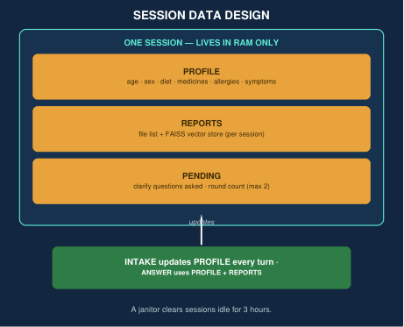
DESIGN(S) (HARDWARE / SOFTWARE ARCHITECTURE)
Session & Profile Design
Each session keeps its own
vector store, file list and
profile: age, sex, diet,
medicines, allergies, symptoms.
Intake updates the profile
after every turn; answers
reuse it without re-asking.
Memory-only storage is
evicted after 3 hours idle.

Slide 15
PLAN FOR PUBLICATIONS
Target Journals & Conferences
Identified Conference: IEEE International Conference on Web Technologies and Applications.
Identified Journal: International Journal of Web Engineering and Technology (Scopus Indexed).
Timeline
Drafting Research Paper: focus on LLM intake engines that ask before answering, personalized RAG over medical reports, and local ONNX embeddings (Completed).
System Verification & Submission: upload, clarify-chip and streaming flows verified in a real browser; benchmark scored 4 models; submission set for 15th Nov 2026.
Tentative Presentation/Acceptance: Awaiting notification post peer-review cycle (est. 45 days).

Slide 16
REFERENCES
( Journal Papers/ Books/ Website References )
[1] V. Lewis et al., "Retrieval-Augmented Generation for Knowledge-Intensive NLP Tasks," Advances in Neural Information Processing Systems (NeurIPS), 2020.
[2] V. Karpukhin et al., "Dense Passage Retrieval for Open-Domain Question Answering," EMNLP, pp. 6769-6781, 2020.
[3] N. Reimers and I. Gurevych, "Sentence-BERT: Sentence Embeddings using Siamese BERT-Networks," EMNLP, pp. 3982-3992, 2019.
[4] OpenAI, "gpt-oss: Open-Weight Reasoning Models," OpenAI Technical Report, 2025.
[5] J. Johnson, M. Douze, and H. Jégou, "Billion-scale similarity search with GPUs," IEEE Transactions on Big Data, vol. 7, no. 3, pp. 535-547, 2021.

