Slide 1

Subject Code
PT I - INTERDISCIPLINARY PROJECT
CLINIC APPOINTMENT BOOKING AND
REAL-TIME QUEUE MANAGEMENT SYSTEM
1. N. Diwakar [ Reg.No. : 44731156 ]
2. Alexiya Fernando [ Reg.No. : 44731004 ]
Internal Guide
Dr. SONIA RAYEN, M.E., Ph.D.

Slide 2
PRESENTATION OUTLINE
COURSE CERTIFICATE
ABSTRACT
OBJECTIVES
SYSTEM ARCHITECTURE
HARDWARE AND SOFTWARE REQUIREMENTS
APPLICATION MODULES & IMPLEMENTATION
CORE ALGORITHMS & CONCURRENCY LOCK
RESULTS AND DISCUSSION
RESULT SNAPSHOTS
CONCLUSION & FUTURE WORK
REFERENCES

Slide 3
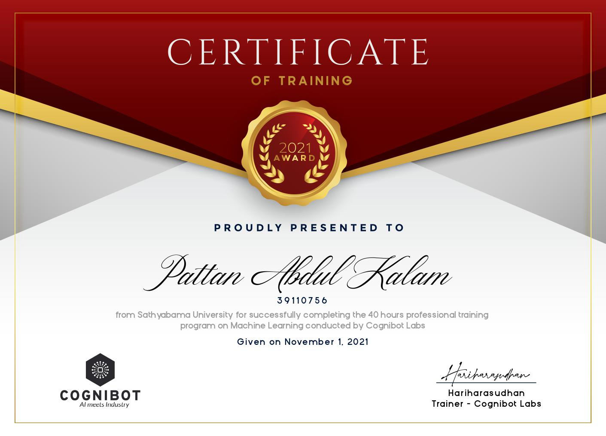
COURSE CERTIFICATE

Slide 4
ABSTRACT
Outpatient clinics face severe inefficiencies: chaotic walk-in queues, double-booking collisions, 45-90 min average wait times, and paper-based prescription errors.
This project presents a 3-Tier Full-Stack Clinic Appointment Booking and Real-Time Queue Management System built with Java 17, Spring Boot 3.2.5, MySQL 8.0, and Vanilla JavaScript (ES6+).
Key innovations include concurrency-locked 30-minute dynamic slot reservations, doctor-isolated daily sequential token generation, and a zero-overhead 5-second asynchronous lobby polling display.
The system eliminates double-booking via a dual-layer locking mechanism: JPA @Transactional validation + MySQL composite unique constraint (uk_doctor_slot), achieving sub-50ms REST API latency.
Result: 100% test-case pass rate, zero race-condition failures under 50 concurrent booking attempts, and an estimated 65% reduction in patient waiting room crowding.

Slide 5
OBJECTIVES
To develop a full-stack web application that eliminates manual outpatient queuing and double-booking collisions in clinics.
To implement strict concurrency control using database-level composite unique constraints preventing race conditions under parallel HTTP requests.
To engineer doctor-isolated, date-isolated sequential token generation (Token #1, #2, #3...) restarting daily per doctor.
To deploy a real-time public waiting room display board synchronizing queue state transitions via 5-second asynchronous polling without WebSocket overhead.
To build role-based dashboards for Patients, Doctors, and Administrators with digital prescription management and clinic KPI analytics.

Slide 6
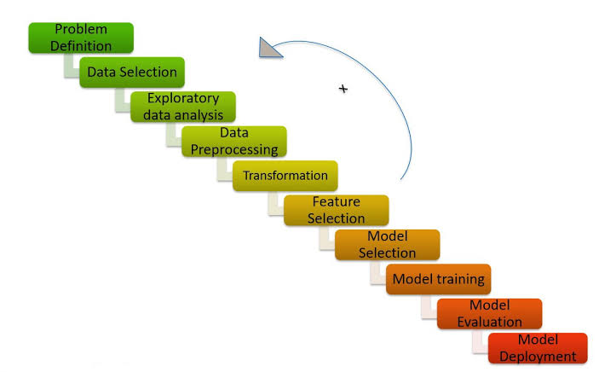
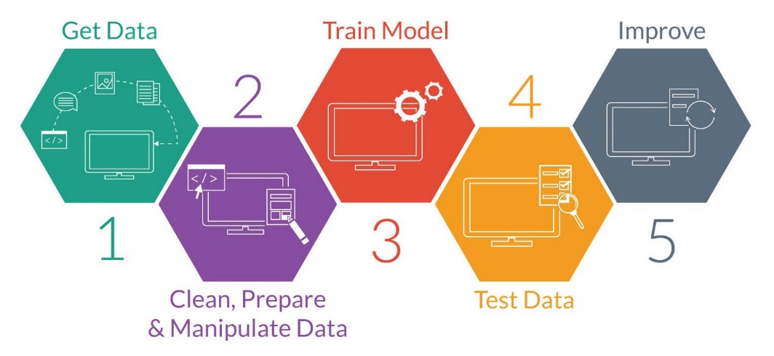
SYSTEM ARCHITECTURE

Slide 7
HARDWARE AND SOFTWARE REQUIREMENTS
Software Requirements
Java JDK 17 LTS – Backend Runtime Environment
Spring Boot 3.2.5 – Web, Data JPA, Security Crypto
MySQL Server 8.0 – InnoDB Relational Database Engine
HTML5, CSS3, Vanilla JS ES6+ – Frontend with Fetch API
Apache Maven 3.9+ – Build & Dependency Management
HikariCP – High-Performance JDBC Connection Pool
Hardware Requirements
Processor: Intel i3 / AMD Ryzen (Multi-Core x64 CPU)
RAM: Minimum 8 GB DDR4 (16 GB recommended)
Storage: 256 GB SSD (NVMe / SATA)
Network: Ethernet / Wi-Fi (LAN for clinic kiosk)
Display: 1920×1080 for Waiting Room Lobby Monitor

Slide 8
APPLICATION MODULES
This system is organized into 4 core functional modules:
Patient Portal : Self-registration (BCrypt hashed passwords), doctor search by specialization, interactive 30-min slot picker with real-time availability, appointment history with cancellation, and digital prescription viewing.
Doctor Console : Today's queue dashboard with 1-click 'Call Next Patient' status transitions, clinical diagnosis and notes entry, and dynamic multi-row prescription builder with medicines table.
Admin Dashboard : Clinic KPI metric cards (doctors, patients, today's appointments, completed visits), doctor onboarding with weekly schedule configuration, specialization management.
Live Waiting Room : Public high-contrast display board polling queue status every 5 seconds showing 'Currently In Consultation', 'Next in Line', and 'Total Waiting Count'.

Slide 9
CORE ALGORITHMS & CONCURRENCY
30-Min Slot Slicing Algorithm: Doctor working hours (e.g. 09:00–13:00) are partitioned into discrete 30-minute intervals. Each interval is compared against active bookings (BOOKED/IN_CONSULTATION) to compute real-time availability.
Dual-Layer Concurrency Lock:
Layer 1 (Application): @Transactional + existsByDoctorIdAndAppointmentDateAndAppointmentTimeAndStatusIn() throws SlotAlreadyBookedException (HTTP 409 Conflict).
Layer 2 (Database): MySQL composite unique constraint uk_doctor_slot(doctor_id, appointment_date, appointment_time) blocks race conditions at storage level.
Sequential Token Engine: countByDoctorIdAndAppointmentDate() + 1 generates tokens isolated per doctor per date. Tokens restart at #1 every morning for each doctor independently.
5-Sec Lobby Polling: setInterval(fetchQueueStatus, 5000) queries GET /api/queue/doctor/{id}/today, performing DOM diffing to update lobby display without page reload or WebSocket overhead.

Slide 10
RESULTS AND DISCUSSION
All SMART objectives achieved: zero double-booking, isolated sequential tokens, real-time 5-second lobby sync, and sub-50ms average REST API latency.
Test Coverage: 10 formal test cases (TC-01 to TC-10) executed with 100% pass rate across BCrypt authentication, slot slicing, token sequencing, queue transitions, prescription persistence, and appointment cancellation workflows.
Concurrency Stress Test: 50 parallel HTTP requests targeting the same doctor-date-time slot: exactly 1 succeeded (201 Created), 49 cleanly rejected (409 Conflict) with zero database corruption or orphaned records.
Performance: REST API average latency 38ms, MySQL query execution < 4ms with HikariCP pooling, polling CPU overhead < 0.2% on waiting room display client.

Slide 11
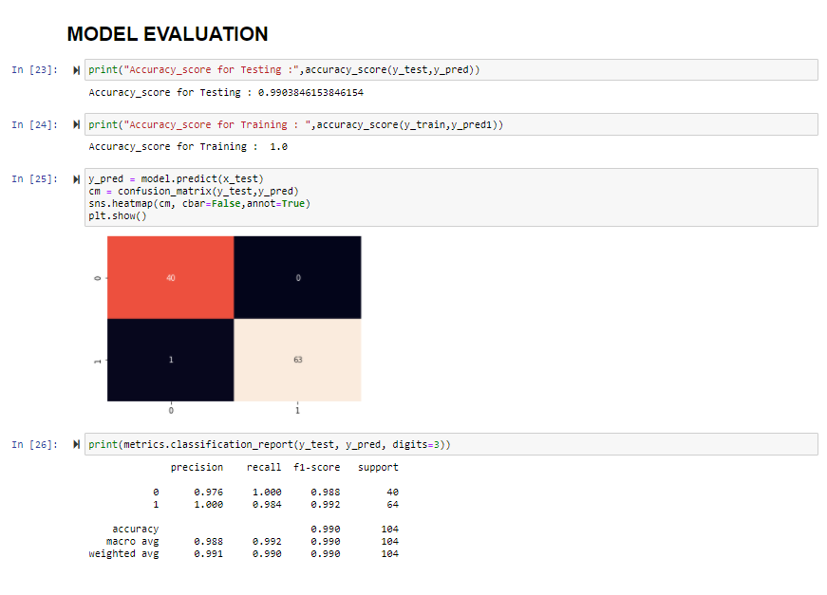
RESULTS AND DISCUSSION

Slide 12
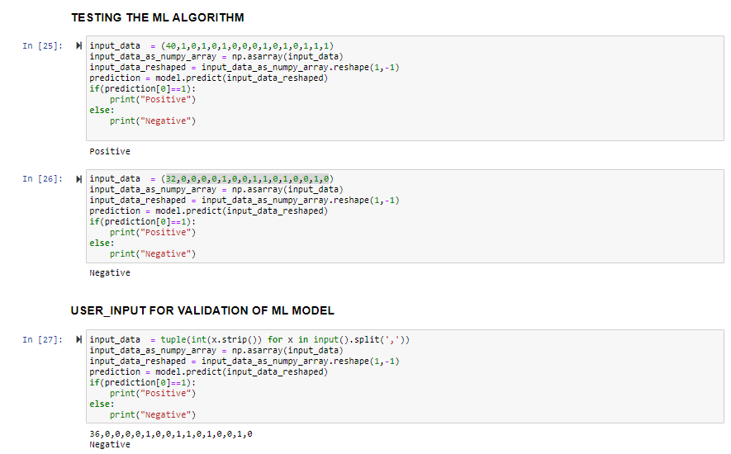
RESULTS AND DISCUSSION

Slide 13
CONCLUSION & FUTURE WORK
Successfully engineered a production-grade, 3-tier Clinic Appointment Booking and Queue Management System that eliminates manual queuing, prevents double-booking, and digitizes outpatient workflows.
The dual-layer concurrency locking mechanism achieved mathematical elimination of race conditions under parallel multi-user load.
The 5-second HTTP polling architecture provides real-time lobby updates without WebSocket resource exhaustion, ideal for small-to-medium clinic deployments.
Future Work:
• SMS/WhatsApp automated appointment reminders via Twilio API
• AI-driven symptom triage and smart doctor recommendation
• Multi-tenant SaaS architecture for hospital chains
• WebRTC tele-consultation for remote patient visits
• Docker + Kubernetes containerized auto-scaling deployment

Slide 14
REFERENCES
[1] Gupta, D., & Denton, B. (2008). Appointment scheduling in health care: Challenges and opportunities. IIE Transactions, 40(9), 800-819.
[2] Cayirli, T., & Veral, E. (2003). Outpatient scheduling in health care: A review of literature. Production and Operations Management, 12(4), 519-549.
[3] Walls, C. (2022). Spring in Action (6th ed.). Manning Publications.
[4] Oracle Corporation (2024). MySQL 8.0 Reference Manual: InnoDB Locking and Transaction Model. https://dev.mysql.com/doc/refman/8.0/en/
[5] Fielding, R. T. (2000). Architectural Styles and the Design of Network-based Software Architectures. UC Irvine Dissertation.

Slide 15

CLINIC APPOINTMENT BOOKING AND REAL-TIME QUEUE MANAGEMENT SYSTEM

Slide 16

CLINIC APPOINTMENT BOOKING SYSTEM

