Slide 1
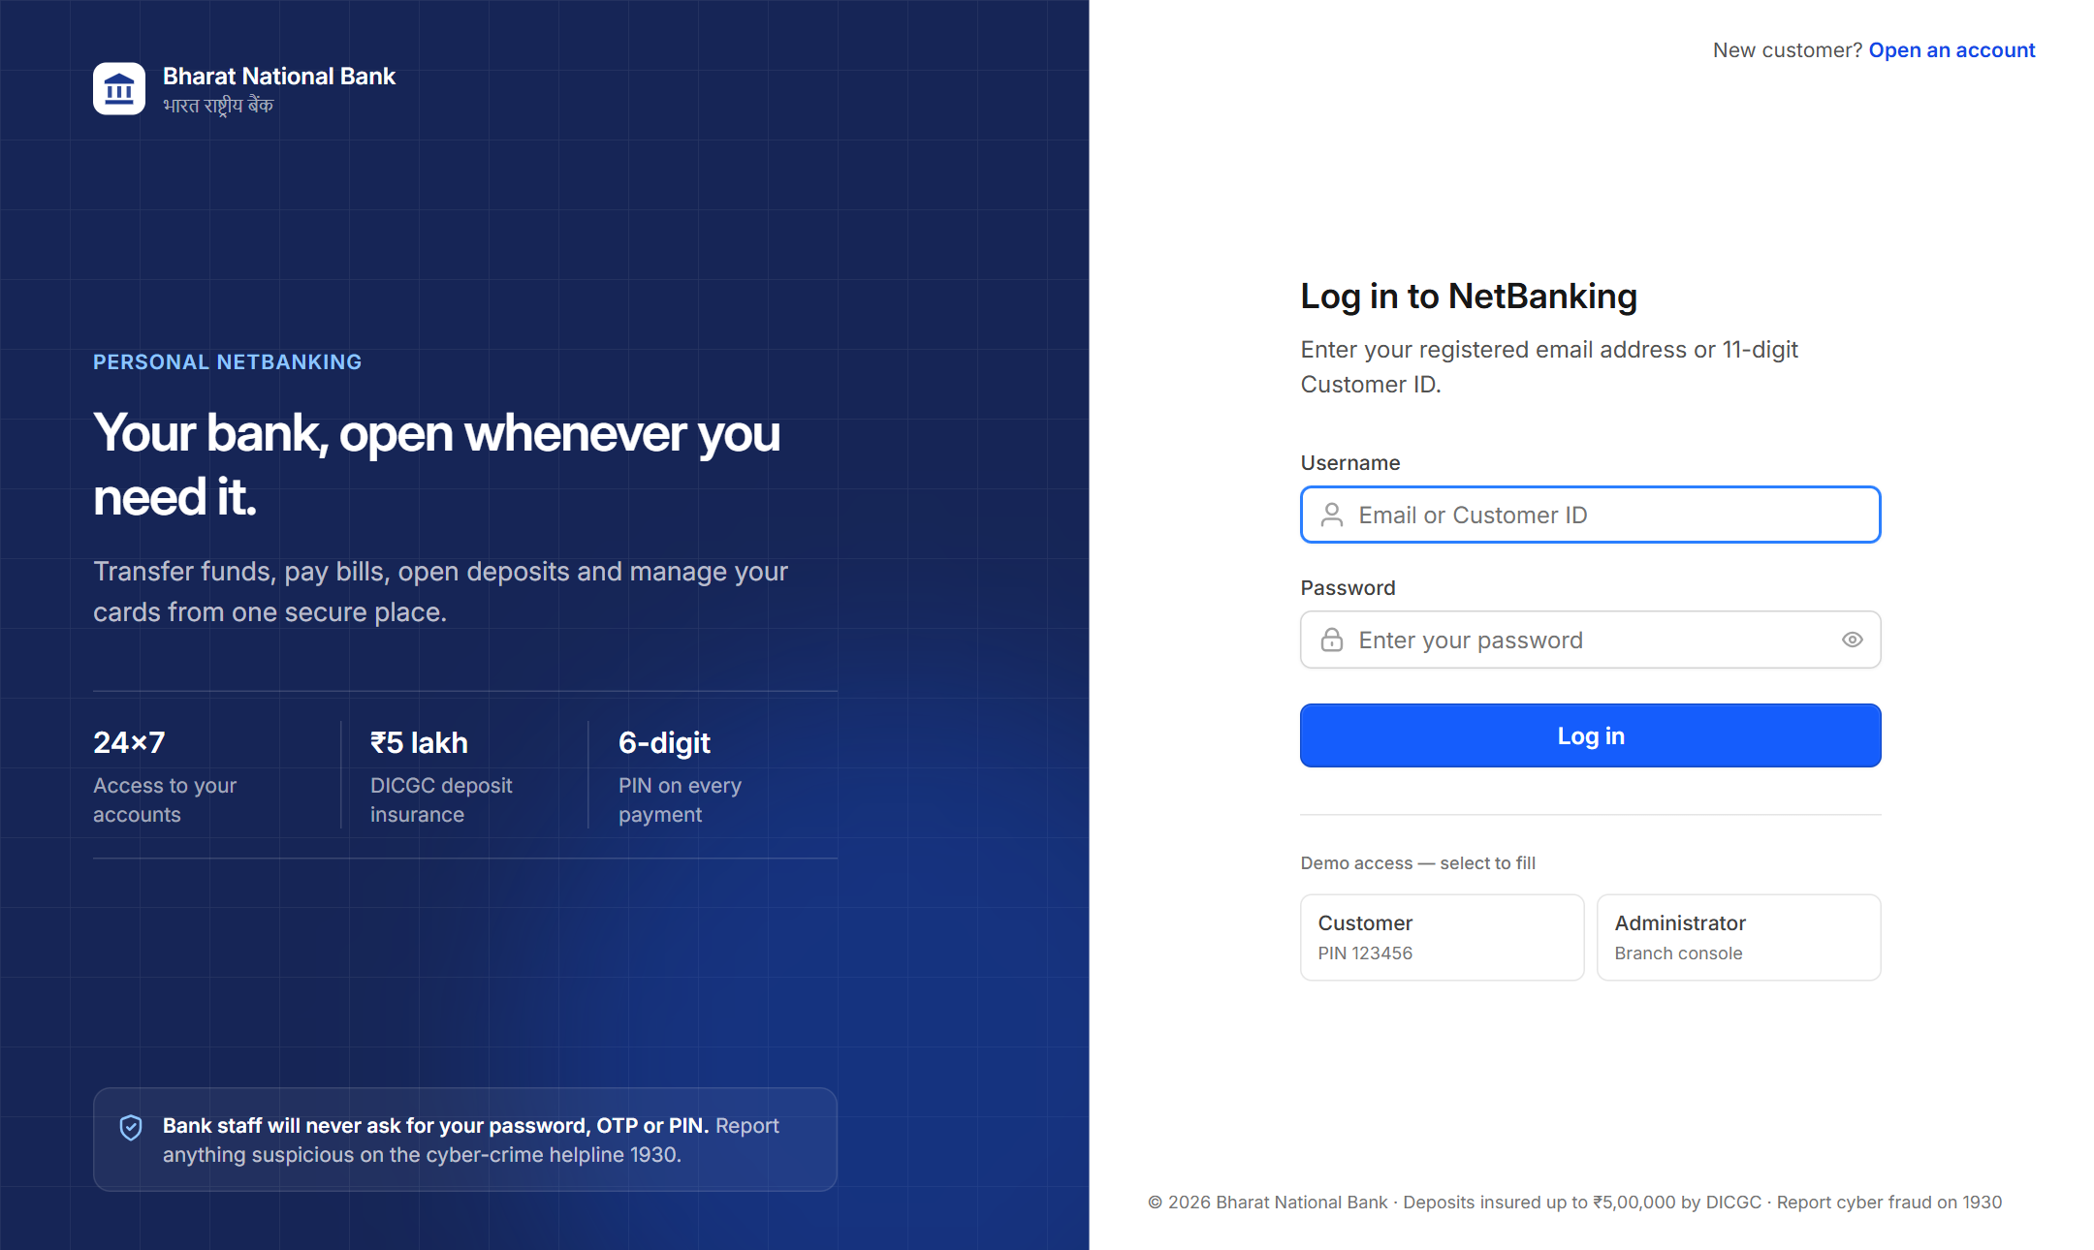
Bharat National Bank
JAVA WEB PROJECT
A secure online banking system built with Java Servlets, JDBC and core Java, with a modern React interface.
Java 17
Spring Boot 3.3
Servlets
JDBC
MySQL
React 19
Customer login page
Presented by Manish
Notes:
Introduce the project: an online banking system for an Indian bank, built in Java. This talk covers the problem, the design, the Java concepts from the rubric, and a tour of the working application.

Slide 2
What this presentation covers
AGENDA
01
Project overview
Problem, objectives, features and technology stack
02
System design
Architecture, database design and request pipelines
03
Core Java concepts
OOP, exception handling, collections, generics, multithreading
04
JDBC & Servlets
DAO classes over JDBC and the servlet-based customer portal
05
Showcase & results
Application screens, security, testing and future scope
Notes:
Five parts. The first two explain what was built and how it is designed; the middle two map directly onto the marking rubric; the last part shows the running system and the results.

Slide 3
Project overview
01
IN THIS SECTION
Problem & objectives
Project at a glance
Features
What problem the system solves and how it is built.
Technology stack

Slide 4




Problem statement & objectives
PROBLEM UNDERSTANDING
Banking is about trust: the system must be correct, private and always available.
The problem
Customers want to check balances, download statements and transfer money any time, without visiting a branch.
Branch staff need one console to onboard customers, manage accounts, approve loans and set limits.
Money must never be lost, even when many requests arrive at once, and no customer may see another's data.
Correct
Private
Atomic transfers with row locks; balances change in one place only
Every query is scoped to the signed-in customer
Who uses it
Secure
Available
Customers
Branch admins
BCrypt passwords and PINs, JWT and session login, account lockout
Web portal and React app on one shared database
Notes:
The problem in one sentence: give customers and staff self-service banking without ever compromising correctness or privacy. The four objectives on the right drive every design decision that follows.

Slide 5
Project at a glance
PROJECT SCOPE
A full-stack system: about 6,400 lines of Java backend and 25 React pages.
55
6
REST API endpoints
Servlets in the portal
11
17
Database tables (JPA entities)
Service classes
3
12
DAO interfaces over JDBC
Automated tests, all passing
Notes:
Some numbers to show the size of the project. The chart shows where the backend code lives: most of the business rules are in the service layer, and the rubric-specific layers (servlets, JDBC DAOs, core model, exceptions) add about 1,500 lines.

Slide 6


Features
SOLUTION OVERVIEW
Two kinds of user, one system.
Customer banking
Branch administration
Accounts & passbook
Savings, Current and Salary; CSV statements
Overview
KPIs, 14-day volume chart, channel mix
Fund transfers
Own accounts, payees, IMPS / NEFT / RTGS, UPI
Customers
Search, onboard, suspend, unlock
Fixed deposits
Rate slabs, maturity preview, early closure
Accounts
Freeze or unfreeze; branch cash deposits
Loans
EMI calculator, apply online, repay and prepay
Ledger
Bank-wide transactions with filters
Debit cards
Block, report lost, channel toggles, limits
Loan approvals
Approve to disburse and charge fees
Bills & recharges
Electricity, mobile, DTH, FASTag and more
Bank settings
Transfer limits, rates, maintenance mode
Service requests
Cheque book, address and nominee changes
Interest run
Monthly savings interest credit
Notes:
Customers get full self-service banking. Branch administrators get a separate console. The servlet portal described later is a third, read-focused interface for customers.

Slide 7
Technology stack
TECHNOLOGY
Standard, well-supported tools at every layer.
Frontend
React 19
TypeScript
Vite
Tailwind CSS 4
Recharts
Why these choices
Web layer
Jakarta Servlets
Spring MVC (REST)
Embedded Tomcat
Servlets + JDBC
Show the Java fundamentals the rubric asks for, with no framework magic.
Spring Boot
Embedded Tomcat and one-command startup for the demo.
React
A modern interface on top of the same Java API.
Security
Spring Security
JWT (jjwt 0.12)
BCrypt
HttpSession
Data access
JDBC
Spring Data JPA
Hibernate
HikariCP pool
Database
MySQL 8
H2 (in-memory, demo)
Core Java
Java 17
Records
java.util.concurrent
Collections
Build & test
Maven
JUnit 5
AssertJ
Spring Boot Test
Notes:
Java 17 and Spring Boot on the backend, with the embedded Tomcat servlet container. Data access uses both raw JDBC (for the rubric) and JPA. MySQL in production; an in-memory H2 database makes the demo run anywhere.

Slide 8
System design
02
IN THIS SECTION
Layered architecture
Database design
Fund-transfer pipeline
How the pieces fit together and how a request flows through them.
Servlet request pipeline
Build & test pipeline

Slide 9
Layered architecture
SOLUTION DESIGN
Two entry points share one database; the outlined path is the plain Servlet + JDBC stack.
CLIENT
PRESENTATION
BUSINESS & DATA ACCESS
DATABASE
Servlet portal /portal/*
HttpServlet, Filter, Listener, HttpSession
DAO layer (jdbc/)
DBConnection, PreparedStatement, ResultSet
MySQL / H2
11 tables + audit log
Browser
HTML pages and the React app
REST API /api/*
Controllers, JWT security filter
Services + JPA
LedgerService, Spring Data repositories
core/ BankAccount hierarchy, interfaces and exceptions, shared by DAOs and servlets
Notes:
Left to right: browser, presentation, business and data access, database. The outlined top path is the classic Java web stack from the rubric. The bottom path serves the React app. Both read and write the same database.

Slide 10
Entity-relationship model
DATABASE DESIGN
Users own accounts; accounts own ledger entries. Every other table hangs off these two.
users
accounts
transactions
PK id
1 : N
PK id
1 : N
PK id
customer_id
FK user_id
FK account_id
email
account_number
reference_id
password_hash
account_type
direction, channel
role, status
balance, status
amount, balance_after
Belongs to a user
Belongs to a user and an account
Belongs to an account
beneficiaries
notifications
fixed_deposits
loans
debit_cards
service_requests
portal_audit_log *
bill_payments
* created and written with plain JDBC; system_settings stands alone
Notes:
Three core tables: users, accounts and transactions, each one-to-many. A transfer between two customers of this bank writes two transaction rows that share a reference id. The audit log table is not a JPA entity; it is created and written with raw JDBC.

Slide 11
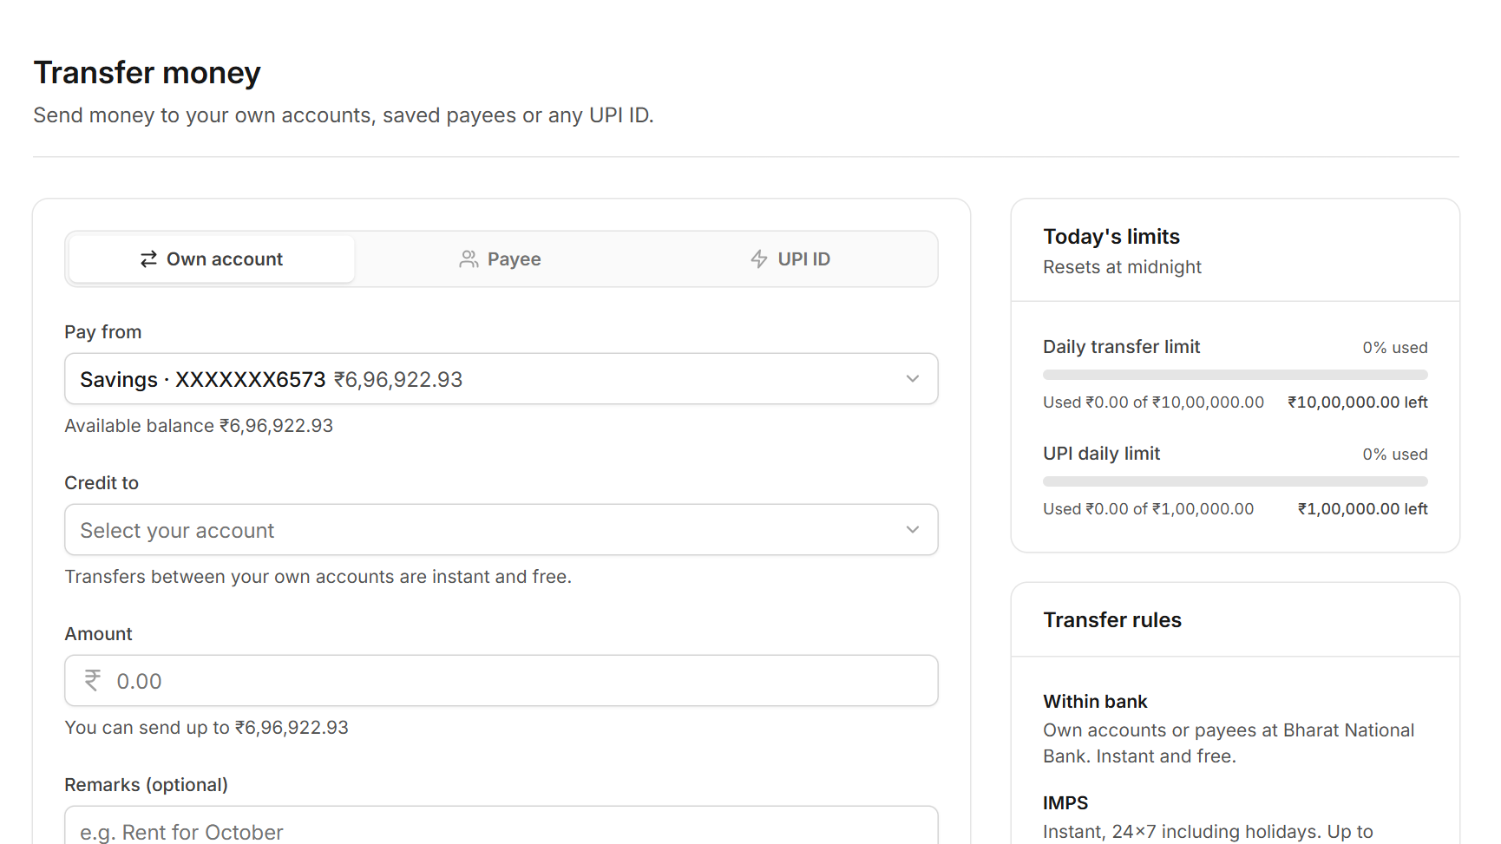

Fund-transfer pipeline
PIPELINE 1
Seven checks and steps run inside one database transaction; any failure rolls the whole transfer back.
Authenticate
Validate
Verify PIN
Check limits
Lock rows
Post ledger
Notify & commit
JWT filter re-reads the user, so a suspended customer is cut off at once
@Valid request DTO with field-level error messages
6-digit transaction PIN checked against its BCrypt hash
Per-channel cap, payee limit, 24-hour cooling, daily and UPI limits
SELECT … FOR UPDATE, always in ascending account-id order
Debit and credit with a shared reference; balance_after recorded
Both parties notified, then @Transactional commits
Transfer screen
(React)
All or nothing
If any step throws, the transaction rolls back: no partial debit, no orphan ledger row. The customer sees a clear JSON error, for example "This exceeds your daily transfer limit."
Notes:
This is the most important flow in the system. Each step can reject the transfer. Locking the two account rows in a fixed order prevents deadlocks between opposite transfers. Because everything runs in one transaction, money is never half-moved.

Slide 12
Servlet request pipeline
PIPELINE 2
What happens between a click in the portal and the HTML page that comes back.
Tomcat
Security chain
Auth filter
doGet()
DAO + JDBC
Html.send()
Embedded container receives GET /portal/report
Spring Security lets /portal/* through to the app
PortalAuthFilter: no session means redirect to login
PortalServlet template: session, errors, audit
PreparedStatement queries scoped to the user
Escaped HTML, no-store cache header
ASYNC LANE (started by doGet() in step 4)
record(event)
request thread returns at once
BlockingQueue
up to 10,000 events
audit-log-writer
background daemon thread
JDBC batch
100 rows, commit / rollback
Result: pages render in milliseconds because the request thread never waits for the audit write, yet every view is still recorded.
Notes:
The synchronous path is the classic servlet pipeline: container, filter, servlet, DAO, response. The template method in PortalServlet also hands an audit event to a queue; a separate thread writes those in batches. That is the producer-consumer pattern in practice.

Slide 13

Build, test & run pipeline
PIPELINE 3
Every build compiles the code, tests it against a real embedded server, and packages the app.
Source
Compile
Unit tests
Integration
Package
Run
Java 17, Maven project, Lombok
javac with annotation processing
BankAccountTest: OOP, exceptions, 8-thread stress test
Real Tomcat on a random port + H2 database
Executable Spring Boot jar
Demo on H2 with sample data; production on MySQL
What every build guarantees
Test results
The code compiles cleanly on Java 17
12 / 12
tests passing
Business rules and thread safety pass the unit tests
6 unit tests and 6 end-to-end tests, run automatically on every build.
Servlets, sessions and JDBC work end to end on a real server
Notes:
The build pipeline: compile, unit tests, integration tests that start the real server, then package. Nothing is packaged unless every test passes.

Slide 14
Core Java concepts
03
IN THIS SECTION
Inheritance & polymorphism
Exception handling
Collections & generics
The object model and concurrency at the heart of the system.
Synchronization
Thread pool & producer-consumer

Slide 15
Inheritance and polymorphism
CORE JAVA | OOP
One abstract account type, three behaviours chosen at runtime.
«interface» InterestBearing
monthlyInterest(), yearlyInterestEstimate()
Same call, different result
BankAccount a = BankAccount.of(type, ...);
a.monthlyInterest(); // ₹1,20,000 at 3%
implements
«abstract» BankAccount
synchronized deposit(), withdraw(), transferTo()
Savings
₹300.00
earns interest
Salary
₹300.00
inherits Savings
SavingsAccount
CurrentAccount
Current
₹0.00
overrides to zero
extends (multi-level)
SalaryAccount
Factory BankAccount.of() picks the subclass
Template method final doGet(), pages override render()
Encapsulation private balance, synchronized access
Notes:
BankAccount is abstract and implements InterestBearing. SalaryAccount extends SavingsAccount: multi-level inheritance. The same monthlyInterest() call returns different values depending on the real object type, which is runtime polymorphism.

Slide 16
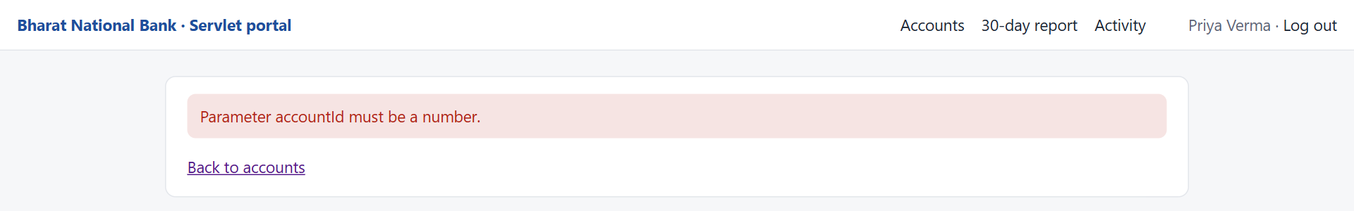
Custom checked exceptions
CORE JAVA | EXCEPTION HANDLING
The compiler forces callers to handle every banking failure.
java.lang.Exception
How each failure reaches the user
400
Bad input, e.g. accountId=abc
IllegalArgumentException
BankingException
checked: callers must handle it
404
Someone else's account
AccountNotFoundException
500
Database error, friendly page
BankingException
InsufficientFunds
Exception
AccountNotFound
Exception
Database
Exception
↺
Failed batch insert
rollback() in the catch block
wraps java.sql.SQLException
Notes:
All banking errors extend one checked exception. DatabaseException wraps SQLException, which is exception chaining. The servlet base class catches each type and maps it to the right HTTP status; try-with-resources closes every JDBC object. The screenshot is the real 400 page.

Slide 17






The right collection for each job
CORE JAVA | COLLECTIONS & GENERICS
Type-safe generics and purpose-built collections, including concurrent ones.
GenericDao<T, ID>
topN(Collection<? extends T>, …)
One generic interface, extended by typed DAOs for accounts and transactions
Generic method with wildcards; a PriorityQueue min-heap keeps the 5 largest transactions
EnumMap<Direction, EnumMap<…>>
BlockingQueue<AuditEvent>
Fast, ordered totals from the SQL GROUP BY, one slot per enum value
Thread-safe hand-off from request threads to the audit writer
ConcurrentHashMap.newKeySet()
LinkedHashMap, TreeSet, unmodifiableList
Worker threads record their names without explicit locking
Spending sorted by amount; read-only results for the servlet
Notes:
Each collection was chosen for a reason: EnumMap for enum keys, PriorityQueue to find the top N without sorting everything, BlockingQueue and ConcurrentHashMap where several threads share data. Generics give type-safe DAOs and reusable helpers.

Slide 18
Safe transfers between threads
CORE JAVA | SYNCHRONIZATION
Fixed lock ordering makes concurrent transfers both correct and deadlock-free.
public void transferTo(BankAccount to,
BigDecimal amount) {
// always lock in account-number order
BankAccount first = compareTo(to) <= 0
? this : to;
BankAccount second = first == this
? to : this;
synchronized (first) {
synchronized (second) {
withdraw(amount); // synchronized
to.deposit(amount); // synchronized
}
}
}
Proved by a stress test
8
threads moving money in both directions at once
16,000
concurrent transfers in one test run
₹0 lost
total balance identical before and after; no deadlock
Notes:
Without synchronization two threads can read the same balance and both write, losing money. Without a fixed lock order, A-to-B and B-to-A transfers can deadlock. The stress test proves both problems are solved.

Slide 19
Thread pool and producer-consumer
CORE JAVA | MULTITHREADING
Two real uses of java.util.concurrent in the running system.
ExecutorService: the 30-day report
ReportServlet
(request thread)
report-worker-1
Savings summary
invokeAll(), merge
sort, top 5, totals
One Callable per account, each with its own JDBC connection; Futures are collected with a 15-second timeout.
report-worker-2
Current summary
Producer-consumer: the audit log
Request threads
record(event)
BlockingQueue
(10,000 events)
audit-log-writer
background thread
Batches of up to 100 rows. flush() uses wait() / notifyAll(); a volatile flag stops the thread cleanly.
Notes:
The report fans out one task per account to a fixed thread pool and merges the results. The audit log is a classic producer-consumer: request threads only enqueue, and one daemon thread drains the queue and writes batches.

Slide 20
JDBC & Servlets
04
IN THIS SECTION
Classes for database operations
JDBC in action
Servlets & URL mappings
Raw JDBC data access and a servlet-based customer portal.
Portal screens
30-day report

Slide 21
Classes for database operations
DATABASE INTEGRATION | JDBC
The DAO pattern keeps SQL in one layer, behind interfaces.
DBConnection
pooled DataSource
AccountDao
interface
JdbcAccountDao
implementation
PreparedStatement
WHERE user_id = ?
ResultSet → object
SavingsAccount, …
conn.setAutoCommit(false);
try (var ps = conn.prepareStatement(SQL)) {
for (AuditEvent e : events) {
ps.setLong(1, e.userId());
...
ps.addBatch();
}
ps.executeBatch();
conn.commit();
} catch (SQLException ex) {
conn.rollback(); // all rows or none
throw ex;
}
3 DAO interfaces + implementations
Accounts, transactions and the audit log
PreparedStatement everywhere
Bound parameters make SQL injection impossible
Aggregates and DDL
SUM … GROUP BY; CREATE TABLE IF NOT EXISTS
Transactions and batches
addBatch / executeBatch, then commit or rollback
Notes:
DBConnection hands out pooled connections. Each DAO is an interface with a JDBC implementation. The code shows the batch insert: auto-commit off, batch, commit, and rollback on failure.

Slide 22
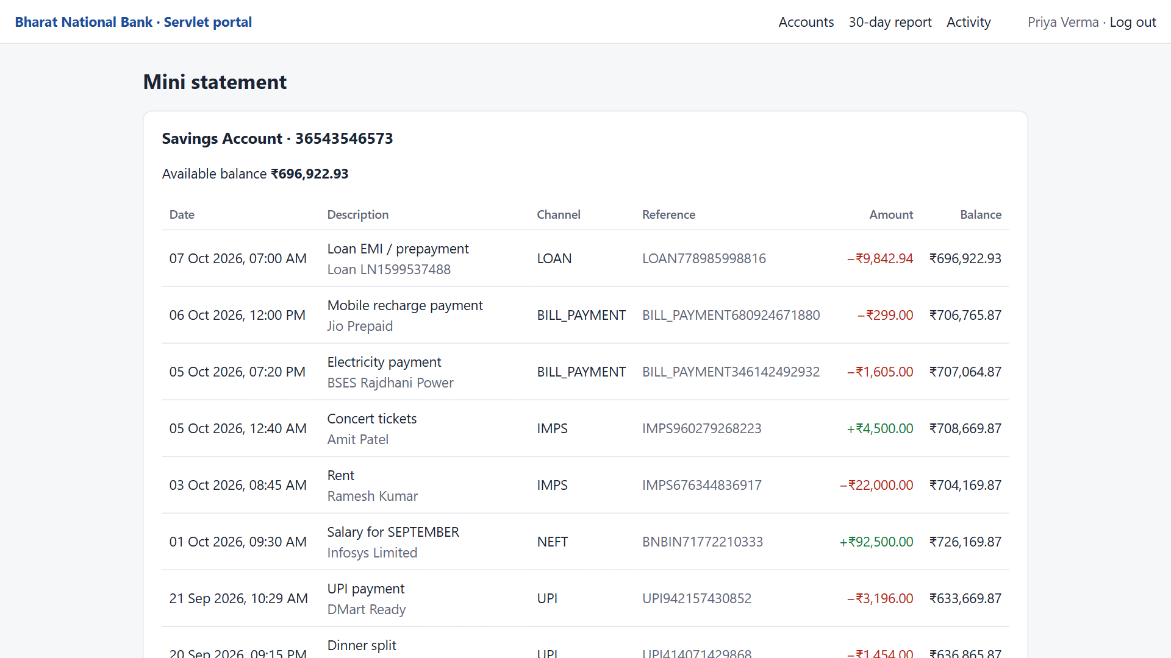


JDBC in action: the mini statement
DATABASE INTEGRATION | JDBC
Every row on this page came through a PreparedStatement in the DAO layer.
Read with JDBC
JdbcTransactionDao.findRecent() returns the latest 25 rows, newest first
Your accounts only
WHERE id = ? AND user_id = ? means another customer's id gives 404
Rows become objects
Each row is mapped to a TransactionRecord and formatted in ₹
Notes:
A live screenshot of the portal. The ownership check is in the SQL itself, so a hand-typed URL with another customer's account id returns 404.

Slide 23



Servlets and URL mappings
SERVLETS & WEB INTEGRATION
Six HttpServlets, one filter and one listener, registered in Java instead of web.xml.
URL | Servlet | What it does
/portal/login | LoginServlet | GET form; POST creates the HttpSession
/portal/logout | LogoutServlet | POST invalidates the session
/portal/accounts | AccountsServlet | Accounts with polymorphic interest
/portal/statement | StatementServlet | Mini statement for ?accountId=
/portal/report | ReportServlet | 30-day report on worker threads
/portal/activity | ActivityServlet | Audit log read back over JDBC
PortalAuthFilter
Redirects to login when there is no session
Lifecycle listener
ServletContextListener + HttpSessionListener count live sessions
Session security
New session at login, 15-minute timeout, HttpOnly and SameSite cookie
PortalWebConfig
Template method: PortalServlet.doGet() is final and handles session, errors and auditing; each page only implements render().
Registers servlets, filter and listener, like web.xml
Notes:
The six servlets and their URLs. Every page servlet extends the abstract PortalServlet, so session handling, error pages and auditing are written once.

Slide 24
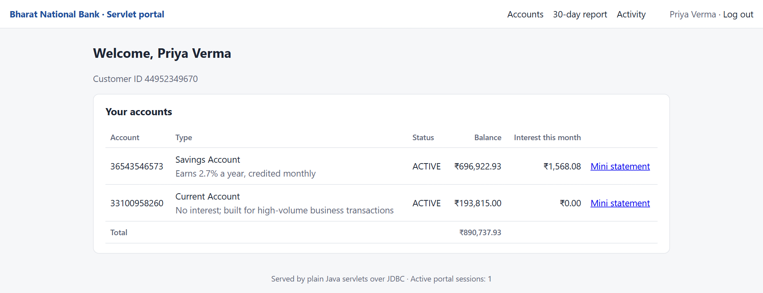
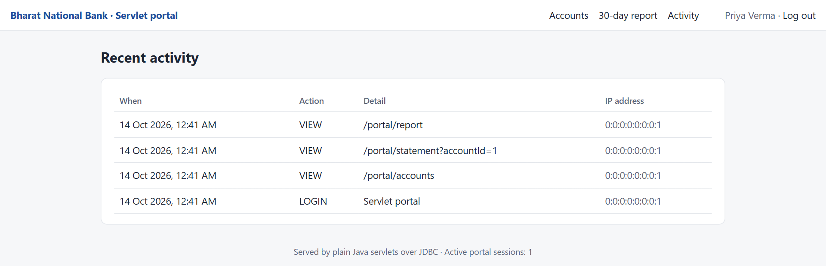
The servlet portal in action
SERVLETS | LIVE SCREENS
Real pages served by plain Java servlets over JDBC.
Accounts: product name and interest come from each subclass
Activity: written by the background thread in JDBC batches
DEMO PATH
1
Sign in
2
Accounts
3
Mini statement
4
30-day report
5
Activity
session created
polymorphism
JDBC reads
thread pool
producer-consumer
Notes:
For the live demo: sign in as priya.v@example.com, open accounts, a mini statement, the report and finally the activity page, which lists every page just visited.

Slide 25
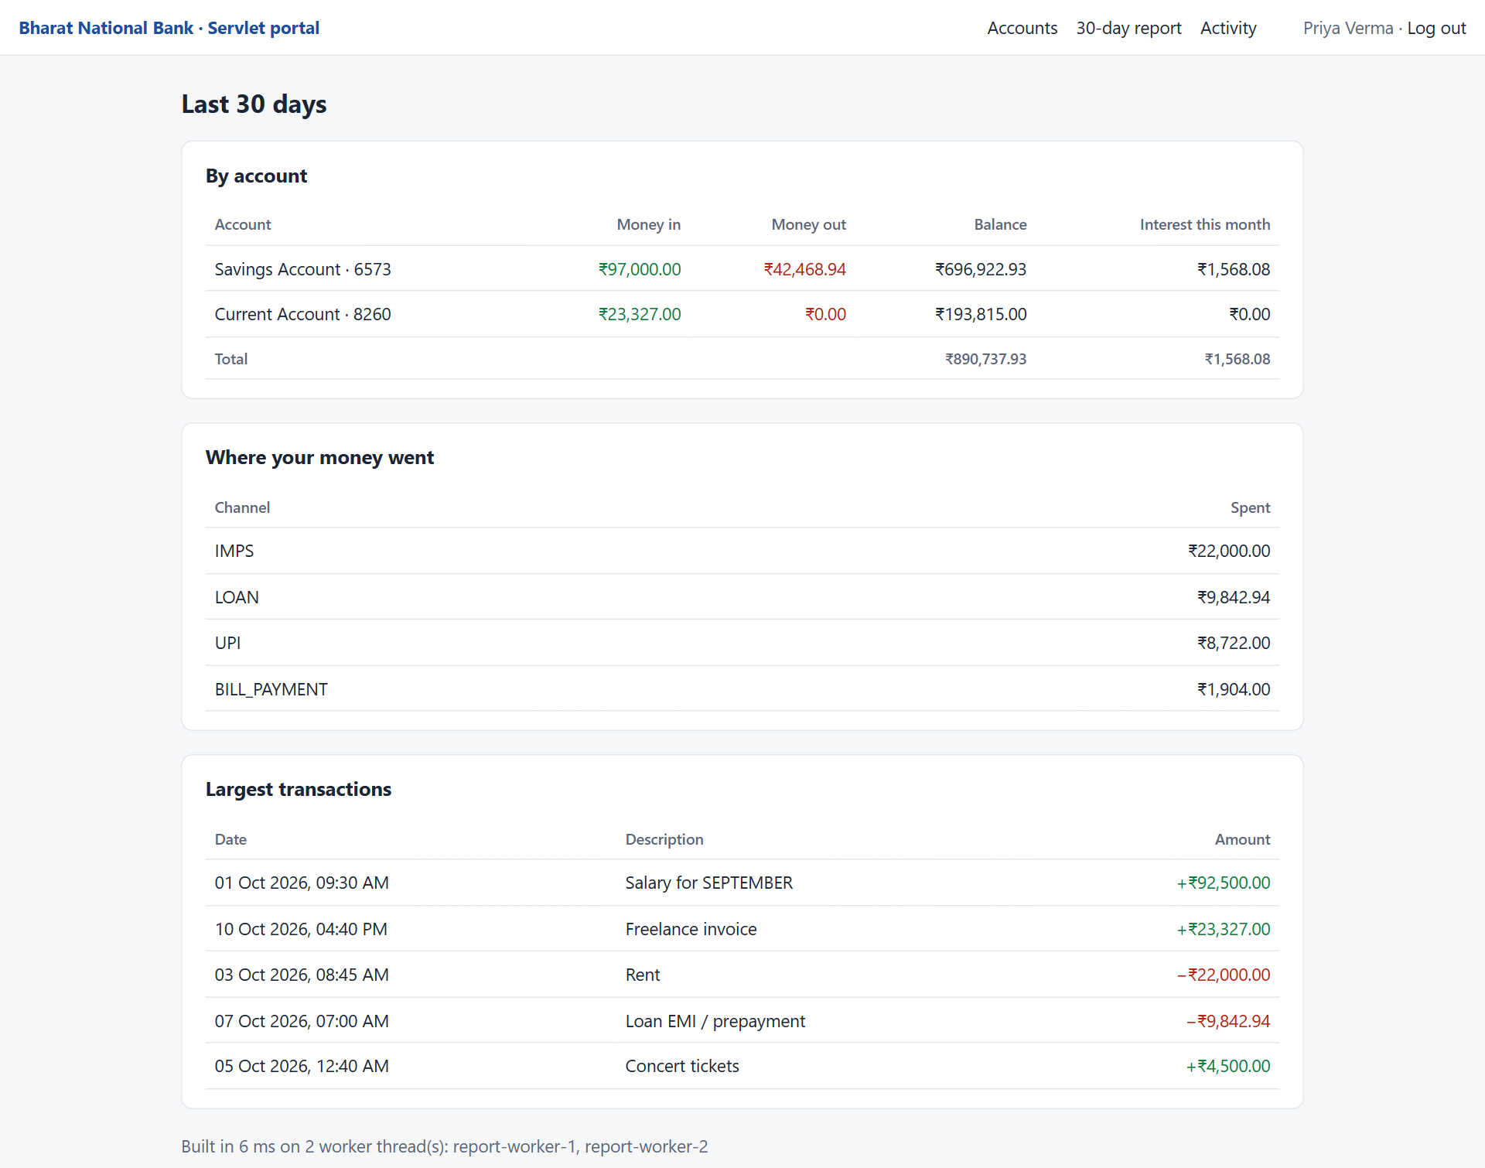
30-day report, built in parallel
SERVLETS | LIVE SCREENS
Each account is summarised on its own worker thread, then merged into one report.
How it is built
JDBC GROUP BY totals per account, computed on report-worker threads, merged with EnumMap.merge() and ranked with a PriorityQueue.
Notes:
The report page shows money in and out per account, spending by channel and the five largest transactions. The chart repeats the channel totals that the SQL GROUP BY returned.

Slide 26
Showcase & results
05
IN THIS SECTION
Customer dashboard
Customer features
Admin console
The complete application, its security and how it was verified.
Security
Testing, challenges & future scope

Slide 27
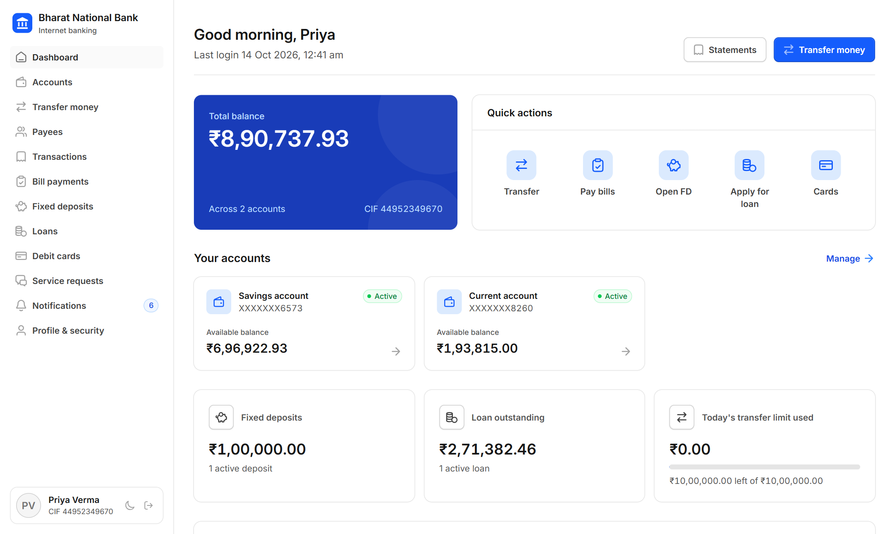
Customer dashboard
APPLICATION | CUSTOMER
Everything a customer needs at a glance, backed by the same Java API.
Live data: balances, the 6-month money flow, deposits, loans and today's transfer limit, all from one /api/dashboard call.
Notes:
The React dashboard. The chart on the right uses the same monthly money-in and money-out figures the dashboard API returns for this customer.

Slide 28
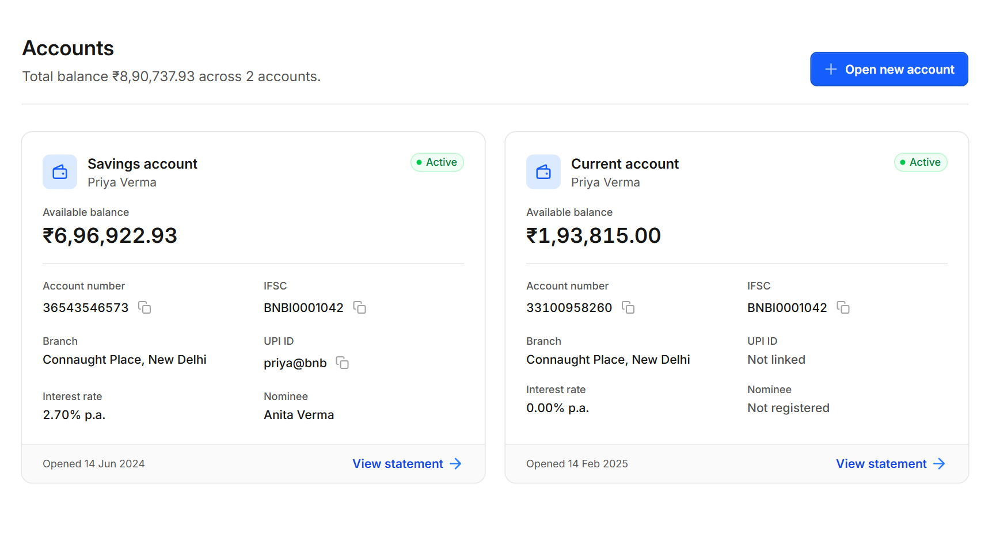
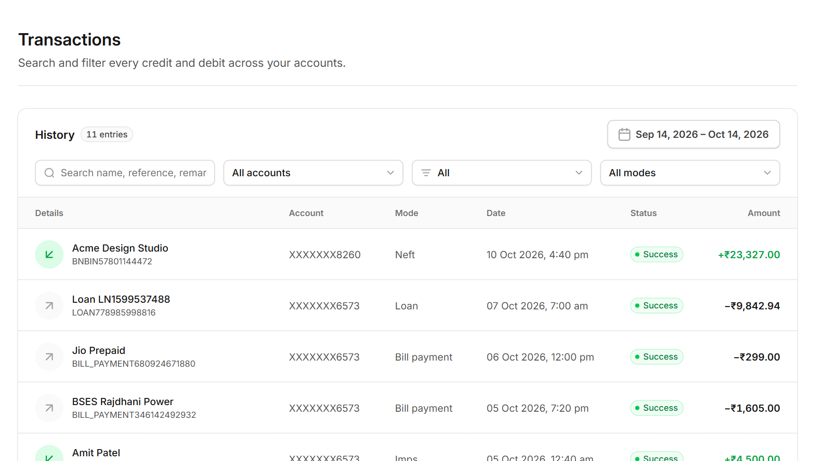
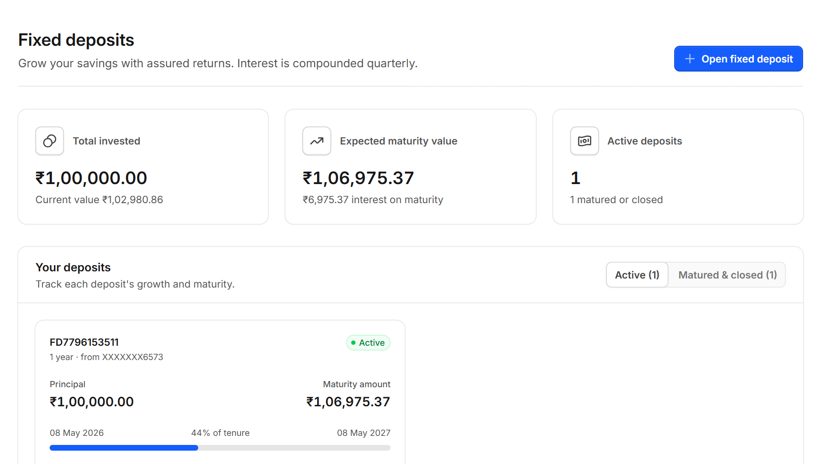
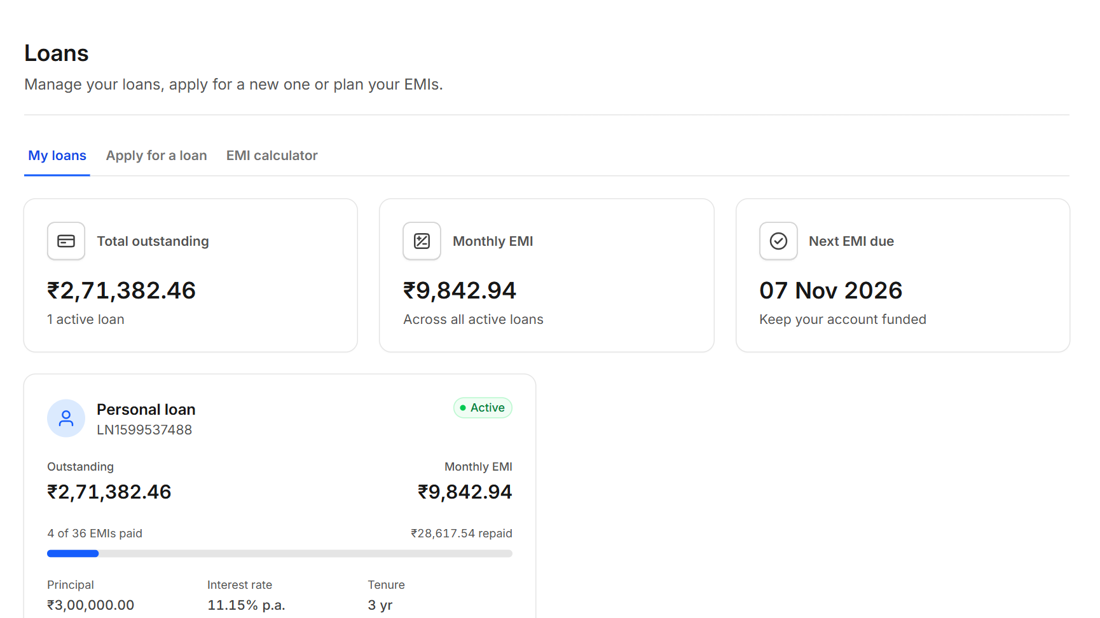
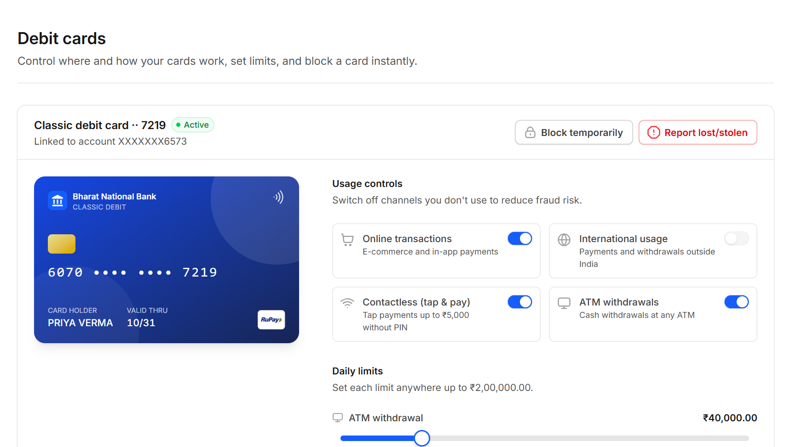
Customer features
APPLICATION | CUSTOMER
Real screens from the running application.
Accounts
Transfer money
Transactions
Fixed deposits
Loans
Debit cards
Notes:
Six of the customer screens: accounts with IFSC and UPI details, transfers with live limits, a searchable passbook, fixed deposits with maturity tracking, loans with EMI progress, and debit-card controls.

Slide 29
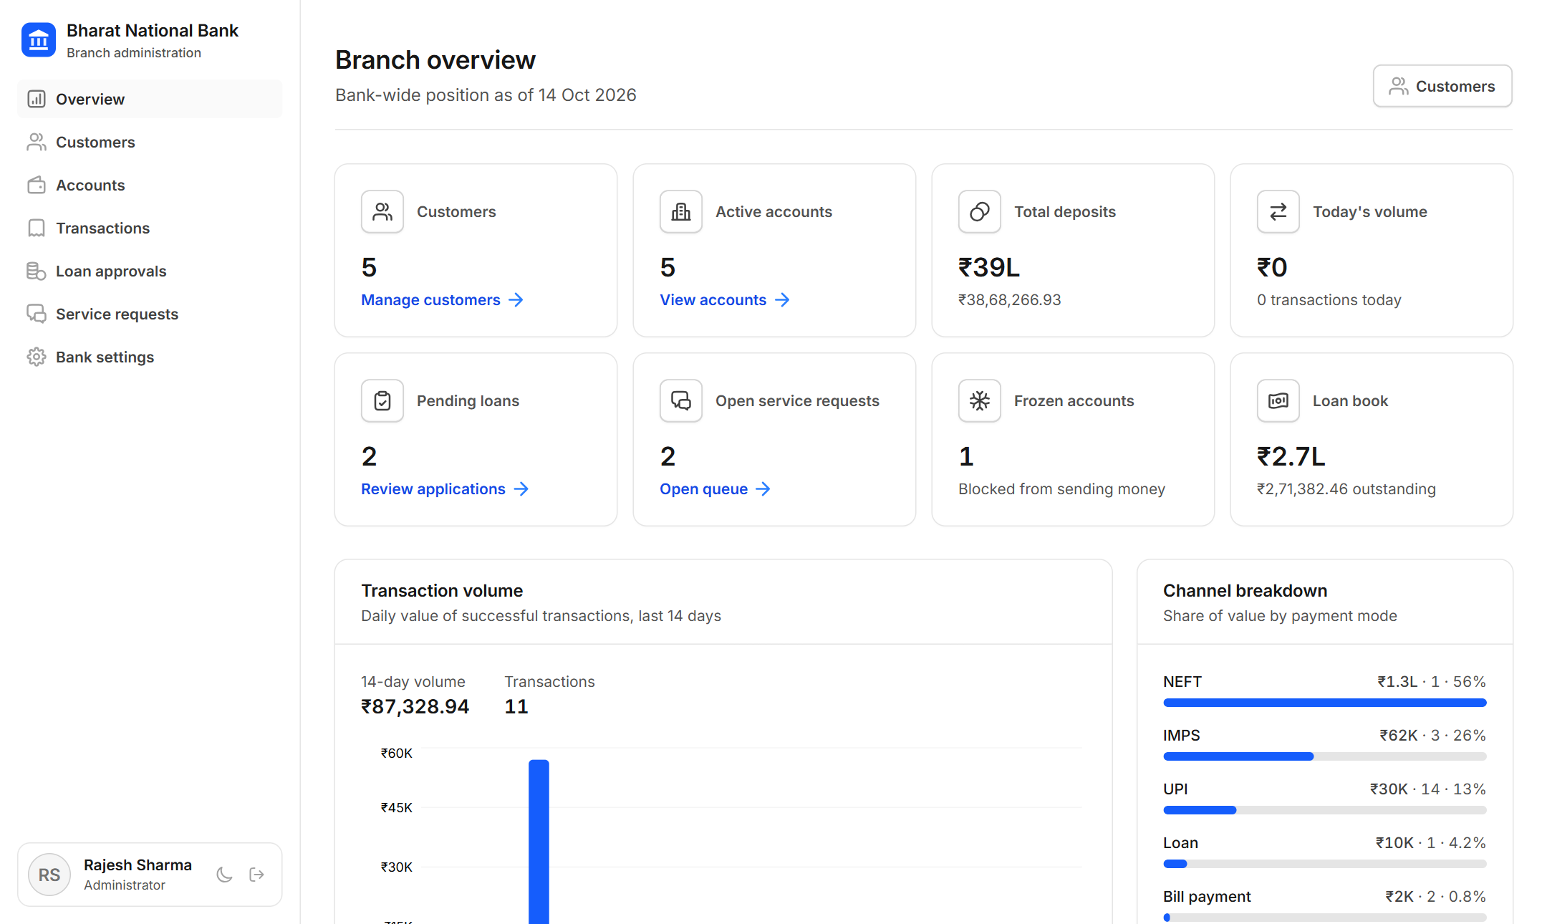
Admin console
APPLICATION | BRANCH ADMIN
Bank-wide KPIs and charts for branch staff.
Notes:
The branch overview: customers, deposits, pending loans, frozen accounts and the loan book. The two charts use the same data as the admin metrics API: share of value by payment channel, and daily transaction value.

Slide 30
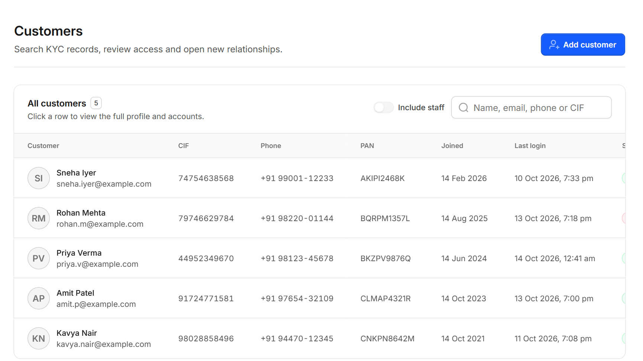
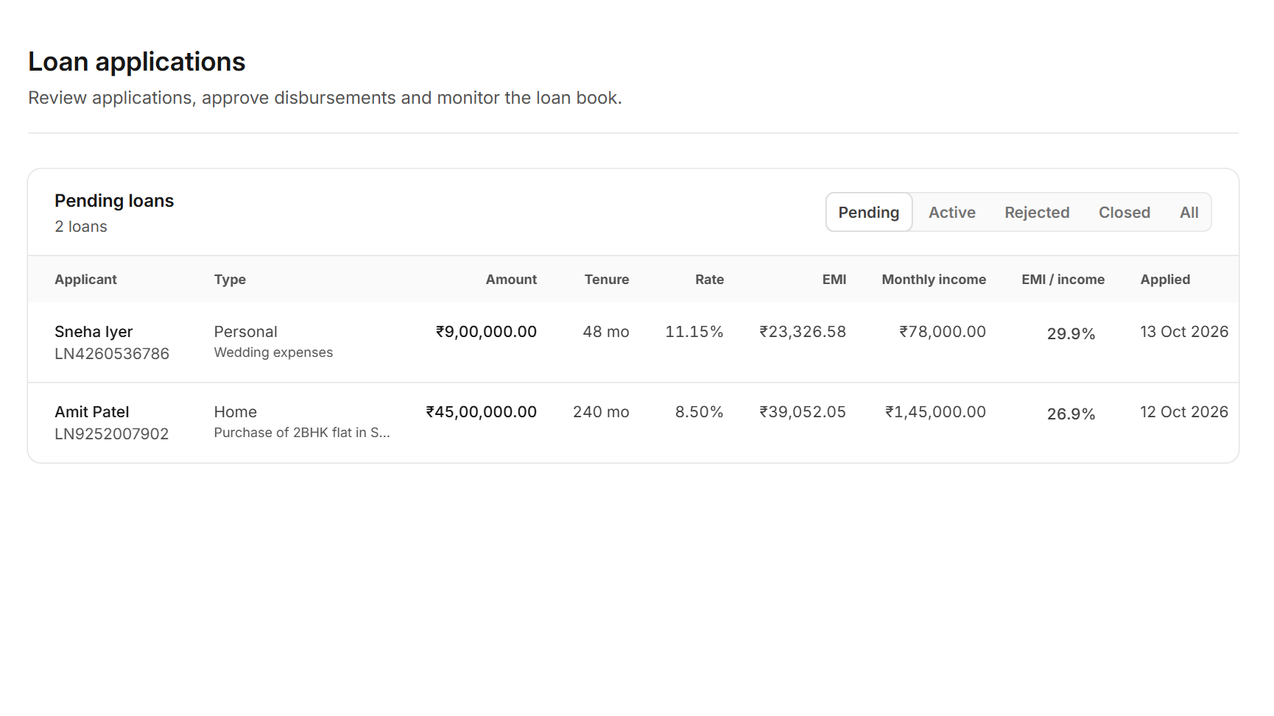
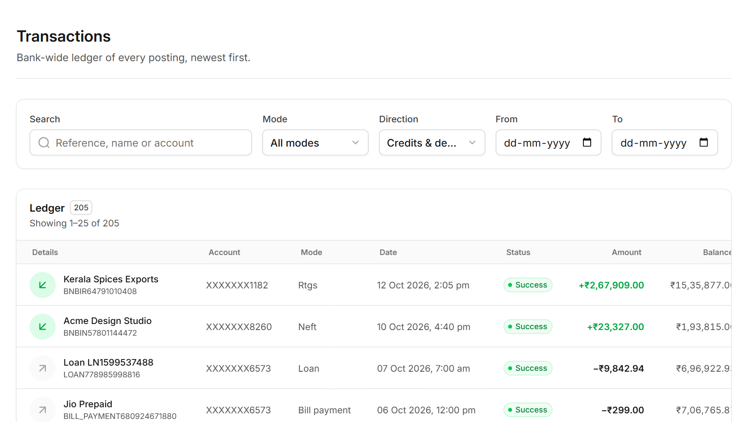
Admin workflows
APPLICATION | BRANCH ADMIN
Staff can manage customers, approve loans and audit every transaction.
Customers
Loan approvals
Bank-wide ledger
Search by name, CIF or PAN; onboard, suspend or unlock
Approve to disburse the loan and charge the processing fee
Every posting, filterable by mode, direction and date
Role-based access: every /api/admin/** endpoint requires ROLE_ADMIN, and the servlet portal turns admins away, so customers and staff never share screens.
Notes:
Three admin workflows. Access is enforced on the server, not just hidden in the UI.

Slide 31






Security built in
SECURITY
Defence in depth, from passwords to SQL to HTML output.
BCrypt hashing
JWT + sessions
Account lockout
Role-based access
Passwords and 6-digit PINs are never stored in plain text
Stateless tokens for the API, HttpSession for the portal
Locked after repeated failed logins; admin unlock
ROLE_ADMIN required for /api/admin/**
SQL injection safe
XSS safe output
Secure cookies
Transfer limits
PreparedStatement and owner-scoped queries
Html.esc() escapes every dynamic value
HttpOnly and SameSite=Lax session cookie
Daily, UPI and per-channel caps; 24-hour payee cooling
Notes:
Security is layered: credentials are hashed, sessions are protected, every query is parameterised and scoped to the owner, and every value written to HTML is escaped.

Slide 32


Verified by automated tests
TESTING & RESULTS
Unit tests for the Java model and end-to-end tests against a real server.
12 / 12
16,000
0
tests passing
concurrent transfers in the stress test
deadlocks or lost rupees
BankAccountTest (unit)
ServletPortalIntegrationTest (end-to-end)
Factory builds the right subclass; interest is polymorphic
Overdraft, bad amount and frozen account throw exceptions
A failed transfer leaves both balances unchanged
8-thread stress test: total conserved, no deadlock
Starts the real server on H2 with demo data
Login, logout and redirect when not signed in
400 for bad input, 404 for another customer's account
DAOs, audit batch and threaded report all checked
Notes:
The end-to-end test starts the actual server on a random port and drives the servlets over HTTP with a cookie-aware client.

Slide 33





Challenges & future scope
LEARNINGS
What was hard, how it was solved, and where the project can go next.
Challenges and solutions
Future scope
Concurrent transfers could overdraw or deadlock
Row locks and synchronized blocks taken in a fixed order
OTP two-factor login
Email and SMS alerts
Audit logging slowed down every page
Producer-consumer queue with batched JDBC inserts
Docker deployment
Customers guessing other account ids
Ownership check inside the SQL WHERE clause
CI pipeline on every push
Demo needed to run without MySQL
dev profile with in-memory H2 and seeded data
Spending insights with ML
Notes:
Four real problems met while building the project and how each was solved. The future-scope items are natural next steps for a production bank.

Slide 34
Thank you
CONCLUSION
Core Java
Abstract classes, interfaces, polymorphism, checked exceptions, generics
Questions and live demo
Concurrency
Deadlock-free synchronized transfers, thread pool, producer-consumer
JDBC + Servlets
DAO pattern over PreparedStatement; filter, listener and session portal
Notes:
Summarise the three takeaways, then invite questions. Offer a live demo if there is time.

