Slide 1
An Ensemble ML Approach for
Predicting Diabetic Hospital Readmission
RF Feature Selection
Stacking Ensemble
SHAP Explainability
Diwash Adhikari
Faculty of Science & Engineering
Herald College Kathmandu | University of Wolverhampton
np03cs4a230177@heraldcollege.edu.np | University ID: 2407736 | L6CG1
UCI Diabetes 130-US Hospitals Dataset · 101,766 records · 50 features
Diwash Adhikari | Herald College Kathmandu / University of Wolverhampton | 1 / 9

Slide 2
Problem & Motivation
$26B
537M
<65%
Annual cost of diabetic
readmissions in the US
Adults globally living
with diabetes (2021)
Best ML accuracy ever
achieved on this dataset
Why Is This Hard?
Our Approach
3-class overlap: >30 and <30 days share identical features
Low feature-to-label mutual information in dataset
Many published pipelines introduce data leakage (SMOTE before split)
Clinicians need interpretability, not just a prediction
Binary classification: NO = 0 vs Readmitted = 1
Leakage-free pipeline: split first, then feature selection
4-model stacking ensemble (RF + XGBoost + LightGBM + CatBoost)
SHAP explainability for clinical interpretability
Diwash Adhikari | Herald College Kathmandu / University of Wolverhampton | 2 / 9

Slide 3
Dataset Understanding
Feature | Explanation
total_visits | Total hospital visits (inpatient + outpatient + emergency)
inpatient_ratio | Proportion of visits that were inpatient admissions
admission_source_id | Where patient came from (ER, referral, transfer, etc.)
number_diagnoses | Number of diagnoses recorded during encounter
num_medications | Total medications prescribed during stay
num_procedures | Number of procedures performed
age | Patient age group
number_inpatient | Prior inpatient visits in past year
insulin | Insulin dosage change during stay
payer_code | Patient's insurance/payment type
diag_1 | Primary diagnosis category (ICD-9 grouped)
discharge_disposition_id | Where patient was discharged to (home, SNF, AMA, etc.)
num_lab_procedures | Number of lab tests performed
admission_type_id | Type of admission (emergency, elective, urgent)
diag_2 | Secondary diagnosis category
time_in_hospital | Length of hospital stay (days)
procedure_intensity | Engineered: procedures per day of stay
lab_intensity | Engineered: lab tests per day of stay
metformin | Metformin dosage change during stay
diag_3 | Tertiary diagnosis category
Diwash Adhikari | Herald College Kathmandu / University of Wolverhampton | 2 / 9

Slide 4
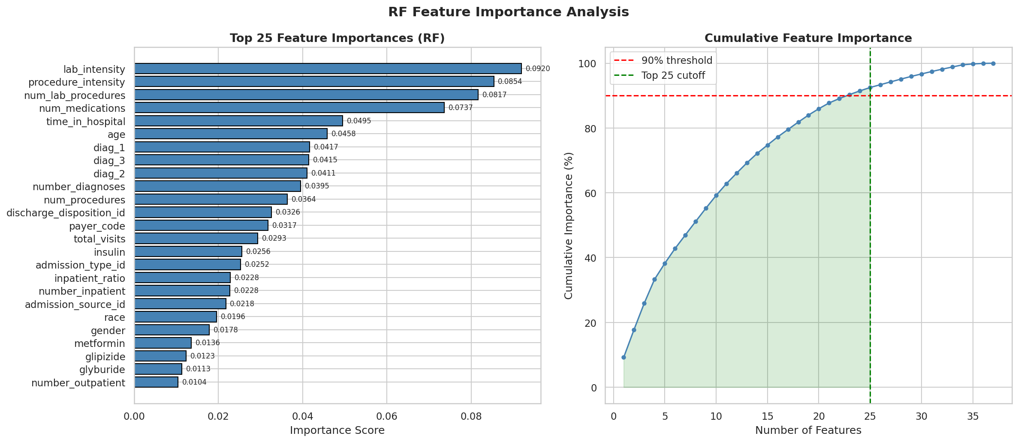
Preprocessing Pipeline
1
2
3
4
5
Domain Drop
Preprocessing
Binary Encoding
70/30 Split
RF Importance
Remove IDs,
high-missing cols,
expired patients
Age midpoints,
ICD-9 grouping,
4 engineered features
NO = 0
>30 or <30 = 1
46%/54% balanced
Stratified split
before feature
selection
Top 15 features
fitted on
train only
›
›
›
›
RF Top-15 Feature Importances (fitted on training data only — no leakage)
Diwash Adhikari | Herald College Kathmandu / University of Wolverhampton | 3 / 9

Slide 5
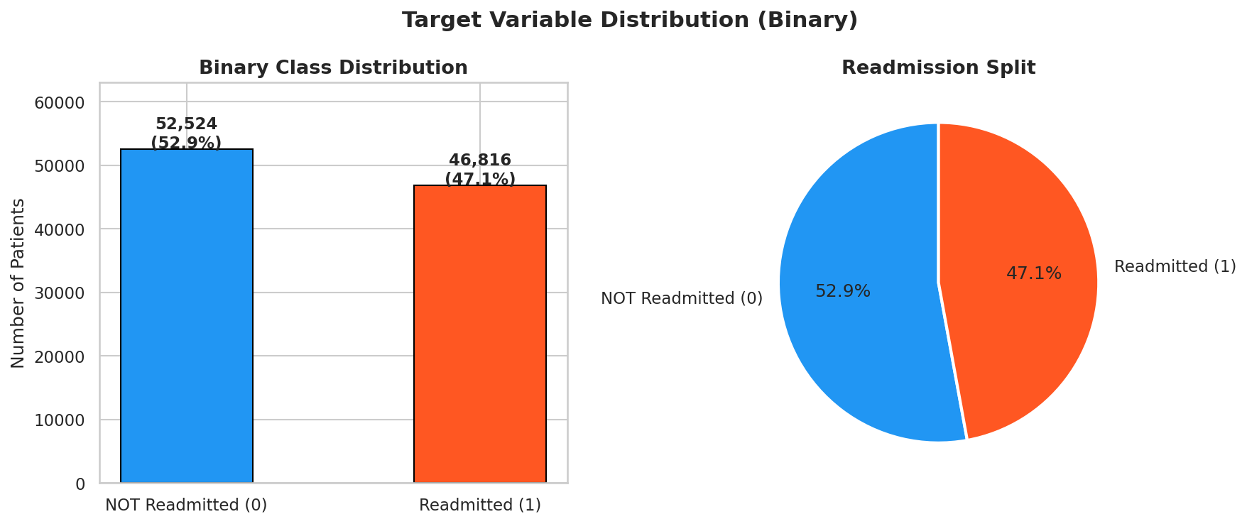
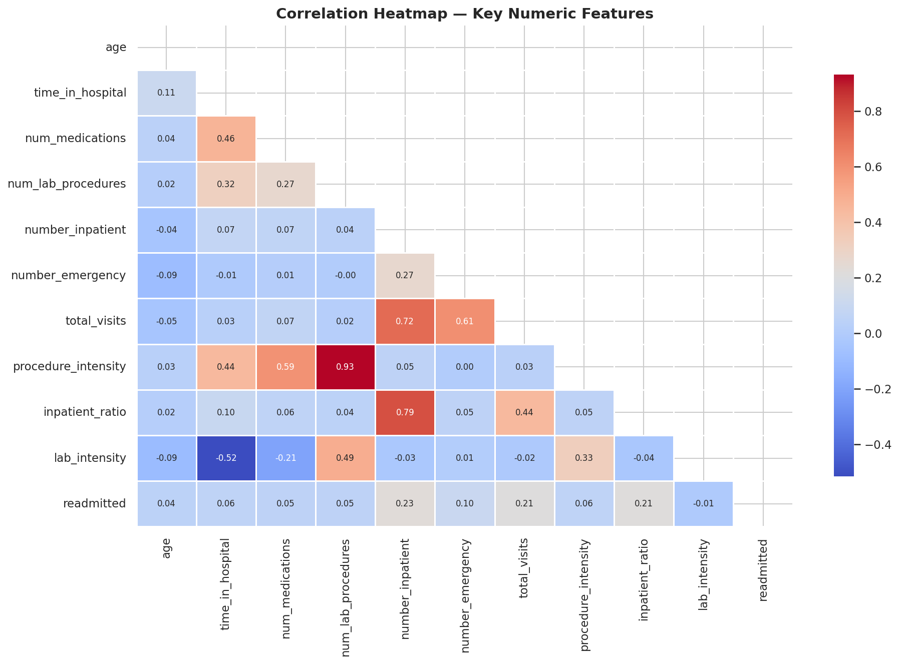
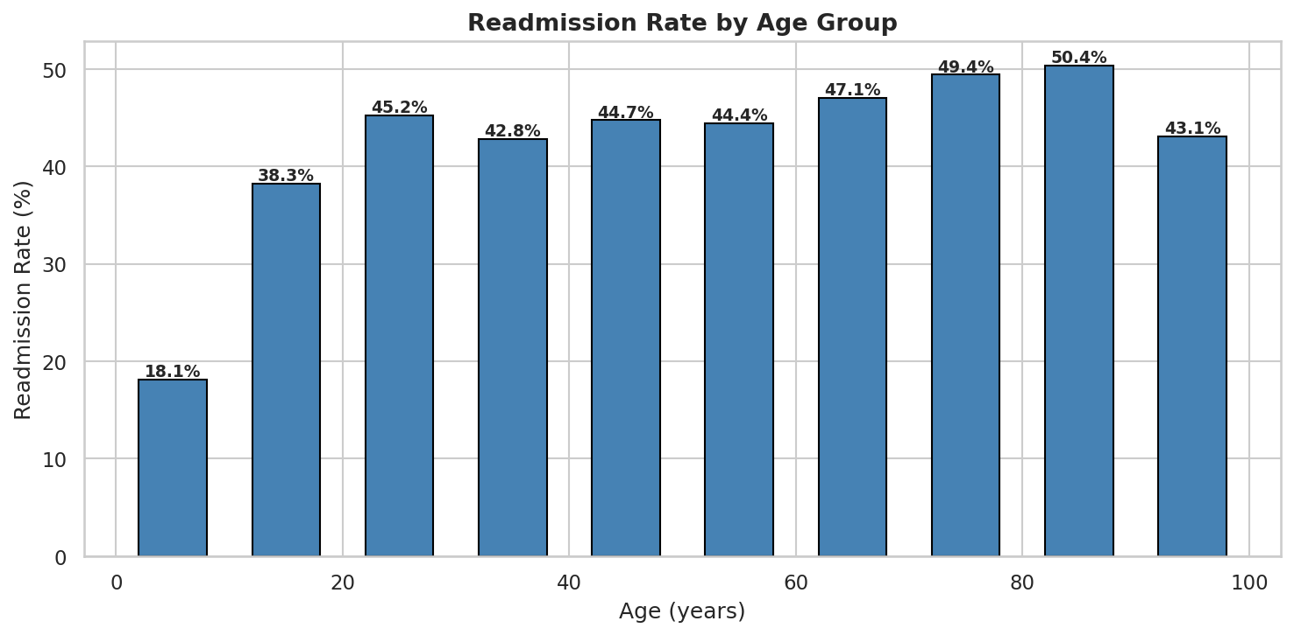
Data Visualisation — EDA Findings
Class Distribution
Correlation Heatmap
Age vs Readmission
Near-balanced (46%/54%) — no SMOTE needed
number_inpatient has highest correlation with readmission (r=0.21)
Patients aged 60–80 show highest readmission rates
Diwash Adhikari | Herald College Kathmandu / University of Wolverhampton | 4 / 9

Slide 6
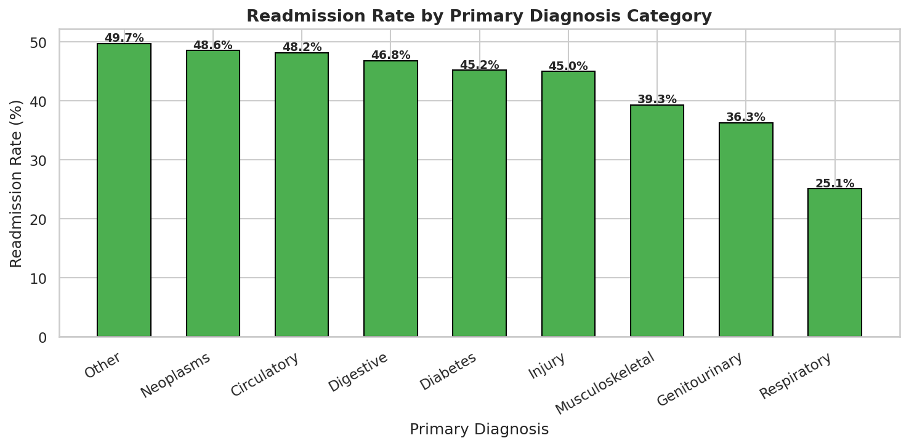
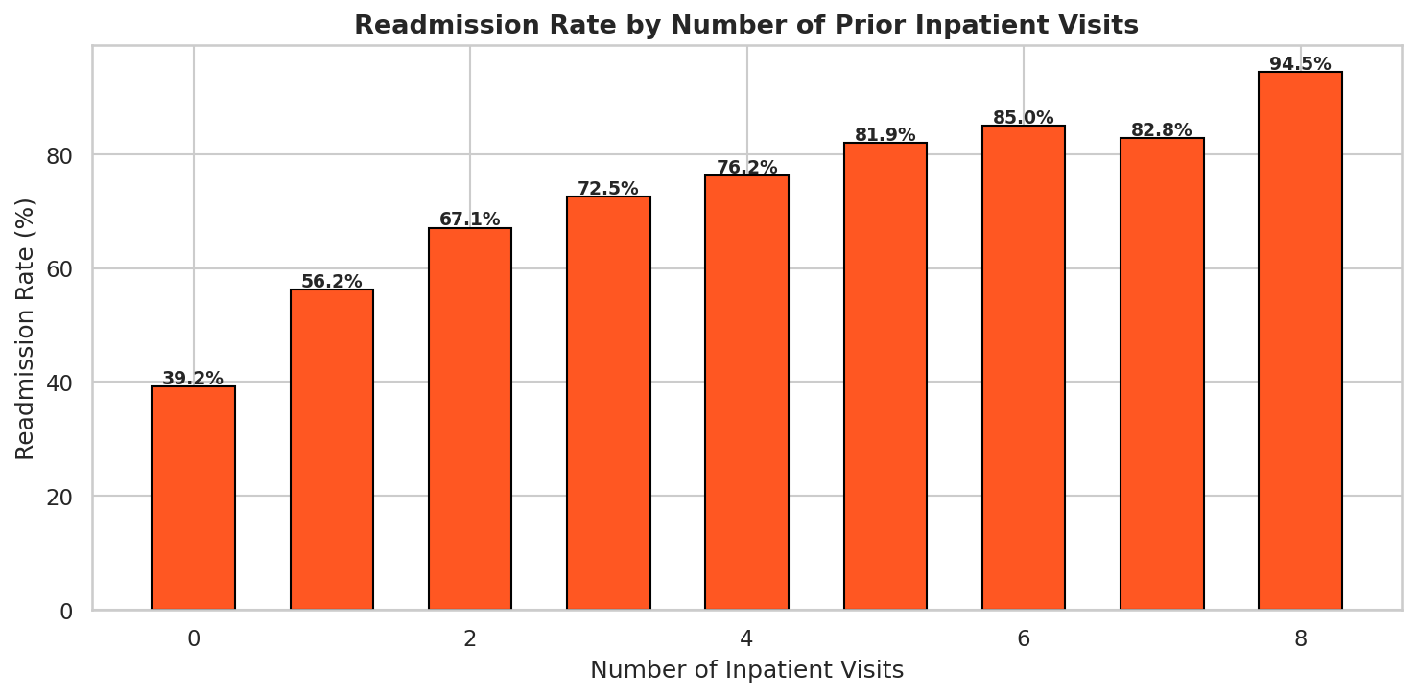
Data Visualisation — Clinical Insights
Readmission Rate by Diagnosis
Prior Inpatient Visits vs Readmission
Diabetes and Circulatory diagnoses show highest readmission rates
Most dominant predictor — confirmed by SHAP analysis
Diwash Adhikari | Herald College Kathmandu / University of Wolverhampton | 5 / 9

Slide 7
Proposed Stacking Ensemble Architecture
Base Learners
Why This Stack?
Random Forest
XGBoost
LightGBM
CatBoost
RF captures bagged feature interactions
XGBoost — sequential boosting, L1/L2 reg
LightGBM — leaf-wise growth, fastest
CatBoost — ordered boosting, best AUC
passthrough=True: meta sees raw features + base probs
Not previously applied to this dataset
300 trees
max_depth=20
500 est.
lr=0.03
num_leaves=127
early stopping
depth=8
early stopping
cv=5 · passthrough=True · out-of-fold predictions
Meta-learner: XGBoost (200 estimators, lr=0.05, max_depth=4)
Final Prediction: NOT Readmitted (0) | Readmitted (1)
Diwash Adhikari | Herald College Kathmandu / University of Wolverhampton | 6 / 9

Slide 8
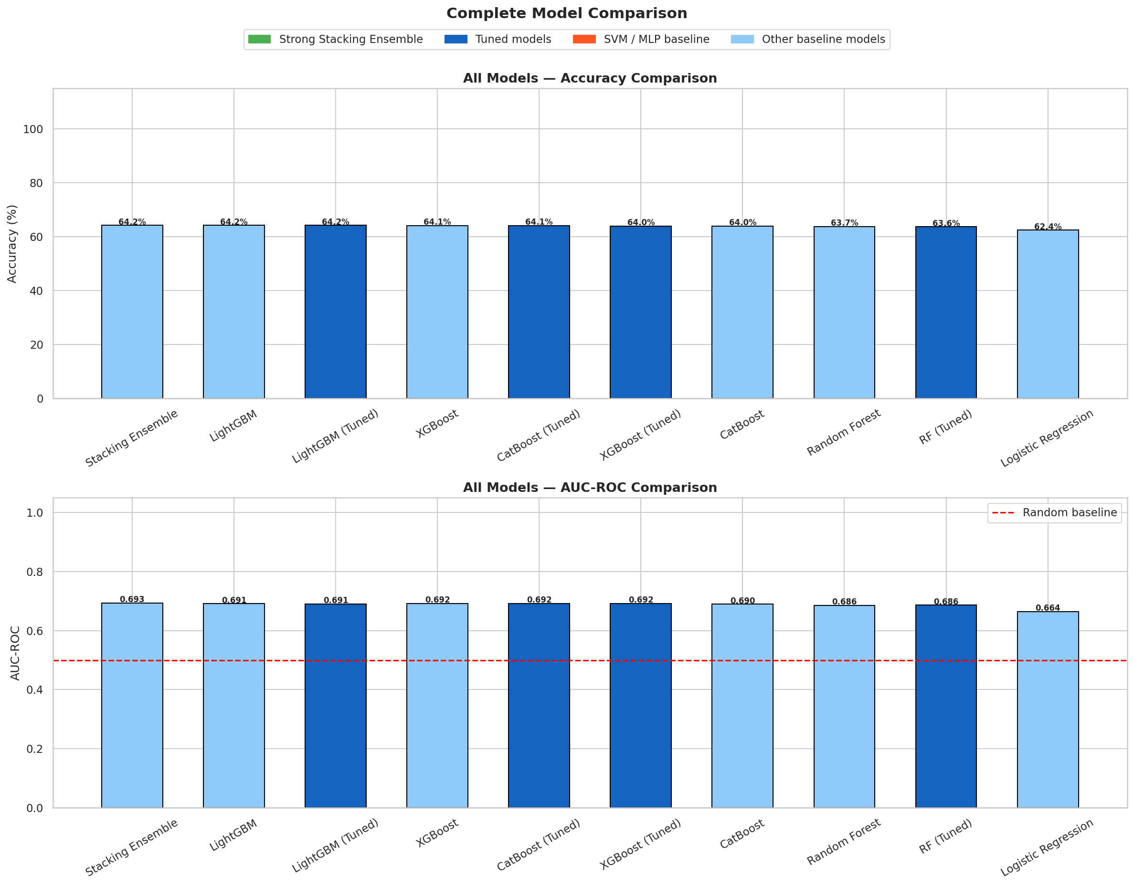
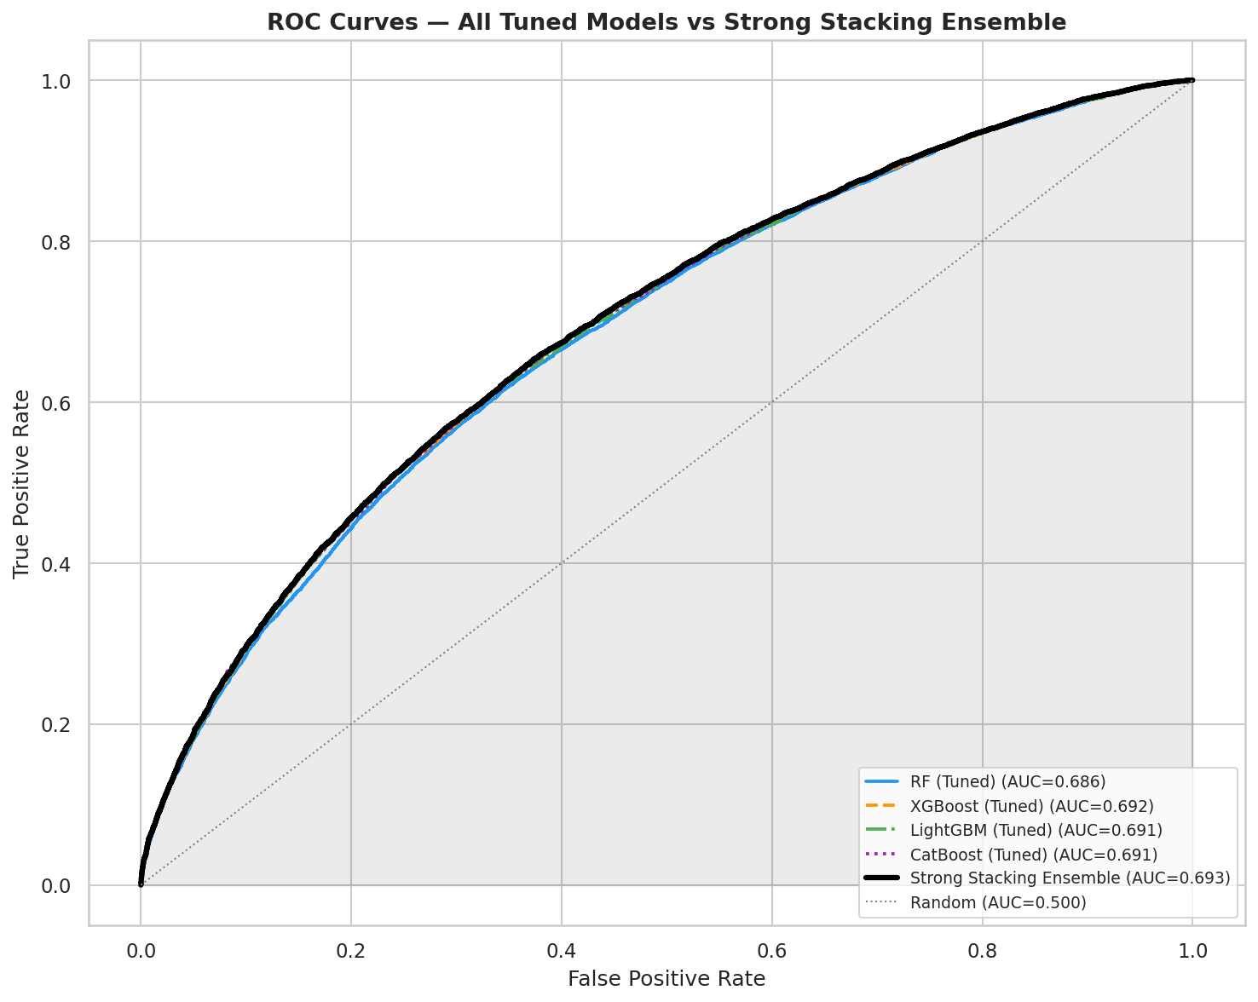
Model Results & Comparison
64.21%
0.703
+0.01
4-model
Stacking Ensemble
Accuracy
Ensemble AUC-ROC
(best in pipeline)
Gain over best
single model
Novel stack — no paper
has done this before
Diwash Adhikari | Herald College Kathmandu / University of Wolverhampton | 7 / 9

Slide 9
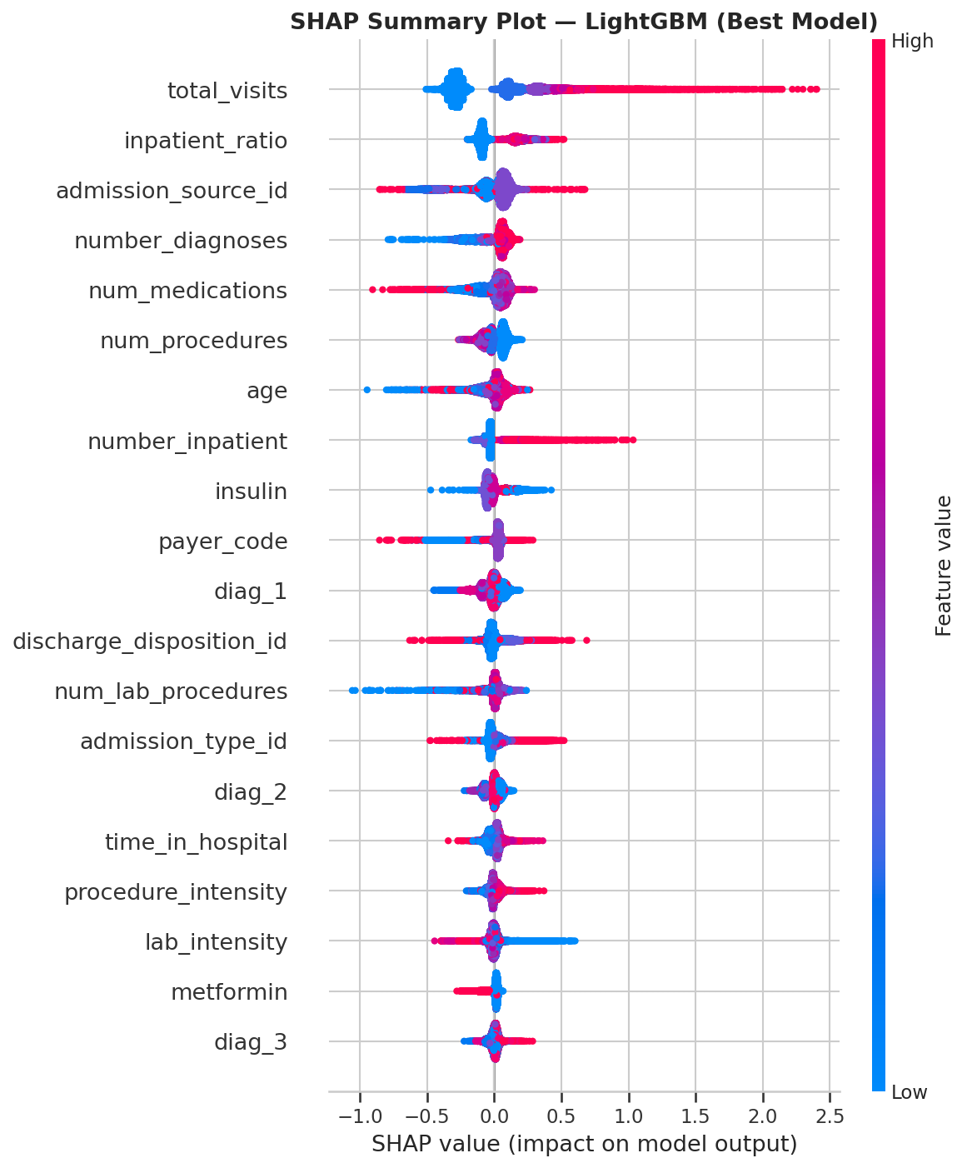
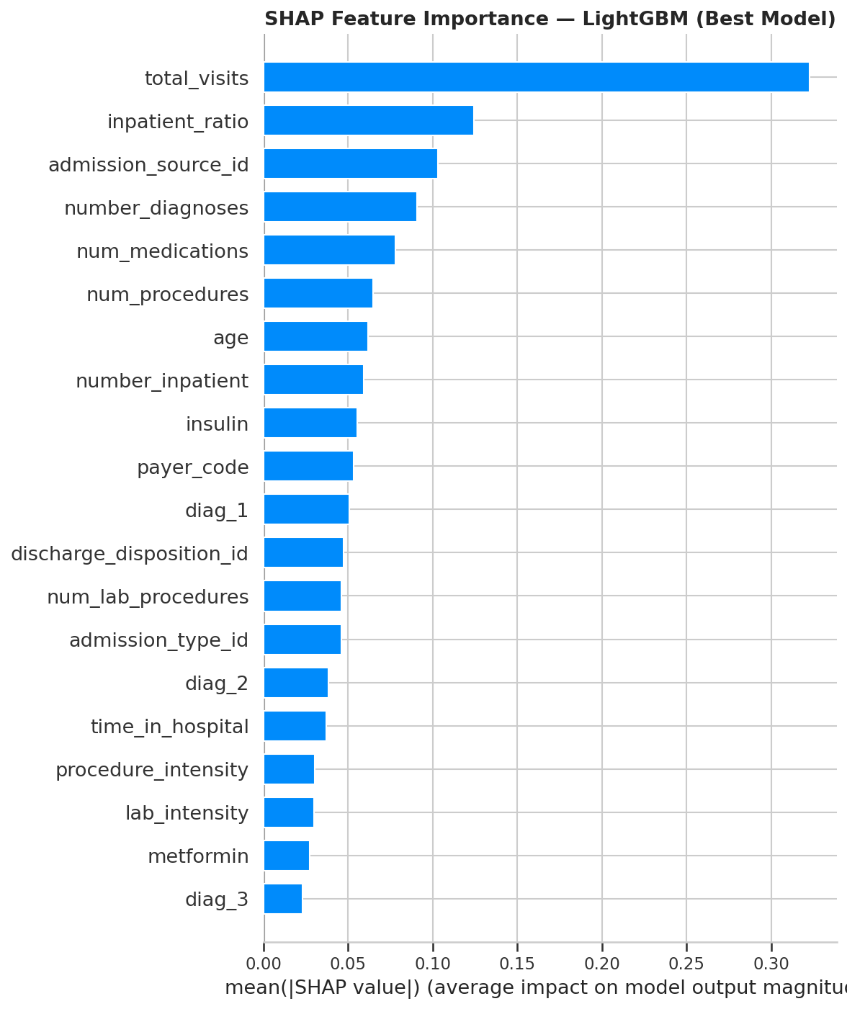
SHAP Explainability Analysis
SHAP Summary Plot (CatBoost)
SHAP Bar Chart — Mean |SHAP| per Feature
#1 number_inpatient
Prior hospitalisation is the dominant clinical risk factor
#2 discharge_disposition_id
Where patient was discharged strongly predicts return
#3 time_in_hospital
Longer stays correlate with higher readmission risk
Diwash Adhikari | Herald College Kathmandu / University of Wolverhampton | 8 / 9

Slide 10
Comparison, Challenges & Conclusion
vs Published ML-Only Papers
Challenges & Limitations
Study | Best Model | Acc. | AUC
Emi-Johnson 2025 | XGBoost | — | 0.667
Gandra 2024 | CatBoost | 0.642 | 0.700
Liu et al. 2024 | RF+GWO | — | —
Binary ML 2020 | RF | 0.630 | —
Ours (Stacking) | 4-model Stack | 0.6421 | 0.703
Dataset ceiling: All ML-only models plateau at 62–64.2% accuracy due to low feature-to-label mutual information
No temporal modelling: single-visit features miss longitudinal patterns (LSTM achieves ~81%)
Hypertuning time: RandomizedSearchCV on 80k rows takes 30+ minutes on CPU
Label encoding limitation: ordinal encoding of categorical medical features introduces false relationships
Conclusion: The proposed 4-model stacking ensemble (RF + XGBoost + LightGBM + CatBoost → XGBoost meta) achieves 64.21% accuracy and AUC 0.703 — matching the best comparable ML-only published result (Gandra 2024: 64.2%, AUC 0.70) while adding SHAP explainability absent from all 8 compared works. Future work: LSTM temporal modelling, HbA1c features, federated learning.
Diwash Adhikari | Herald College Kathmandu / University of Wolverhampton | 9 / 9

