Slide 1
A PRESENTATION ON PROPOSED
BEANT COLLEGE OF ENGINEERING AND TECHNOLOGY , GURDASPUR
HUMAN FOLLOWING ROBOT
Under the guidance of
DR. Ajay Kumar
By:
Dixant Dutt (1702075)
Viren Kaushal(1702094)
At
Department Of Electronics and Communication Engineering

Slide 2
OUTLINE OF PRESENTATION
INTRODUCTION
LITERATURE SURVEY
BLOCK DIAGRAM
DESCRIPTION OF BLOCKS
CIRCUIT DIAGRAM
DESCRIPTION OF COMPONENTS
METHODOLOGY

Slide 3
INTRODUCTION
Robotic technology has increased appreciably in past couple of years. Such innovations were only a dream for some people a couple of years back. But in this rapid moving world, now there is a need of robot such as “A Human Following Robot” that can interact and co-exist with them. The development of robot technology had increased significantly due to industrial and military applications. Most robots were used in industrial and military use but intelligent robots for general daily use is yet to be implemented. Human Following Robot is one of the applications that could be implemented under robot technology. Because of its human following capability, Human Following Robots can work as assistants for humans in various situations and it can also acquire or monitor certain information associated with the human subject. Possible application scenarios include assistance for elderly people and general service robots for shopping centres,hospitals and public areas. A key requirement for service robots is the ability to detect humans and to interact them.

Slide 4
LITERATURE SURVEY
We saw a various projects from YouTube and various other platforms but we saw a HUMAN FOLLOWING ROBOT as a unique concept basically the robots used in today world are working through Wi-Fi ,Bluetooth or through Internet .Which means, these are easy to hack and we saw that our Human Following Robot works with its sensors and connections which states that it is non-hackable . There is no remote which can control that, if we Off the switch or break the connection then only it stop working.
By adding only few things like trolly, platform and we can use the robot in our day to day life as shopping cart or as human following bag.

Slide 5
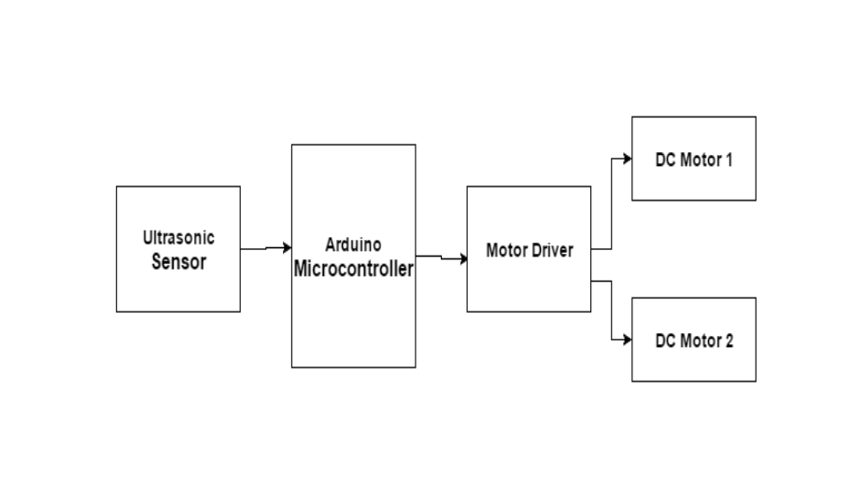
BLOCK DIAGRAM

Slide 6
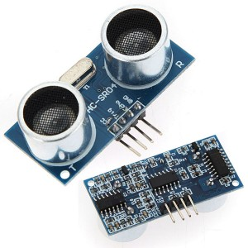
DESCRIPTION OF BLOCKS
ULTRASONIC SENSOR
Ultrasonic sensors work by sending out a sound wave at a frequency above the range of human hearing. The transducer of the sensor acts as a microphone to receive and send the ultrasonic sound. Our ultrasonic sensors, like many others, use a single transducer to send a pulse and to receive the echo. The sensor determines the distance to a target by measuring time lapses between the sending and receiving of the ultrasonic pulse.
Here, We will use ultrasonic Sensor-HCSR04.Some of its features are-
• Frequency is 44KHz
• Speed of Sound waves is 340m/s
• Distance can be calculated as Speed x Time / 2

Slide 7
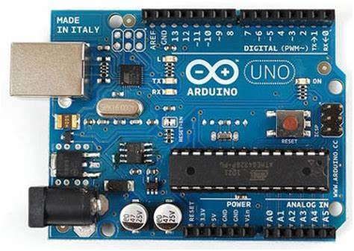
ARDUINO MICROCONTROLLER
It is the brain of our project. It can give all the command to their sub ordinate components which should by operated by the human behaviour. And it also give feedback to the other components and human. So that it can be the used as a medium of communication between human and robots & vice versa.
Here, We will use ATmega328P microcontroller. Some of its features are-
• 8-bit microcontroller
• 8KB ROM
• 256 bytes RAM
• 3 timers
• 32 I/O pins
• 1 serial port
• 8 interrupt sources

Slide 8
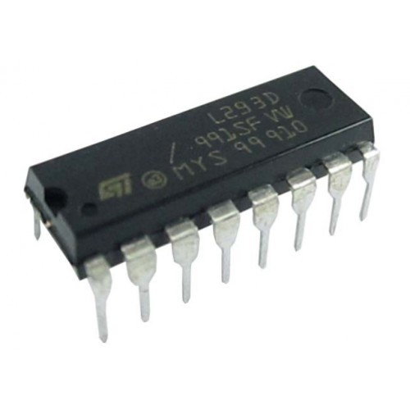
Motor Driver IC
Here Motor Driver Board is designed to Work with L293D IC. Some of its features are-
This can control 2 DC Motors, their direction using control lines and their speed using PWM.
Speed and Direction control is possible
Motor voltage Vcc2 (Vs): 4.5V to 36V
Maximum Peak motor current: 1.2A
Maximum Continuous Motor Current: 600mA
Supply Voltage to Vcc1(vss): 4.5V to 7V
Transition time: 300ns (at 5Vand 24V)
Automatic Thermal shutdown is available
Available in 16-pin DIP, TSSOP, SOIC packages

Slide 9
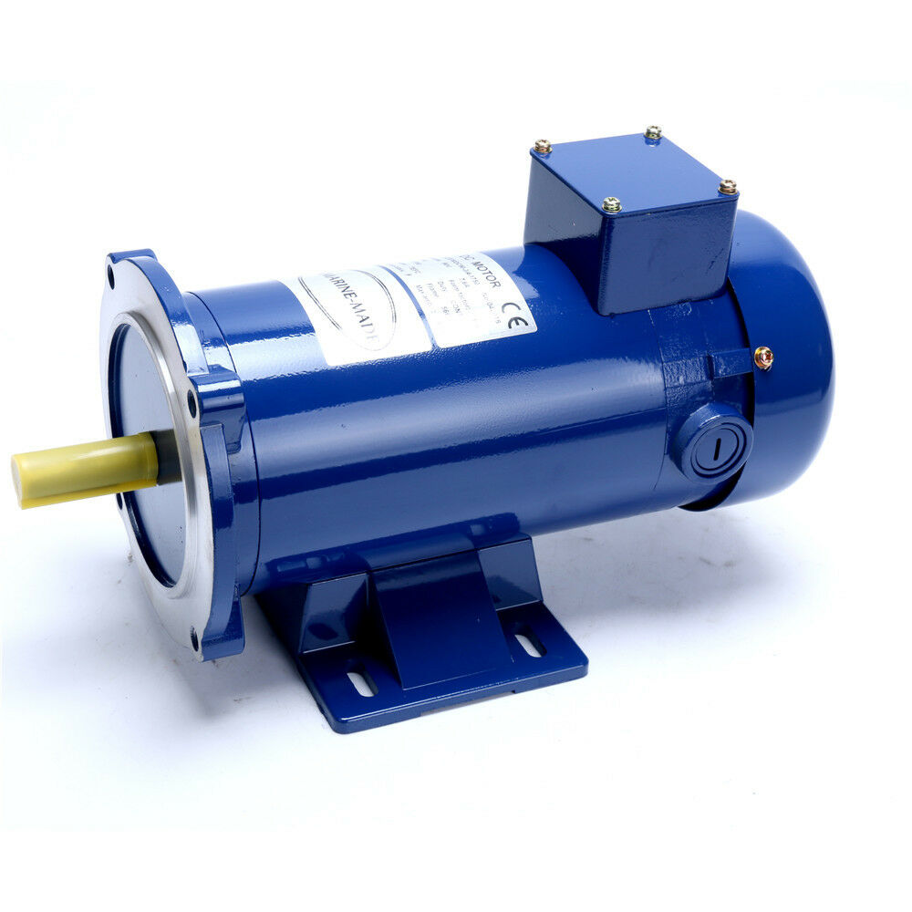
DC MOTOR
Here 4 DC motor are used to drive the cart. Where two are normally in working mode and other two are used in standby mode. The purpose of providing a standby is used as back also. And is it used when the carts is overloaded.
The very basic construction of a dc motor contains a current carrying armature which is connected to the supply end through commutator segments and brushes are placed within the north south poles of a permanent or an electro-magnet

Slide 10
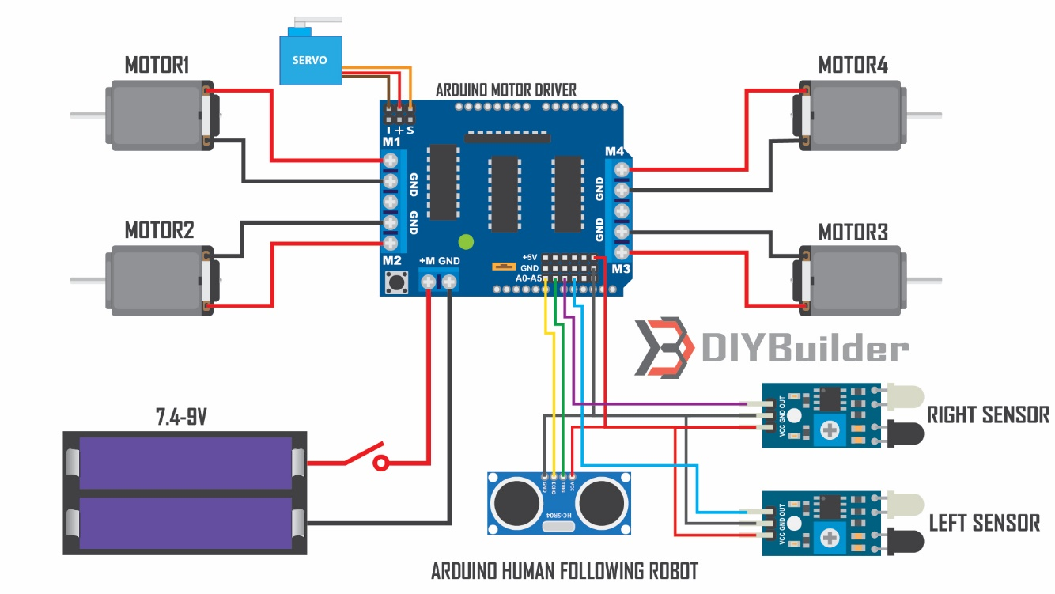
CIRCUIT DIAGRAM

Slide 11
LIST OF COMPONENTS
This project includes hardware and software sections:
Hardware section consists
Arduino UNO
Ultrasonic sensor HCSR04
Infrared Sensors
Motor Driver Shield
Gear Motor
Servo Motor
Jumper Wires
Software section consist
Arduino IDE

Slide 12
DESCRIPTION OF COMPONENTS
HARDWARE SECTION
Arduino UNO -The Arduino Uno is an open-source microcontroller board based on the Microchip ATmega328P microcontroller and developed by Arduino.cc. The board is equipped with sets of digital and analog input/output pins that may be interfaced to various expansion boards and other circuits.
Ultrasonic sensor HCSR04 - Ultrasonic sensor is a device that able to measure the distance to an obstacle by using sound waves. The sound wave is travelled out at a specific frequency and returned when its sense a thing to measure distance in real time.
Infrared Sensors - An infrared sensor is an electronic device, that emits in order to sense some aspects of the surroundings. An IR sensor can measure the heat of an object as well as detects the motion.
Motor Driver Shield - The Motor Shield is a driver module for motors that allows you to use Arduino to control the working speed and direction of the motor. Based on the Dual Full-Bridge Drive Chip L298, it is able to drive two DC motors or a step motor.

Slide 13
Gear Motor - A gearmotor is an all-in-one combination of an electric motor and a gearbox. This makes it a simple, cost-effective solution for high-torque, low-speed applications because it combines a motor with a gear reducer system.
Servo Motor - A servomotor is a rotary actuator or linear actuator that allows for precise control of angular or linear position, velocity and acceleration. It consists of a suitable motor coupled to a sensor for position feedback.
Jumper Wires - A jump wire is an electrical wire, or group of them in a cable, with a connector or pin at each end, which is normally used to interconnect the components of a breadboard or other prototype or test circuit, internally or with other equipment or components, without soldering.
SOFTWARE SECTION
Arduino IDE - The Arduino Integrated Development Environment is a cross-platform application that is written in functions from C and C++. It is used to write and upload programs to Arduino compatible boards, but also, with the help of 3rd party cores, other vendor development boards.

Slide 14
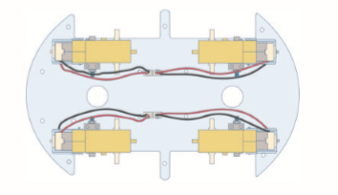
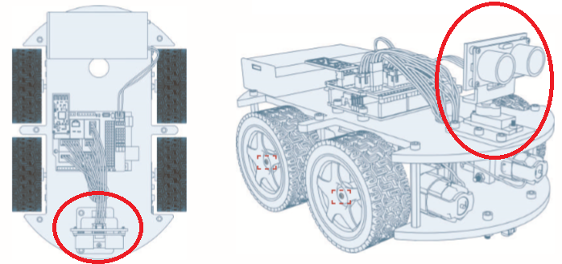
METHODOLOGY
We will start making project by so we have to start with a platform, we will attach 4 gear motors with it. Then we will attach one servo motor in front side of platform and Arduino UNO and motor driver in centre and we put battery holder in back side we will attach those things on platform with the help of glue gun. Then, the ultrasonic sensor will be placed on the front of the robot to detect human leg and we add it on servo motor which can help the robot to move the ultrasonic sensor to detect wide area .We also add IR sensors to sense IR light and it will help robot to detect the obstacles. We will connect the connection with jumper cables as given in circuit diagram. After doing all this we will give program to Arduino UNO .And, the robot will start working when we put batteries in battery holder.

Slide 15
APPLICATIONS
Can assist in carrying loads for people working in hospitals, libraries, airports, etc.
Can service people at shopping centres or public areas.
Can assist elderly people, special children and babies.
Can follow a particular Vehicle.

