Slide 1

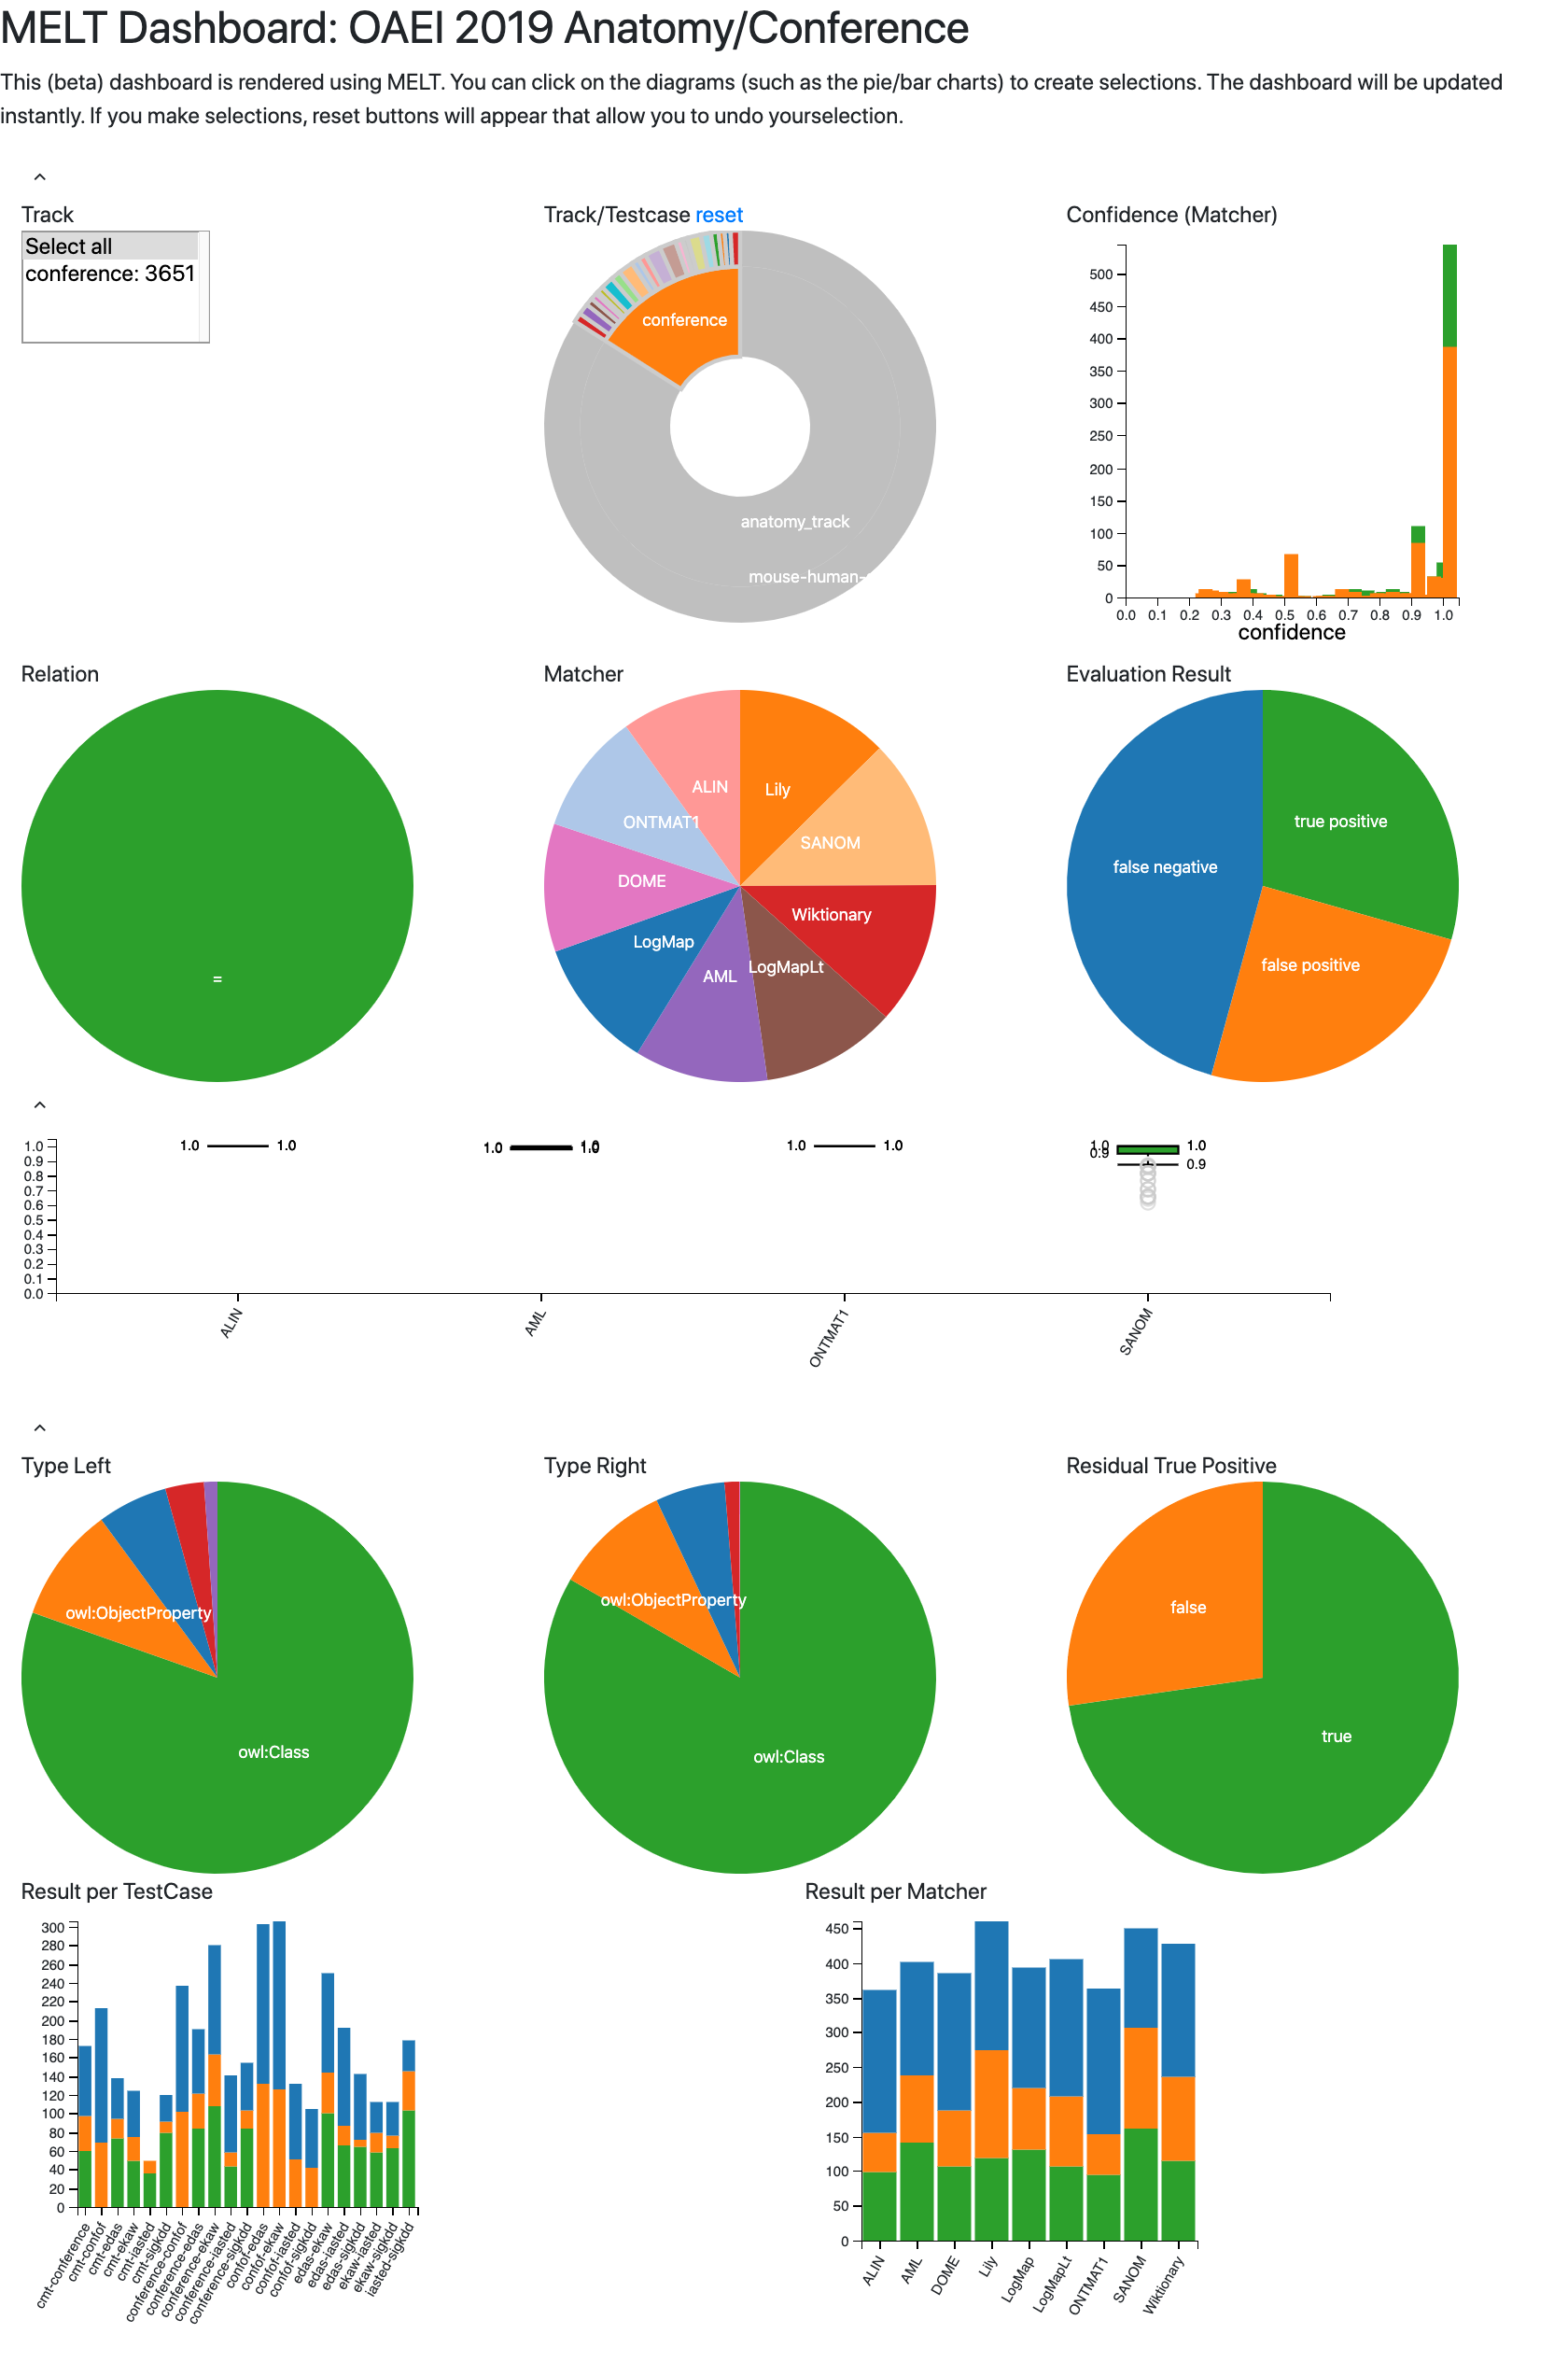
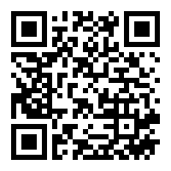
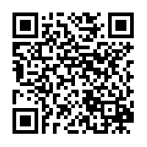

Visual Analysis of Ontology Matching Results with the MELT Dashboard
Jan Portisch
jan@informatik.uni-mannheim.de
Sven Hertling
sven@informatik.uni-mannheim.de
Heiko Paulheim
heiko@informatik.uni-mannheim.de
”An interactive Web user interface for ontology alignment evaluation built with the Matching EvaLuation Toolkit (MELT)”
Track/Testcase Selection Aggregations are calculated on the fly.
Confidence Filters Filter results by matcher confidence level.
Matcher Selection Evaluate an individual matcher or multiple matchers at once and see how their performance compares.
A Visual Confusion Matrix Understand the distribution of matches. The dashboard also allows to directly view true positives, false negatives and false positive instances.
Confidence Filters Are use interested in the distribution of confidences? This is no problem with the MELT Dashboard confidence boxplot!
Type Selector Are you Interested only in the performance of class mappings? No problem, just use the type selector.
Aggregation per Test Case. See how currently selected matcher results compare on the level of test cases!
Comparison of Individual Matchers See how matcher results compare!
Much more features are available.
Try out the new MELT Dashboard!
PDF
Demo
GitHub

