Slide 1
Bank Churn Prediction
Data Science & Machine Learning Project

Slide 2
🌐 Project Overview
Objective: Predict customer churn in a bank using machine learning models to help the business retain customers and reduce loss.
Tools Used: Python, Pandas, Seaborn, Scikit-learn, RandomForest, XGBoost, LightGBM, Matplotlib, GridSearchCV, SMOTE.
Data: 10,000+ records with 14 attributes including demographics, bank behavior, and churn status.

Slide 3
📌 Project Objective
Identify customers likely to churn based on historical bank data.
Enable business to proactively improve customer retention.

Slide 4
📊 Data Overview
Target Column: Exited (1 = Churned, 0 = Not Churned)
Key Features:
Age
Credit Score
Balance
Tenure
Geography
Gender
Products, etc.
Data Challenges:
Imbalanced classes
Outliers in numerical features
Some irrelevant columns

Slide 5
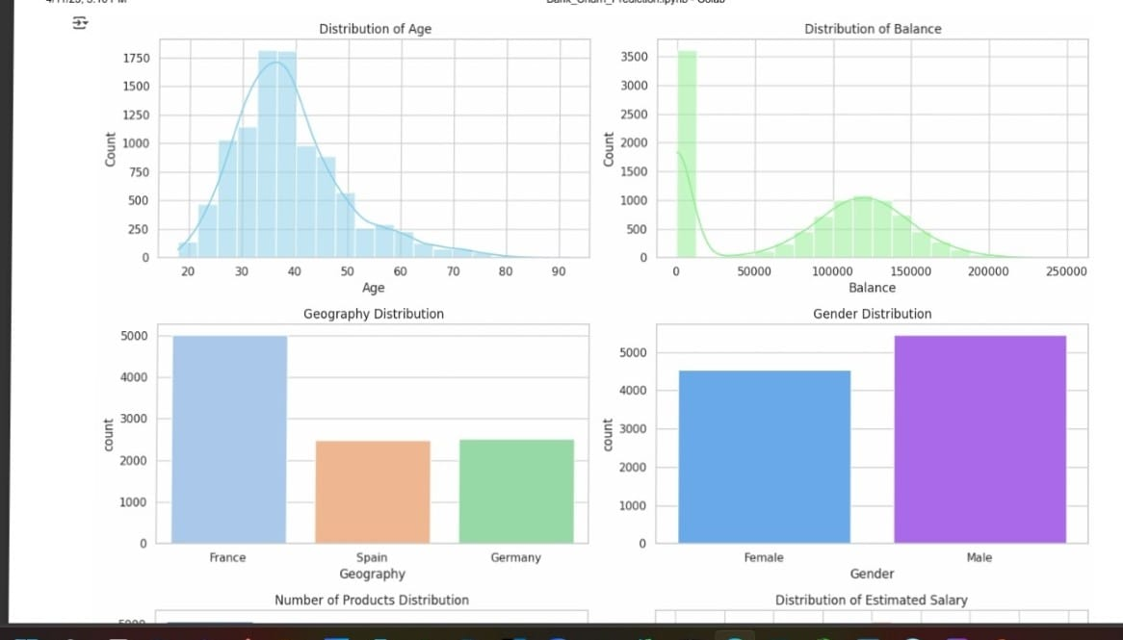
📊 Univariate Analysis
Majority of customers are from France.
Most customers hold 1 product.
More men than women are in the dataset.
Most customers are not active members.

Slide 6
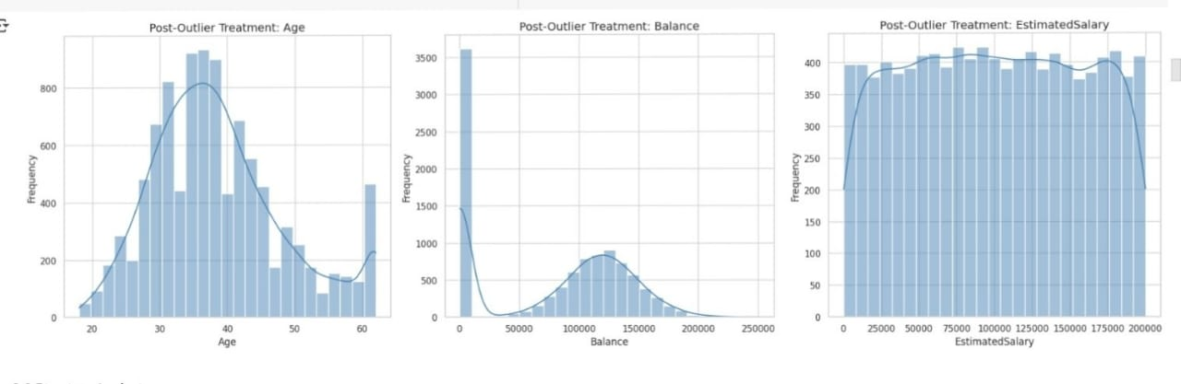
🔄 Outlier Treatment
Applied IQR capping to: Age, Balance, Estimated Salary.
Credit Score did not show significant outliers.

Slide 7
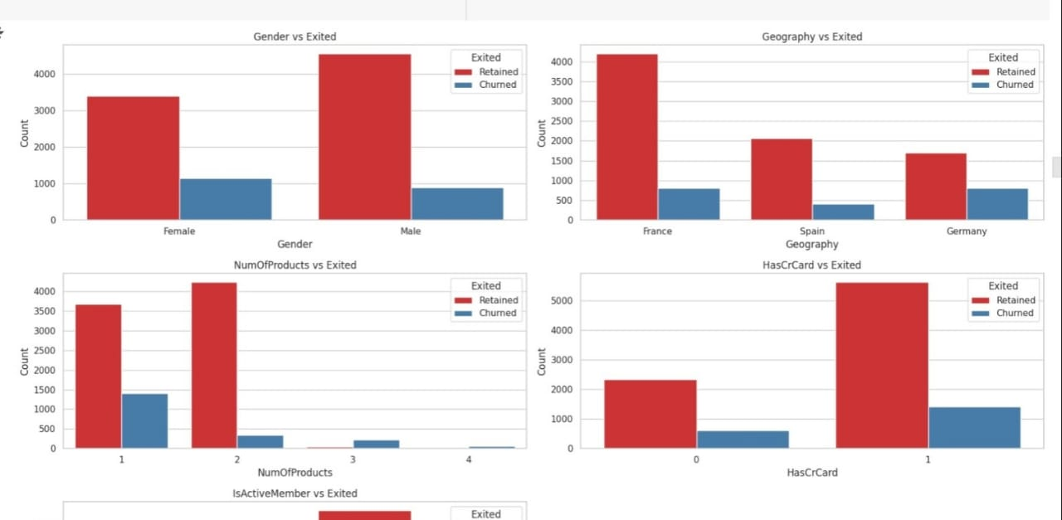
📊 Bivariate Analysis (Target vs Features)
Age: Older customers more likely to churn.
Balance: High balance is correlated with churn.
Gender: Females show slightly higher churn rate.
Active Members: Inactive customers have higher churn.

Slide 8
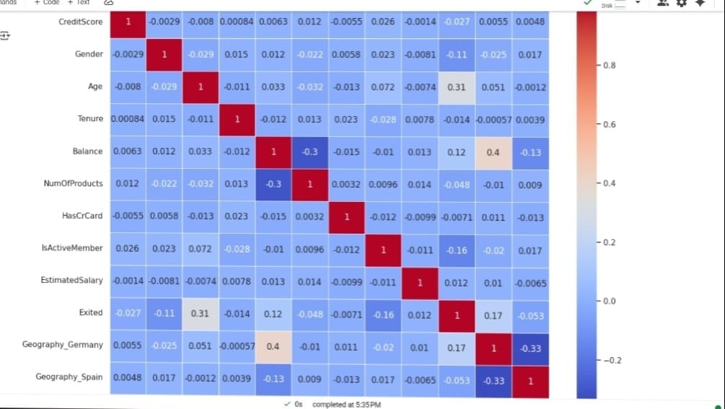
🤾 Multicollinearity Check
Used VIF and heatmap.
No multicollinearity found. All VIF < 5

Slide 9
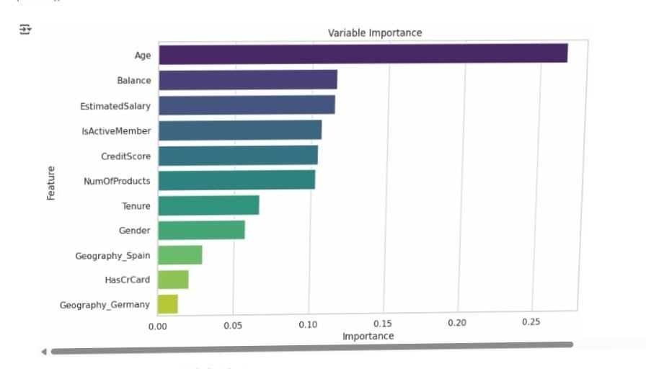
🔧 Feature Engineering
Dropped irrelevant columns (CustomerId, Surname).
Label encoded categorical features.
Standardized numerical features post-SMOTE.
Selected top 10 features using Random Forest importance.

Slide 10
🎓 Train/Test Split & SMOTE
Train-test split: 80/20
Applied SMOTE to handle class imbalance on training data.

Slide 11
📈 Model Building (Baseline)
Logistic Regression
Random Forest
XGBoost
LightGBM
Best Baseline Performer: LightGBM (AUC = 0.81)

Slide 12
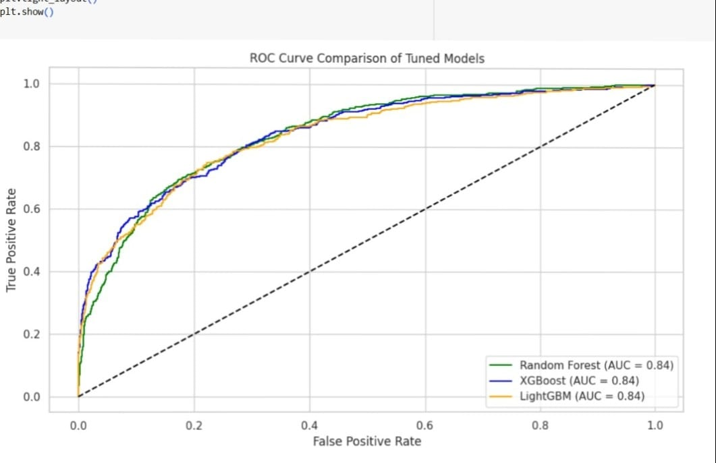
⚖️ Hyperparameter Tuning (Top 3 Models)
Random Forest (AUC = 0.84)
XGBoost (AUC = 0.84)
LightGBM (AUC = 0.85)
Best Final Model: LightGBM (Highest AUC and best balance in recall & precision)

Slide 13
📊 Final Insights
Older customers, high balance, and inactive status are key churn indicators.
Geography and Gender play a moderate role.
Proper SMOTE & feature selection significantly improved model performance.

Slide 14
🌟 Business Recommendation
Focus retention campaigns on older, inactive customers with high balances.
Improve product engagement and active memberships.

Slide 15
💼 Outcome
Model Chosen: Tuned LightGBM
Accuracy: 83% Precision: 71% Recall: 76% F1 Score: 73% AUC Score: 0.850

Slide 16
📍 Thank You!
Project by: Dixit Jadav
LinkedIn: www.linkedin.com/in/dixit-jadav-30ba08301

