Slide 1
Unveiling Netflix:
A Data-Driven Story of Content Insights
By
Dixit Jadav
• Cleaning, Analysis, Visualization & Modeling • machine learning project to classify Movies vs TV Shows
Netflix using structured features.

Slide 2
Dataset Overview
•Total Records: ~8,800+
Columns: 12 original features
Date Range: Titles from 1925 to 2021+
Content Types: Movies 🎬 and TV Shows 📺
Genres: Documentaries, Dramas, International, Comedies, etc.
Attributes include:
Title, Type, Director, Cast
Country, Date Added, Release Year
Duration, Genre (Listed In), Rating

Slide 3
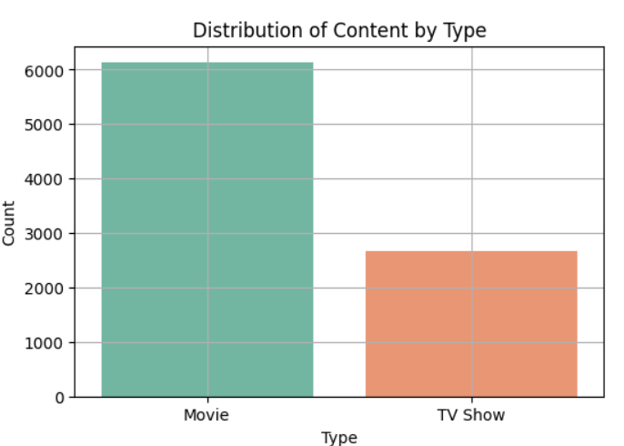
Data Cleaning & Preparation
• Handled missing values • Extracted duration in minutes and type (min/seasons) • Derived features like genre, country, title word count • One-hot encoded categorical variables

Slide 4
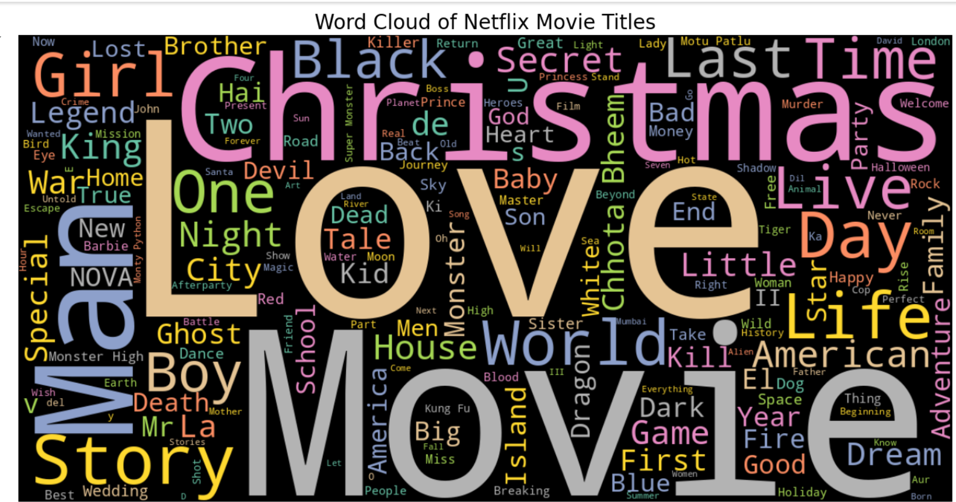
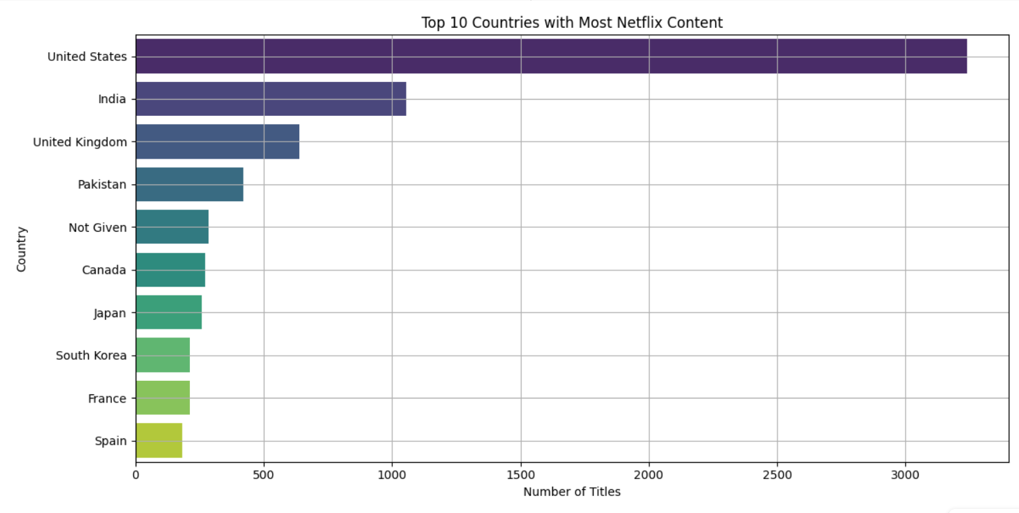
Exploratory Data Analysis (EDA)
• Visualized duration distribution, country-wise counts • Identified top genres and their frequency • Found Christmas/Love themes in titles • Explored seasonal distribution in TV shows

Slide 5
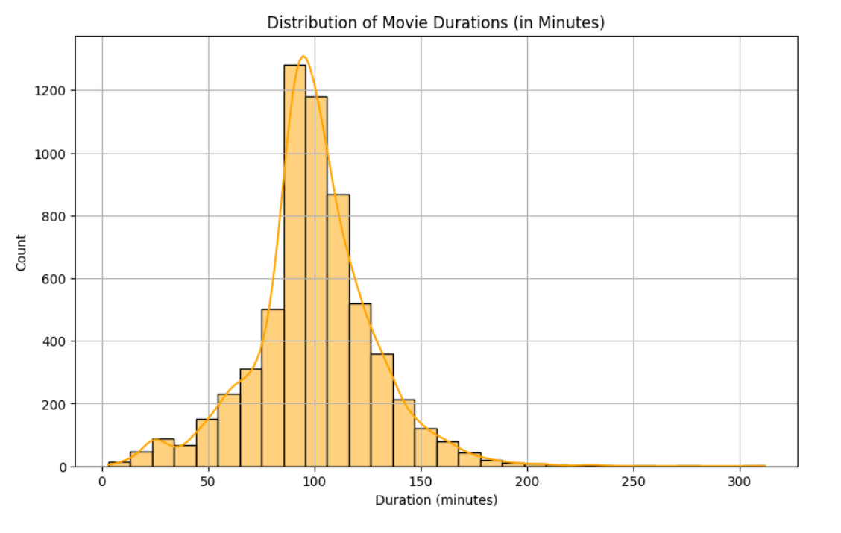
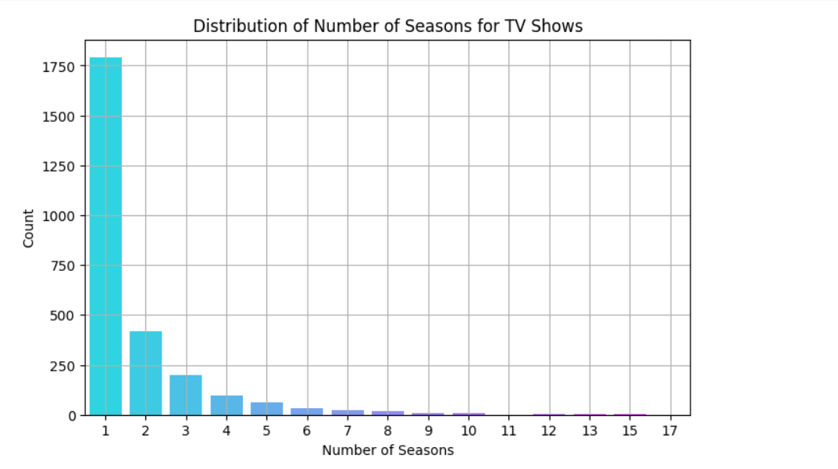
Feature Engineering
• Created binary target: is_movie • Extracted top genres as binary columns • Added title_word_count, is_christmas, is_love • Added duration category and release_decade

Slide 6
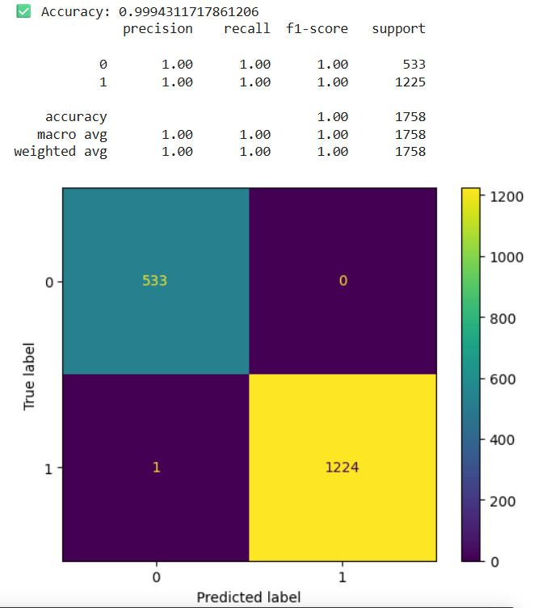
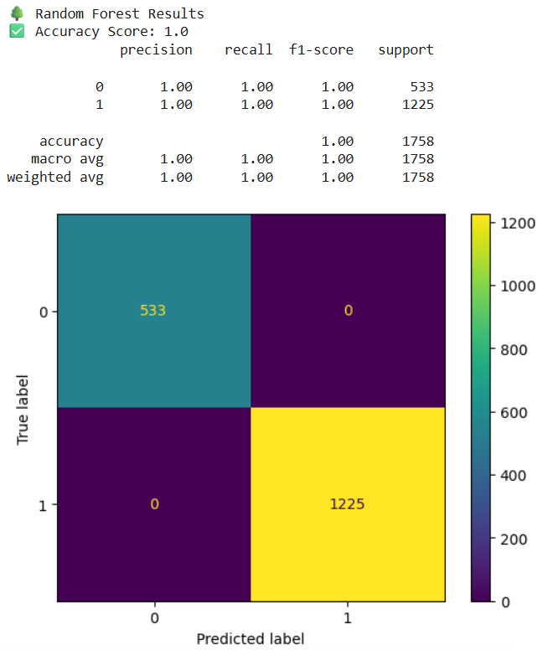
Modeling Results
• Logistic Regression Accuracy: 99.9% • Random Forest Accuracy: 100% • Excellent Precision, Recall, F1-scores • Very low misclassification, indicating clear feature patterns

Slide 7
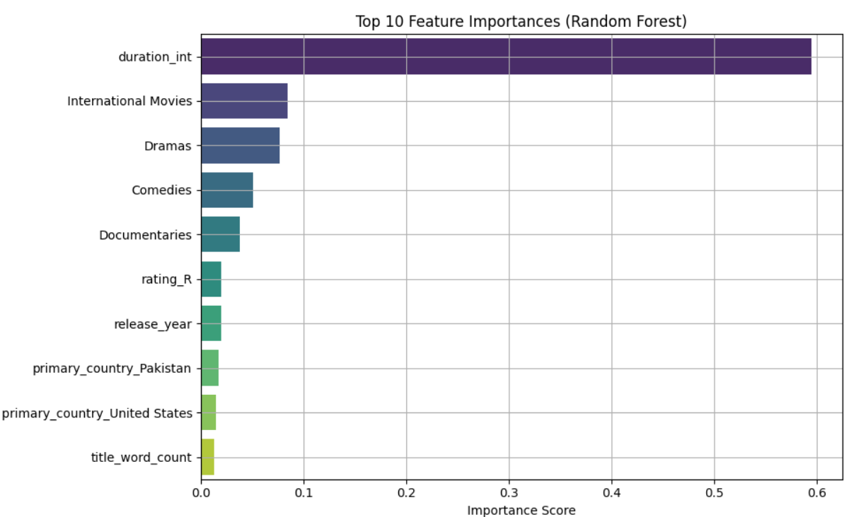
Feature Importance
• Most Important: duration_int • Followed by genres (International Movies, Dramas) • Country and title features had low importance • Model heavily influenced by content duration and genres

Slide 8
🎯 Why High Accuracy?
The classification task (Movie vs TV Show) is simple and well-defined
duration_int is a strong predictor (minutes vs seasons)
Data was cleaned and engineered well
Models like Random Forest handle this structure perfectly
✅ Features clearly separate the classes — so high accuracy is expected, not surprising.

Slide 9
Final Insights
• Classification between Movies and TV Shows is highly separable using
provided metadata • Random Forest provides excellent accuracy and feature importance
visualization • Logistic Regression is interpretable and nearly as accurate • Outlier detection was assessed but not aggressively treated, since key
models used (Random Forest, Logistic Regression) are robust, and most
outliers (like long movie durations) were deemed valid and informative.
Note: "The model achieves nearly 100% accuracy because the 'duration_int' feature strongly distinguishes Movies (in minutes) from TV
Shows (in seasons). However, this may not generalize to datasets from
other platforms or more complex streaming categories where metadata
may differ or be inconsistent." ✅ Best Models: Logistic Regression & Random Forest

