Slide 1
MULTI-CLOUD DEVOPS PIPELINE
Automated Multi-Cloud CI/CD & DevSecOps Framework across AWS and Microsoft Azure
Course & Academic Details
Project Presenter
Course Title: Agile Development Process And DevOps Lab
Course Code: ISWE406P – L45+L46
Faculty In-Charge: Dr. Arunkumar
Academic Year: 2026
Student Name: Dixith Babu A B
Register Number: 24MIS0427
Project Scope: End-to-End DevSecOps GitOps Pipeline
Cloud Environments: AWS (Sydney) & Azure (Central India)
Dixith Babu A B | Reg No: 24MIS0427 | Agile Development Process And DevOps Lab (ISWE406P) | Dr. Arunkumar
1 / 10

Slide 2
EXECUTIVE SUMMARY
Problem Statement & Project Objectives
The Problem in Modern DevOps
Proposed Solution & Objectives
Single-Cloud Vulnerability: Reliance on a single hyperscaler exposes organizations to regional outages, service degradation, and vendor lock-in with unpredictable pricing.
Right-Shifted Security Vulnerabilities: Security scanning is often conducted post-deployment, allowing high-risk CVEs, dependency flaws, and root execution exploits to enter production.
Multi-Cloud Delivery Friction: Deploying across AWS and Azure independently causes configuration drift, fragmented tooling, and severe operational deployment friction.
Simultaneous Parallel Delivery: Automate concurrent container promotion to Amazon ECR (ap-southeast-2 Sydney) and Azure ACR (Central India) upon a single Git commit to main.
Shift-Left DevSecOps Gates: Enforce automated Flake8 static linting, Pytest regression testing, and Aqua Trivy CVE scanning before any artifact is compiled or published.
Hardened Non-Root Containers: Engineer a two-stage minimal Dockerfile running under an unprivileged user (UID 10001) for defense-in-depth isolation.
Active-Active High Availability: Provide zero-vendor-lock-in active-active service parity with synchronized /health and /version telemetry.
Dixith Babu A B | Reg No: 24MIS0427 | Agile Development Process And DevOps Lab (ISWE406P) | Dr. Arunkumar
2 / 10

Slide 3
AGILE FRAMEWORK
Agile Scrum Methodology & Sprint Delivery
16 SP
15 SP
15 SP
Sprint 1: Base Service & Infrastructure
Sprint 2: CI & DevSecOps Quality Gates
Sprint 3: Parallel Continuous Deployment
• Engineered Python Flask REST microservice with create_app() factory.
• Authored hardened 2-stage Dockerfile with non-root UID 10001.
• Defined endpoints: / (discovery), /health (status), and /version.
• Established Git repository governance and branch protection.
• Integrated Flake8 enforcing PEP 8 and cyclomatic complexity <= 10.
• Developed 6 Pytest unit tests covering status codes and schemas.
• Integrated Aqua Security Trivy for container & filesystem CVE scans.
• Enforced shift-left automated build break upon security defect.
• Configured GitHub Actions workflow with parallel deployment tracks.
• Automated AWS track: IAM authentication, ECR push (Sydney).
• Automated Azure track: Service Principal RBAC, ACR push (India).
• Validated active-active production probing and telemetry parity.
Agile Velocity Summary: Delivered 46 Story Points across 3 Sprints with a 100% Commitment Completion Rate & Zero Sprint Spillover.
Dixith Babu A B | Reg No: 24MIS0427 | Agile Development Process And DevOps Lab (ISWE406P) | Dr. Arunkumar
3 / 10

Slide 4
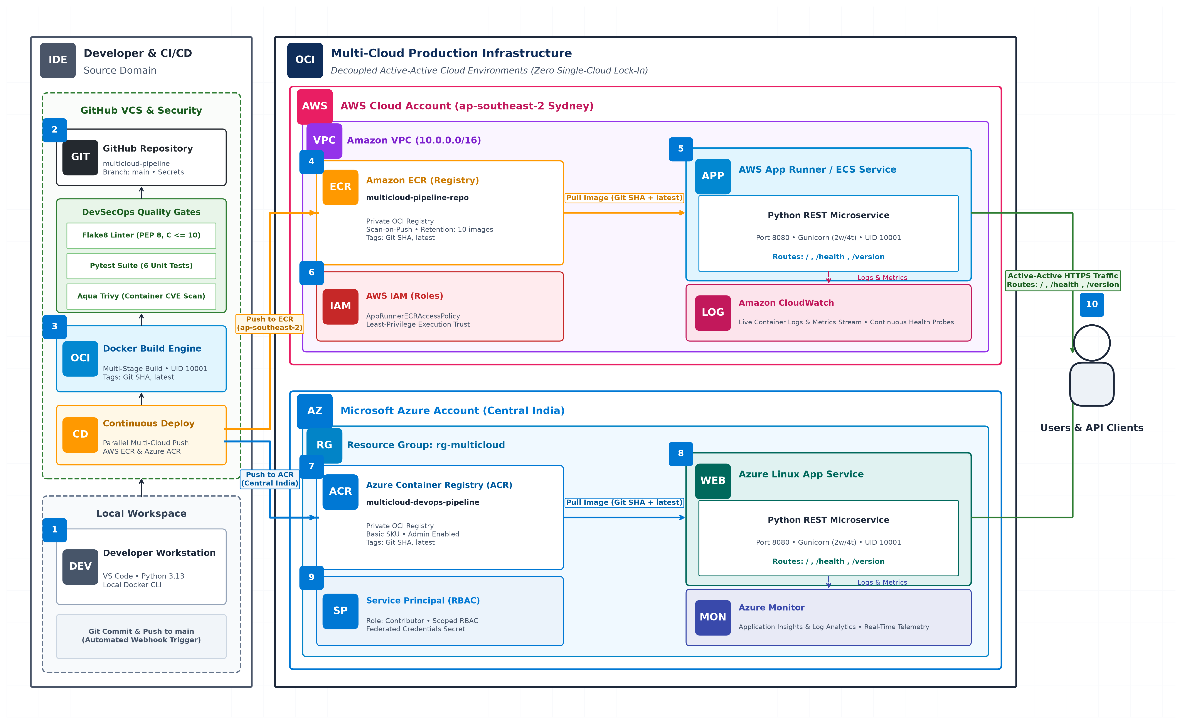
SYSTEM ARCHITECTURE
Enterprise Multi-Cloud Reference Architecture
Numbered Process Lifecycle: [1] Local Push -> [2] DevSecOps Gates -> [3] Docker OCI -> [4-6] AWS Sydney ECR/AppRunner -> [7-9] Azure India ACR/AppService -> [10] Active-Active Users
Dixith Babu A B | Reg No: 24MIS0427 | Agile Development Process And DevOps Lab (ISWE406P) | Dr. Arunkumar
4 / 10

Slide 5
CONTAINERIZATION & SECURITY
Microservice Architecture & Container Hardening
Python Flask Microservice Architecture
Hardened Multi-Stage Containerization
Application Factory Pattern: Engineered with create_app() in src/app.py to ensure isolated state and dynamic test-runner instantiation.
GET / (Discovery): Emits service metadata, API capability registry, active version, and start timestamp.
GET /health (Health Probe): Returns JSON status ('healthy'), live system uptime (seconds), active cloud provider, and hosting region.
GET /version (Release Telemetry): Emits Git commit SHA and environment tags for live cross-cloud deployment synchronization.
Production WSGI (Gunicorn): Bound to 0.0.0.0:8080 with 2 worker processes, 4 threads per worker, and 60s timeout.
Multi-Stage Build Pipeline: Stage 1 installs compilers and wheels into /opt/venv. Stage 2 copies only the compiled runtime, omitting GCC, pip cache, and dev packages.
Non-Root Security Context: Enforces CIS Docker Benchmark compliance. Creates appgroup:appuser with explicit UID 10001:10001.
Zero Root Privileges: In the event of a container breakout, the executing process holds zero administrative rights over the host Linux kernel.
Immutable Tagging Convention: Artifacts are dual-tagged with the deterministic Git commit SHA and latest for traceable rollbacks.
Minimal Image Attack Surface: Built atop python:3.13-slim, drastically reducing CVE footprint compared to full base images.
Dixith Babu A B | Reg No: 24MIS0427 | Agile Development Process And DevOps Lab (ISWE406P) | Dr. Arunkumar
5 / 10

Slide 6
QUALITY ASSURANCE
Shift-Left Quality & DevSecOps Security Gates
CODE QUALITY
UNIT TESTING
SECURITY AUDIT
Flake8 Static Linter
Pytest Regression Suite
Aqua Trivy Vulnerability Scan
• Automated AST static code analysis across all src/ modules.
• Enforces strict PEP 8 formatting and line-length limits (88 chars).
• McCabe Cyclomatic Complexity Gate strictly enforced (Max-C <= 10).
• Audit Outcome: 0 errors, 0 warnings across entire codebase.
• 6 automated unit test cases using pytest client test fixtures.
• Validates discovery (/), health probe (/health), and version (/version).
• Verifies dynamic uptime monotonicity and 404 JSON error schemas.
• Test Outcome: 6/6 tests passing (100% pass rate in < 0.25s).
• Pre-deployment vulnerability scanning of container filesystem & OCI layers.
• Continuous detection against NVD and GitHub Advisory CVE databases.
• Automated CI build failure upon encountering unmitigated High/Critical CVEs.
• Security Outcome: 0 Critical / 0 High CVEs in production image.
Shift-Left DevSecOps Principle: Any failure in static linting, unit tests, or CVE thresholds terminates the pipeline immediately, protecting production registries.
Dixith Babu A B | Reg No: 24MIS0427 | Agile Development Process And DevOps Lab (ISWE406P) | Dr. Arunkumar
6 / 10

Slide 7
PIPELINE ORCHESTRATION
GitHub Actions CI/CD Workflow Orchestration
Job 1: CI & Security Gate
Job 2: AWS Deployment Track
Job 3: Azure Deployment Track
• Runner: Ubuntu Latest (GitHub-Hosted).
• Step 1: Repository checkout & Python 3.13 setup.
• Step 2: Dependency caching for deterministic builds.
• Step 3: Flake8 static linting execution.
• Step 4: Pytest automated unit regression suite.
• Step 5: Docker image compilation.
• Step 6: Aqua Trivy container CVE scanner.
• Status: Gate clearance triggers parallel CD jobs.
• Region: Sydney (ap-southeast-2).
• Authentication: Scoped IAM Access Keys.
• Registry Login: aws-actions/amazon-ecr-login.
• Tagging: Git commit SHA + latest tags.
• Push: Published to Amazon ECR private repository.
• Service Rollout: AWS App Runner container pull.
• Telemetry: Logs streamed to Amazon CloudWatch.
• Execution Time: Parallel completion in ~1m 45s.
• Region: Central India (rg-multicloud).
• Authentication: Azure Service Principal (RBAC).
• Provider Auto-Registration: Microsoft.Web & ACR.
• Registry Login: azure/docker-login.
• Tagging: Git commit SHA + latest tags.
• Push: Published to Azure Container Registry (ACR).
• Service Rollout: Azure Linux App Service update.
• Telemetry: Telemetry streamed to Azure Monitor.
Dixith Babu A B | Reg No: 24MIS0427 | Agile Development Process And DevOps Lab (ISWE406P) | Dr. Arunkumar
7 / 10

Slide 8
PROBLEM SOLVING
Technical Challenges Encountered & Resolutions
1
AWS Service Control Policies (SCP) & Region Restriction
Issue: Initial pipeline runs targeting us-east-1 failed with AuthorizationHeaderMalformed and AccessDenied. Investigation revealed organizational SCPs blocking provisioning outside authorized regions.
Resolution: Re-architected pipeline and Terraform variables to target AWS Sydney (ap-southeast-2). Created ECR repository and validated short-lived IAM credentials within permitted policies.
2
Azure Resource Provider Dynamic Auto-Registration
Issue: Early Azure deployments failed due to unregistered Resource Providers (Microsoft.ContainerRegistry and Microsoft.Web) in the fresh cloud subscription.
Resolution: Integrated automated pre-flight CLI registration commands directly in multicloud-deploy.yml (az provider register) to guarantee provider readiness before resource provisioning.
3
Pytest Cloud Environment Injection Isolation
Issue: Testing dynamic runtime provider detection (verifying that the service detects AWS vs Azure) risked polluting global process environment variables across tests.
Resolution: Architected Pytest monkeypatch fixtures to cleanly inject and teardown CLOUD_PROVIDER and REGION variables, achieving strict test isolation and 100% reproducibility.
Dixith Babu A B | Reg No: 24MIS0427 | Agile Development Process And DevOps Lab (ISWE406P) | Dr. Arunkumar
8 / 10

Slide 9
RESULTS & METRICS
Experimental Results & Verification Metrics
Code Quality Audit
Unit Regression Suite
Security CVE Scan
Deployment Parity
100%
6 / 6
0 CVEs
2 Clouds
• Flake8: 0 Errors / 0 Warnings
• PEP 8 Compliance: Verified
• Cyclomatic Complexity: <= 10
• Black-compatible formatting
• Tests Executed: 6 scenarios
• Status: 100% Passed
• Duration: < 0.25 seconds
• Client fixtures & monkeypatching
• Critical CVEs: 0 detected
• High CVEs: 0 detected
• Base Image: python:3.13-slim
• Non-Root UID: 10001 confirmed
• AWS Sydney: ap-southeast-2
• Azure India: Central India
• Total Pipeline Time: 3m 42s
• Active-Active /health HTTP 200
Live Production Endpoint Verification Telemetry
AWS Sydney Target: Image Tag: 123456789012.dkr.ecr.ap-southeast-2.amazonaws.com/multicloud-pipeline:latest | /health -> HTTP 200 (healthy)
Azure India Target: Image Tag: multiclouddevops.azurecr.io/multicloud-devops-pipeline:latest | /health -> HTTP 200 (healthy)
Active-Active Sync: Both cloud runtimes report identical commit SHA, zero configuration drift, and independent regional telemetry streams.
Dixith Babu A B | Reg No: 24MIS0427 | Agile Development Process And DevOps Lab (ISWE406P) | Dr. Arunkumar
9 / 10

Slide 10
SUMMARY & OUTLOOK
Conclusion & Future Enhancements
Key Project Achievements
Future Enhancements & Next Steps
Cloud Provider Independence: Eliminated single-cloud vendor lock-in by implementing active-active, synchronized deployments across AWS and Microsoft Azure.
Proactive Security Governance: Embedded shift-left DevSecOps quality gates that successfully prevent vulnerable, non-standard, or failing code from reaching registries.
Enterprise Hardening: Achieved zero root privileges in container runtime using UID 10001 (appuser) and multi-stage build optimization.
Agile Engineering Discipline: Demonstrated structured iterative development across 3 Scrum Sprints (46 SP) using Gherkin criteria and automated CI/CD pipelines.
Global DNS Latency Routing: Integrate Amazon Route 53 or Azure Traffic Manager to automatically route consumer traffic to the lowest-latency cloud endpoint.
Distributed Tracing with OpenTelemetry: Implement cross-cloud distributed telemetry collectors for unified observability across AWS App Runner and Azure App Service.
Multi-Cloud Data Replication: Expand to stateful workloads with cross-cloud database replication using Amazon DynamoDB Global Tables or Azure Cosmos DB.
Kubernetes Expansion (EKS & AKS): Scale deployment targets from PaaS container hosts to managed Kubernetes clusters managed via ArgoCD GitOps controllers.
Dixith Babu A B | Reg No: 24MIS0427 | Agile Development Process And DevOps Lab (ISWE406P) | Dr. Arunkumar
10 / 10

