Slide 1
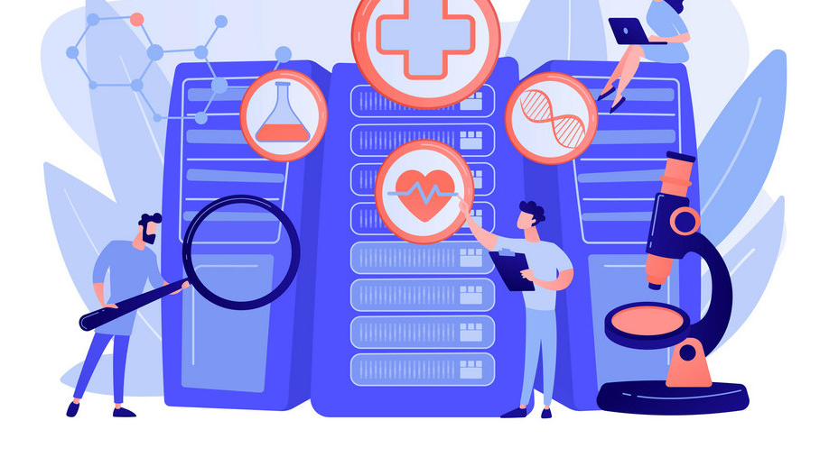
Usage of Big Data Analytics in Healthcare
Presented By:
Dixith Kumar Bandari

Slide 2
Introduction
Big data's extensive use in the healthcare industry ranges from analyzing historical data to predicting effective treatment techniques and discovering new technologies for preventing health issues.
The healthcare industry has undergone a significant transformation in recent years, driven by the adoption of advanced technology.
Big Data analytics has played a crucial role in improving patient outcomes, optimizing clinical procedures, and reshaping the healthcare environment.
The study aims to investigate the diverse applications of big data in healthcare, focusing on its potential to facilitate intelligent decision-making, provide novel insights, and enhance predictive modeling.
The introduction of Big Data analytics into healthcare represents a departure from traditional procedures, with a focus on identifying meaningful patterns and exploring its impact on diagnosing illnesses, personalizing care plans, and improving patient care administration.
This data-driven change signifies a shift in the healthcare landscape, and the study delves into various aspects of this transformation, highlighting its significance in personalized care and the administration of patient care.

Slide 3
Literature Review
"The use of Big Data Analytics in healthcare" (Batko & Ślęzak, 2022) underscores the significance of extracting patterns from large health datasets for informed decision-making in healthcare settings.
Schulte and Bohnet-Joschko's scoping review (2022) advocates for a patient-centric healthcare system through personalized treatment approaches, emphasizing Big Data's potential to support people-centered and integrated health services.
Mehta and Pandit's systematic review (2018) provides a comprehensive overview of the intersection of Big Data analytics and healthcare, showcasing synergies capable of revolutionizing traditional healthcare approaches.
Cozzoli et al.'s study on organizational implications (2022) offers a theoretical framework for understanding how big data analytics can be applied to healthcare organization management.
Borges do Nascimento et al. (2021) explore the broader impact of Big Data analytics on public health and individual well-being through an overview of systematic reviews, suggesting avenues for future research.
Ramesh and Santhi's exploration (2020) illuminates Big Data analytics' potential to facilitate intelligent networks and revolutionize health informatics, contributing to the ongoing evolution of healthcare practices.
Akundi et al.'s comparative study (2020) zooms in on machine learning algorithms within Big Data in healthcare, providing insights into the effectiveness of different approaches.

Slide 4
Technical Details
Cloud Computing: The scalability and accessibility of Big Data solutions in healthcare are enhanced by cloud computing platforms like Microsoft Azure and Amazon Web Services.
Data Warehousing: Efficient storage and management of large healthcare datasets, both structured and unstructured, support quick query processing and real-time analytics.
Machine Learning and Predictive Analytics: Machine learning algorithms analyze past patient data, enabling trend identification and forecasting for proactive patient management and tailored treatment planning.
Data Acquisition and Integration: Gathering diverse healthcare datasets, including medical imaging, genetic data, and electronic health records, creates a comprehensive patient health picture.
Natural Language Processing (NLP): NLP technologies extract valuable information from unstructured sources, enhancing comprehension of patient narratives for diagnosis and therapy insights.
Data Governance and Security Solutions: Ensuring the security and integrity of medical data through encryption technologies, data quality guidelines, and exploring blockchain for auditable data transfers.
Wearable Devices and IoT: Integration of wearable devices and the Internet of Things provides real-time patient data, with examples like fitness trackers and smartwatches continuously collecting health data for analysis.

Slide 5
The Promise
Big Data enables improved predictive analytics for proactive health intervention and early problem identification.
Enhanced illness diagnosis and timely treatment decisions result from evaluating diverse data sources, including genetic information and electronic health records (EHRs).
Tailored treatment plans, considering unique patient data, improve treatment effectiveness and minimize adverse outcomes.
Big Data ensures efficient resource allocation in healthcare, saving costs, reducing wait times, and enhancing overall service delivery.
Real-time monitoring and action facilitated by Big Data benefit prompt addressing of patients' health issues, especially for long-term illnesses.
Accelerated medical research and development occur through Big Data's evaluation of large datasets, leading to faster discoveries in novel medications and therapies.
Population health management benefits from Big Data, aiding in identifying health patterns, allocating resources for prevention, and implementing targeted treatments at the population level.
Integration of Big Data in healthcare offers benefits like improved population health management, optimized resource use, tailored treatment, enhanced predictive analytics, and accelerated research and development, crucial for a responsive and efficient healthcare system.

Slide 6
The Obstacles and Challenges
Security concerns in healthcare data, driven by its sensitivity, require robust measures to prevent cyber threats and unauthorized access. This challenge is further complicated by the ongoing need to balance patient privacy, mandated by laws like HIPAA.
Ensuring reliable insights from big data analytics in healthcare demands addressing biased analyses stemming from inadequate, inconsistent, or inaccurate data. Strong data governance, standardized formats, and validation procedures are essential components for reliability.
Disparate systems in healthcare pose obstacles to seamless information flow, emphasizing the necessity for protocols ensuring data interchange and interoperability. Overcoming these challenges is crucial for obtaining comprehensive perspectives on patient health.
Ethical considerations in big data analytics involve securing informed consent, ensuring transparency in data usage, and mitigating algorithmic bias, particularly when dealing with vulnerable groups. Continuous refinement of ethics rules and regulations is imperative.
Resource, technology, and staff challenges impact the efficient application of big data analytics, especially for smaller healthcare companies. Overcoming these obstacles requires providing sufficient training for healthcare personnel to interpret and use big data insights effectively.
Collaboration among data scientists, legislators, healthcare practitioners, and technology specialists is crucial for addressing the multifaceted challenges in big data analytics. Ongoing efforts are necessary for the healthcare sector to fully realize the transformative potential of big data in patient care and administration.

Slide 7
Suggestions
Develop robust data governance policies for accuracy and security. Invest in advanced cybersecurity measures to safeguard sensitive healthcare data.
Promote standardized protocols for enhanced interoperability among healthcare systems. Facilitate collaboration for creating a unified data ecosystem and shared insights.
Educate patients about Big Data benefits and encourage active engagement in data decisions.
Offer ongoing training for healthcare professionals to interpret and utilize Big Data insights. Encourage healthcare organizations to adopt data-driven decision-making processes.
Integrate real-time monitoring systems for prompt action on patient health issues.
Encourage collaborative research efforts to accelerate medical discoveries through Big Data analytics.
Continuously refine and adhere to ethical guidelines for transparent data usage. Conduct public awareness campaigns to educate the general population about Big Data benefits.
Allocate resources for technology infrastructure, overcoming challenges related to limitations. Use data-driven insights for efficient resource allocation, saving costs, and enhancing service delivery.

Slide 8
Conclusion
Comprehensive insights facilitated by cloud computing, data warehousing, and diverse data sources.
Natural Language Processing enhances patient narratives for improved understanding.
Machine learning and predictive analytics offer personalized treatment regimens.
Real-time patient data from wearable technology and IoT improves analytics.
Persistent challenges include data security and ethical dilemmas.
Strong data governance is essential to address security concerns.
Ongoing research into ethical frameworks is necessary for responsible data use.
Collaboration among politicians, data scientists, and healthcare practitioners is crucial for future success.
Continuous innovation in technology is essential to keep pace with evolving healthcare needs.
Public awareness and education are vital for fostering a data-driven healthcare culture.

Slide 9
References
Schulte, T., & Bohnet-Joschko, S. (2022). How can Big Data Analytics Support. People Centred and Integrated Health Services: A Scoping Review. International journal of integrated care, 22(2), 23. https://doi.org/10.5334/ijic.5543
Mehta, N., & Pandit, A. (2018). Concurrence of big data analytics and healthcare: A systematic review. International journal of medical informatics, 114, 57–65. https://doi.org/10.1016/j.ijmedinf.2018.03.013
Hansen, M. M., Miron-Shatz, T., Lau, A. Y., & Paton, C. (2014). Big Data in Science and
Healthcare: A Review of Recent Literature and Perspectives. Contribution of the IMIA Social
Media Working Group. Yearbook of medical informatics, 9(1), 21–26. https://doi.org/10.15265/IY2014-0004.
T. Ramesh, V. Santhi, Exploring big data analytics in health care, International Journal of Intelligent Networks, Volume 1, 2020, Pages 135-140, ISSN 2666-6030, https://doi.org/10.1016/j.ijin.2020.11.003.
Borges do Nascimento I, Marcolino M, Abdulazeem H, Weerasekara I, Azzopardi-Muscat N, Gonçalves M, Novillo-Ortiz D. I mpact of Big Data Analytics on People’s Health: Overview of Systematic Reviews and Recommendations for Future Studies, J Med Internet Res 2021;23(4):e27275, URL: https://www.jmir.org/2021/4/e27275
Cozzoli, N., Salvatore, F. P., Faccilongo, N., & Milone, M. (2022). How can big data analytics be used for healthcare organization management? Literary framework and future research from a systematic review. BMC health services research, 22(1), 809. https://doi.org/10.1186/s12913-022-08167-z

Slide 10
Batko, K., & Ślęzak, A. (2022). The use of Big Data Analytics in healthcare. Journal of big data, 9(1), 3m https://doi.org/10.1186/s40537-021-00553
Akundi, S. H., R, S., & PM, M. (2020). Big Data Analytics in Healthcare using Machine
Learning Algorithms: A Comparative Study. International Journal of Online and Biomedical Engineering (iJOE), 16(13), pp. 19–32. https://doi.org/10.3991/ijoe.v16i13.18609
Yichuan, Wang., Nick Hajli. Exploring the path to big data analytics success in healthcare,
Journal of Business Research,Volume 70,2017,Pages 287-299,ISSN 0148-2963,
https://doi.org/10.1016/j.jbusres.2016.08.002.

