Slide 1
E-commerce Website
Presented by-
Diya Gupta (2210990303)
Garima (2210990313)
Garima (2210990314)
Under the supervision of:
Vikas Patel
Parul Gahelot
CSE Department
Chitkara University, Punjab

Slide 2
Table of Content
Introduction
Problem Statement
Motivation of research
Tools & technologies
Code Snapshots
Future Scope
Conclusion
References

Slide 3
Introduction
Ecommerce website allows people to buy and sell physical goods, services, and digital products over the internet rather than at a brick-and-mortar location. Through an e-commerce website, a business can process orders, accept payments, manage shipping and logistics, and provide customer service.
E-commerce has continued to grow in popularity and importance, particularly in light of the COVID-19 pandemic, which has led to a surge in online shopping as people seek to minimize in-person interactions.
All freelancers, as well as small and large businesses, have benefited from e-commerce which enables them to sell their goods and services at a scale that was not possible with traditional offline retail.

Slide 4
Problem Statement
Many ecommerce websites lack a seamless and user-friendly experience for customers.
Issues such as slow loading times, complicated navigation, and limited product information contribute to customer frustration.
The current landscape hinders customer satisfaction and results in high bounce rates.
Our goal is to design and implement an ecommerce website that prioritizes user experience and accessibility.
By addressing these challenges, we aim to enhance customer satisfaction and drive increased sales.

Slide 5
Motivation of Research
Understanding Customers: We want to learn what customers like and want when they shop online so we can make our website better for them.
Keeping Up with Trends: By looking at what's popular in online shopping right now, we can make sure our website stays up-to-date and competitive.
Making Shopping Easier: Research helps us figure out what parts of our website might be confusing or frustrating for customers, so we can fix them and make shopping easier.
Choosing the Right Products: We want to pick the products that people are most interested in buying, so we do research to find out what those are.
Growing Our Business: Ultimately, by doing research and making improvements based on what we learn, we hope to attract more customers, sell more products, and make our ecommerce business successful.

Slide 6
Tools & Technologies
HTML (Hypertext Markup Language) : HTML is the standard markup language for creating web pages and web applications.
Role: Used for structuring the content of the e-commerce website, including headers, paragraphs, images, and other elements
CSS (Cascading Style Sheets): CSS is a style sheet language used for describing the presentation of a document written in HTML.
Role: Used for styling the visual aspects of the e-commerce website, including layout, colors, fonts, and animations
JavaScript: JavaScript is a programming language that enables interactive web pages and web applications.
Role: Used for implementing dynamic and interactive features on the e-commerce website, such as fetching data from APIs, handling user interactions, and creating responsive designs.

Slide 7
Tools & Technologies
Version Control System (e.g., Git): Version control systems are software tools that help track changes to files and manage collaborative development projects.
Role: Used for managing the project's source code, tracking changes, and enabling collaboration among team members.
Code Editor (Visual Studio Code): Code editors are software tools used for writing and editing code files.
Role: Used for writing, editing, and debugging HTML, CSS, and JavaScript code for the e-commerce website.
Fake Store API: Fake Store API is a public API that provides mock data for an e-commerce store, including products, categories, and users.
Role: Used for fetching realistic product data to populate the e-commerce website's catalog and simulate real-world scenarios during development and testing.

Slide 8
Future Scope
We are thinking of some modifications and adding some new features on our system .
Some of them are –
GUI modification (more user friendly)
Users can signup/login using their social media account such as facebook ,google ,etc.
Checkout functionality
Add to cart
Payment gateway

Slide 9
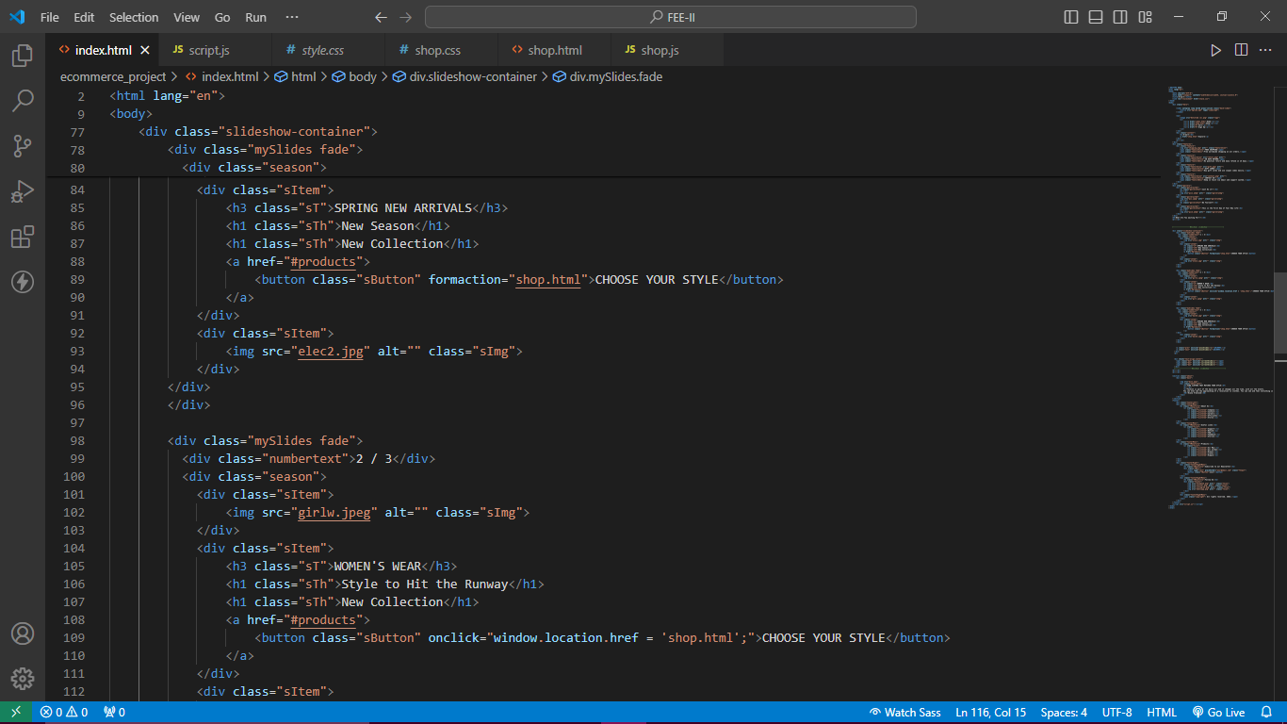
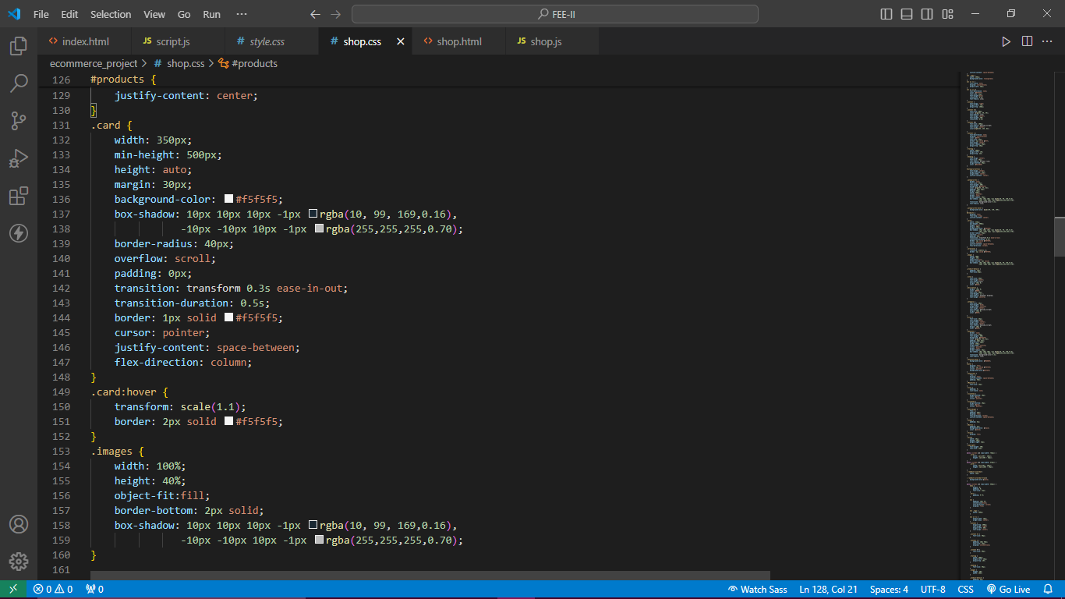
Code Snapshots

Slide 10
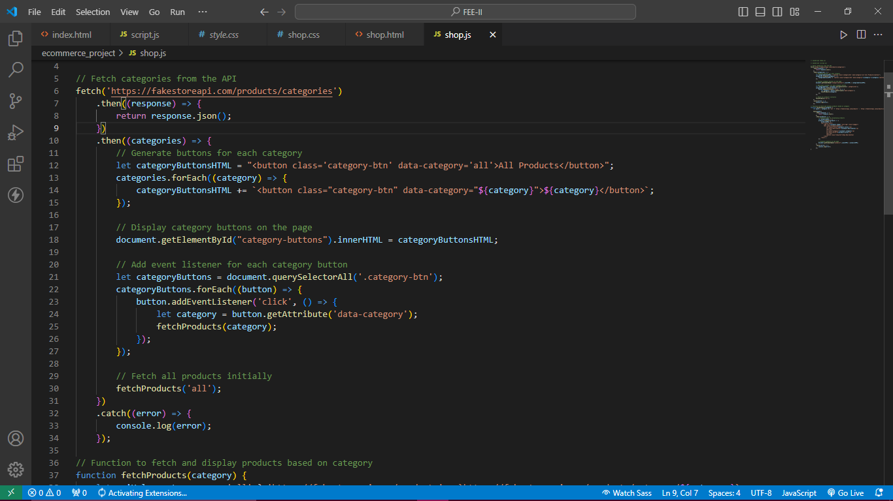
Code Snapshots

Slide 11
Conclusion/Theme Plan
Key Points:
Throughout this presentation, we've discussed project overview, outlining our objectives and vision for creating a user-friendly, efficient and appealing online shopping platform.
We delved into the technologies and tools used, including HTML, CSS, and JavaScript, to design and develop the website's frontend interface.3.
We explored the backend functionality powered by JavaScript to enable dynamic interactions and seamless user experiences.

Slide 12
References
https://www.w3schools.com
https://fakestoreapi.com/docs
https://www.youtube.com/watch?si=xG7uMJe-UwDO640H&v=ubw2hdQIl4E&feature=youtu.be
https://getbootstrap.com

Slide 13
Questions???
Any
Questions??

