Slide 1
IoT-Based Classroom Light Control System
Naimisha Girish - 21CSB0F08 Diya Kevat - 21CSB0F10
Vaishnavi Pradeep Nambiar - 21CSB0F12
April 3, 2025

Slide 2
Introduction
Problem Statement: Classroom lights are often left on even when the room is empty, leading to unnecessary energy wastage.
Objectives:
Develop a motion-activated lighting system to automate lighting control.
Optimize energy efficiency by reducing unnecessary power consumption.
Implement remote monitoring and data logging using ThingSpeak.
Ensure the system is user-friendly, cost-effective, and scalable.

Slide 3
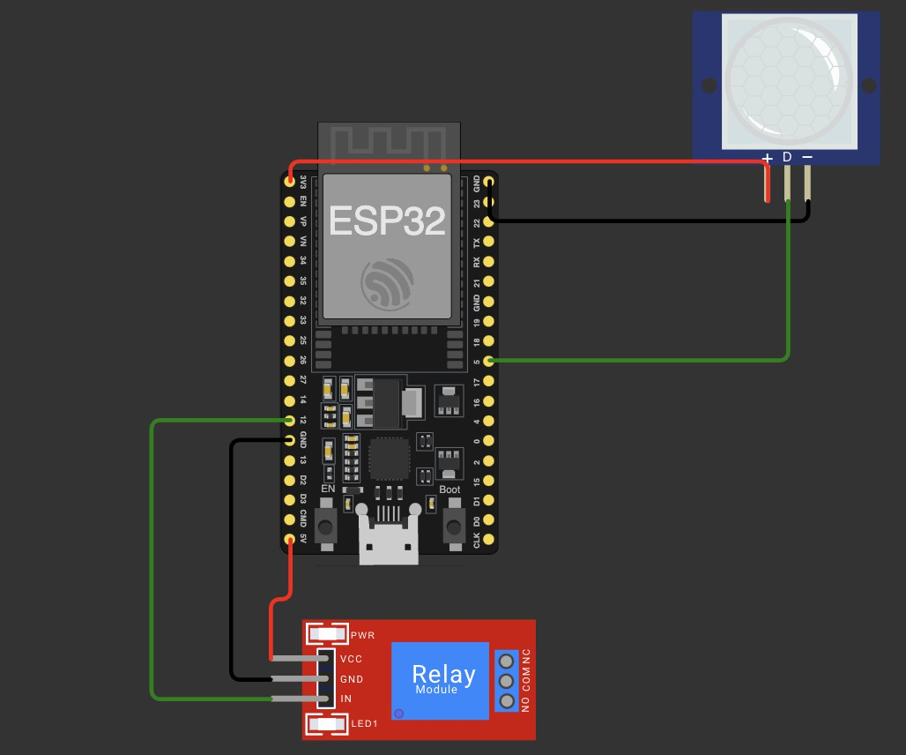
Proposed Solution
An ESP32-based Motion-Activated Smart Lighting System integrated with ThingSpeak for real-time data logging.
Key Components: PIR Motion Sensor, ESP32 Microcontroller, Relay Module, WiFi Connection, ThingSpeak
Solution Explanation: The PIR sensor detects motion and signals the ESP32, which activates the relay to turn on the light. If no motion is detected for 10 seconds, the light turns off automatically. The ESP32 sends real-time data to ThingSpeak every 15 seconds for monitoring motion count, light status, and energy usage.
Figure: System Architecture

Slide 4
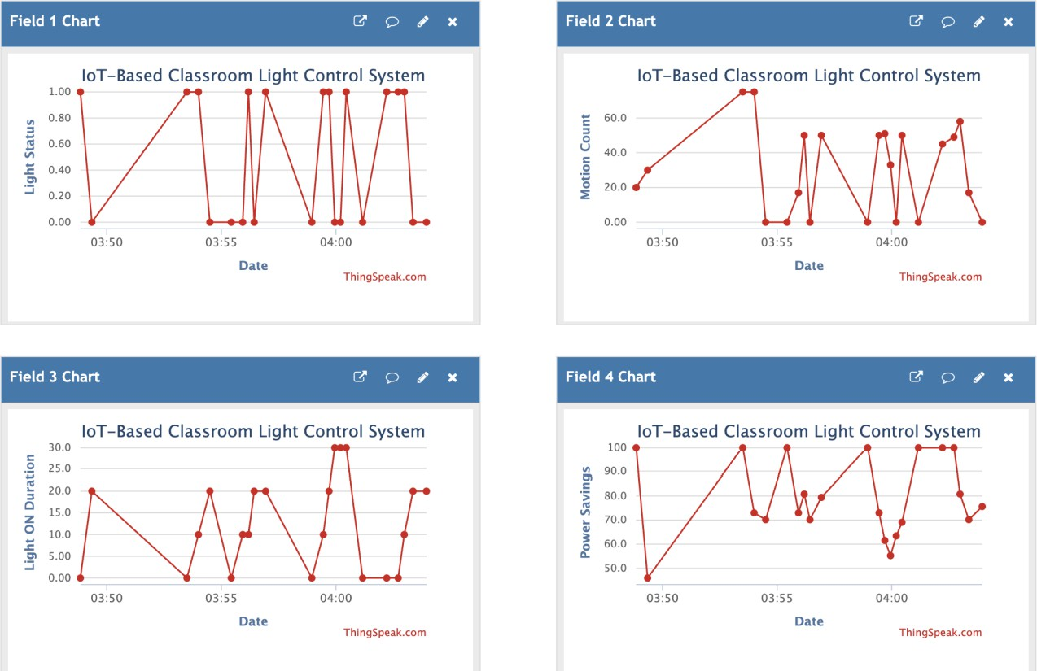
Results and Testing
Motion Detection Accuracy: PIR sensor detected motion with an average response time of 1-2 seconds.
Auto Turn-Off Efficiency: The system successfully turned off the light exactly after 10 seconds of inactivity.
Data Transmission Reliability: Data was transmitted to ThingSpeak every 15 seconds with a 99% success rate.
Figure: Result Graphs

Slide 5
Conclusion
Automated Lighting Control: The system efficiently turned the light ON upon motion detection and OFF after 10 seconds of inactivity, minimizing manual effort.
Efficient Power Usage: By activating lights only when needed, the system reduced energy waste and improved power efficiency.
Reliable Data Logging: ThingSpeak integration provided real-time monitoring of motion count, light status, and energy consumption for better analysis and optimization.
Contributions:
Naimisha Girish: Set up ThingSpeak integration and implemented energy tracking.
Diya Kevat: Developed the ESP32 control logic and motion detection system.
Vaishnavi Nambiar: Managed hardware setup, sensor calibration, data analysis, and documentation.

