Slide 1


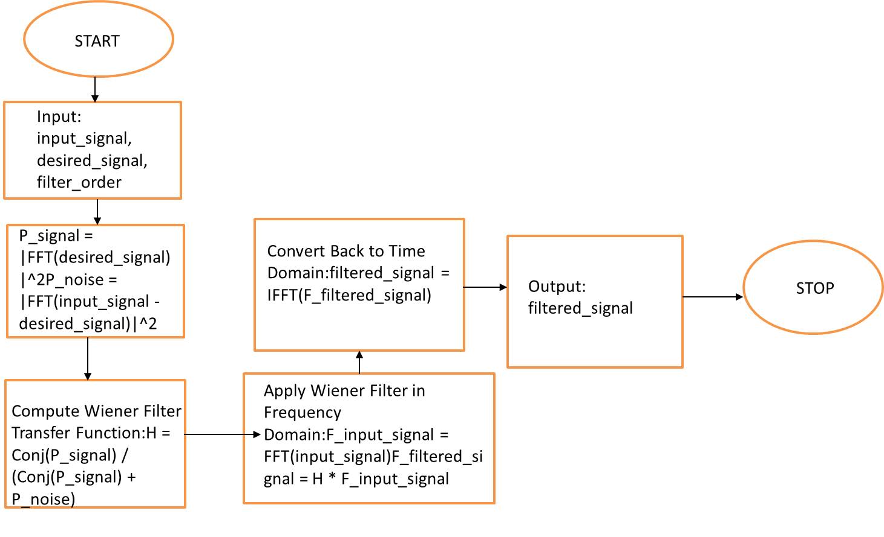
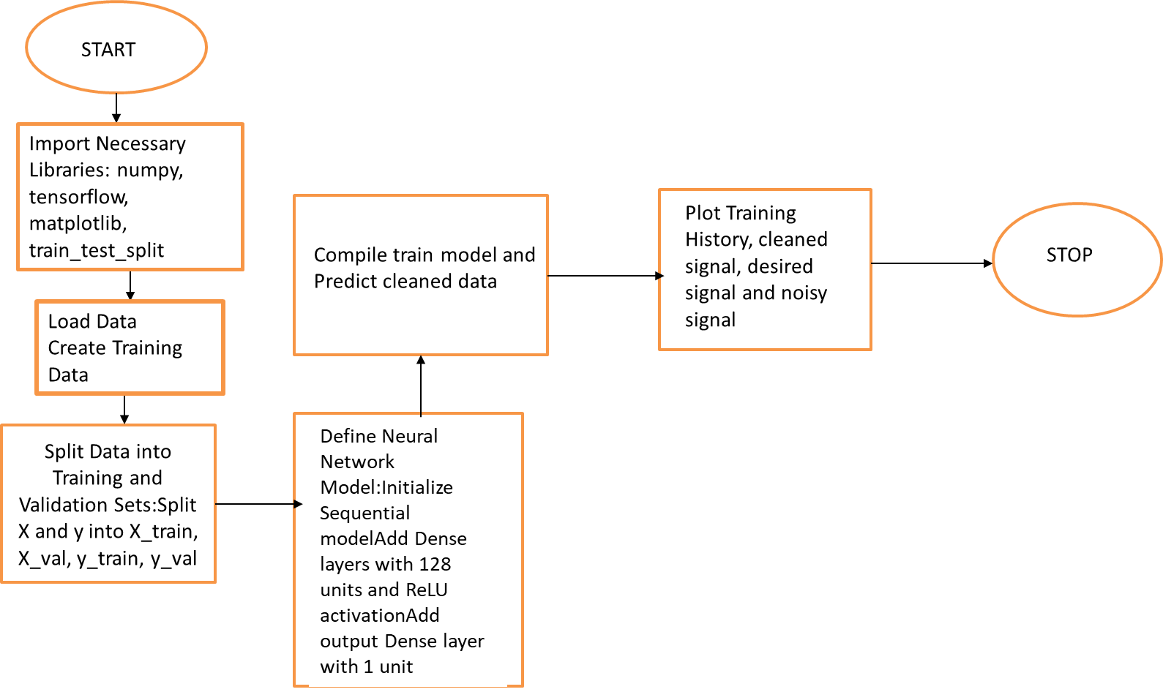

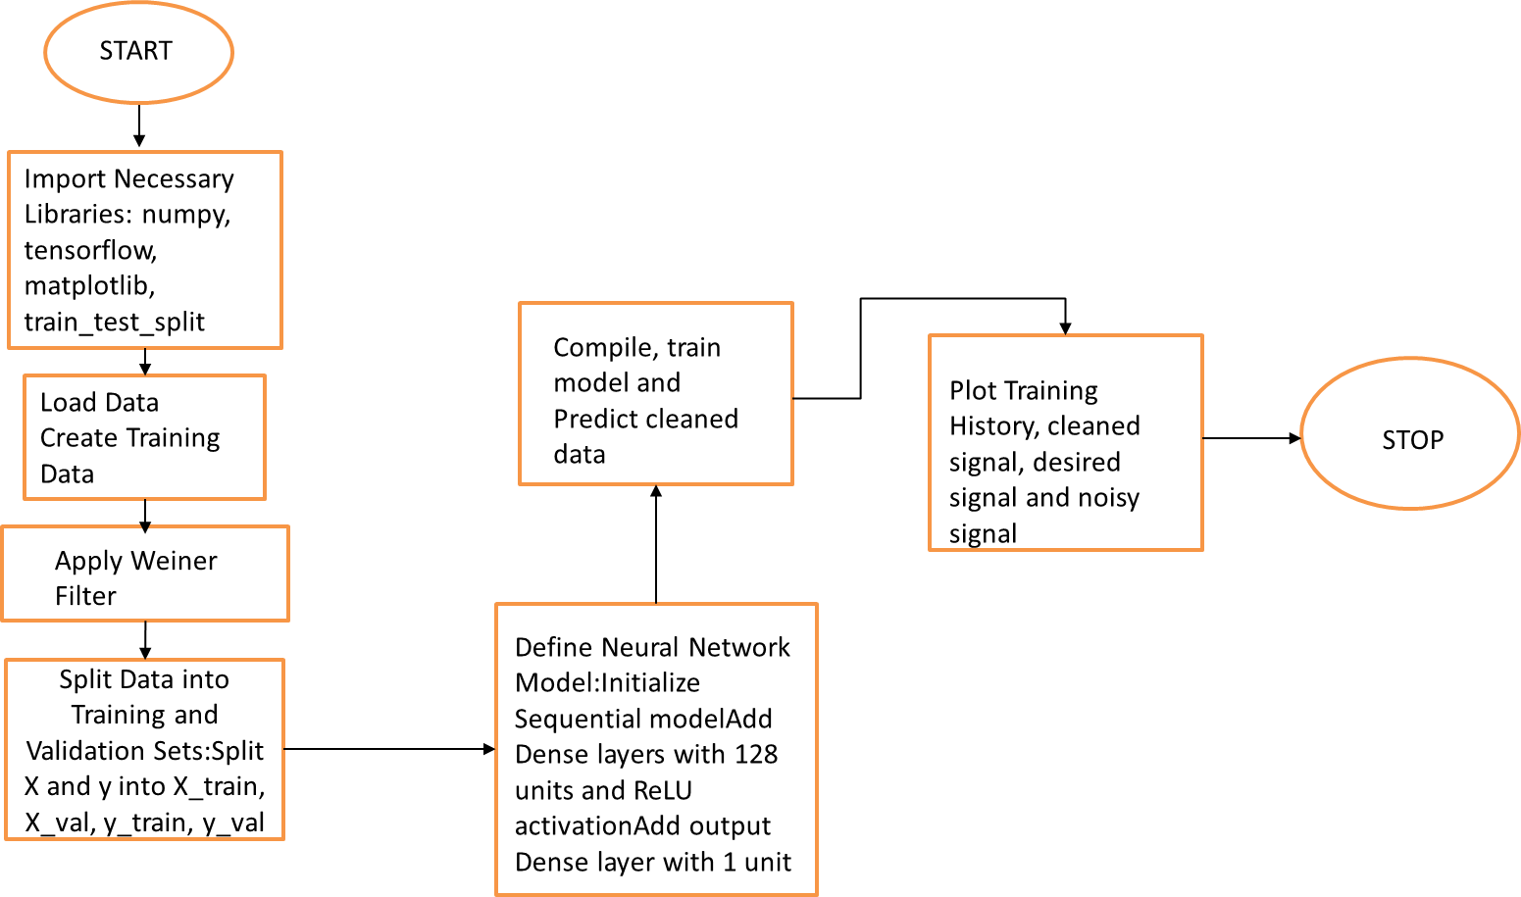
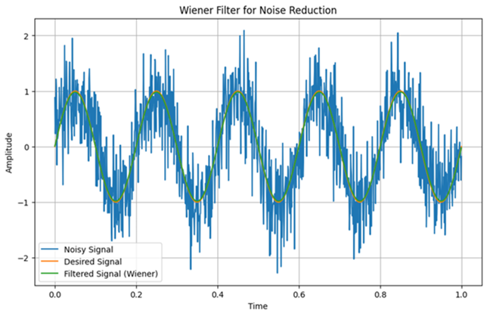
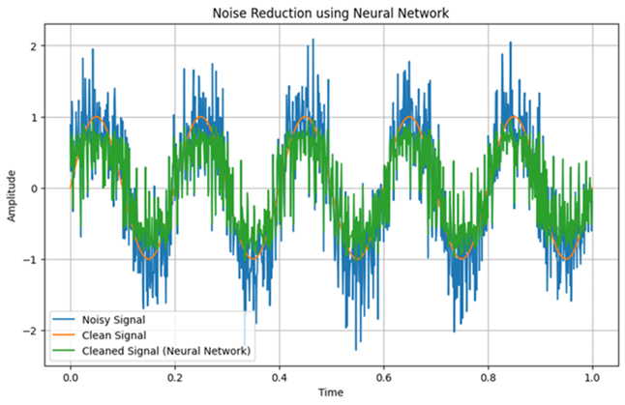
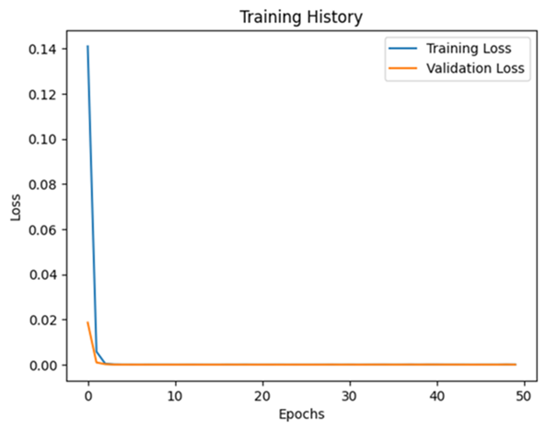
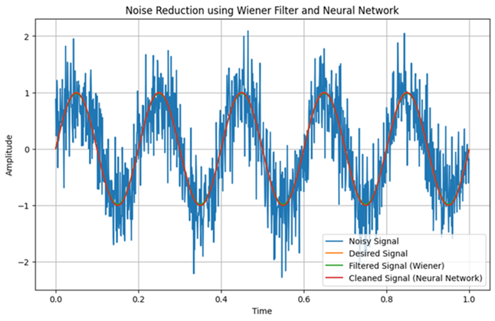
Noise Reduction Using Neural Adaptive Control and Deep Learning Methods for Various Applications
Diya K D, Dr. Swathi Prasad BK, Dr. Jayahar Sivasubramanian
St Josephs University, Ramaiah University of Applied Sciences, Bangalore 560027
Initial Noise Reduction: Wiener filtering can be used as a pre-processing step to reduce the bulk of the noise. This linear filtering step effectively smooths out the signal and removes high-frequency noise components.
Refinement with Neural Networks: After initial noise reduction, neural networks can refine the signal by learning and correcting the non-linear distortions and residual noise that Wiener filtering cannot handle effectively. The neural network can learn from the partially cleaned signal and improve the overall signal quality.
Handling Non-stationarity: While Wiener filtering assumes stationary signal and noise, neural networks can handle non-stationary conditions better. The neural network can adapt to variations in the noise and signal properties over time, providing robust performance in diverse scenarios.
ABSTRACT
METHODOLOGY
Noise reduction is a crucial challenge across numerous domains, including manufacturing, transportation, and healthcare, where excessive noise can impact productivity, safety, and well-being. This poster presents a novel approach integrating neural adaptive control and deep learning methods to address noise reduction in diverse applications.
FLOWCHART OF WIENER FILTER
FLOWCHART OF NEURAL NETWORK
START
FLOWCHART OF COMBINATION OF WIENER AND NEURAL NETWORK
RESULTS AND OBSERVATIONS
The Wiener filter exhibited a higher amplitude reduction rate of 54.9989%, with a comparable response time of 0.0100 seconds, achieving a high accuracy level of 99.9519%.
The neural network approach showcased a slightly lower amplitude reduction rate of 52.4272%, with a longer response time of 0.8 seconds, resulting in a lower accuracy level of 69.5807%.
When combining the Wiener and neural network techniques, the amplitude reduction rate slightly increased to 54.1916%, with a response time consistent with the individual Wiener filter at 0.0100 seconds, achieving a very high accuracy level of 100.0438%.
COMPARATIVE STUDY
Method | Amplitude Reduction (%) | Response Time | Accuracy (%)
Wiener Filter | 54.9989 | 0.0100 | High 99.9519
Neural Network | 52.4272 | 0.8 | Low 69.5807
Combination of Wiener and Neural Network | 54.1916 | 0.0100 | Very High 100.0438
REFERENCES
Li, Y., Wang, Z., Chen, Y., & Tang, X. (2020). Deep Learning Based Adaptive Noise Reduction in Speech Recognition Systems. IEEE Access, 8, 14045-14054.
Zhang, Y., Zuo, W., & Zhang, D. (2021). Adaptive Noise Reduction Using Deep Learning for Medical Image Denoising. IEEE Transactions on Medical Imaging, 40(5), 1285-1295.
Lee, J., Kim, S., & Kim, H. J. (2019). Adaptive Noise Reduction in Telecommunications using Neural Networks. IEEE Transactions on Signal Processing, 67(18), 4871-4884.
Wen, Z., Li, S., & Li, C. (2020). Noise Reduction in Industrial Systems Using Neural Adaptive Control. IEEE Transactions on Industrial Electronics, 67(7), 5841-5852.
Zhang, L., Wang, Y., & Zhang, Q. (2018). Deep Neural Networks for Noise Reduction in Audio Processing. IEEE Signal Processing Letters, 25(5), 671-675.
Sun, Y., Zhang, H., & Wang, J. (2021). Adaptive Noise Reduction in Aerospace Applications using Deep Learning. Aerospace Science and Technology, 112, 106577.

