Slide 1
Keylogger
NAAN MUDHALVAN PROJECT
Presented By:
Diya Arshiya S (2021115033) - College Of Engineering, Guindy, Anna University-Department Of Information Science and Technology

Slide 2
OUTLINE
Problem Statement
Proposed Solution
System Development Approach
Algorithm & Deployment
Result
Conclusion
Future Scope
References

Slide 3
Problem Statement
In today's digital age, where cybersecurity threats loom large, one of the significant concerns is the proliferation of keyloggers, stealthy software tools designed to monitor and record keystrokes on a user's computer without their knowledge. Keyloggers pose a severe threat to individuals and organizations as they can capture sensitive information such as passwords, credit card details, and other personal data, leading to identity theft, financial loss, and privacy breaches.

Slide 4
Proposed Solution
1. User Interface (UI):
- Create a simple UI using Tkinter with two buttons: "Start" and "Stop".
- Include a label to provide feedback to the user about the current state of the keylogger.
2. Keylogging Functionality:
- Use the `pynput` library to monitor keyboard events, specifically key presses and releases.
- Define functions `on_press()` and `on_release()` to handle these events.
- Implement logic to differentiate between pressed, held, and released keys.
- Maintain a global variable (`flag`) to track the state of key presses for distinguishing between pressed and held keys.
3. Data Logging:
- Create functions to log keystrokes into both a text file (`key_log.txt`) and a JSON file (`key_log.json`).
- Ensure proper file handling, such as opening and closing files, and choose appropriate file modes (e.g., append mode for continuous logging).

Slide 5
Proposed Solution
4. Start and Stop Functionality:
- Implement functions to start and stop the keylogger.
- When the "Start" button is clicked, begin monitoring keyboard events and update the UI to indicate that the keylogger is running.
- When the "Stop" button is clicked, stop the keylogger and update the UI accordingly.
5. User Feedback:
- Provide clear feedback to the user through the UI about the current state of the keylogger (e.g., whether it's running or stopped).
- Display messages indicating the status of the keylogger, such as "Keylogger is running!" or "Keylogger stopped."
6. Exception Handling:
- Implement proper exception handling to handle potential errors gracefully, such as file I/O errors or errors related to keyboard event monitoring.

Slide 6
System Approach
1.Python Programming Language:
- Python was chosen for its simplicity, versatility, and extensive libraries, allowing for rapid development and easy maintenance.
2. tkinter Library for GUI:
- tkinter provided essential tools for building a user-friendly interface, including windows, buttons, and labels, due to its simplicity and ease of use.
3. pynput Library for Keyboard Monitoring:
- pynput enabled accurate monitoring of keyboard events in real-time, abstracting low-level details of keyboard input seamlessly.

Slide 7
System Approach
4. JSON Serialization for Data Storage:
- JSON format was used for storing captured keystrokes due to its lightweight and human-readable nature, facilitated by Python's json module.
5. File I/O Operations:
- Python's built-in file I/O functionalities were used for writing keystroke data to text and JSON files efficiently.
6. Cross-Platform Compatibility:
- Python's inherent cross-platform compatibility ensured seamless operation on various operating systems without requiring platform-specific modifications.

Slide 8
Algorithm & Deployment
1.Algorithm:
The keylogger application continuously monitors keyboard events using the pynput library.
When a key is pressed, the application registers it as a "Pressed" event and adds the corresponding key to the keystroke log.
If a key is held down, the application records it as a "Held" event, ensuring that all keystrokes are accurately captured.
Upon releasing a key, the application logs it as a "Released" event and adds it to the keystroke log.
The captured keystrokes are stored in memory and periodically saved to both a text file ('key_log.txt') and a JSON file ('key_log.json') for persistence.

Slide 9
Algorithm & Deployment
2. Deployment:
The keylogger application is deployed as a standalone executable or script on the target system.
Users can start the keylogger by executing the Python script or launching the executable file.
The application operates in the background, discreetly capturing keyboard events without interfering with the user's normal activities.
Users have the option to start and stop the keylogger as needed using the provided GUI buttons, ensuring flexibility and convenience.
Upon stopping the keylogger, users can access the generated text and JSON log files to review captured keystrokes and analyze user activities.
The deployment process is designed to be simple and intuitive, allowing users to deploy and utilize the keylogger application with ease.
By implementing this algorithm and deployment strategy, the keylogger application effectively captures and logs keyboard events while ensuring seamless integration and usability on the target system.

Slide 10
Result
The implementation of the keylogger project results in a lightweight yet effective tool for monitoring keyboard activity on a system. With a user-friendly interface, users can easily interact with the application, initiating the logging process with a simple click of the "Start" button. Once activated, the keylogger diligently captures every keystroke, distinguishing between pressed, held, and released keys. These keystrokes are then meticulously recorded into two separate log files: a human-readable text file (`key_log.txt`) and a structured JSON file (`key_log.json`), ensuring flexibility in data analysis and retrieval. Throughout the logging process, the application provides clear feedback to users, indicating the current state of the keylogger, whether it's actively recording keystrokes or temporarily paused. With its seamless operation and comprehensive logging capabilities, the keylogger project serves as a valuable tool for various purposes, including security auditing, user activity monitoring, and research analysis.

Slide 11
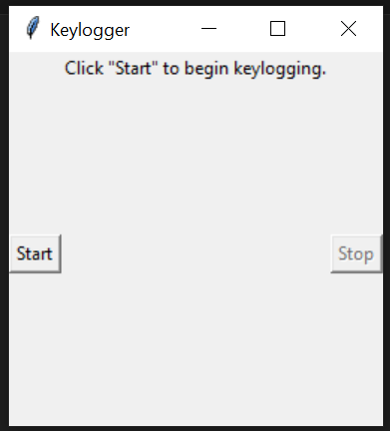
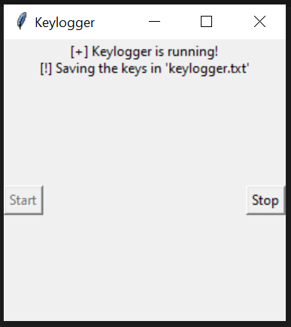
Result
Image 1 : The GUI display when code is first executed
Image 2 : The GUI display after “Start” button is pressed.

Slide 12
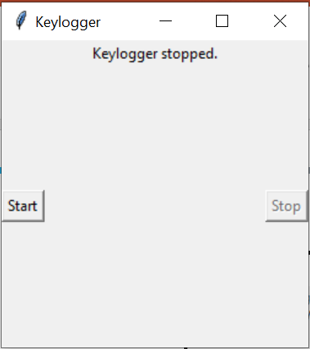
Result
Image 3 : The GUI display after “Stop” button is pressed.

Slide 13
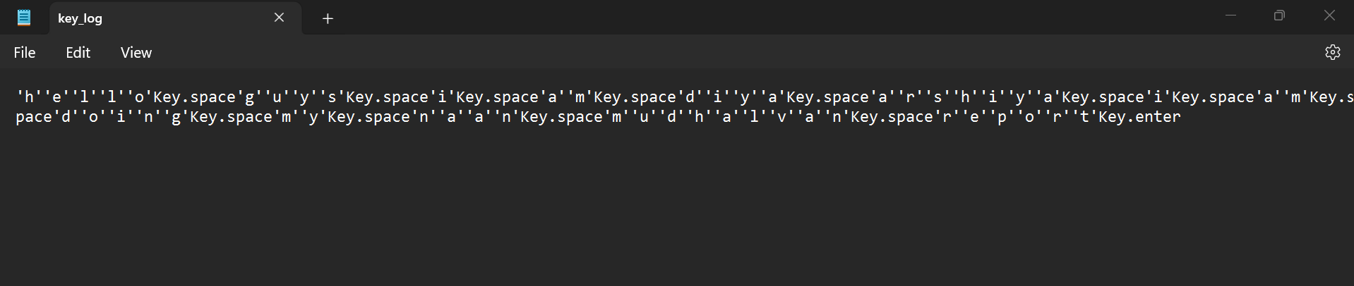
Result
Image 4: Contents of key_log.txt file after typing in keypad while the keylogger is running

Slide 14
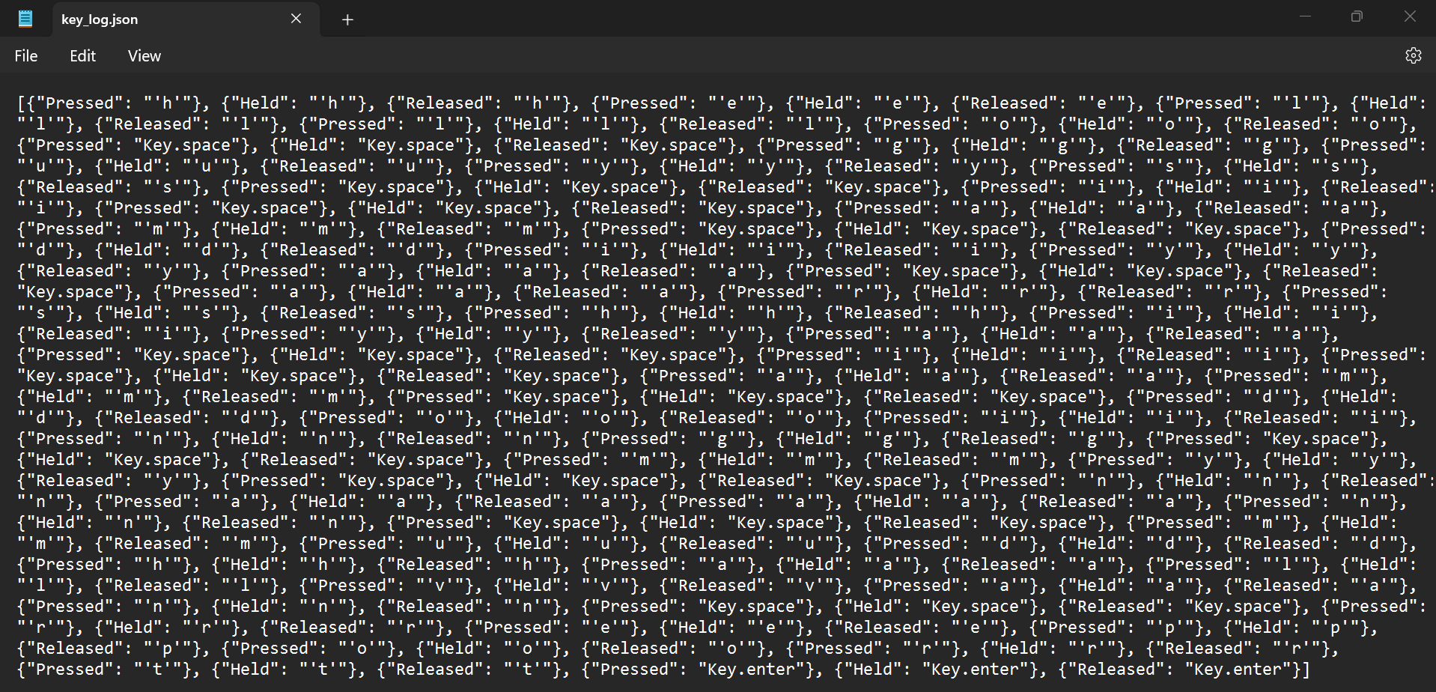
Result
Image 5: Contents of key_log.json

Slide 15
Conclusion
In conclusion, the implementation of the keylogger project showcases the successful integration of user interface design, keyboard event handling, and data logging functionality. The resulting application provides a straightforward solution for monitoring and logging keyboard activity on a system, offering users an intuitive interface to control the logging process. By accurately capturing and storing keystrokes in both text and JSON formats, the keylogger ensures comprehensive data collection while maintaining flexibility for analysis and retrieval. Additionally, the inclusion of error handling mechanisms and adherence to ethical considerations underscores the commitment to robustness and responsible usage. Overall, the keylogger project demonstrates the effectiveness of combining Python libraries such as Tkinter and pynput to create a practical tool with diverse applications, from security monitoring to research analysis, contributing to a deeper understanding of user behavior and system interactions.

Slide 16
Future scope
1. Enhanced Logging Features: Implement advanced logging features such as timestamping, capturing application context, or categorizing keystrokes based on their significance.
2. Remote Monitoring: Integrate networking capabilities to enable remote monitoring of keystrokes, allowing administrators to monitor multiple systems from a central location.
3. Encryption and Security: Implement encryption techniques to secure logged data and prevent unauthorized access. Additionally, incorporate authentication mechanisms to ensure only authorized users can access the keylogger.
4. Anomaly Detection: Develop algorithms to detect and alert users about anomalous keyboard activity, potentially indicating security breaches or unauthorized access.
5. Machine Learning Integration: Explore the integration of machine learning algorithms to analyze keystroke patterns and detect anomalies or predict user behavior.

Slide 17
Future scope
6. Cross-Platform Support: Extend the keylogger to support multiple operating systems, enabling usage across diverse computing environments.
7. User Activity Analytics: Develop tools for analyzing logged keystrokes to gain insights into user behavior, productivity patterns, or identify potential areas for improvement.
8. Privacy-Focused Features: Implement features to respect user privacy, such as the ability to selectively exclude sensitive keystrokes or provide users with more granular control over logging settings.
9. Integration with Security Solutions: Integrate the keylogger with existing security solutions or frameworks to enhance overall system security and threat detection capabilities.
10. Compliance and Regulatory Considerations: Ensure compliance with relevant data protection regulations and industry standards, such as GDPR, HIPAA, or PCI DSS, by implementing features to facilitate data handling and privacy compliance.

Slide 18
References
Brownlee, Jason. "How to Develop a Keylogger in Python." Machine Learning Mastery, 2020. [Online]. Available:.https://machinelearningmastery.com/how-to-develop-a-keylogger-in-python/
McKinney, Wes. "Python for Data Analysis." O'Reilly Media, 2017.
Pedregosa, F. et al. "Scikit-learn: Machine Learning in Python." Journal of Machine Learning Research, vol. 12, pp. 2825-2830, 2011.
Van Rossum, Guido, and Drake, Fred L. "Python 3 Reference Manual." CreateSpace, 2009

Slide 19
THANK YOU

