Slide 1
Music Genre Classification
Features:-
Zero Crossing Rate.
Spectral Centroid.
Chroma Frequencies
Spectral Roll-off
Mel-Frequency Cepstral Coefficients.
Validation and Testing
Feature Extraction
1
2
3
4
5
Initial Steps.(Completed)
Training KNN Method
Deployment on a Web Interface (Tentative)
Dataset Collection, GITZAN
Paper:-https://ieeexplore.ieee.org/document/1021072

Slide 2
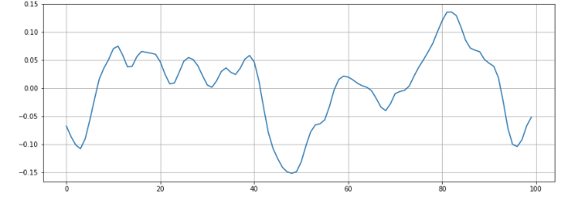
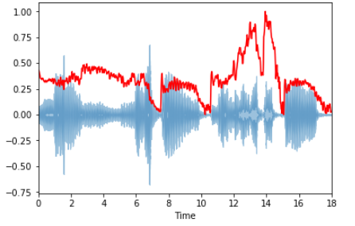
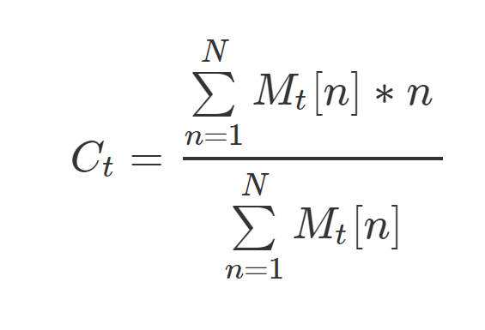
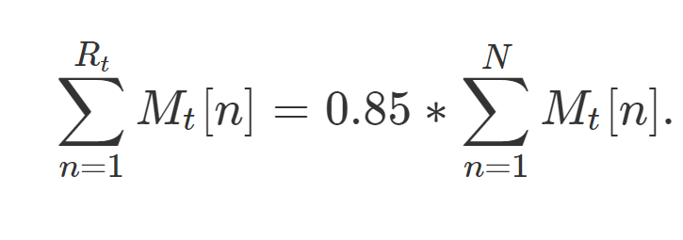
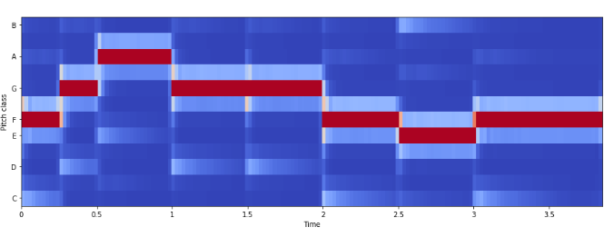
Zero Crossing Rate
Spectral Centroid.
Spectral Roll-off
Chroma Frequencies
Refrences:-
1- Blog https://towardsdatascience.com/music-genre-classification-with-python-c714d032f0d8
2- G. Tzanetakis and P. Cook, "Musical genre classification of audio signals," in IEEE Transactions on Speech and Audio Processing, vol. 10, no. 5, pp. 293-302, July 2002.

