Slide 1

Emergency
PS CODE:- SIH1620
TEAM MEMBERS:-DIYA GUPTA
GHANISHA
INSTITUTE NAME:-JMIT
THEME NAME:-Med/Bio/Health Tech

Slide 2
About the idea
Need For This
Hospitals often struggle with a shortage of beds, particularly during busy times like flu season, emergencies, or pandemics. When patients need inpatient care, long wait times can become a major issue, leading to treatment delays, crowded emergency rooms, and higher risks for patients. The challenge lies in managing bed availability in a way that prioritizes patients based on their needs while reducing wait times and making the best use of hospital resources.
Hospital Bed Availability Management System
Optimizing Bed Utilization in Healthcare Facilities
Real-time Hospital Bed Count Monitoring
Efficient Bed Allocation for Enhanced Patient Care
Automated Hospital Bed Tracking Solution
Improving Healthcare Resource Management

Slide 3
Idea / approach details
Technology Stack
•A Real-Time Bed Tracking System tracks bed availability and patient status.
•A Dynamic Bed Allocation Algorithm prioritizes and assigns hospital beds based on real-time needs.
•Integration with Electronic Health Records (EHR) allows seamless access to patient data.
•Patient Flow Optimization streamlines the movement of patients through the hospital, ensuring timely admissions, transfers, and discharges for efficient care.
•Optimizing Ambulance Dispatch and Patient Transport with Real-Time Bed Tracking:-The app optimizes ambulance dispatch by tracking real-time bed availability, directing ambulances to hospitals with open capacity, reducing wait times, and ensuring quicker patient care.
AI image recognition:-Open AI
Front-end:- HTML, CSS, JS REACT ,flutter.
Back-end:- Node.js/ Python, java.
Cloud hosting:-AWS/ google cloud platform.
Database:-MongoDB.
GPS & Mapping:-google maps API.

Slide 4
IDEA / APPROACH DETAILS
USE CASES
Ambulance driver:-Uses the app to view available hospitals with open beds, select the best hospital based on proximity and capacity, and receives optimized routes for patient transport.
System (App/Software):Provides real-time data on bed availability, hospital capacity, ambulance location, and routes, ensuring seamless communication between all actors involved.
Hospital Bed Manager:-Monitors real-time bed availability, assigns beds to incoming patients, and updates the system when beds are vacated or assigned.

Slide 5








Location
Application
Hospital
name of hospital
Ambulance driver
hospital staff
Data Base
AI Image
Recognition

Slide 6
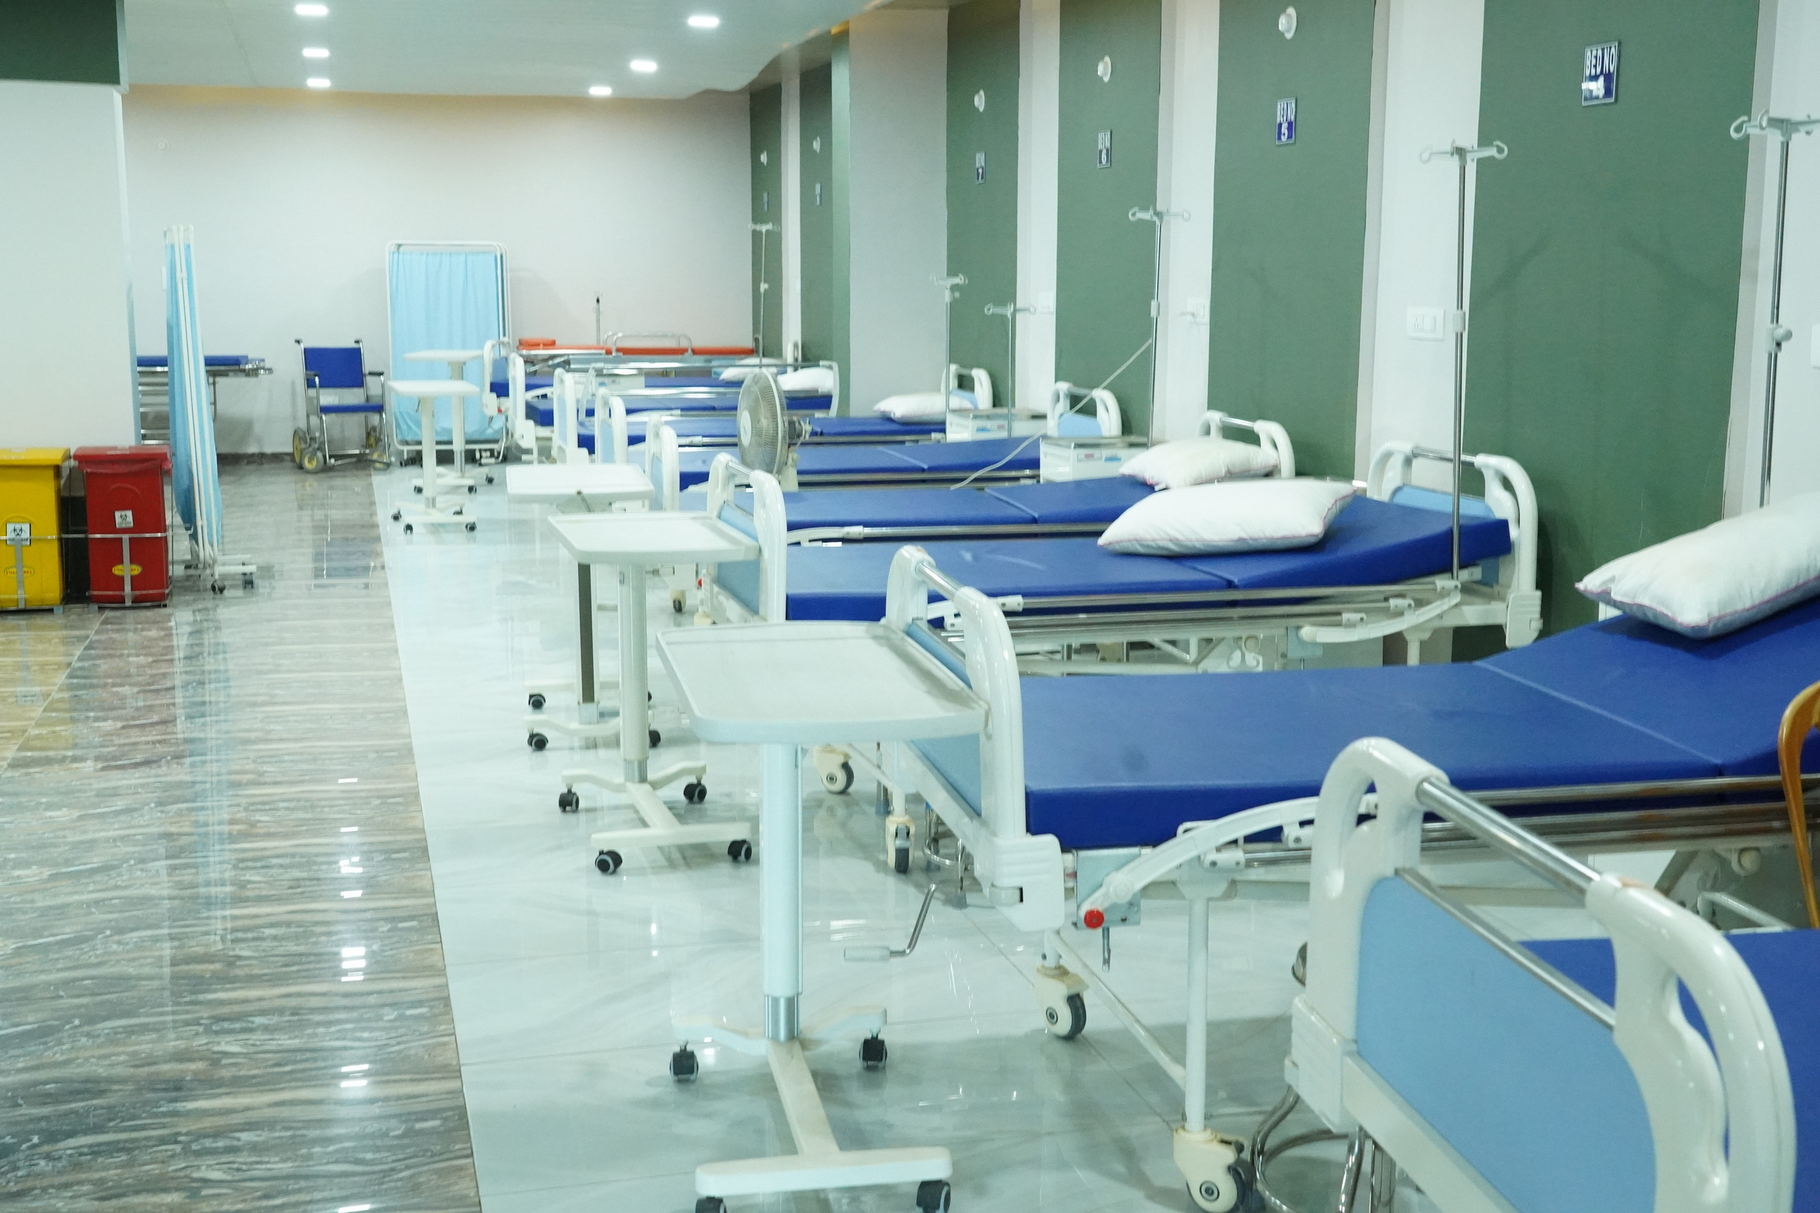
Dependencies/ show-stoppers
•Data Accuracy: Incorrect bed availability or patient data could disrupt operations.
•GPS/Traffic Data: Inaccuracies in ambulance routing could lead to delays.
•IoT Reliability: Failure of IoT devices could cause inaccurate bed status updates.
•Scalability: Inability to handle high traffic during peak demand.
•Mobile App Development: Functional apps for real-time communication and updates.
•Cloud Infrastructure: Scalable cloud platforms for data management.
•Ambulance GPS Integration: Accurate location and traffic data for routing optimization.

Slide 7
THANKYOU

