Slide 1


PREDICTIFY
BY CODE CRACKERS

Slide 2
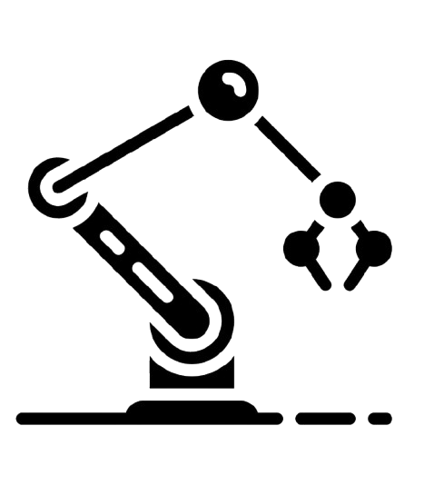
PREDICTIFY
Predictive maintenance is about preventing machine problems before they occur. Instead of waiting for equipment to fail, modern factories use technologies like artificial intelligence (AI) and machine learning to monitor their machines closely. This allows them to detect issues early. As a result, operations remain smooth, unexpected surprises are minimized, and maintenance can be planned at convenient times rather than being rushed. We are designing an application for this exact purpose. This app will track machine performance in real-time, using smart predictions to extend their operational life, reduce unexpected downtime, and ultimately save both time and money.

Slide 3
Objectives
Regularly check important machine details such as vibration, temperature, and pressure.
Spot any unusual changes in sensor readings automatically.
Predict possible equipment failures before they occur.
Display both current and past data visually with graphs and charts.
Use the information gathered to make informed maintenance decisions.
Plan maintenance tasks ahead of time using predictive algorithms.
Aim to cut down on unexpected downtime and lower maintenance costs.
Provide a user-friendly dashboard for easy and quick oversight.

Slide 4
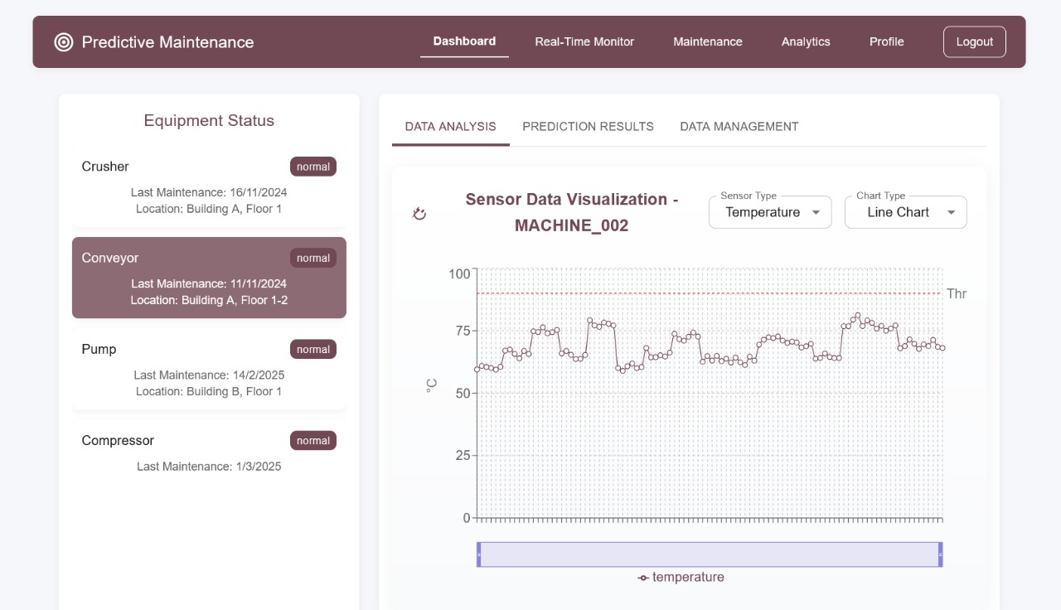



Our App: Revolutionizing Predictive Maintenance
Data Analysis
Unlocking the Power of Your Data
Prediction Result.
Smarter Predictions. Stronger Performance
Maintenance
Maintenance that Thinks Ahead.

Slide 5
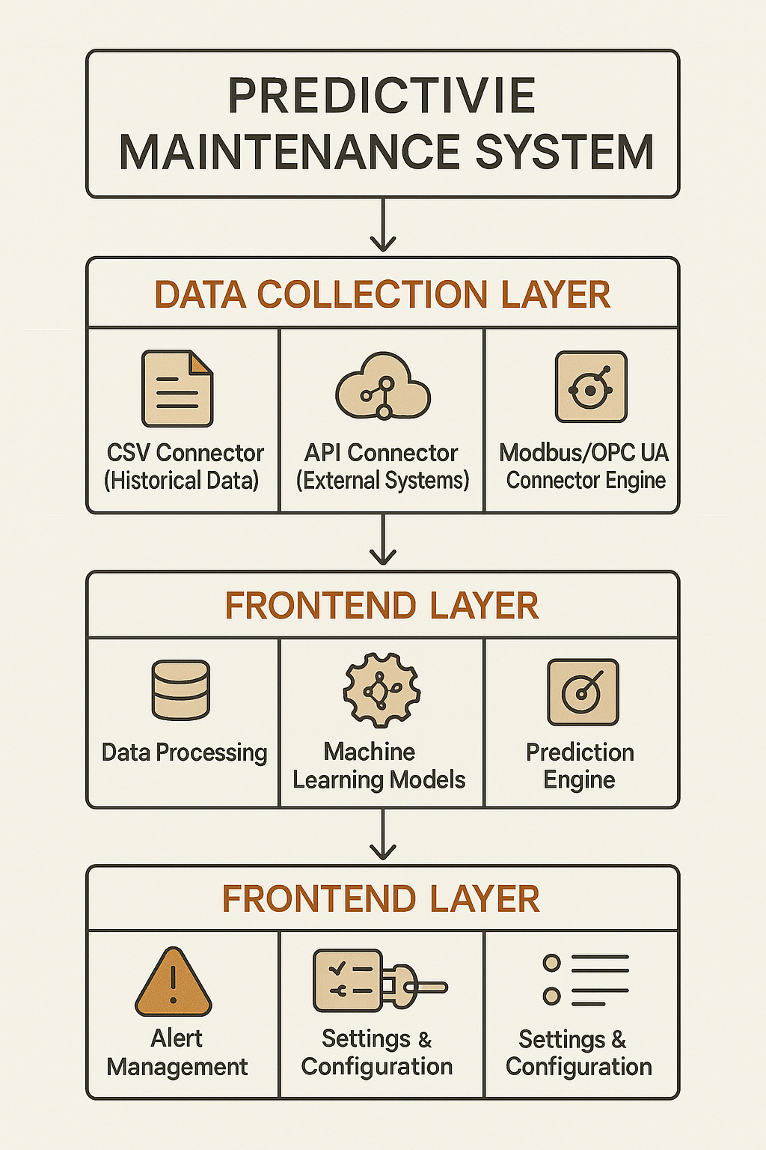
Predictive Maintenance System Overview
Our system is divided into three key layers:
Data Collection: Gathers data from CSV files, external systems, and industrial connectors.
Processing Layer: Cleans data, runs machine learning models, and generates predictions.
User Interface: Displays insights, sends alerts, and allows system configuration.

Slide 6
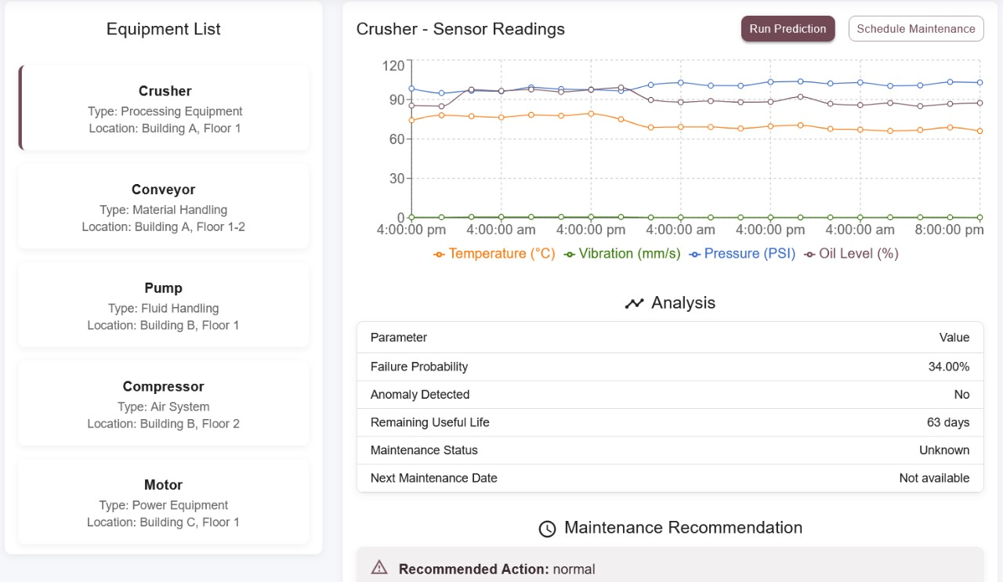
Equipment Monitoring Dashboard
Displays real-time sensor data (Temperature, Vibration, Pressure, Oil Level).
Provides failure probability and remaining useful life (RUL).
Allows predictions and scheduling maintenance.
Generates insights and recommendations to prevent equipment failure.

Slide 7
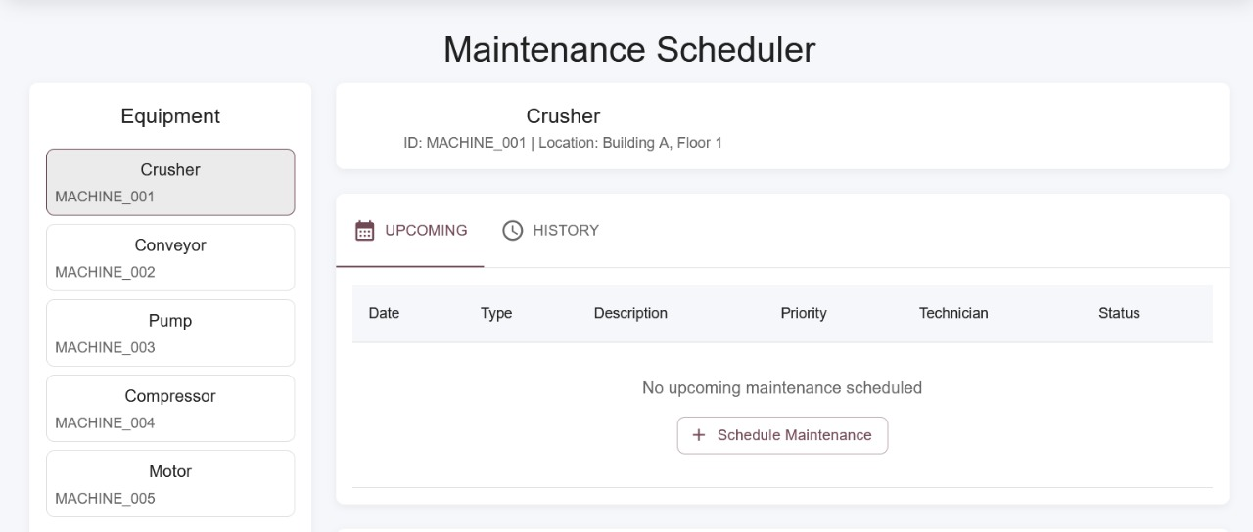
Maintenance Scheduler
View and manage equipment-specific maintenance schedules.
Allows assigning priority, type, and technician details.
Provides history tracking and upcoming schedule overview.
Ensures timely maintenance to reduce downtime and improve reliability.

Slide 8
Conclusion
The app assists you in tracking industrial equipment real-time using sensor data.
Predictive analytics enable it to forecast issues even before they arise, meaning fewer surprise breakdowns and less maintenance expense.
It provides data-driven recommendations for scheduling maintenance to maximise equipment longevity and performance.
The application applies sophisticated machine learning models to provide stable predictions and is convenient for maintenance scheduling and verification.
It also sets the stage for potential enhancements such as the incorporation of IoT devices and automated process establishment.

