Slide 1

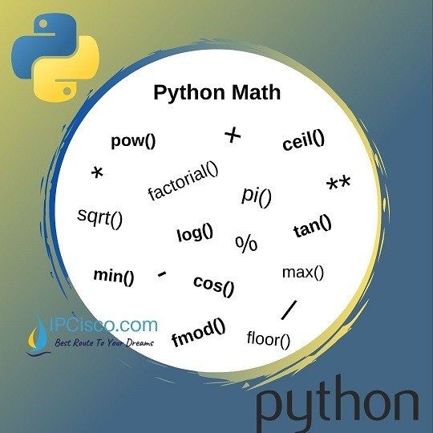
Numpy

Slide 2
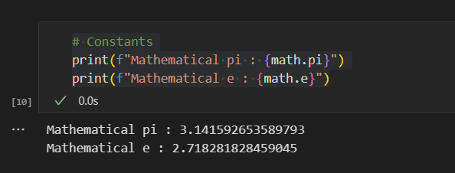
Math library in python(Constants)

Slide 3
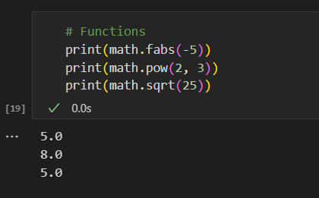
Functions

Slide 4
Functions

Slide 5
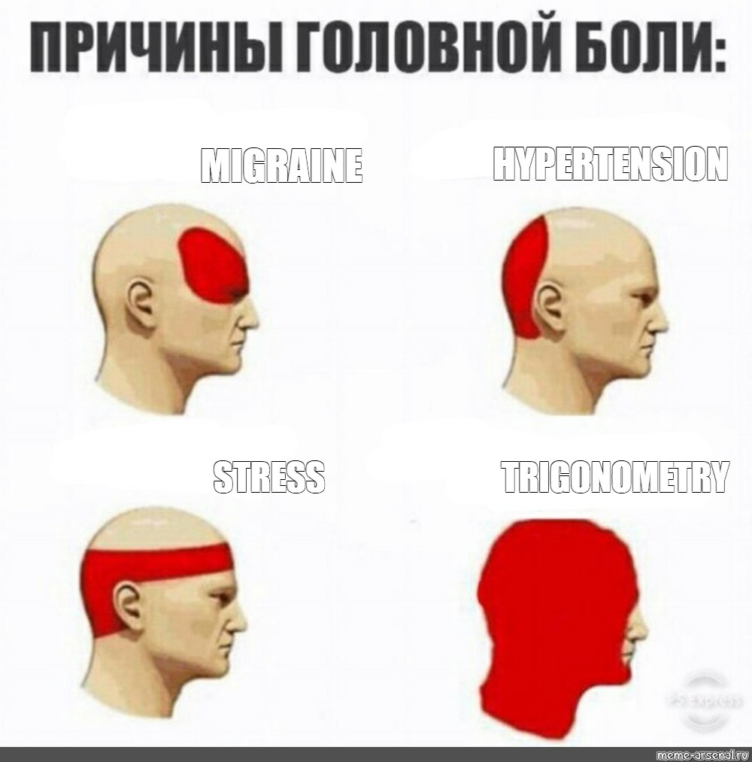
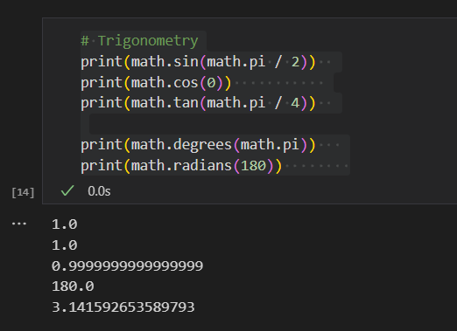
Trigonometry

Slide 6
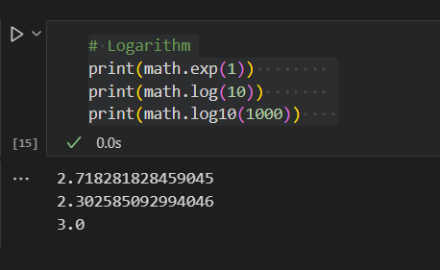
Logarithm

Slide 7
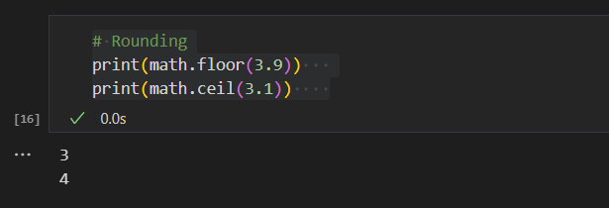
Yaxlitlash(Rounding)

Slide 8
Numpy

