Slide 1

Information on Japanese Prefectures
By Izzy Scrimsher and Brian Fitzpatrick

Slide 2
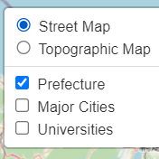
What information can you find?
Life expectancy
Population
Universities
City names
Shinkansen (bullet train) stations

Slide 3
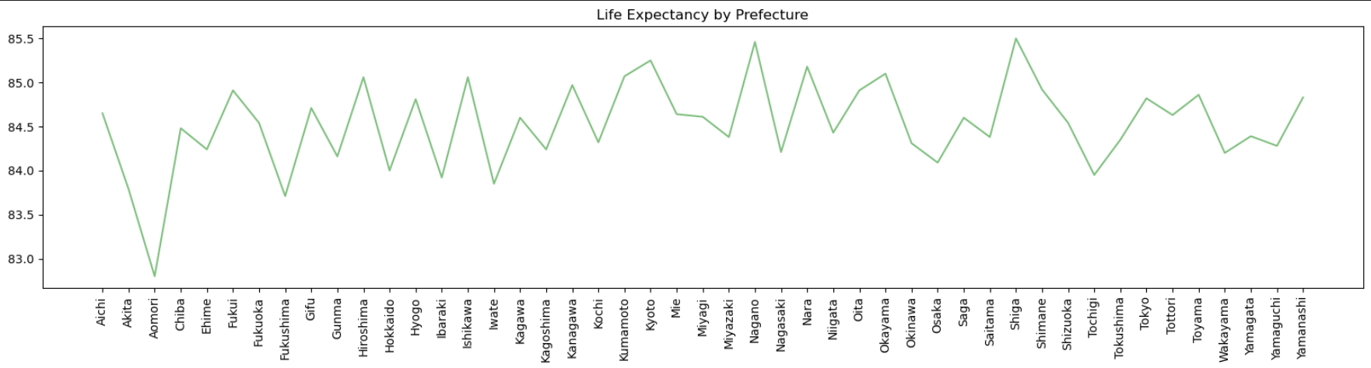
Life Expectancy
Graph of life expectancy by prefecture is displayed on the page

Slide 4
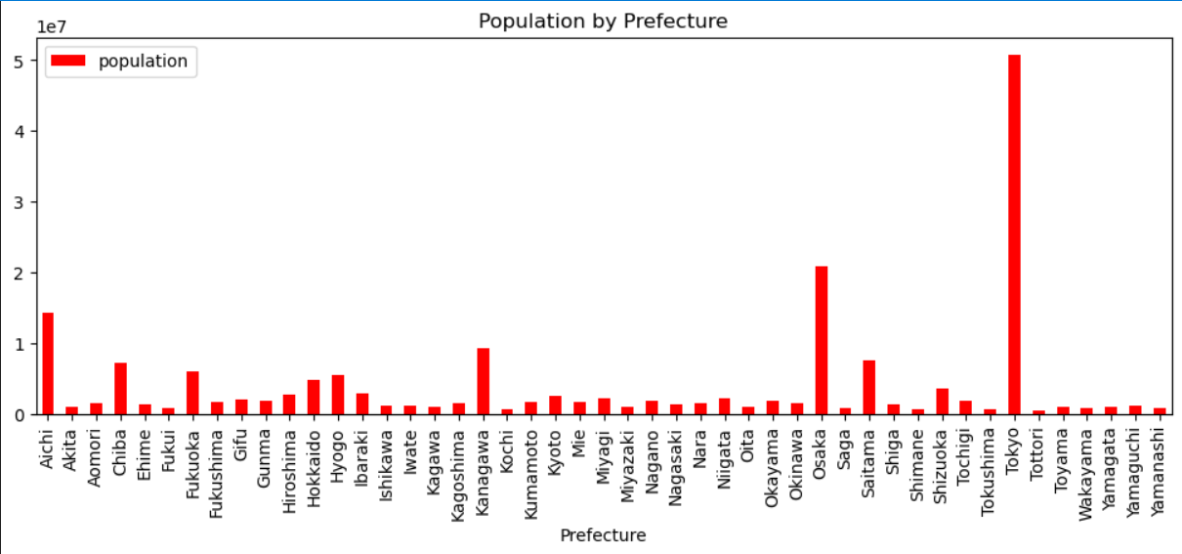
Population
Graph of population by prefecture is displayed on the page

Slide 5
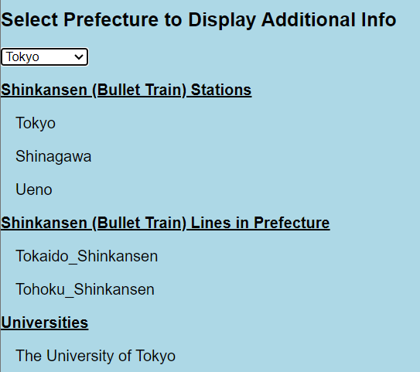
Universities
Select a prefecture by a drop-down menu and it will list major universities
On the map, select a university pin drop for rating of the university

Slide 6
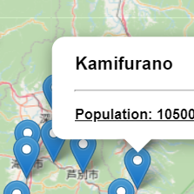
City Names
Select a pin drop on the map to see the name and population of different cities

Slide 7
Shinkansen (bullet train) Stations
Select a prefecture on the drop-down menu to see what shinkansen stations are there and what lines run through the prefecture

Slide 8
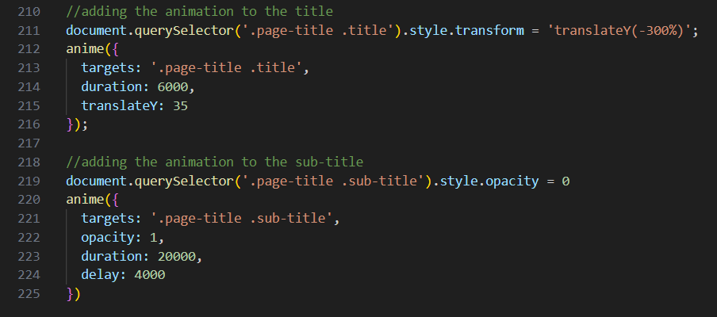
Code For Animation
Anime JavaScript library used to animate the title and subtitle

Slide 9
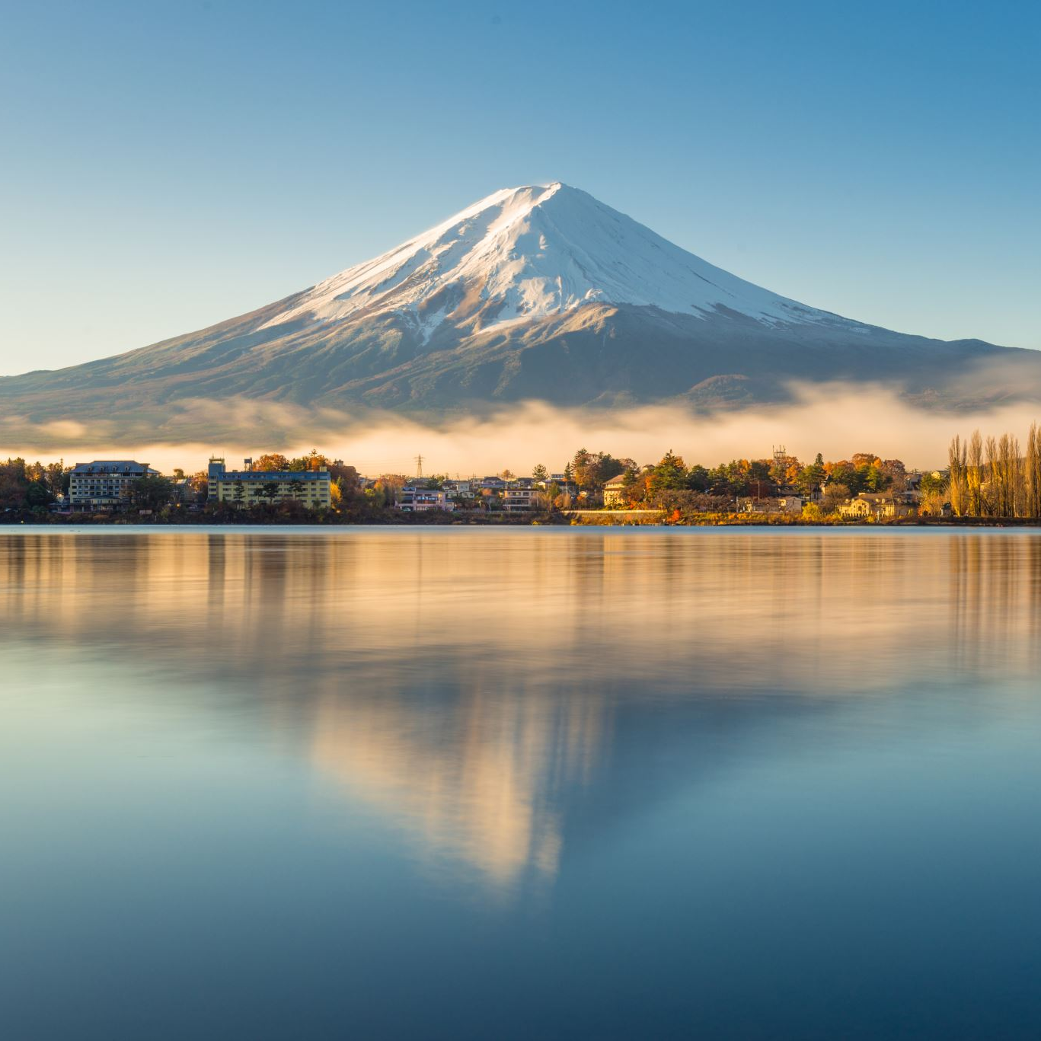
datasources
World Cities Database (worldcities.csv) https://simplemaps.com/data/world-cities
Japan life Expectancy (Japan_life_expectancy.csv) https://www.kaggle.com/datasets/gianinamariapetrascu/japan-life-expectancy
Japanese Universities https://www.kaggle.com/datasets/webdevbadger/japanese-universities
Japen Prefecture Latitude Longitude (Japan_prefecture_latlng.csv) https://www.kaggle.com/datasets/corochann/japan-prefecture-latitude-longitude
Shinkansen Stations in Japan https://www.kaggle.com/datasets/japandata509/shinkansen-stations-in-japan
City and prefecture
Prefecture.csv (https://github.com/nobuf/list-of-cities-in-japan/blob/master/build/prefectures.csv)
Cities_in_japan_2023.csv (https://github.com/nobuf/list-of-cities-in-japan/blob/master/build/cities_in_japan_2023.csv)

