Slide 1
The Road to a Digital Twin
Cláudio Gomes, Hao Feng, Casper Thule, Kenneth Lausdahl,
Peter Gorm Larsen

Slide 2
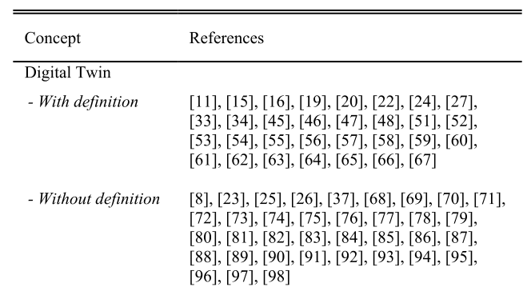
How do others define a Digital Twin?
Hard to pick one.
Our summary, from [2,3]:
Digital Twin: “when the data flows between an existing physical object and a digital object […] A change made to the physical object automatically leads to a change in the digital object and vice versa.”
[2] – Ongoing work by Til Boettjer et. al. on surveying the digital twin literature.
[3] – Fuller, Aidan, Zhong Fan, Charles Day, and Chris Barlow. “Digital Twin: Enabling Technologies, Challenges and Open Research.” IEEE Access 8 (2020): 108952–71. https://doi.org/10.1109/ACCESS.2020.2998358.
[1] - Barbara Rita Barricelli, Elena Casiraghi, and Daniela Fogli, “A Survey on Digital Twin: Definitions, Characteristics, Applications, and Design Implications,” IEEE Access 7 (2019): 167653–71.

Slide 3
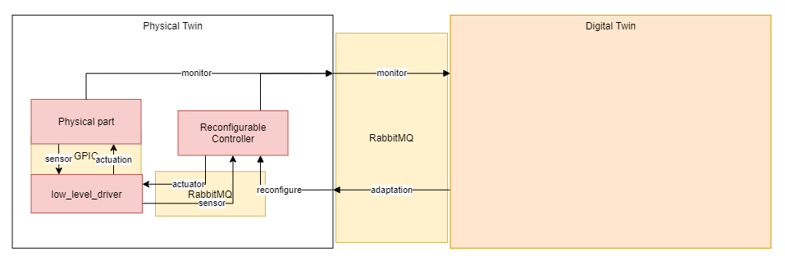
The abstract view

Slide 4
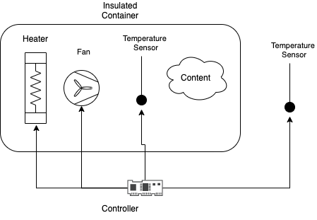
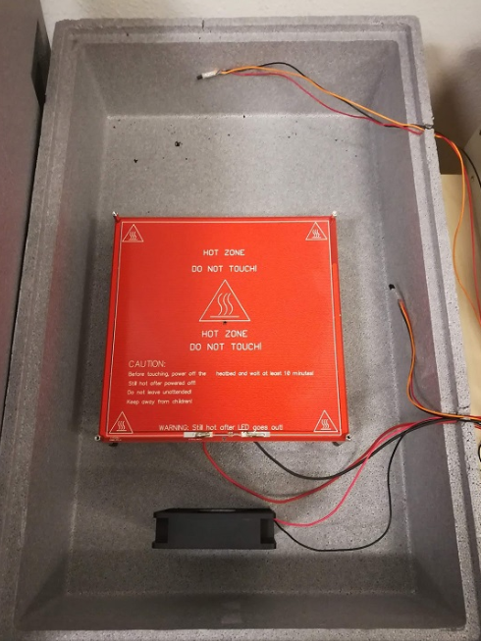
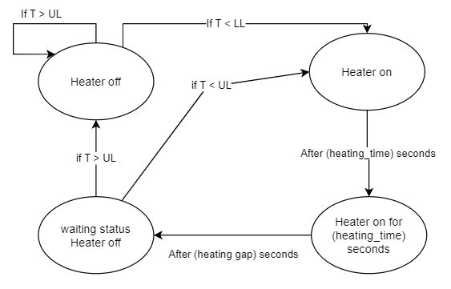
Example Physical Twin: Plant
Explain Incubator Setup
Controller
[1] – Full details in technical report by Hao Feng et. al.

Slide 5
Example Physical Twin: Controller
Controller
[1] – Full details in technical report by Hao Feng et. al.

Slide 6
Benefits of our digital twin
Safety Monitoring
3D Visualization
Support for decision making
Predictive maintenance
Fault Diagnosis
….

Slide 7
Benefits of our digital twin
Self-adaptation

Slide 8
Constructing a Digital Twin

Slide 9
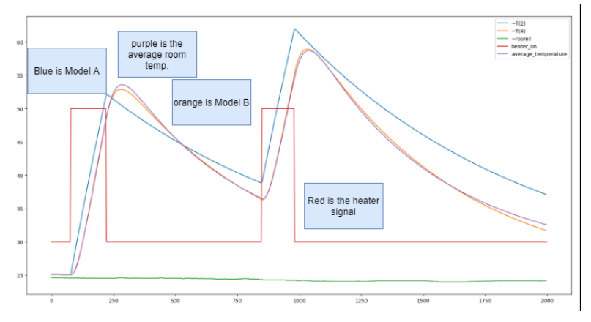
One-way Communication
Using RabbitMQ message broker
Physical twin produces timestamped messages:
Controller signals
Plant sensor measurements
Remake fig to just show the measurements.

Slide 10
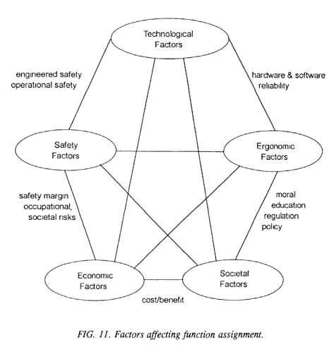
Visualization
Develop useful ways to display data about the Physical Twin
Not just 3D visualization, but 3D visualizations featured in many DT papers (about 5 out of every 7 papers read by Til Boettjer et. al. [2]
Out of scope, but contributions welcome!
[1] - International Atomic Energy Agency. “Control Room Systems Design for Nuclear Power Plants.” Nuclear Power Engineering Section, 1995. https://inis.iaea.org/collection/NCLCollectionStore/_Public/27/002/27002051.pdf.
[2] – Ongoing work by Till Boettjer et. al. on surveying the digital twin literature.

Slide 11
Example Monitor
Kalman used for hidden state?

Slide 12
Example Monitor
Kalman used for hidden state?

Slide 13
Two-way Communication
Physical twin modified to accept new values for parameters of the controller.
But safe limits to these have been hard-coded.
More safety issues remain…

Slide 14
Lessons on Reusability
Hard to reap the benefits of automatic adaptation through Digital Twin without having a physical twin that is ready to receive such adaptations
In incubator case study, the software controller needs to be reconfigurable automatic.
This poses challenges in safety which conflict with the vision of a DT being an open ended framework: how to ensure that the software is not inadvertently reconfigured to a bad configuration by an untested optimizer?
Challenging to devise general purpose DT features that work “plug-and-play”.
E.g., temperature uniformity monitoring requires offline experimentation with more sensors than those available in the system
Useful visualization is heavily dependent on application.

Slide 15
Lessons on Reusability
Monitoring techniques may require offline experimentation to calibrate the models used.

