Slide 1
The Road to a Digital Twin
Cláudio Gomes, Hao Feng, Casper Thule, Kenneth Lausdahl,
Peter Gorm Larsen

Slide 2
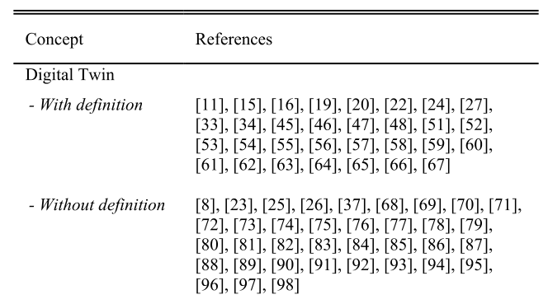
How do others define a Digital Twin?
Hard to pick one.
Our summary, from [2,3]:
Digital Twin: “when the data flows between an existing physical object and a digital object […] A change made to the physical object automatically leads to a change in the digital object and vice versa.”
[2] – Ongoing work by Til Boettjer et. al. on surveying the digital twin literature.
[3] – Fuller, Aidan, Zhong Fan, Charles Day, and Chris Barlow. “Digital Twin: Enabling Technologies, Challenges and Open Research.” IEEE Access 8 (2020): 108952–71. https://doi.org/10.1109/ACCESS.2020.2998358.
[1] - Barbara Rita Barricelli, Elena Casiraghi, and Daniela Fogli, “A Survey on Digital Twin: Definitions, Characteristics, Applications, and Design Implications,” IEEE Access 7 (2019): 167653–71.

Slide 3
Our Goal & Benefits of DTs
Physical Twin
Digital Twin
3D Visualization
Safety Monitoring
Predictive maintenance
Fault Diagnosis
Support for decision making
...
Self-reconfiguration
Plant
Communication
Controller

Slide 4
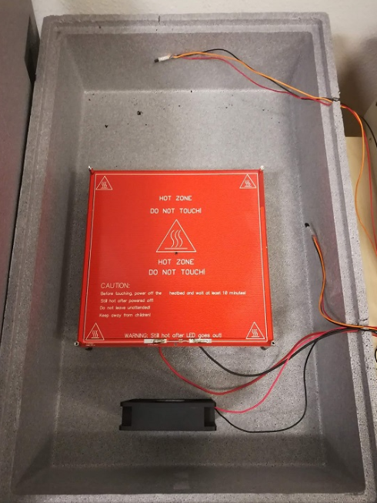

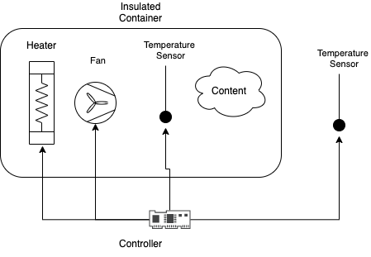
Example Physical Twin: Plant
Room Temperature
Physical Twin
Plant
Controller
[1] – Full details in technical report by Hao Feng et. al.

Slide 5
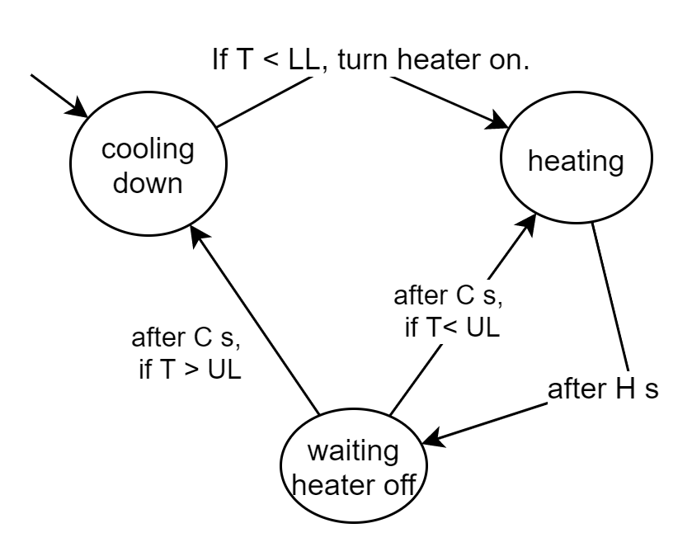
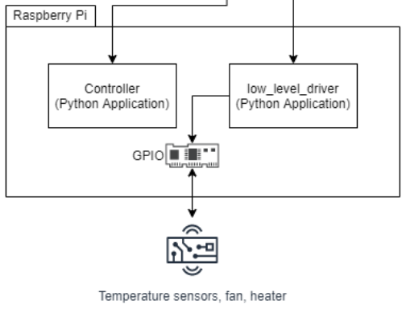
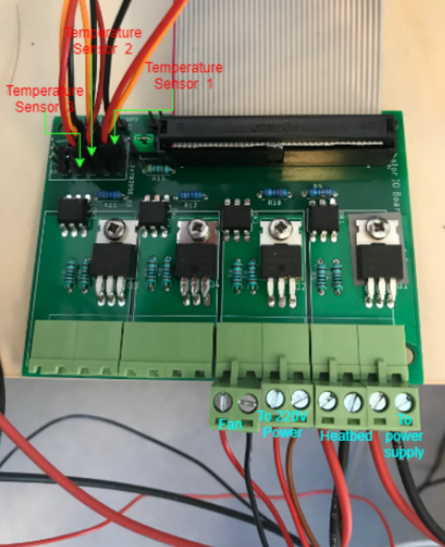
Example Physical Twin: Controller
Physical Twin
Plant
Controller
[1] – Full details in technical report by Hao Feng et. al.

Slide 6
Constructing a Digital Twin
Physical Twin
Digital Twin
3D Visualization
Safety Monitoring
Predictive maintenance
Fault Diagnosis
Support for decision making
...
Self-reconfiguration
Communication

Slide 7
One-way Communication
Physical Twin
RabbitMQ
Digital Twin
Data Recorder
data.csv
Kalman Filter
timestamp: XX
heater: on
t1: 22°C
t2: 32°C
t3: 33°C
…
Controller
Notes:
Using RabbitMQ message broker
Physical twin produces timestamped messages:
Controller signals
Plant sensor measurements

Slide 8
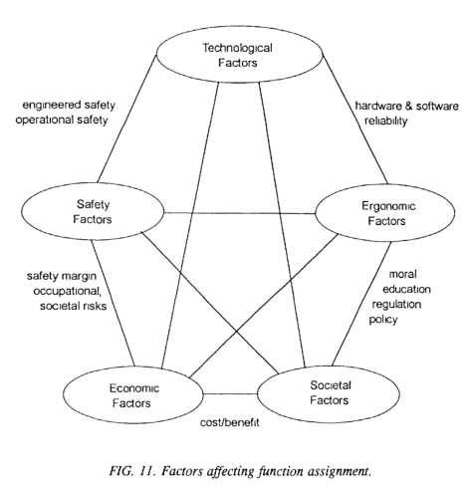
Visualization
Challenge: develop useful ways to display data about the Physical Twin
3D visualizations are featured in 5/7 DT papers read by Til Boettjer et. al. [2]
Out of our scope due to very specific to application.
[1] - International Atomic Energy Agency. “Control Room Systems Design for Nuclear Power Plants.” Nuclear Power Engineering Section, 1995. https://inis.iaea.org/collection/NCLCollectionStore/_Public/27/002/27002051.pdf.
[2] – Ongoing work by Till Boettjer et. al. on surveying the digital twin literature.
Notes:
Develop useful ways to display data about the Physical Twin
Not just 3D visualization, but 3D visualizations are featured in many DT papers (about 5 out of every 7 papers read by Til Boettjer et. al. [2]
Out of scope, but contributions welcome!

Slide 9
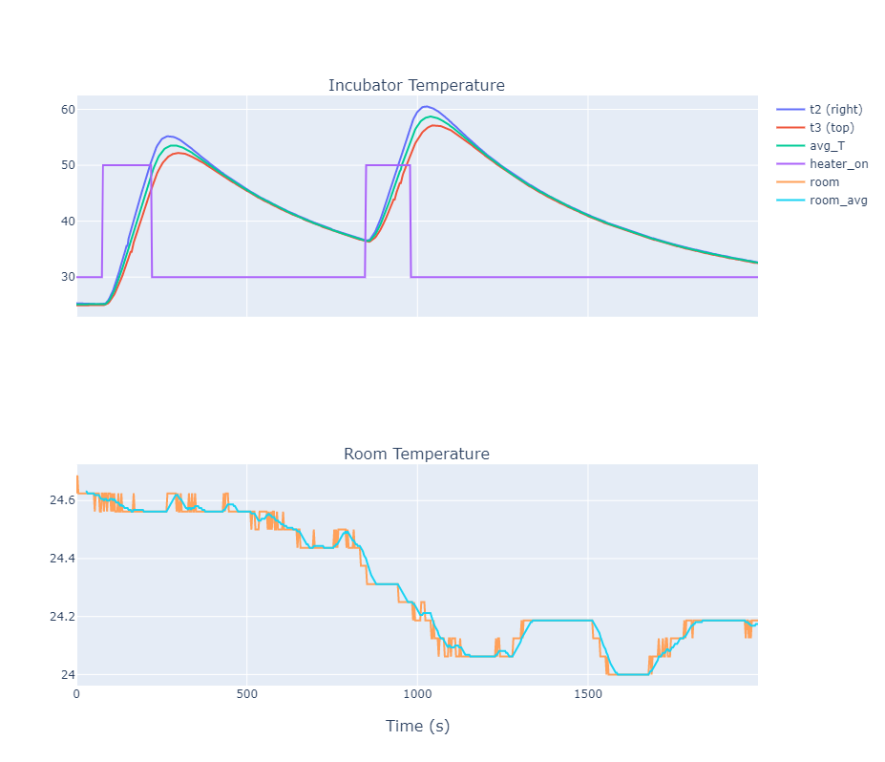

Visualization
Digital Twin
3D Visualization
Safety Monitoring
Predictive maintenance
Fault Diagnosis
Support for decision making
...
Self-reconfiguration
incubator_data.html

Slide 10






State Estimation: Kalman Filter
Digital Twin
3D Visualization
Safety Monitoring
Predictive maintenance
Fault Diagnosis
Support for decision making
...
Self-reconfiguration
Plant
Room: $R_{k}=1\text{9}\text{°}\text{C}$
Digital Twin
Styrofoam
Model
Safety Monitor
$$B_{k}=80\text{°}\text{C}$$
$$T_{k}=25\text{°}\text{C}$$
Predictive Maintenance
Kalman Filter
$$\left[\begin{matrix}B_{k+1} \\ T_{k+1}\end{matrix}\right]$$
Decision Support
$$H_{k}=1$$
$$T_{k}=25\text{°}\text{C}$$
$$R_{k}=1\text{9}\text{°}\text{C}$$
…
Controller
$$H_{k}=1$$
Notes:
Goal: translate what is observable from the system (temperature of the two sensors) into the state of the system (temperature of heatbed and average temperature).
Show a diagram of this.
KF accomplishes two things:
Fares well with noisy measurements,
And allows us to recover the “hidden variables” of the incubator
BUT: It needs a model!

Slide 11




Modelling Plant
Plant
Model
Room: $R_{k}=1\text{9}\text{°}\text{C}$
$$\left[\begin{matrix}B_{k+1} \\ T_{k+1}\end{matrix}\right]=M(θ,\left[\begin{matrix}B_{k} \\ T_{k}\end{matrix}\right],\left[\begin{matrix}H_{k} \\ R_{k}\end{matrix}\right])$$
Styrofoam
$$B_{k}=80\text{°}\text{C}$$
$$T_{k}=25\text{°}\text{C}$$
Kalman Filter
Notes:
Explain Model: inputs/outputs/parameters
dTh_dt = 1.0*(-G_heater*(-T + T_h) + V_heater*i_heater*on_heater)/C_heater
dT_dt = 1.0*(-G_box*(T - T_room) + G_heater*(-T + T_h))/C_air

Slide 12



Parameter Estimation
Physical Twin
Digital Twin
Plant
Data Recorder
data.csv
Controller
$$H_{k}=1$$
$$T_{k}=25\text{°}\text{C}$$
$$R_{k}=1\text{9}\text{°}\text{C}$$
Model
$$\left[\begin{matrix}B_{k+1} \\ T_{k+1}\end{matrix}\right]=M(θ,\left[\begin{matrix}B_{k} \\ T_{k}\end{matrix}\right],\left[\begin{matrix}H_{k} \\ R_{k}\end{matrix}\right])$$
LSE Solver
Best Parameters
$$\tilde{θ}=\left[\begin{matrix}486 \\ 0.8 \\ 33 \\ 0.7\end{matrix}\right]$$
calibration_results.html
Notes:
1. Run experiment

Slide 13
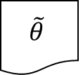

State Estimation: Kalman Filter Results
Digital Twin
3D Visualization
Safety Monitoring
Predictive maintenance
Fault Diagnosis
Support for decision making
...
Self-reconfiguration
Plant
Digital Twin
Room: $R_{k}=1\text{9}\text{°}\text{C}$
Styrofoam
Model
$$\tilde{θ}$$
$$B_{k}=80\text{°}\text{C}$$
$$T_{k}=25\text{°}\text{C}$$
Kalman Filter
$$\left[\begin{matrix}B_{k+1} \\ T_{k+1}\end{matrix}\right]$$
$$H_{k}=1$$
$$T_{k}=25\text{°}\text{C}$$
$$R_{k}=1\text{9}\text{°}\text{C}$$
Controller
kalman_results.html
$$H_{k}=1$$

Slide 14
Kalman Filter vs Tracking Simulator [1]
KF runs at every sample
Needs linearization
Needs modified model
Fast (can be run real-time)
Handles noise
TS needs periodic re-calibration
Works for non-linear models
Estimates both parameters and states
Slow (soft real-time)
[1] - Legaard, Christian Møldrup, Cláudio Gomes, Peter Gorm Larsen, and Frederik F. Foldager. “Rapid Prototyping of Self-Adaptive-Systems Using Python Functional Mockup Units,” to appear. SummerSim ’20. Virtual event: ACM New York, NY, USA, 2020.

Slide 15
Monitoring
Digital Twin
3D Visualization
Safety Monitoring
Predictive maintenance
Fault Diagnosis
Support for decision making
...
Self-reconfiguration

Slide 16
Monitoring
Digital Twin
3D Visualization
Safety Monitoring
Predictive maintenance
Fault Diagnosis
Support for decision making
...
Self-reconfiguration
Plant
Digital Twin
Room: $R_{k}=1\text{9}\text{°}\text{C}$
Styrofoam
Model
$$\tilde{θ}$$
$$B_{k}=80\text{°}\text{C}$$
$$T_{k}=25\text{°}\text{C}$$
Kalman Filter
$$\left[\begin{matrix}B_{k+1} \\ T_{k+1}\end{matrix}\right]$$
$$H_{k}=1$$
$$T_{k}=25\text{°}\text{C}$$
$$R_{k}=1\text{9}\text{°}\text{C}$$
Controller
kalman_results.html
$$H_{k}=1$$

Slide 17
Other Interesting Monitoring Problems
Detect fan anomalies
Detect PCB anomalies
…

Slide 18
What-If Analysis
Show use case: work around power outage: how much do we need to warm up the incubator to keep it from going below a certain threshold?
Explain how it relates to previous setup.

Slide 19
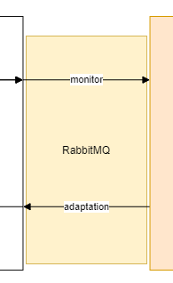
Two-way Communication
Physical twin modified to accept new values for parameters of the controller.
But safe limits to these have been hard-coded.
More safety issues remain…

Slide 20
Example Self-Adaptation Loop
Explain the optimization algorithm for the incubator:
Triggered when an objects gets placed inside the incubator.
After the properties of that object have been identified.
Finds a better configuration for the controller based on the newly identified plant model.

Slide 21
Big Picture
Talk about the case studies we want to make digital twins for.

Slide 22
Lessons/Challenges on Reusability
Hard to reap the benefits of automatic adaptation through Digital Twin without having a physical twin that is ready to receive such adaptations
In incubator case study, the software controller needs to be reconfigurable automatic.
This poses challenges in safety which conflict with the vision of a DT being an open ended framework: how to ensure that the software is not inadvertently reconfigured to a bad configuration by an untested optimizer?
Challenging to devise general purpose DT features that work “plug-and-play”.
E.g., temperature uniformity monitoring requires offline experimentation with more sensors than those available in the system
Useful visualization is heavily dependent on application.

Slide 23
Lessons/Challenges on Reusability
Monitoring techniques may require offline experimentation to calibrate the models used.
How to create a usable dashboard for all the previous techniques?

