Slide 1

Digesting the Digital Twin
Cláudio Gomes, Hao Feng, Casper Thule,
Kenneth Lausdahl, Peter Gorm Larsen

Slide 2
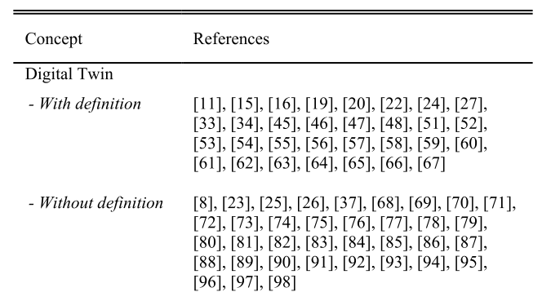
How do others define a Digital Twin?
Hard to pick one.
Our summary, from [2,3]:
Digital Twin: “when the data flows between an existing physical object and a digital object […] A change made to the physical object automatically leads to a change in the digital object and vice versa.”
[1] - Barbara Rita Barricelli, Elena Casiraghi, and Daniela Fogli, “A Survey on Digital Twin: Definitions, Characteristics, Applications, and Design Implications,” IEEE Access 7 (2019): 167653–71.
[2] – Ongoing work by Til Boettjer et. al. on surveying the digital twin literature.
[3] – Fuller, Aidan, Zhong Fan, Charles Day, and Chris Barlow. “Digital Twin: Enabling Technologies, Challenges and Open Research.” IEEE Access 8 (2020): 108952–71. https://doi.org/10.1109/ACCESS.2020.2998358.

Slide 3
Our Goal & Benefits of Digital Shadows
Physical Twin
Digital Shadow
Communication
3D Visualization
Safety Monitoring
Predictive maintenance
Fault Diagnosis
Support for decision making
Plant
Controller

Slide 4
Our Goal & Benefits of Digital Twin
Physical Twin
Digital Twin
3D Visualization
Safety Monitoring
Predictive maintenance
Fault Diagnosis
Support for decision making
Self-reconfiguration
Plant
Communication
Controller

Slide 5
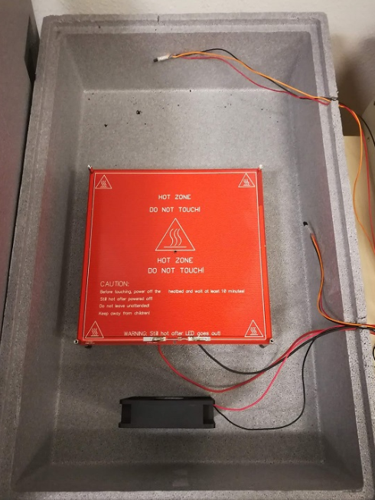

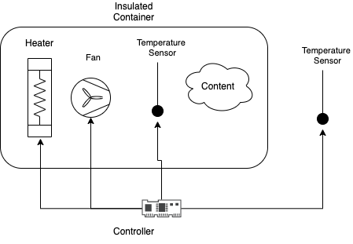
Example Physical Twin: Plant
Room Temperature
Physical Twin
Plant
Controller
[1] – Full details in technical report by Hao Feng et. al.

Slide 6
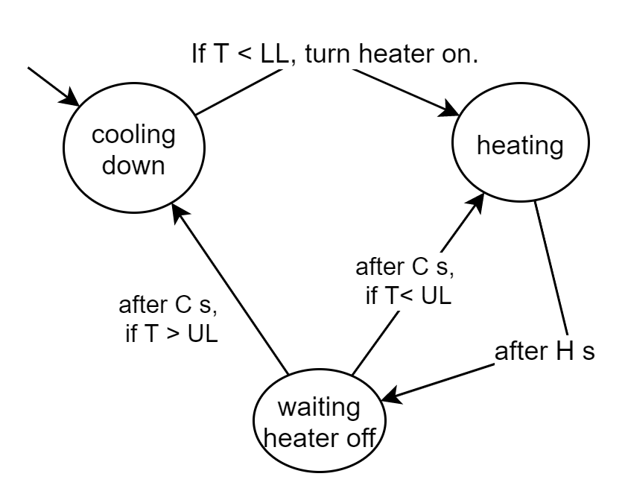
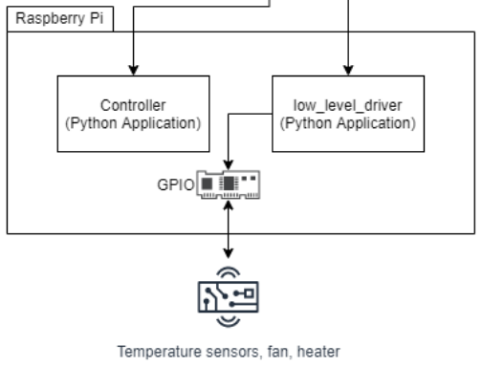
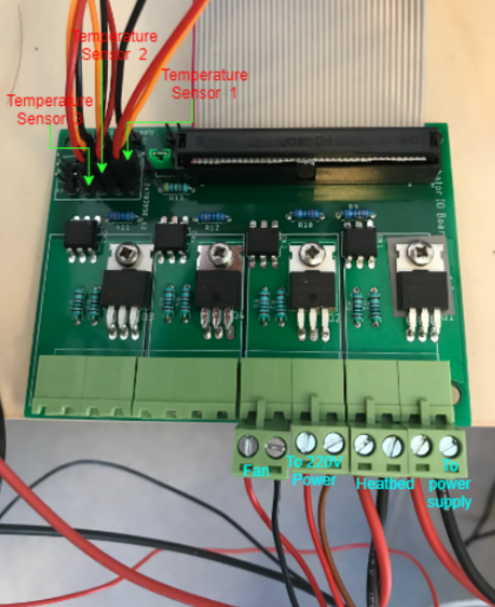
Example Physical Twin: Controller
Physical Twin
Plant
Controller
[1] – Full details in technical report by Hao Feng et. al.
Notes:
Explain Ctrl parameters

Slide 7
Atoms of a Digital Shadow
Physical Twin
Digital Shadow
3D Visualization
Safety Monitoring
Predictive maintenance
Fault Diagnosis
Support for decision making
Communication

Slide 8
One-way Communication
Physical Twin
RabbitMQ
Digital Shadow
Data Recorder
data.csv
Kalman Filter
timestamp: XX
heater: on
t1: 22°C
t2: 32°C
t3: 33°C
…
Controller
AMQP is the protocol.
RabbitMQ is the implementation of it.
It is tested in industry for years.
Setup by Casper and Kenneth
Notes:
Using RabbitMQ message broker
Physical twin produces timestamped messages:
Controller signals
Plant sensor measurements

Slide 9
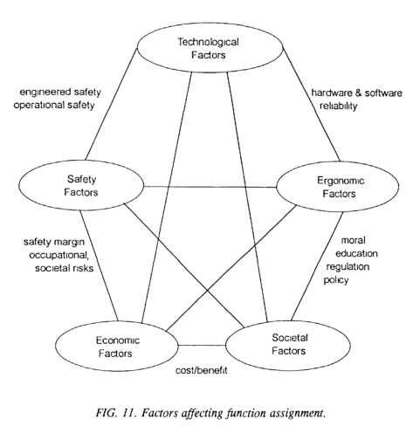
Visualization
Challenge: develop useful ways to display data about the Physical Twin
3D visualizations are featured in 5/7 DT papers read by Til Boettjer et. al. [2]
Out of our scope due to very specific to application.
[1] - International Atomic Energy Agency. “Control Room Systems Design for Nuclear Power Plants.” Nuclear Power Engineering Section, 1995. https://inis.iaea.org/collection/NCLCollectionStore/_Public/27/002/27002051.pdf.
[2] – Ongoing work by Till Boettjer et. al. on surveying the digital twin literature.
Notes:
Develop useful ways to display data about the Physical Twin
Not just 3D visualization, but 3D visualizations are featured in many DT papers (about 5 out of every 7 papers read by Til Boettjer et. al. [2]
Out of scope, but contributions welcome!

Slide 10
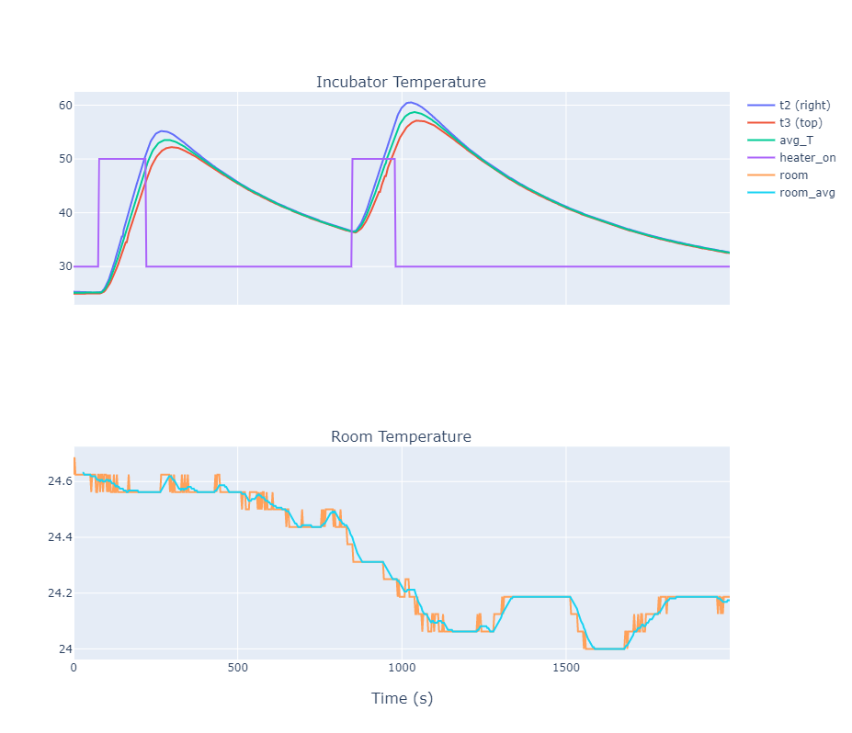

Visualization
Digital Shadow
3D Visualization
Safety Monitoring
Predictive maintenance
Fault Diagnosis
Support for decision making
incubator_data.html
Same framework we use in the into-cps application.

Slide 11






State Estimation: Kalman Filter
Digital Shadow
3D Visualization
Safety Monitoring
Predictive maintenance
Fault Diagnosis
Support for decision making
Plant
Room: $R_{k}=1\text{9}\text{°}\text{C}$
Digital Shadow
Styrofoam
Model
Safety Monitor
$$B_{k}=80\text{°}\text{C}$$
$$T_{k}=25\text{°}\text{C}$$
Predictive Maintenance
Kalman Filter
$$\left[\begin{matrix}B_{k+1} \\ T_{k+1}\end{matrix}\right]$$
Decision Support
$$H_{k}=1$$
$$T_{k}=25\text{°}\text{C}$$
$$R_{k}=1\text{9}\text{°}\text{C}$$
…
Controller
$$H_{k}=1$$
Notes:
Goal: translate what is observable from the system (temperature of the two sensors) into the state of the system (temperature of heatbed and average temperature).
Show a diagram of this.
KF accomplishes two things:
Fares well with noisy measurements,
And allows us to recover the “hidden variables” of the incubator
BUT: It needs a model!

Slide 12




Modelling Plant
Plant
Model
Room: $R_{k}=1\text{9}\text{°}\text{C}$
$$\left[\begin{matrix}B_{k+1} \\ T_{k+1}\end{matrix}\right]=M(θ,\left[\begin{matrix}B_{k} \\ T_{k}\end{matrix}\right],\left[\begin{matrix}H_{k} \\ R_{k}\end{matrix}\right])$$
Styrofoam
$$B_{k}=80\text{°}\text{C}$$
$$T_{k}=25\text{°}\text{C}$$
Kalman Filter
Notes:
Explain Model: inputs/outputs/parameters
dTh_dt = 1.0*(-G_heater*(-T + T_h) + V_heater*i_heater*on_heater)/C_heater
dT_dt = 1.0*(-G_box*(T - T_room) + G_heater*(-T + T_h))/C_air

Slide 13



Parameter Estimation
Physical Twin
Digital Shadow
Plant
Data Recorder
data.csv
Controller
$$H_{k}=1$$
$$T_{k}=25\text{°}\text{C}$$
$$R_{k}=1\text{9}\text{°}\text{C}$$
Model
Moving Average
$$\left[\begin{matrix}B_{k+1} \\ T_{k+1}\end{matrix}\right]=M(θ,\left[\begin{matrix}B_{k} \\ T_{k}\end{matrix}\right],\left[\begin{matrix}H_{k} \\ R_{k}\end{matrix}\right])$$
LSE Solver
Best Parameters
$$\tilde{θ}=\left[\begin{matrix}486 \\ 0.8 \\ 33 \\ 0.7\end{matrix}\right]$$
calibration_results.html
Notes:
1. Run experiment

Slide 14
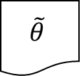

State Estimation: Kalman Filter Results
Digital Shadow
3D Visualization
Safety Monitoring
Predictive maintenance
Fault Diagnosis
Support for decision making
Plant
Digital Shadow
Room: $R_{k}=1\text{9}\text{°}\text{C}$
Styrofoam
Model
$$\tilde{θ}$$
$$B_{k}=80\text{°}\text{C}$$
$$T_{k}=25\text{°}\text{C}$$
Kalman Filter
$$\left[\begin{matrix}B_{k+1} \\ T_{k+1}\end{matrix}\right]$$
$$H_{k}=1$$
$$T_{k}=25\text{°}\text{C}$$
$$R_{k}=1\text{9}\text{°}\text{C}$$
Controller
kalman_results.html
$$H_{k}=1$$

Slide 15
Kalman Filter vs Tracking Simulator [1]
KF runs at every sample
Needs linearization
Needs modified model
Fast (can be run real-time)
Handles noise
TS needs periodic re-calibration
Works for non-linear models and co-simulations
Estimates both parameters and states
Slow (soft real-time)
Does not handle noise
[1] - Legaard, Christian Møldrup, Cláudio Gomes, Peter Gorm Larsen, and Frederik F. Foldager. “Rapid Prototyping of Self-Adaptive-Systems Using Python Functional Mockup Units,” to appear. SummerSim ’20. Virtual event: ACM New York, NY, USA, 2020.

Slide 16

Monitoring
Digital Shadow
3D Visualization
Safety Monitoring
Predictive maintenance
Fault Diagnosis
Support for decision making
Plant
Digital Shadow
Styrofoam
Model
$$\tilde{θ}$$
Kalman Filter
State
Anomaly Detector
Controller

Slide 17
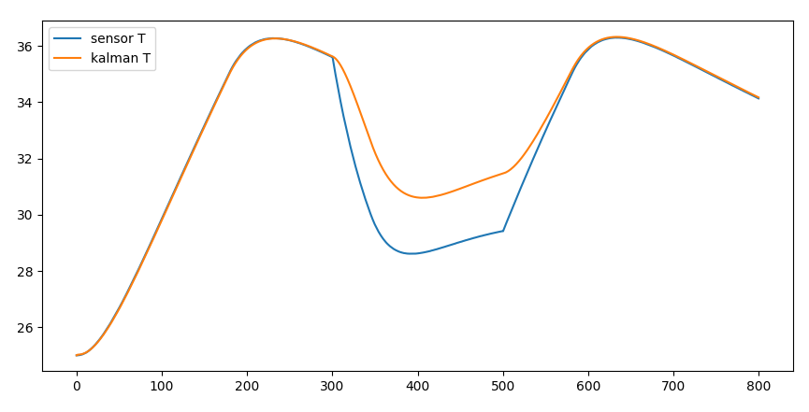
Anomaly Detector Results
Digital Twin
3D Visualization
Safety Monitoring
Predictive maintenance
Fault Diagnosis
Support for decision making
...
Self-reconfiguration
Open Lid
Close Lid

Slide 18


Fault Diagnosis
Digital Shadow
3D Visualization
Safety Monitoring
Predictive maintenance
Fault Diagnosis
Support for decision making
Plant
Digital Shadow
Styrofoam
Model Normal
$${\tilde{θ}}_{Normal}$$
Kalman Filter Normal
State
Anomaly Detector
Model Fault
$${\tilde{θ}}_{Fault}$$
Kalman Filter Fault
State
Fault Scenario Detector
Controller

Slide 19
What-If (Co)-Simulations
Digital Shadow
3D Visualization
Safety Monitoring
Predictive maintenance
Fault Diagnosis
Support for decision making
Plant
Digital Shadow
Styrofoam
Model
$$\tilde{θ}$$
Kalman Filter
State
What-If Simulation
Controller
Notes:
Show use case: work around power outage: how much do we need to warm up the incubator to keep it from going below a certain threshold?
Explain how it relates to previous setup.

Slide 20
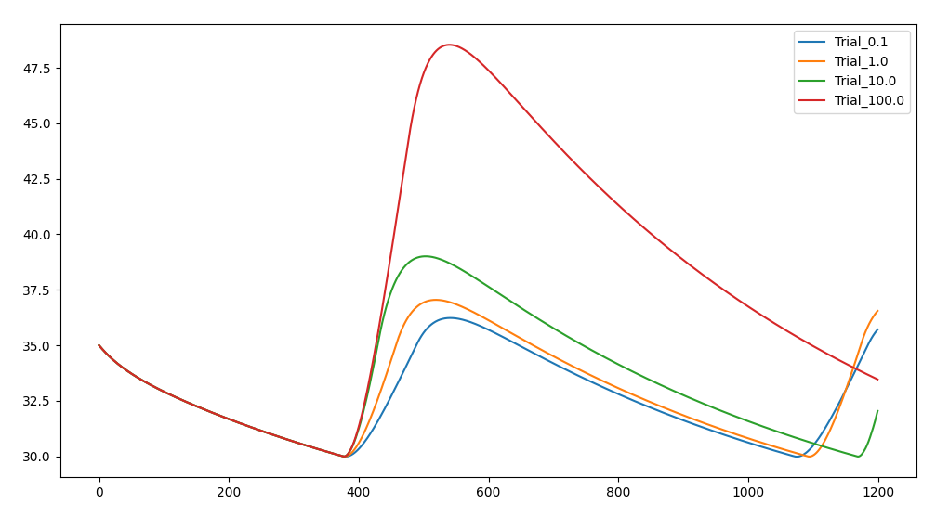
What-If Simulations: Example
Best Ctrl Configuration
Current Ctrl Configuration
Plan Power Outage
Estimated Intervention Time with Best Config

Slide 21
Two-way Communication
Physical Twin
Digital Twin
3D Visualization
Safety Monitoring
Predictive maintenance
Fault Diagnosis
Support for decision making
...
Self-reconfiguration
Plant
Communication
Controller
Notes:
Physical twin modified to accept new values for parameters of the controller.
But safe limits to these have been hard-coded.
More safety issues remain…

Slide 22


Self-Adaptation Example
Digital Twin
3D Visualization
Safety Monitoring
Predictive maintenance
Fault Diagnosis
Support for decision making
Self-reconfiguration
Physical Twin
Digital Twin
Controller
Model
$$\tilde{θ}$$
RabbitMQ
H=40.0
C=10.0
Kalman Filter
State
What-If Simulation
Configurator
New Configuration
Notes:
Warnings:
New configurations must be triple checked before being applied.
Controller must always have hard-coded safety checks.

Slide 23
Complex Self-Adaptation Example
Kalman Filter
Start when object is placed inside the incubator.
Schedule experiment to gather relevant data
E.g., let the plant cool down to a safe temperature, then ramp up heating for some time.
Configure controller for the new experiment
Gather experiment data
Run parameter estimation for new experiment
Re-configure Kalman filter with new parameters
Run What-if simulations to optimize controller behavior
Re-configure controller
Anomaly Detector
Configurator
Data Recorder
LSE Solver
What-If Simulation
Configurator

Slide 24
Research Questions
Digital Twin
Data Recorder
Goals:
3D Visualization
Safety Monitoring
Predictive maintenance
Fault Diagnosis
Support for decision making
...
Self-reconfiguration
What-If Simulation
Configurator
Physical Twin
Kalman Filter
Plant
LSE Solver
RQ1: Are these the atoms of a digital twin?
Controller
Anomaly Detector
RQ2: How to describe their orchestration to accomplish complex tasks?
Visualizer
RQ3: How to quickly engineer new digital twins?
Moving Average

Slide 25
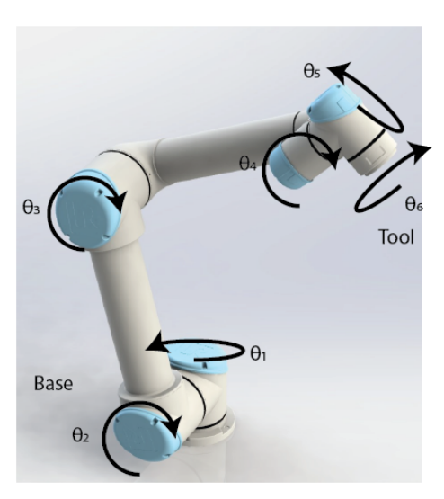
Ongoing Case Studies
UR Robot Arm
Developed with Emil Madsen and Carlos Hansen
Modelling and parameter estimation done.
Linearization of the model for KF done.
Desktop Robotti
Mirgita is doing safety monitoring using Gazebo and co-simulation (acting as DT)
Mathias working on indoor position tracking with cameras on the robot.
Bachelor students built a more detailed calibrated model.

Slide 26
Related Ongoing Work
RabbitMQ FMU
One way communication into what-if co-simulations.
Thule, Casper, Cláudio Gomes, and Kenneth Lausdahl. “Formally Verified FMI Enabled Data Broker: RabbitMQ FMU,” SummerSim ’20. Virtual event: ACM New York, NY, USA, 2020.
Tracking Simulator and PyFMU:
Legaard, Christian Møldrup, Cláudio Gomes, Peter Gorm Larsen, and Frederik F. Foldager. “Rapid Prototyping of Self-Adaptive-Systems Using Python Functional Mockup Units,” SummerSim ’20. Virtual event: ACM New York, NY, USA, 2020.
Python Interface to COE (to run What-if Co-simulations)
Fault injection in Co-simulations
e.g., simulate network effects.
High-performance Co-simulations
Parallel co-simulations in DSE in cluster

Slide 27
Cláudio Gomes, Hao Feng, Casper Thule,
Kenneth Lausdahl, Peter Gorm Larsen

