Slide 1
The Road to a Digital Twin
Cláudio Gomes, Hao Feng, Casper Thule, Kenneth Lausdahl,
Peter Gorm Larsen

Slide 2
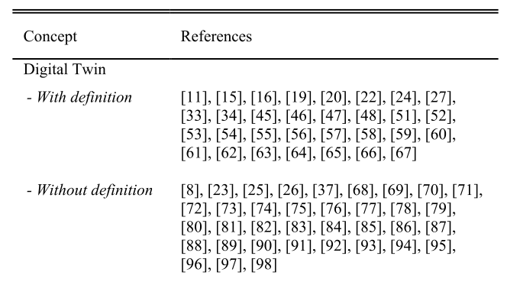
How do others define a Digital Twin?
Hard to pick one.
Our summary, from [2,3]:
Digital Twin: “when the data flows between an existing physical object and a digital object […] A change made to the physical object automatically leads to a change in the digital object and vice versa.”
[2] – Ongoing work by Til Boettjer et. al. on surveying the digital twin literature.
[3] – Fuller, Aidan, Zhong Fan, Charles Day, and Chris Barlow. “Digital Twin: Enabling Technologies, Challenges and Open Research.” IEEE Access 8 (2020): 108952–71. https://doi.org/10.1109/ACCESS.2020.2998358.
[1] - Barbara Rita Barricelli, Elena Casiraghi, and Daniela Fogli, “A Survey on Digital Twin: Definitions, Characteristics, Applications, and Design Implications,” IEEE Access 7 (2019): 167653–71.

Slide 3
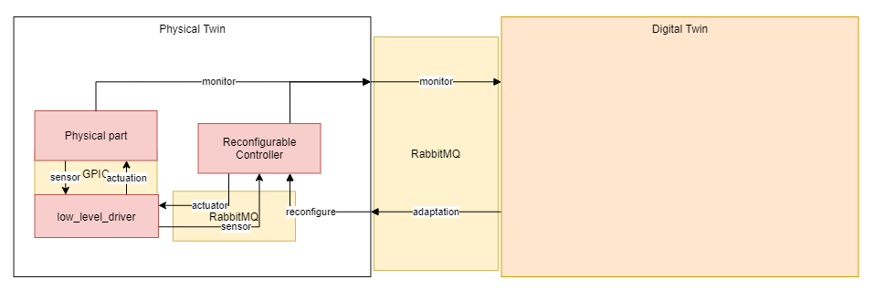
The abstract view

Slide 4
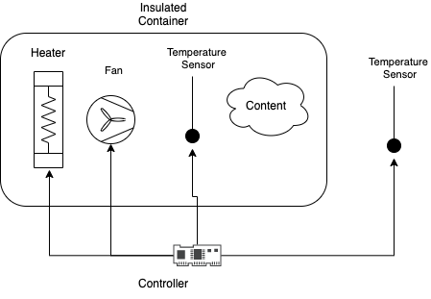
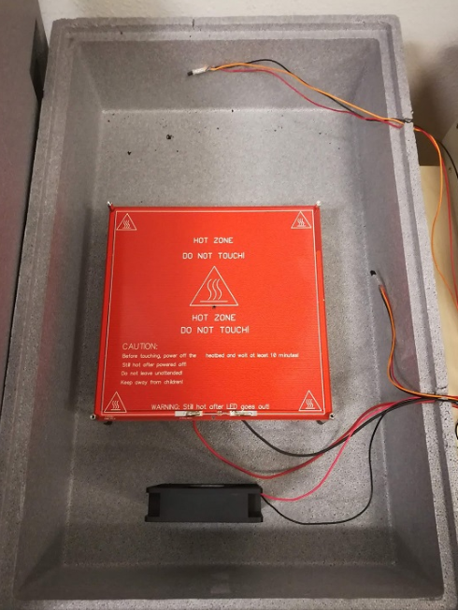
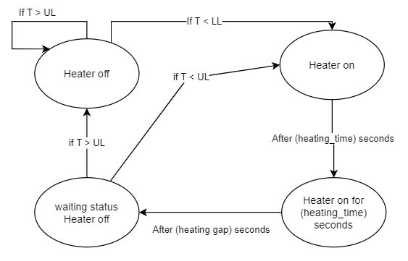
Example Physical Twin: Plant
Explain Incubator Setup
Controller
[1] – Full details in technical report by Hao Feng et. al.

Slide 5
Example Physical Twin: Controller
Controller
[1] – Full details in technical report by Hao Feng et. al.

Slide 6
Benefits of our digital twin
Safety Monitoring
3D Visualization
Support for decision making
Predictive maintenance
Fault Diagnosis
….

Slide 7
Benefits of our digital twin
Self-adaptation

Slide 8
Constructing a Digital Twin

Slide 9
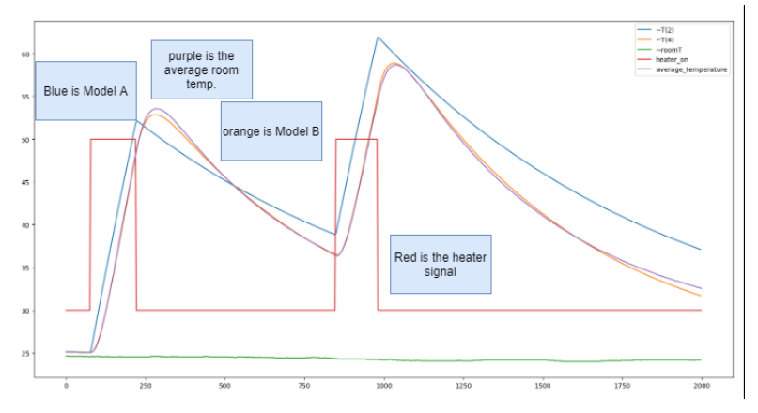
One-way Communication
Using RabbitMQ message broker
Physical twin produces timestamped messages:
Controller signals
Plant sensor measurements
Remake fig to just show the measurements.

Slide 10
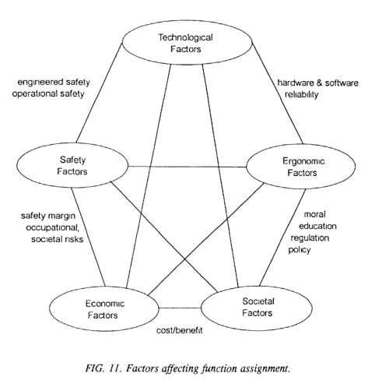
Visualization
Develop useful ways to display data about the Physical Twin
Not just 3D visualization, but 3D visualizations featured in many DT papers (about 5 out of every 7 papers read by Til Boettjer et. al. [2]
Out of scope, but contributions welcome!
[1] - International Atomic Energy Agency. “Control Room Systems Design for Nuclear Power Plants.” Nuclear Power Engineering Section, 1995. https://inis.iaea.org/collection/NCLCollectionStore/_Public/27/002/27002051.pdf.
[2] – Ongoing work by Till Boettjer et. al. on surveying the digital twin literature.

Slide 11
State Estimation: Kalman Filter
Goal: translate what is observable from the system (temperature of the two sensors) into the state of the system (temperature of heatbed and average temperature).
Show a diagram of this.
KF accomplishes two things:
Fares well with noisy measurements,
And allows us to recover the “hidden variables” of the incubator
BUT: It needs a model!

Slide 12
State Estimation: Kalman Filter
Explain Model: inputs/outputs/parameters
dTh_dt = 1.0*(-G_heater*(-T + T_h) + V_heater*i_heater*on_heater)/C_heater
dT_dt = 1.0*(-G_box*(T - T_room) + G_heater*(-T + T_h))/C_air

Slide 13
State Estimation: Kalman Filter
Model needs to be calibrated
Explain parameter estimation procedure and results.

Slide 14
State Estimation: Kalman Filter
Explain input and outputs of kalman filter.
Skip the internals and refer to the work of Hao
Incubator
Ctrl
Plant

Slide 15
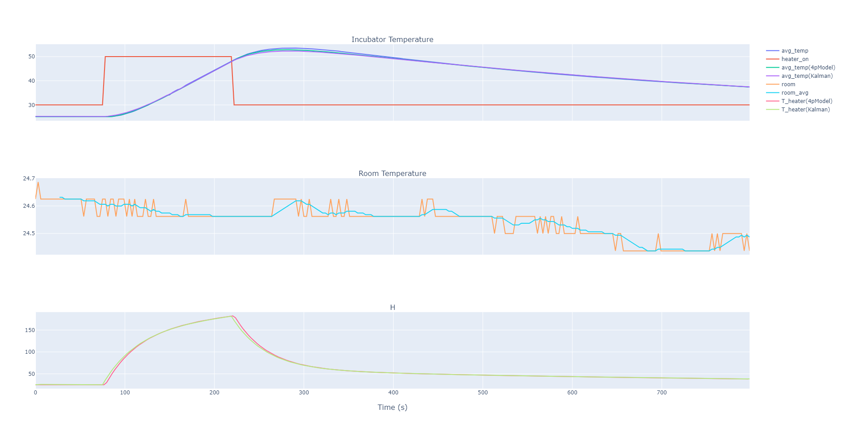
State Estimation: Kalman Filter
Results of KF

Slide 16
State Estimation: Kalman Filter
Results of KF

Slide 17
State Estimation: Kalman Filter
Results of KF on Physical Incubator

Slide 18
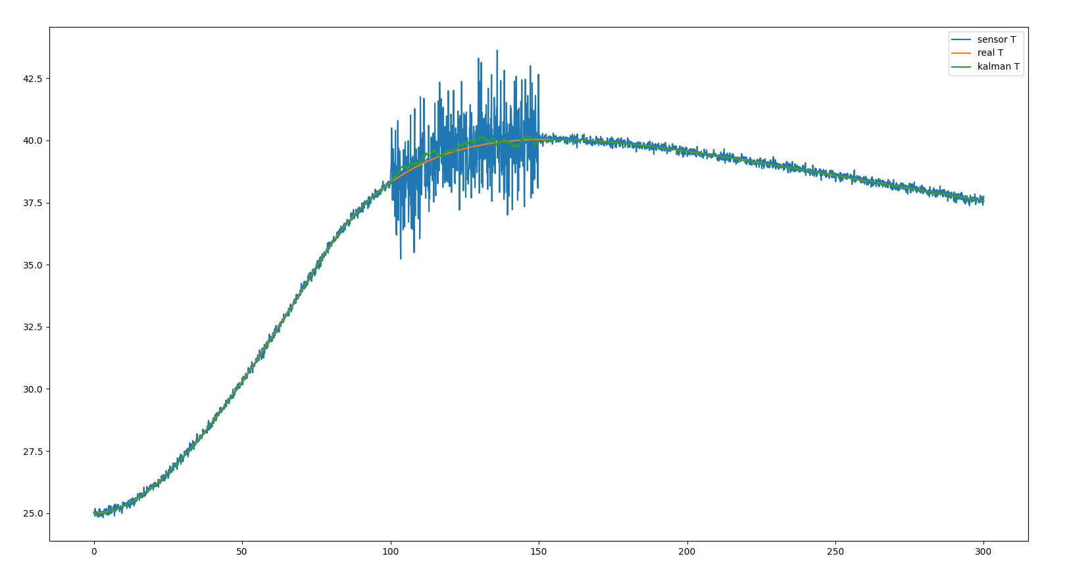
Application of Kalman Filter to Noise
Run Kalman filter through simulation model instead of real thing to demonstrate detection of faults.
Show diagram of setup and show the equivalence to the real system.

Slide 19
Monitoring
Show setup to detect objects and/or open lid

Slide 20
Other Interesting Monitoring Problems
Detect fan anomalies
Detect PCB anomalies
…

Slide 21
What-If Analysis
Show use case: work around power outage: how much do we need to warm up the incubator to keep it from going below a certain threshold?
Explain how it relates to previous setup.

Slide 22
Two-way Communication
Physical twin modified to accept new values for parameters of the controller.
But safe limits to these have been hard-coded.
More safety issues remain…

Slide 23
Example Self-Adaptation Loop
Explain the optimization algorithm for the incubator:
Triggered when an objects gets placed inside the incubator.
After the properties of that object have been identified.
Finds a better configuration for the controller based on the newly identified plant model.

Slide 24
Big Picture
Talk about the case studies we want to make digital twins for.

Slide 25
Lessons/Challenges on Reusability
Hard to reap the benefits of automatic adaptation through Digital Twin without having a physical twin that is ready to receive such adaptations
In incubator case study, the software controller needs to be reconfigurable automatic.
This poses challenges in safety which conflict with the vision of a DT being an open ended framework: how to ensure that the software is not inadvertently reconfigured to a bad configuration by an untested optimizer?
Challenging to devise general purpose DT features that work “plug-and-play”.
E.g., temperature uniformity monitoring requires offline experimentation with more sensors than those available in the system
Useful visualization is heavily dependent on application.

Slide 26
Lessons/Challenges on Reusability
Monitoring techniques may require offline experimentation to calibrate the models used.
How to create a usable dashboard for all the previous techniques?

