Slide 1
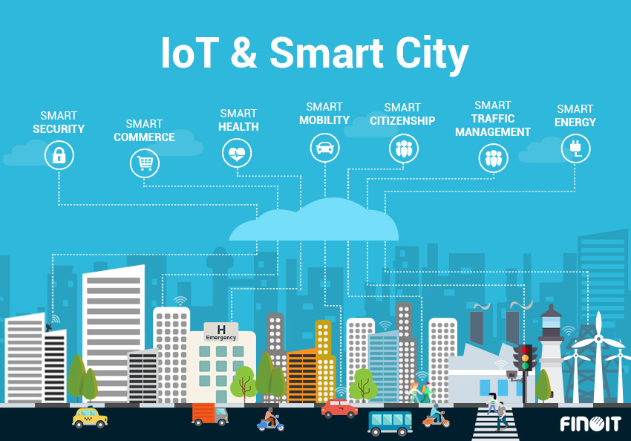
Presented By:Group 14

Slide 2
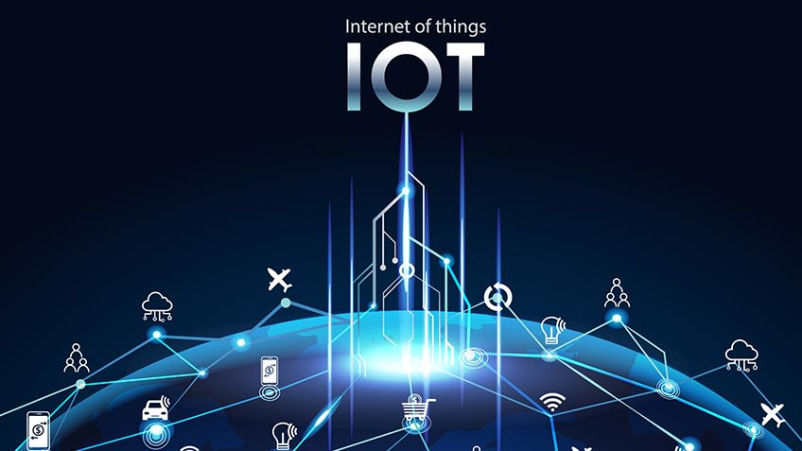
What is IoT?
The Internet of Things (IoT) is the network of physical objects or "things" embedded with electronics, software, sensors, and network connectivity, which enables these objects to collect and exchange data.
The Internet of Things (IoT) refers to a system of interrelated, internet-connected objects that are able to collect and transfer data over a wireless network without human intervention.

Slide 3
What is Smart City?
IBM defines a smart city as “one that makes optimal use of all the interconnected information available today to better understand and control its operations and optimise the use of limited resources.”
Smart cities use a variety of software, user interfaces and communication networks alongside the Internet of Things (IOT) to deliver connected solutions for the public.
Current Smart Cities of India Future Smart Cities
Bhopal. Agartala
Bhubaneswar. Pondicherry
Pune. Dehradun
Indore. Vishakhapatnam
Surat. Jaipur
Ludhiana.
Kochi.
Ahmedabad

Slide 4
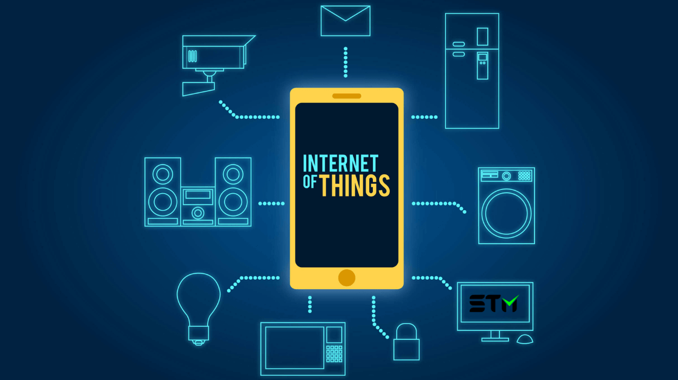
REASONS FOR HAVING IOT IN A SMART CITY
Enhanced digital requirment
Security
Reduced environmental footprint
Revenue generation
Lighten the workload with automation

Slide 5
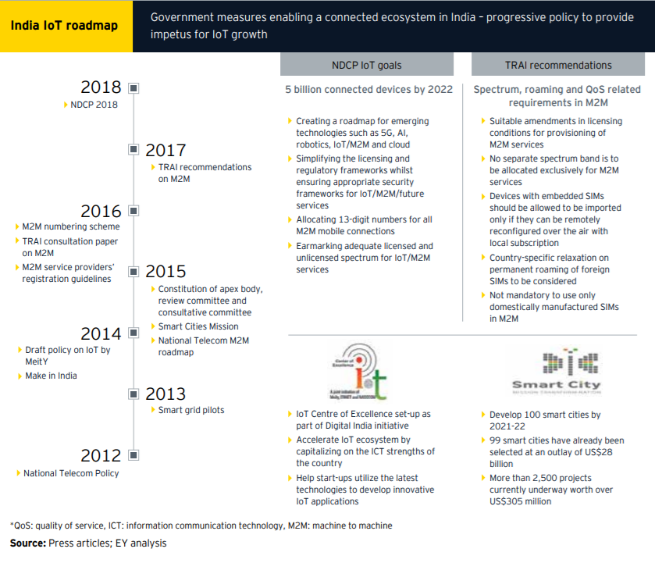
Government Initiatives
Draft IoT Policy 2016
In line with the GoI’s vision of a Digital India,the Department of Electronics and InformationTechnology launched India’s first draft IoT Policy Document in 2016. It will play an essential role in realizing the GoI’s vision of building US$15b Indian IoT market and enabling India to hold nearly 5%-6% of global IoT industry.
National Digital Communications Policy (NDCP) 2018
NDCP has set futuristic goals and undertaken crucial policy initiatives to address the problem of communications and access of digital services in India. The goals set for 2022 are crucial policy initiatives which will address the problem of access and are a welcome step to take India towards a vibrant digital economy. This policy aims to create a roadmap for the emerging technologies in areas like IoT.
Smart Cities Mission (SCM) 2015
The SCM aims at developing 100 Smart Cities with a total proposed investment of nearly US$31b.
IoT Centre of Excellence (CoE) by NASSCOM, DEITY and ERNET
IoT CoE is a Digital India initiative to revolutionize the Indian IoT ecosystem with
modern infrastructure and by facilitating co-creation of IoT solutions via a hub and spoke network of dedicated CoE.

Slide 6
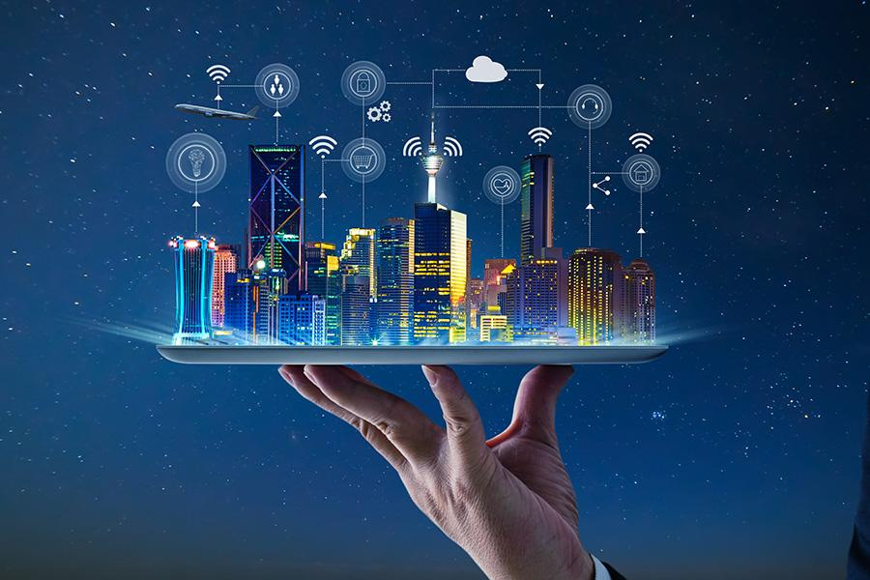
Applications of IoT in smart cities
IoT-enabled smart city use cases span multiple areas: from contributing to a healthier environment and improving traffic to enhancing public safety and optimizing street lighting.
Smart Infrastructure
Road traffic
Smart meters & billing
Public safety
Smart Parking
Wi-Fi coverage

Slide 7
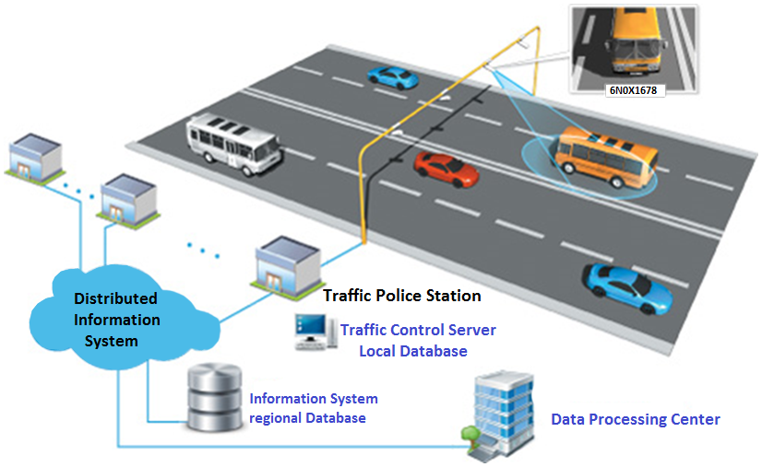
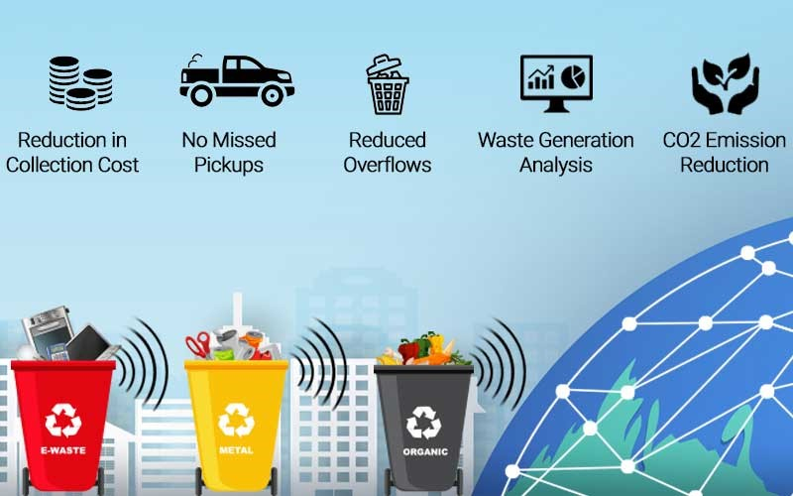
Applications of IOT
1. Traffic Management :
Pavement integrated sensors send real-time updates of traffic flow to a central traffic management platform, which analyses the data and automatically adjusts traffic lights to the traffic situation within seconds.
2.Smart Parking :
Sensors are built into the ground and report the location of free parking spaces via a mobile app the driver downloads.
3.Smart Waste Management :
Municipalities or waste management companies can attach a sensor to a dumpster to measure its fill level. These “smart” dumpsters can then transmit their real-time fill level information to waste collectors.

Slide 8
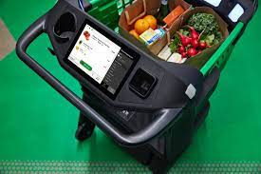
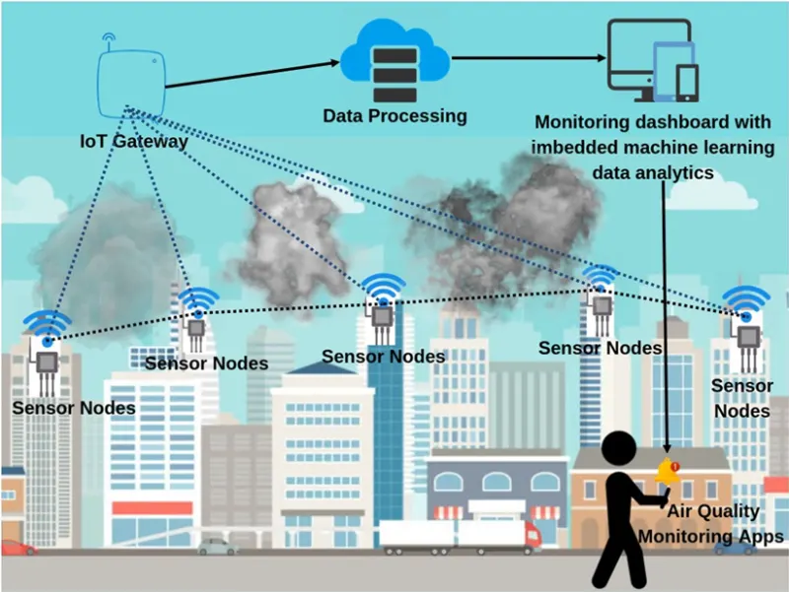
4.IoT Retail Shops
The retail store allows you to go cashless by deducting money from your online wallet.
Amazon Fresh uses “smart cart” for online payment and solves long queue issues
5.Air Quality Management
Smart-Air has been developed which monitor air quality and transmit the data to a web server via LTE in real time.
Volatile Organic Compound Sensor - installed in smart air to
detect Volatile organic compounds (VOCs)

Slide 9
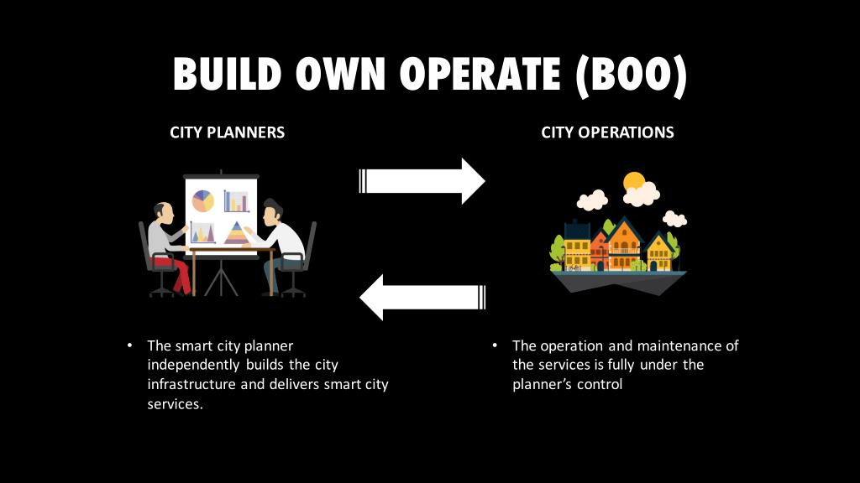
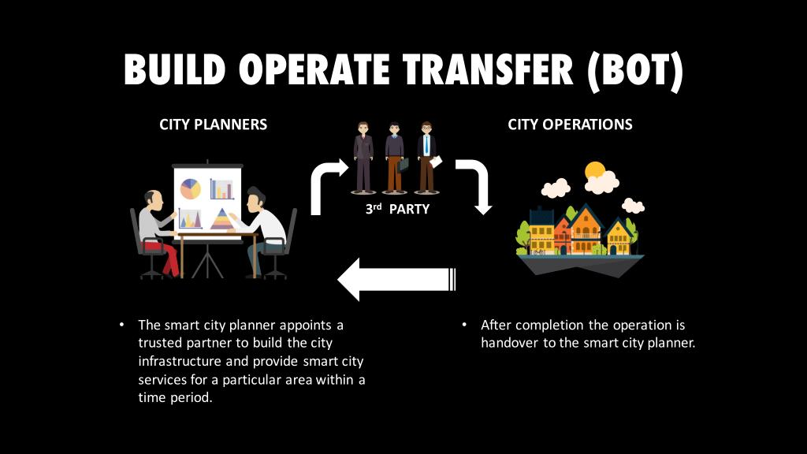
Smart City Business Models
Build Own Operate (BOO) –
The city planner independently builds the city infrastructure and delivers services.
Build Operate Transfer (BOT) –
The city planner independently builds the city infrastructure and delivers services.
.

Slide 10
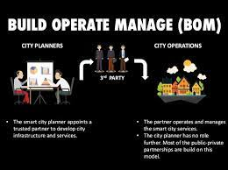
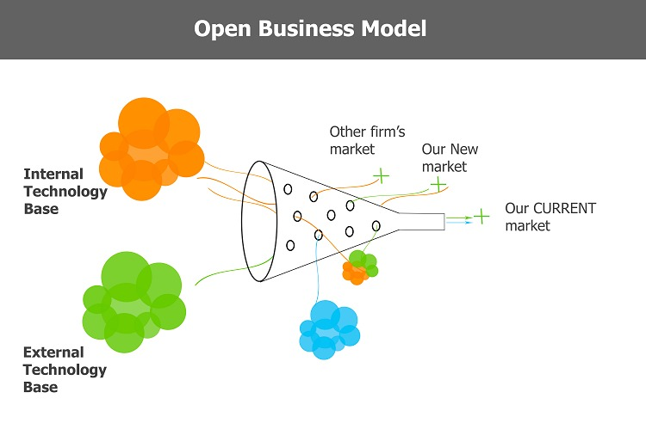
Open Business Model (OBM)–
The city planner allows any qualified company or business organization to build city infrastructure and provide services.
Build Operate Manage (BOM) –
The smart city planner appoints a trusted partner to develop city infrastructure and services.

Slide 11
Types of Network Sensors and Their
Roles in Smart Cities
1. Electronic Sensors
The main function of electronic sensors is to detect different energy forms through the use of
electroscope, magnetic anomalies and voltage detectors among others.
2. Chemical Sensors
The chemical sensor currently includes sensors such as carbon dioxide sensors, oxygen sensors,
electronic nose and catalytic bead sensors among others.
3. Smart Grid Sensors
Different sensors are utilized in smart grids to ensure efficient generation,transmission and distribution of power from the generating source to the end users.

Slide 12
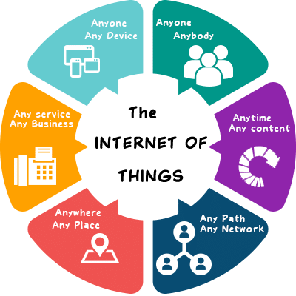
Significance
It’s predicted that more than 60% of the planet’s population will live in cities by the year 2030. Large populations demand large resources. Residents will need access to water, efficient and environmentally-friendly transportation, clean air, and practical sanitation and waste management. With the clever use of smart city practices and widespread deployment of IoT technology, the cities of tomorrow will be able to meet the demands of their residents in an effective and efficient way.
IoT will create smart transport solutions; reduce the consumption of fuel in vehicles, accelerate traffic flows and prioritize repair schedule of vehicles. There will be clever surveillance systems, doorbells and locks, providing you the safety at your home and business organization or place of work

Slide 13
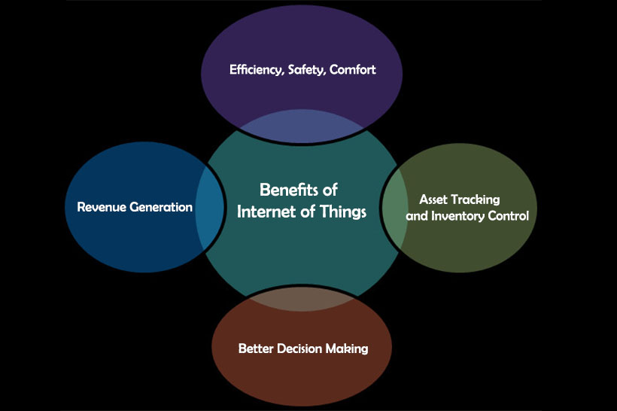
Benifits of IOT
01.
Economic Development and Oppurtunities.
02.
Increased Digital Equity
03.
Efficient Public Utilities
04.
Better Life Quality
05.
Effective Data-Driven Decision Making

Slide 14
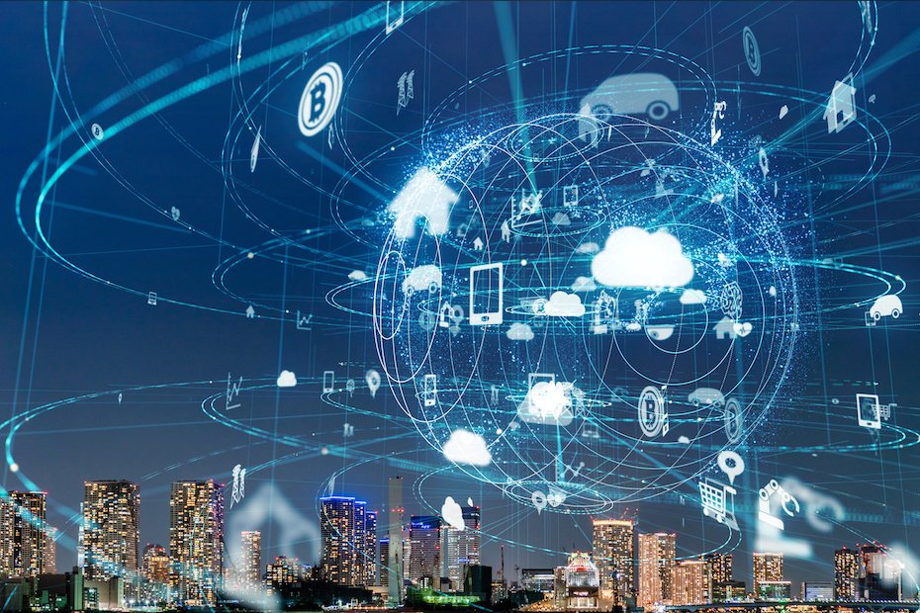

CHALLENGES TO BE FACED....
Vulnerable to hacks
Most of the connections with objects will be enabled through RFID. RFID record metadata or control individual target through radio waves and thus are vulnerable to hacks.
Lack of Proper Infrastructure
Technology have disrupted every aspect of a city; however, the infrastructure remains unchanged.The obsolete 19th century infrastructure will never be able
to meet the needs of an IoT-enabled smart city.
Inadequate Funds:
The issues of connectivity and lack of proper infrastructure
directly stem from the insufficient funds
invested by governments.

Slide 15
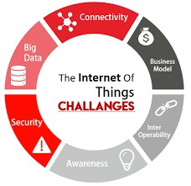
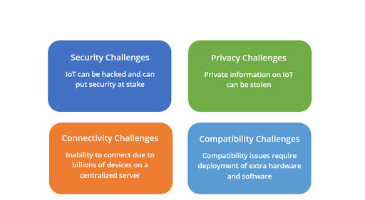
Lack of experienced professionals
For preparing a strategy to achieve smart city project success,
identifying areas for implementation of technologies,
and operating these tools, tech experts are required.
Security
With every new IoT device, every server, every data transmission
in a smart city, the security risk grows
Misuse of Privacy
The main cause of concern is that misuse of privacy is
possible since not every connected device is cyber-resilient.
Initial setup cost
It require deployment of extra hardware and software hence
it is costly.

Slide 16
.....MEMBERS.....
Yashwant Bibhupad
1906524
Aniket Mondol
1906531
Aniket Sahu
1906532
Ankit Raj
1906534
Silpa Patra
1906590

Slide 17
Thank You!!

