Slide 1
Divij Seth
Portfolio Deck

Slide 2
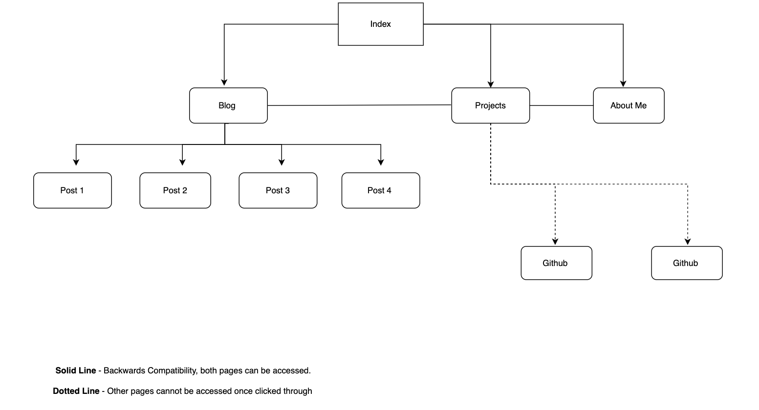
Sitemap

Slide 3
Sitemap
All pages navigate seamlessly, and all pages can be accessed via the navigation bar.
Social links are present on all pages.
Aim of the design was to make navigation as visible as possible.

Slide 4
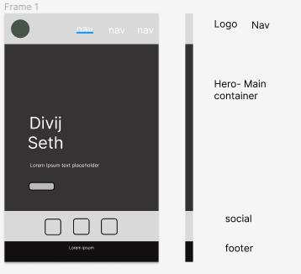
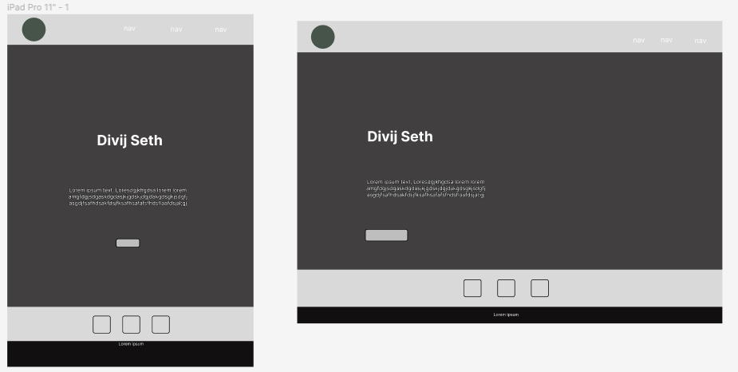
Home Page Wireframes

Slide 5
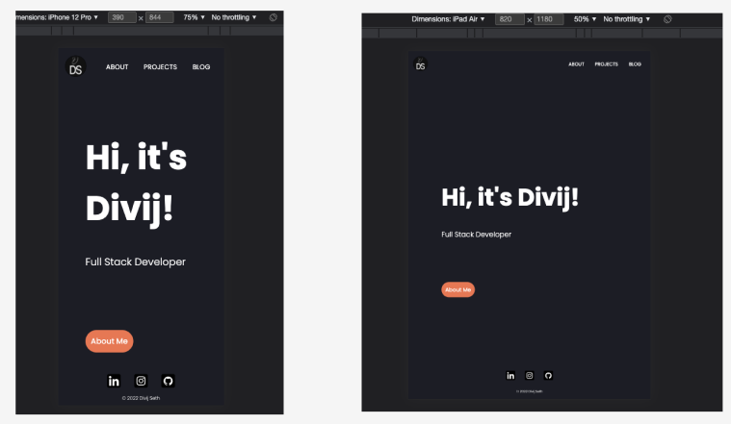
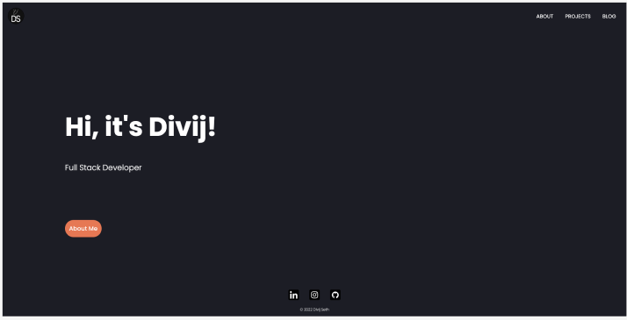
Home Page Live

Slide 6
Home Page
Design process was to make the landing page minimal, with a tonal colour palette, subtle animations and digestible content.
The components are the navigation menu, social links and a suggested about me button, to make the viewer get to know me before diving further into the website.
There is little content about me on the landing page, this is to ensure that the home page acts as a landing page to quickly navigate off.
The navigation components, and social links are present amongst all pages to allow the viewer to change pages or get to know me further at any time they wish.

Slide 7
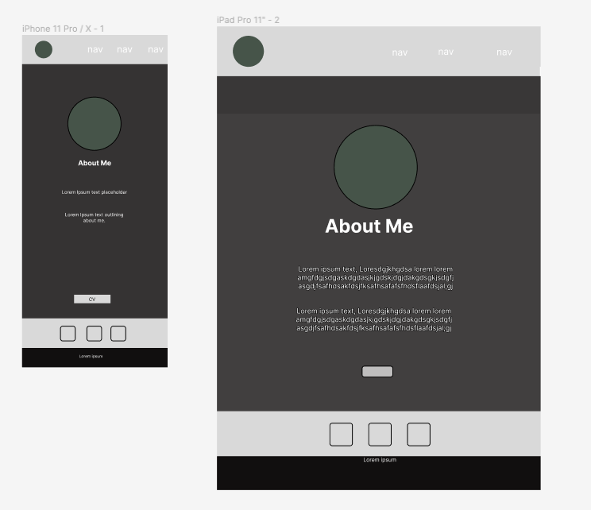
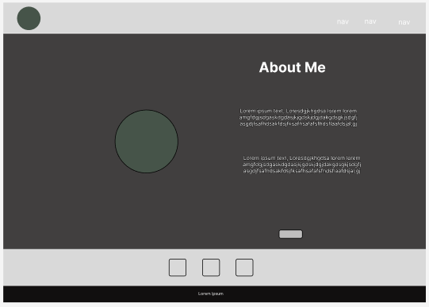
About Me Wireframes

Slide 8
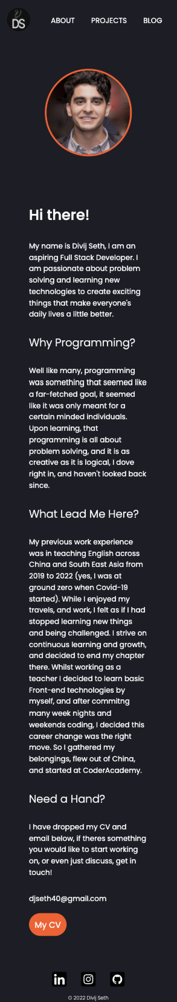
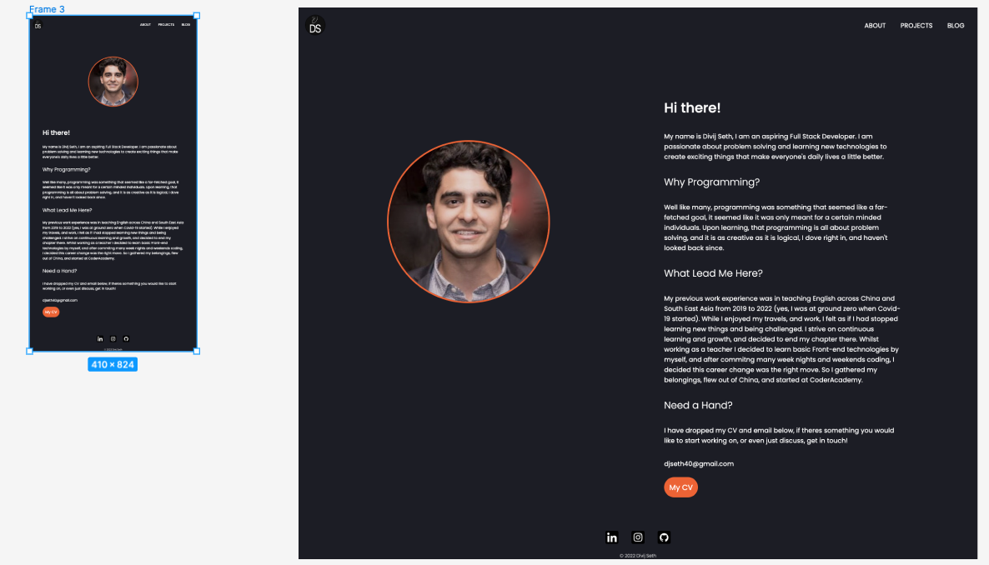
About Me Live

Slide 9
About Me
This page serves as a ’get to know me’ page, where I talk about my why, my previous experience, and my interests.
The components of navigation stay the same, as well as the links.
My CV and my email are at the end of the page, with a mailto navigation that allows viewers to contact me by clicking my email.
Visual cues with the use of cursor pointers and buttons allow the viewer to know that these are links and navigable.
Design stays consistent across all pages and viewports to ensure the content is the focal point.

Slide 10
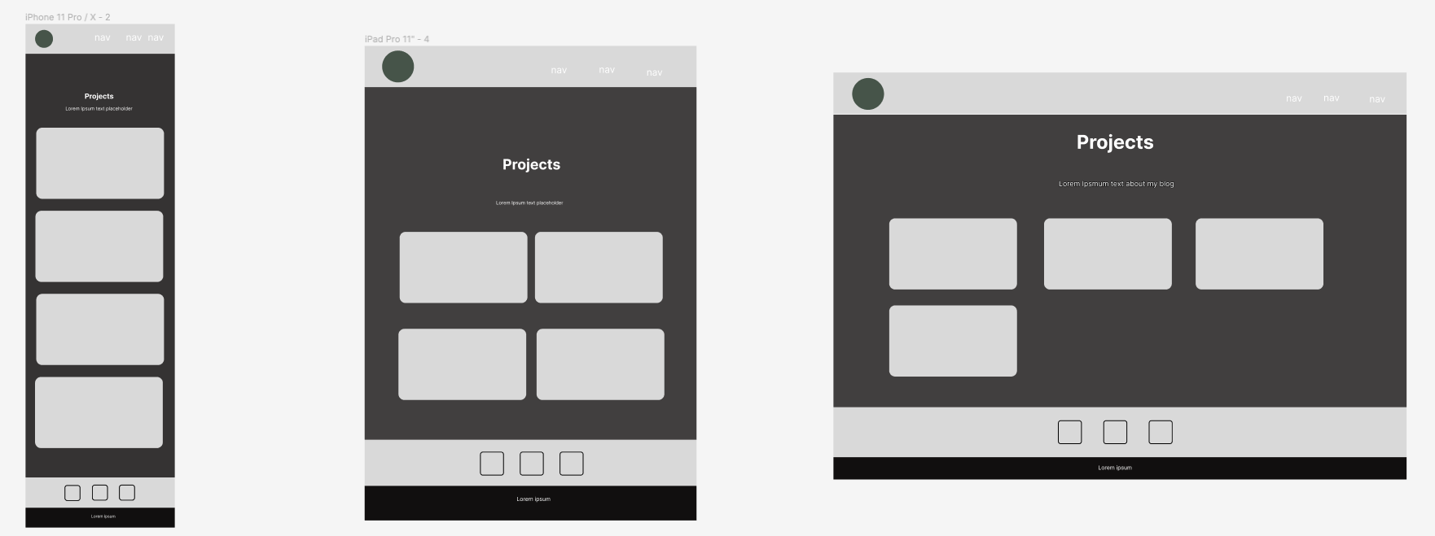
Projects Wireframes

Slide 11
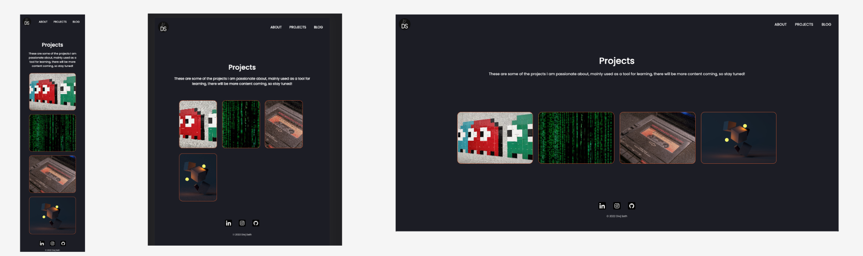
Projects Live

Slide 12
Projects
Used flexbox to form a responsive grid that responds to viewport.
On mobile the layout stacks vertically to allow long scrolling.
On tablets, the tile heights match the verticality of the screen, and rotate with screen rotate.
On desktop view, the width of the tiles expand to match the screen.
Information is hidden behind the tiles, allowing the viewer to engage through hovers, just to add slight curiosity before clicking through.

Slide 13
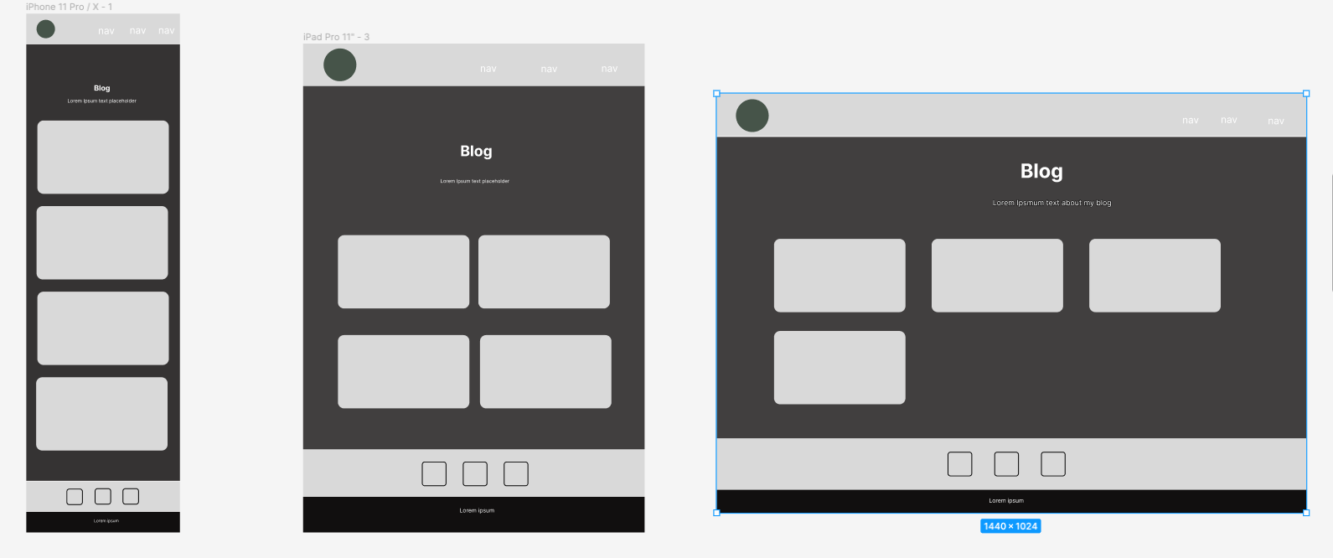
Blog Page Wireframe

Slide 14
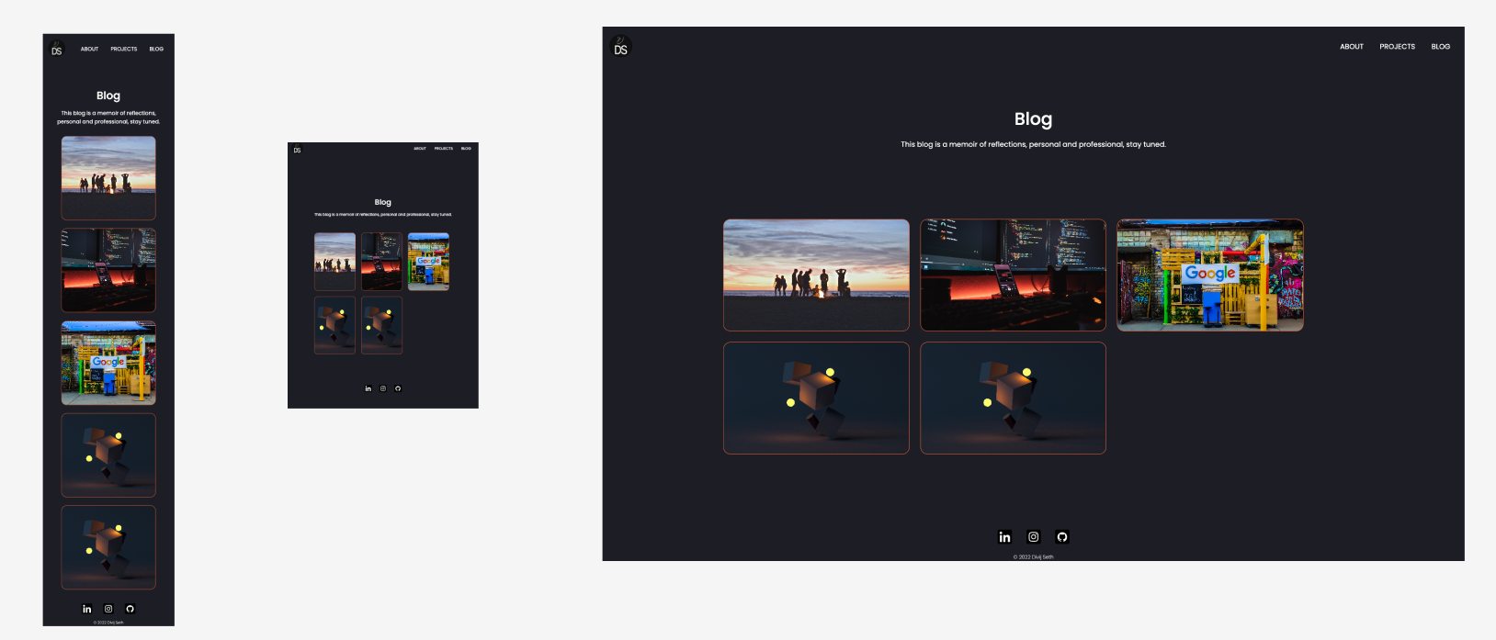
Blog Page Live

Slide 15
Blog Page
Design is consistent with projects page, which allows the users to easily navigate using the tiles. The assumption is they have already learned how to navigate through the projects page, and are doing it with low effort via the blogs page.
Components have all been styled consistently, with animations also staying consistent to ensure there are no distractions.

Slide 16
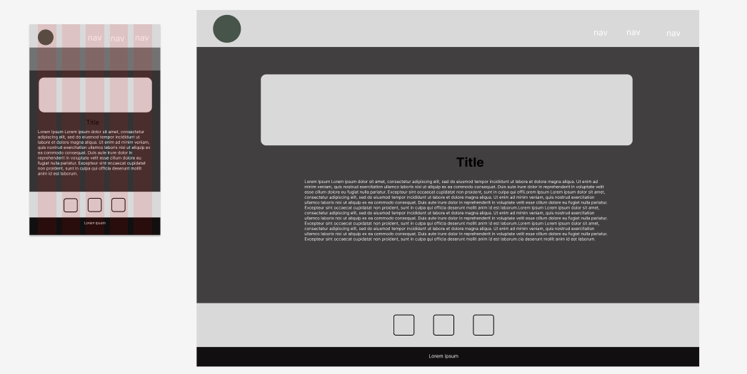
Blog Posts Wireframe

Slide 17
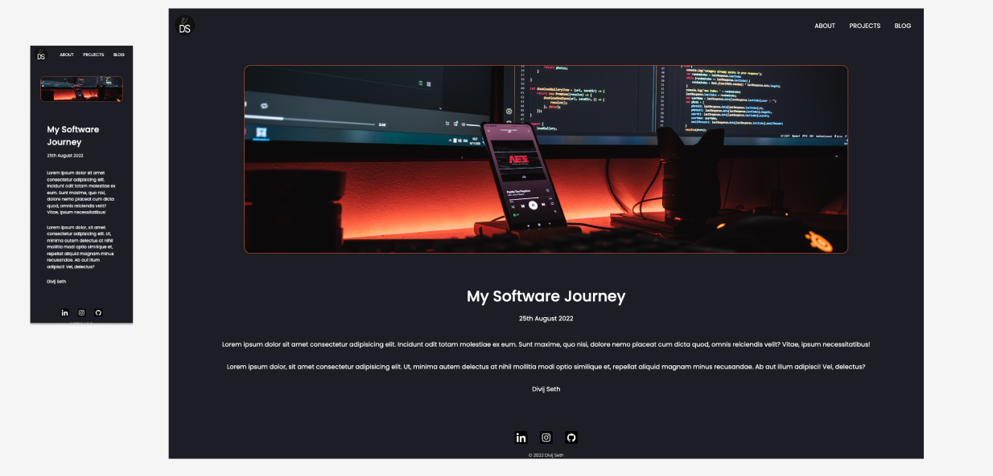
Blog Posts Live

Slide 18
Blog Posts
The blog post is headed with a banner image, consistent with the tile that they clicked, and it adjusts relative to the viewport.
Text is placed directly underneath, as naturally the viewer would progress from the banner image and scroll.
These posts will serve as reflective, creative pieces of my journey through life, which will allow the viewers to gain a better understanding of who I am.
Consistent styling across all blog posts, and it’s components, again to make sure the content is the main premise.

Slide 19
Favourite Parts? Challenges?
Designing a corner of the internet was my favourite part, being able to push my personality using design cues, and copy writing.
The challenges I faced were to write clean, maintainable code, as this website will be built on top of. I wanted to ensure, that when I come back to add more functionality, I am still able to go through my code base and understand it.

