Slide 1




































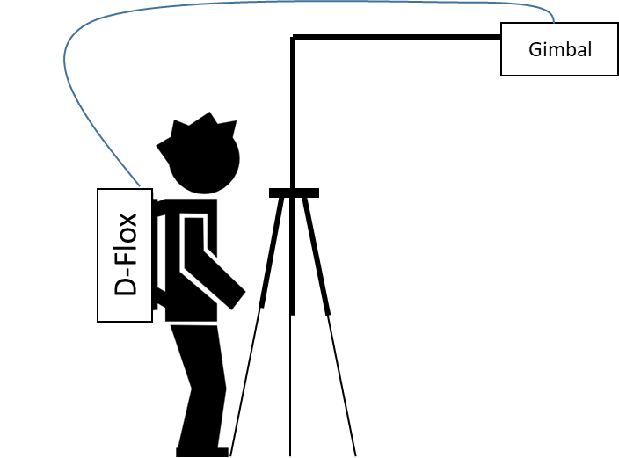














Delta SIF procedure – SELHAUSEN Shuttle variant
4
5
3
6
one field shuttle design with backpack and campbel analytics tower (wheat or SB) one or two transects,
9-10 locations, with varying lai,
10 repetitions between the +- 3 hours around solar noon (13:00) - 10:00- 16:00;
at each location sampling time 2 min = 4-5 readings,
one transect is measured in 18-20 min.
2
7
1
8
Mobile (M-FLoX)
Fig1. Measurement setup. A – side view of mobile system, with fiber optic height and estimated IFOV. B – two-device measurement protocol. A reference device is fixed on a permanent position tracking daily SIF, the mobile system measures SIF at locations along transects. Minimum measurement time at location is 5 minutes.

Slide 2
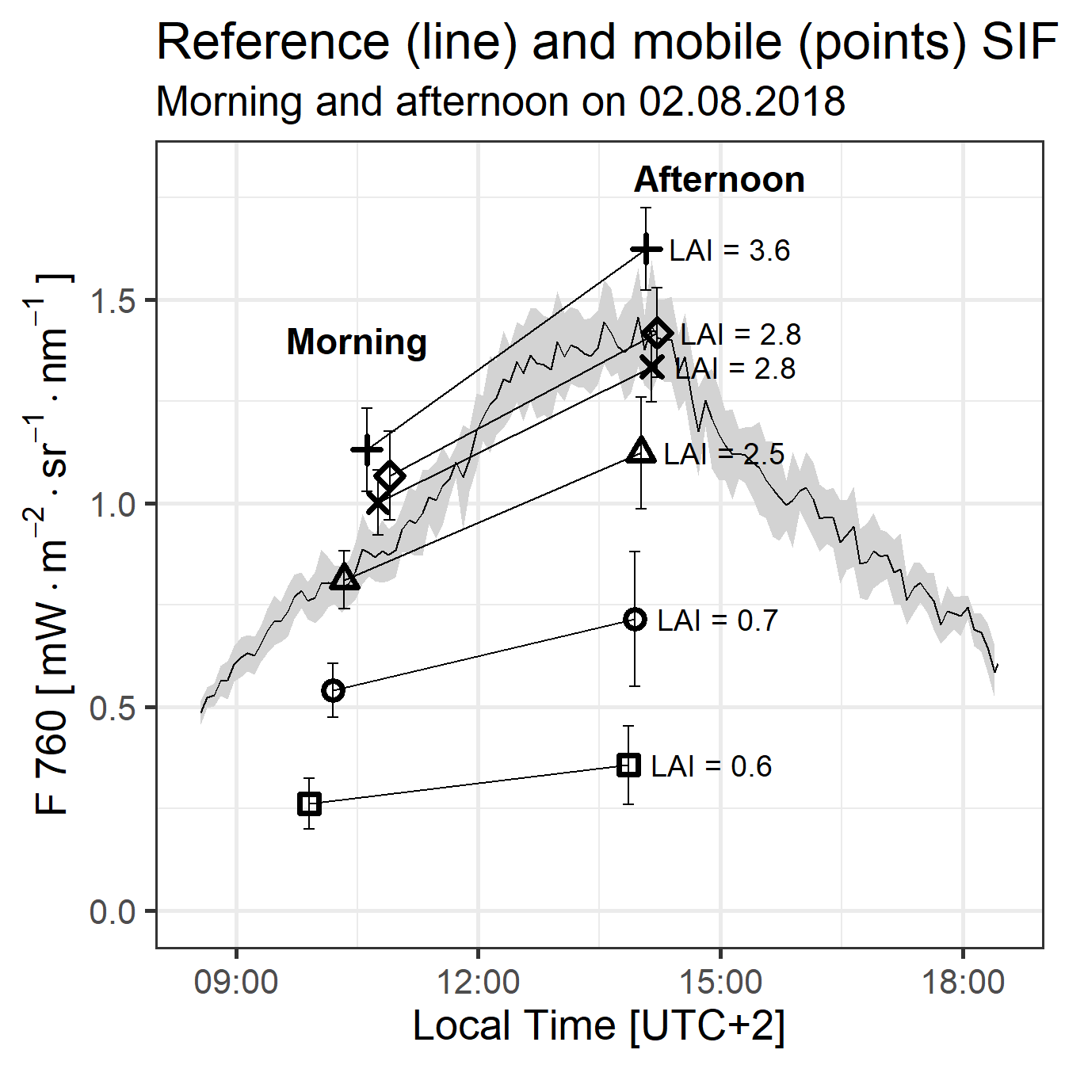
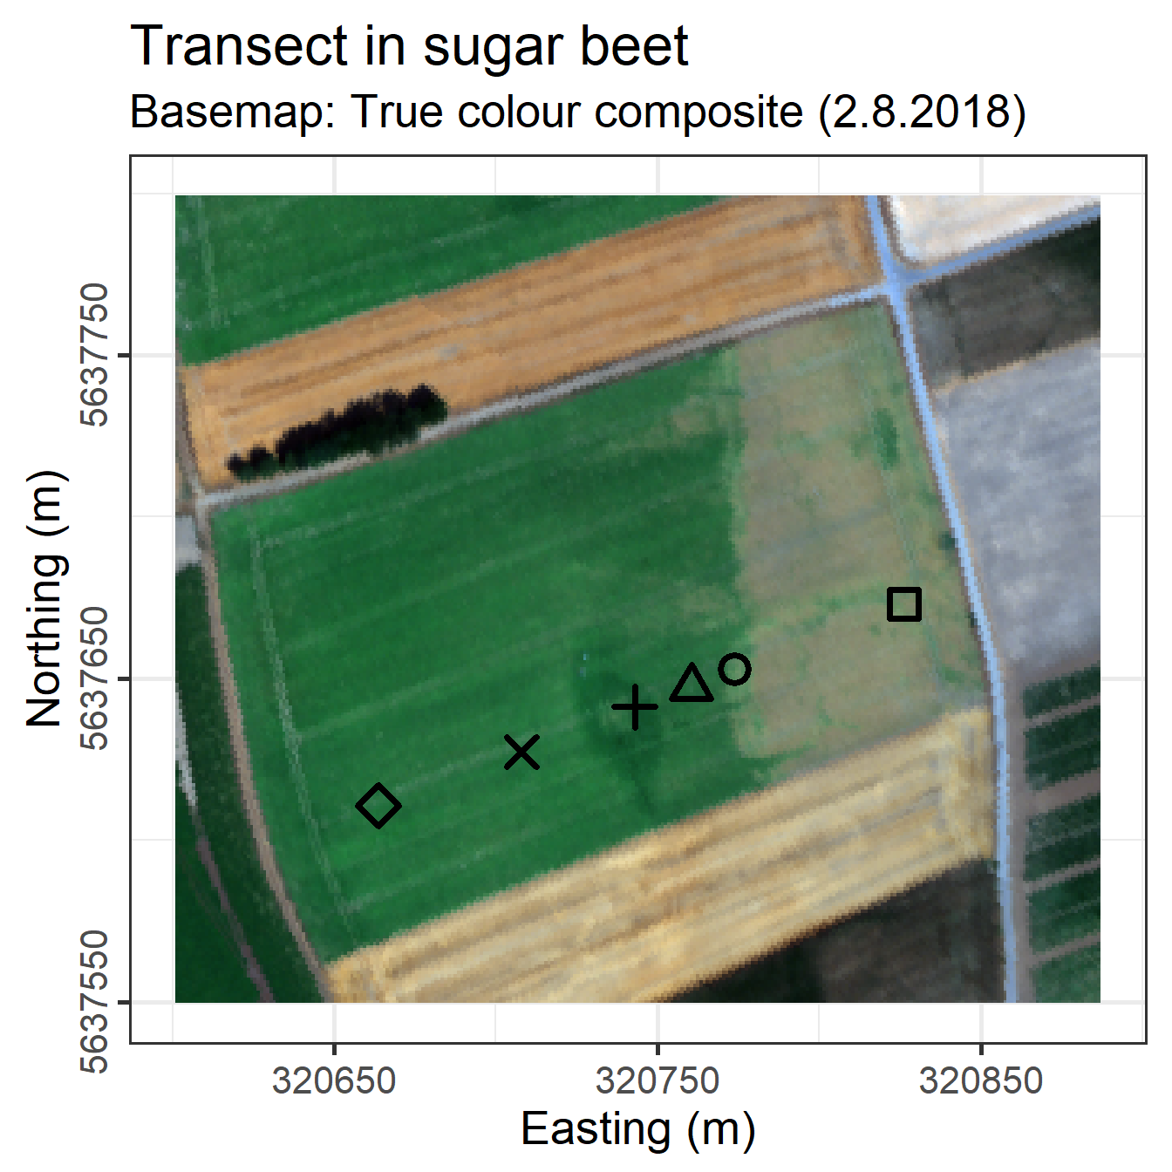
Rep 2
Rep 1
Loc 2
Loc 1
Fig 7. Test transect in Sugar Beet (Beta vulgaris L.) measured morning (10.00 – 10.30) and afternoon (13:30-14:00) on 02.08. 2018. LAI was measured the day before. Right – field boundaries with transect locations from HyPlant. Left – Sun-induced fluorescence measurement retrieved at 760 nm using iFLD method

Slide 3
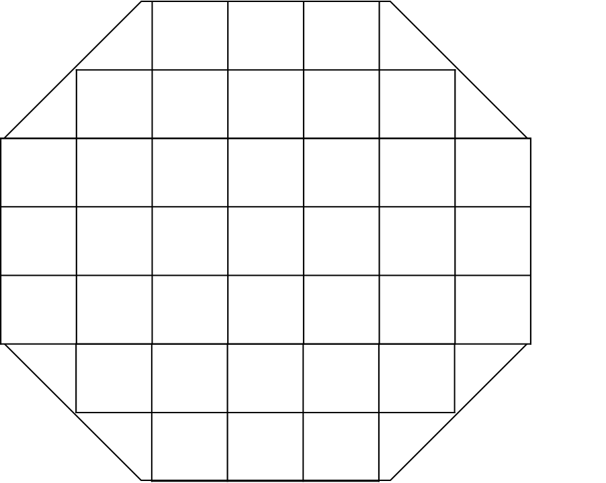
CKA – phenotyping procedure
FLOX
3 rings with elevated CO2
3 Control rings
40 varieties in each ring
tower (wheat or SB) one or two transects,
?? locations, with varying varieties,
?? repetitions between the +- 3 hours around solar noon (13:00) - 10:00- 16:00;
at each location sampling time 1-2 min = 4-5 readings,
one repetition lasts ?? min.

Slide 4
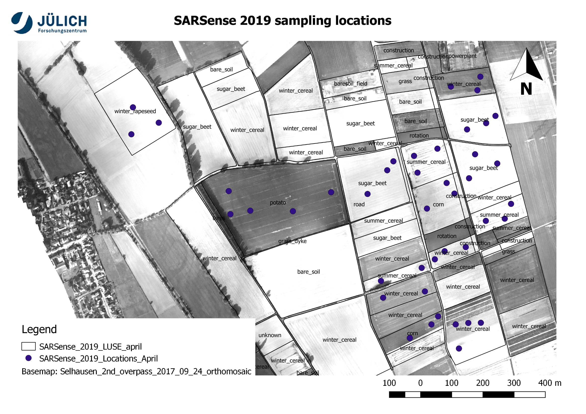
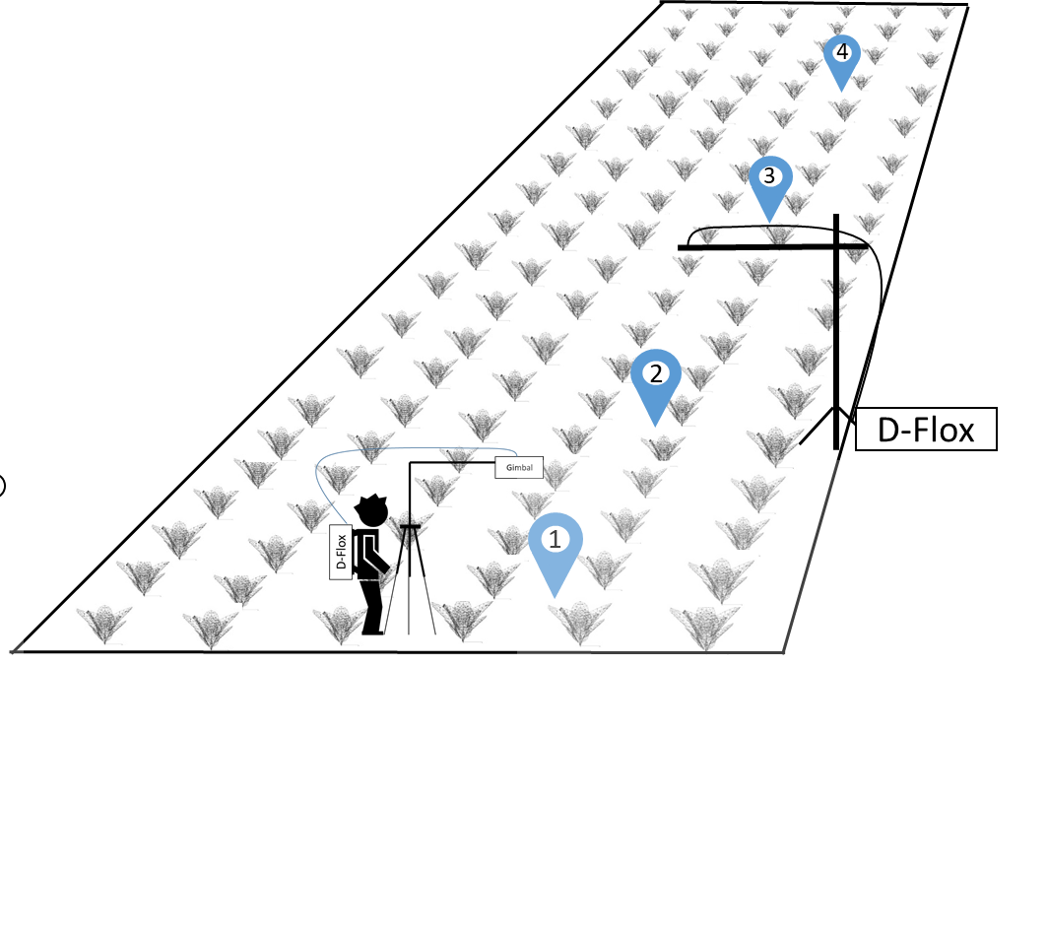
SARSense
14 fields
20 (40) random locations
2 repetitions between the +- 3 hours around solar noon (13:00) - 10:00- 16:00;
at each location sampling time 2 min = 4-5 readings

