Slide 1

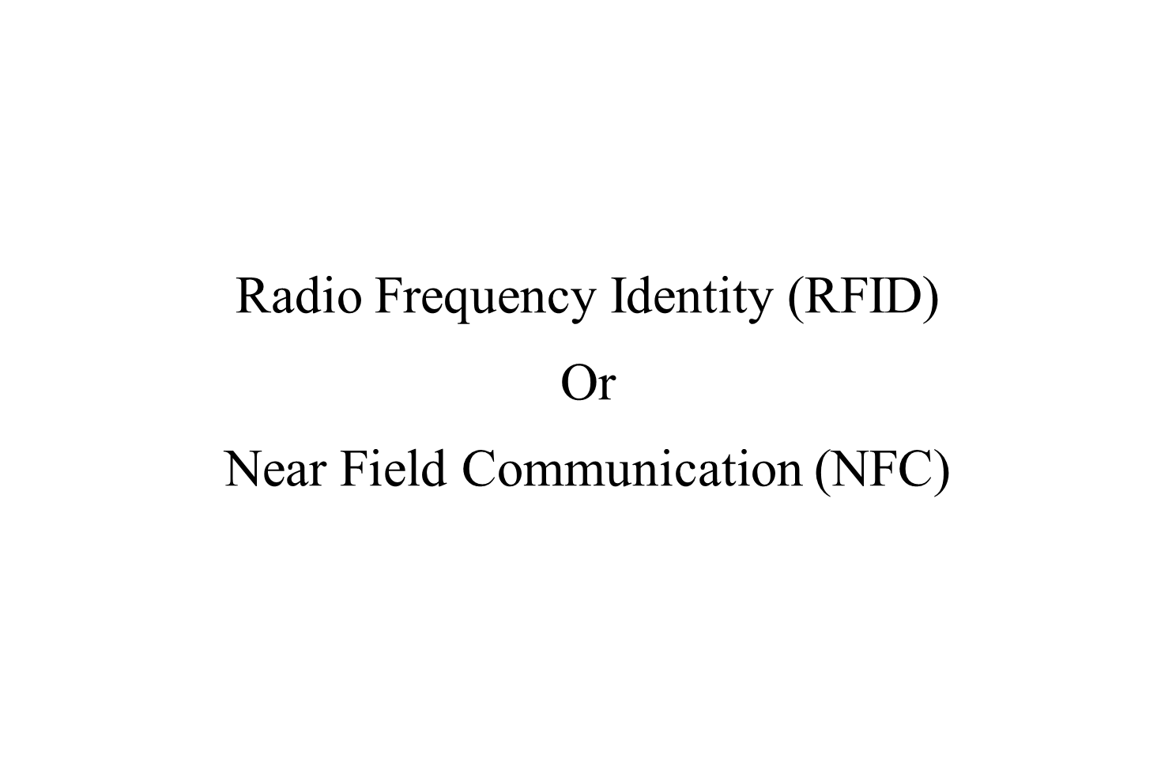

Slide 2

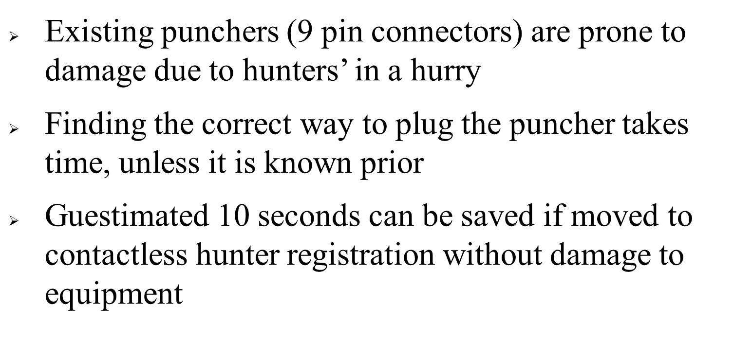

Slide 3

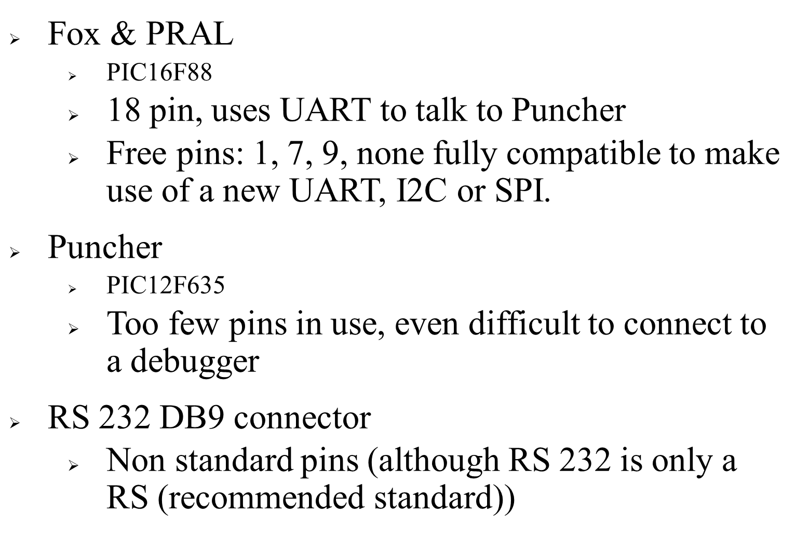

Slide 4



Slide 5

Need a cheaper way to source these items: aliexpress?
23 SEK
Fox
230 SEK
1 uA (standby)
128 SEK
Arduino
RTC
RFID Hunter tag
PN532
RFID Reader
366 SEK
Arduino Mini (No usb ☹): https://www.adafruit.com/products/2378
RTC: DS3231 https://learn.adafruit.com/adafruit-ds3231-precision-rtc-breakout/overview
NFC: PN532: https://www.adafruit.com/products/789
http://www.elechouse.com/elechouse/index.php?main_page=product_info&cPath=90_93&products_id=2242
https://www.seeedstudio.com/125khz-rfid-module-uart-p-171.html
RFID: https://www.fasttech.com/product/1200002-rewritable-programmable-nxp-mifare-nfc-tag-keychai

Slide 6
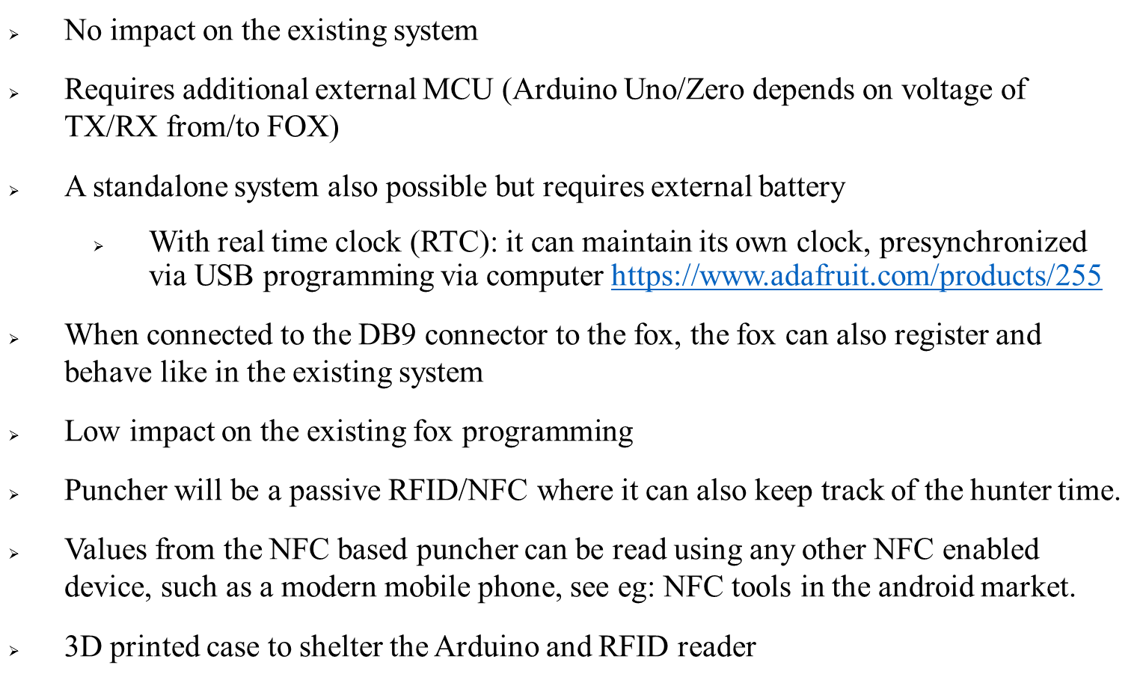

Slide 7

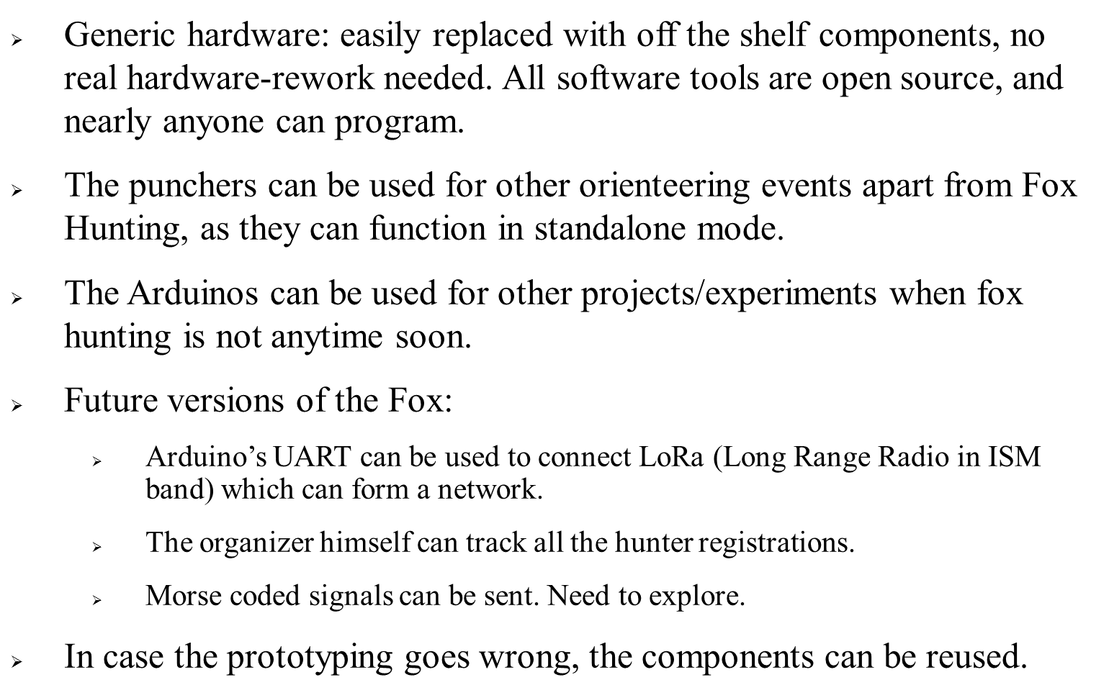

Slide 8



Slide 9

