Slide 1

JS Back-end
Course Introduction
SoftUni Team
Technical Trainers
Software University
https://softuni.bg

Slide 2
Table of Contents
Introduction
Course Objectives
Trainers and Team
Course Details

Slide 3
Have a Question?
sli.do
#js-web

Slide 4












SoftUni Diamond Partners

Slide 5


Educational Partners

Slide 6
JS Back-end
Course Objectives

Slide 7
Course Objectives
Extend the skills, gained in JS Advanced, by introducing server-side JavaScript technologies
Learn to use the most common techniques in web development
Request routing
HTML templates
Database storage
Apply the fundamentals of application architecture and code convention through the MVC pattern

Slide 8
JS Back-end – Course Topics
Introduction to Node.js
Node Utilities
ExpressJS and Templating
MongoDB and Mongoose
Sessions and Authentication
Validation and Error Handling
Workshop: Building a REST API

Slide 9

Trainers and Team

Slide 10
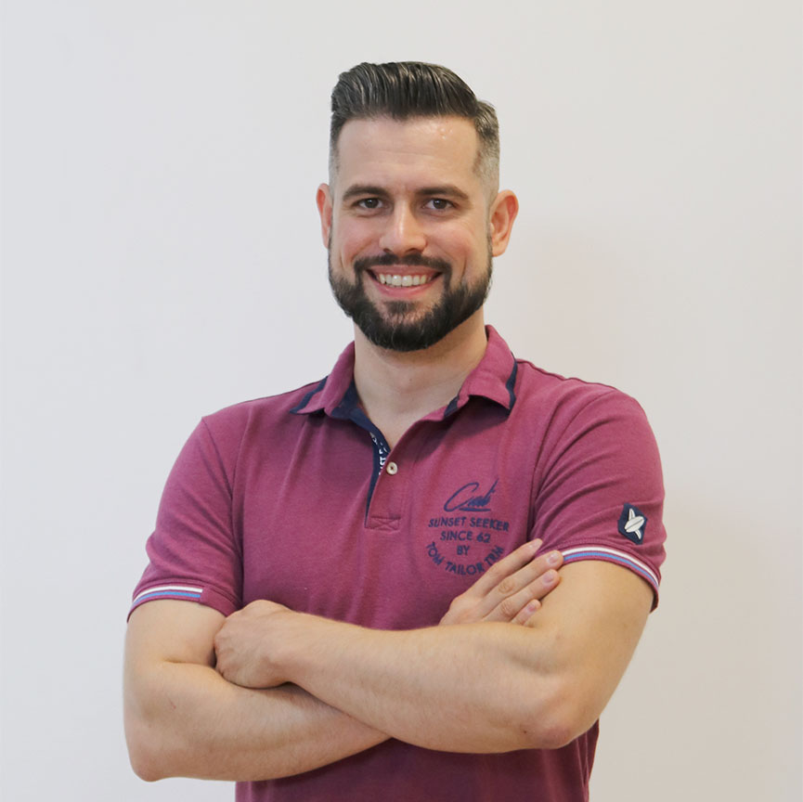
Ivaylo Papazov
Senior Software Engineer at Payhawk
Trainer at SoftUni
Experience with JS, React, Node.js, MongoDB
6+ years professional experience

Slide 11

Course Details
Schedule

Slide 12

Practical Exam
Structure: 1 problem for 4 hours
Multi-page application
Use database storage
Implement user profiles
Express.js with external libraries
Exam: 25 Jun 2022
Retake: 18 Aug 2022
Link to Exams

Slide 13
Theoretical Exam
20 questions for 30 minutes
Multiple-choice
English
Automated quiz system
Available online
You can submit your answers just one time

Slide 14
JS Web Module Timeline
JS Back-end
Start: 16. May 2022
Exam: 25. Jun 2022
16.
25.
6 weeks
2 times per week
May
June
ReactJS
Start: 27. Jun 2022
Project Defense: 13. Aug 2022
27.
13.
6 weeks
2 times per week
June
August
Retakes
JS Back-end: 18. Aug 2022
ReactJS: 21. Aug 2022
August

Slide 15
Course Scoring
Practice grade:
Theory grade:
SoftUni Certificate: 5.00 from Practice
CPE Certificate: 3.00 average from Practice + Theory
Practical Exam
100 %
Theoretical Exam
100 %
15

Slide 16




Course Web Site, Forum and FB Group
Official web site:
Official discussion forum:
Official Facebook group:
Official SoftUni JavaScript Community:
softuni.bg/trainings/3712/js-back-end-may-2022
softuni.bg/forum/categories/107/
facebook.com/groups/JSBackEndMay2022
facebook.com/groups/SoftUniJavaScriptCommunity/

Slide 17
Questions?
Notes:
17

Slide 18
Trainings @ Software University (SoftUni)
Software University – High-Quality Education, Profession and Job for Software Developers
softuni.bg, softuni.org
Software University Foundation
softuni.foundation
Software University @ Facebook
facebook.com/SoftwareUniversity
Software University Forums
forum.softuni.bg
Notes:
18

Slide 19

License
This course (slides, examples, demos, exercises, homework, documents, videos and other assets) is copyrighted content
Unauthorized copy, reproduction or use is illegal
© SoftUni – https://about.softuni.bg/
© Software University – https://softuni.bg
Notes:
19

