Slide 1

Introduction to Node.js
Overview, Modules, Web Server, Request and Response
SoftUni Team
Technical Trainers
Software University
https://softuni.bg

Slide 2
Table of Contents
Introduction to Node.js
Event Loop
Modules
Node.js Web Server
Request and Response Wrapper

Slide 3
Have a Question?
sli.do #js-web

Slide 4

Introduction to Node.js

Slide 5
Node.js Overview
A runtime environment for JS that runs on the server
Advantages
One language for server and client
Asynchronous and Event Driven
Very fast
Efficient package manager

Slide 6
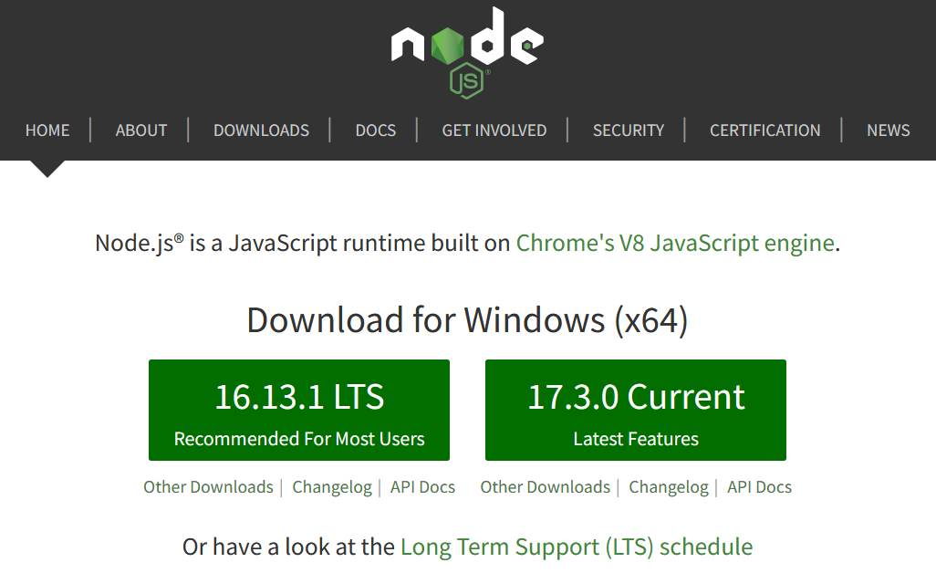
Installation
Go to http://nodejs.org and install the latest version
To check the currently installed version of the node, type in the command prompt/terminal:
node -v

Slide 7

Environment Setup
From the terminal
Interpret code from a file
Save the script to index.js
Execute from the terminal:
node // Starts REPL
let a = 5
let b = 3
a + b // 8
node index.js

Slide 8
NPM Packages
Node.js projects are usually set up as NPM packages
From the terminal, inside the target directory
Answer questions to initialize the project
A package.json file will be created with initial configuration
To bypass all questions (take default values):
npm init
npm init -y

Slide 9
Configuration (Package.json)
{
"name": "demo",
"version": "1.0.0",
"description": "Node.js demo project",
"main": "index.js",
"engines": { // Sets versions of Node.js
"node": ">= 6.0.0", and other commands
"npm": ">= 3.0.0" },
"scripts": { // Defines a set of node scripts
"start": "node index.js" },
"keywords": [],
"author": "",
"license": "ISC"
}

Slide 10

Event Loop

Slide 11


The Event Loop
Long-running processes
Order of completion
is not guaranteed

Slide 12
Stack calls
function foo(x) {
return x * x;
}
function bar(y) {
return foo(y + 2);
}
bar(8);
Stack

Slide 13
Stack calls
function foo(x) {
return x * x;
}
function bar(y) {
return foo(y + 2);
}
bar(8);
Stack
bar(8)

Slide 14
Stack calls
function foo(x) {
return x * x;
}
function bar(y) {
return foo(y + 2);
}
bar(8);
Stack
foo(10)
bar(8)

Slide 15
Stack calls
function foo(x) {
return x * x;
}
function bar(y) {
return foo(y + 2);
}
bar(8);
Stack
return
bar(8)

Slide 16
Stack calls
function foo(x) {
return x * x;
}
function bar(y) {
return foo(y + 2);
}
bar(8);
Stack
bar(8)

Slide 17
Stack calls
function foo(x) {
return x * x;
}
function bar(y) {
return foo(y + 2);
}
bar(8);
Stack
return

Slide 18
Stack calls
function foo(x) {
return x * x;
}
function bar(y) {
return foo(y + 2);
}
bar(8);
GC

Slide 19
Stack calls
function foo(x) {
return x * x;
}
function bar(y) {
return foo(y + 2);
}
bar(8);
Stack

Slide 20
function init(el){
el.addEventListener(
"click",
handler
);
}

Slide 21
Stack calls
Stack
Browser APIs
Hidden implementation

Slide 22
Stack calls
Stack
Browser APIs
Hidden implementation
init

Slide 23
Stack calls
Stack
Browser APIs
Hidden implementation
addEventListener
init

Slide 24
Stack calls
Stack
Browser APIs
Hidden implementation
addEventListener
init
Event Callback

Slide 25
Stack calls
Stack
Browser APIs
Hidden implementation
return
init
Event Callback

Slide 26
Stack calls
Stack
Browser APIs
Hidden implementation
return
Event Callback

Slide 27
Stack calls
Stack
Browser APIs
Hidden implementation
GC
Event Callback

Slide 28
Stack calls
Stack
Browser APIs
Hidden implementation
Event Callback

Slide 29
Stack calls
Stack
Browser APIs
Hidden implementation
Message Queue
….
Event Callback

Slide 30
Stack calls
Stack
Event Loop
Browser APIs
Hidden implementation
Message Queue
….
Event Callback

Slide 31
Stack calls
Stack
Event Loop
Browser APIs
Hidden implementation
Message Queue
H
….
Event Callback

Slide 32
Stack calls
Stack
Event Loop
Browser APIs
Hidden implementation
Message Queue
H
H
Event Callback

Slide 33
Stack calls
Stack
Event Loop
Browser APIs
Hidden implementation
Message Queue
H
H
Event Callback

Slide 34
Stack calls
Stack
Event Loop
Browser APIs
Hidden implementation
Message Queue
H
H
handler
Event Callback

Slide 35
Stack calls
Stack
Event Loop
Browser APIs
Hidden implementation
Message Queue
H
handler
Event Callback

Slide 36
Stack calls
Stack
Event Loop
Browser APIs
Hidden implementation
Message Queue
H
return
Event Callback

Slide 37
Stack calls
Stack
Event Loop
Browser APIs
Hidden implementation
GC
Message Queue
H
Event Callback

Slide 38
Stack calls
Stack
Event Loop
Browser APIs
Hidden implementation
Message Queue
H
Event Callback

Slide 39
Stack calls
Stack
Event Loop
Browser APIs
Hidden implementation
Message Queue
H
handler
Event Callback

Slide 40
Stack calls
Stack
Event Loop
Browser APIs
Hidden implementation
Message Queue
handler
Event Callback

Slide 41
Stack calls
Stack
Event Loop
Browser APIs
Hidden implementation
Message Queue
return
Event Callback

Slide 42
Stack calls
Stack
Event Loop
Browser APIs
Hidden implementation
GC
Message Queue
Event Callback

Slide 43
Stack calls
Stack
Event Loop
Browser APIs
Hidden implementation
Message Queue
Event Callback

Slide 44

Modules

Slide 45
Modules
Allow larger apps to be split and organized
Each module has its own context
It cannot pollute the global scope
Node.js includes three types of modules
Core Modules
Local Modules
Third-Party Modules

Slide 46
Local Modules
Created locally in the Node.js application
Include different functionalities in separate folders
Use module.exports to expose a function, object or variable
Loaded using the require() function
module.exports = myModule
const myModule = require('./myModule.js');

Slide 47
Third-Party Modules
Installed from Node Package Manager (NPM)
Run from the terminal
To use in your code
To install globally (for use from the terminal)
npm install express --save-exact
const express = require('express');
npm install mocha
47

Slide 48
Core Modules
Includes all functionalities of Node.js
Load automatically when Node.js process starts
Need to be imported in order to be used
Commonly used modules are
http - used to create Node.js server
url, querystring, path, fs
const module = require('module');

Slide 49
URL Module
Provides utilities for URL resolution and parsing
Parses an address with the parse() function
Returns an object with info about the url
Splits web address into readable parts
const url = require('url');
let urlObj = url.parse(req.url);

Slide 50
URL Parts
Host 'localhost:8080'
Path '/home'
Search/query '?year=2017&month=february'
let host = urlObj.host
let path = urlObj.pathname
let query = urlObj.query
let search = urlObj.search

Slide 51
Query String Module
Provides utilities for parsing and formatting URL query strings
Parses a query string into an object
const queryString = require('querystring');
const qs = querystring
.parse('year=2017&month=february');
const year = qs.year; // 2017
const month = qs.month; // february

Slide 52
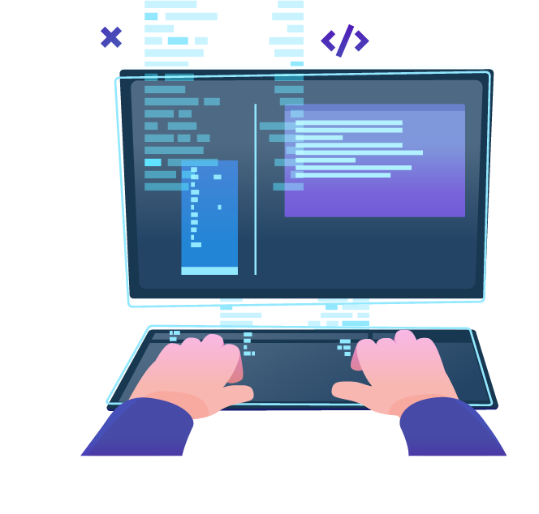
Node.js Web Server

Slide 53
Web Servers
All physical servers have hardware
The hardware is controlled by the operating system
Web servers are software products that use the operating system to handle web requests
Web servers serve Web content
The requests are redirected to other software products (ASP.NET, PHP, etc.), depending on the webserver settings

Slide 54
Node.js Web Server
Creating a simple Node.js web server
const http = require('http');
http.createServer((req, res) => {
res.write('Hi!');
res.end();
}).listen(1337);
console.log('Node.js server running on port 1337');

Slide 55

Request & Response Wrappers

Slide 56
The Request Wrapper
Used to handle incoming http requests
Properties
httpVersion - '1.1' or '1.0'
headers - object for request headers
method - 'GET', 'POST', etc.
url - the URL of the request

Slide 57
Request Wrapper Example
const http = require('http');
const url = require('url');
const port = 1337;
http.createServer((req, res) => {
let path = url.parse(req['url']).pathname;
if (path === '/') {
// TODO: Send 'Welcome to home page!'
}
}).listen(port);

Slide 58
The Response Wrapper
Used to retrieve a response to the client
Functions
Create response header
Send the actual content to the client
End the response

Slide 59
Response Wrapper Example
const http = require('http');
const port = 3000;
http.createServer((req, res) => {
res.writeHead(200, { // Response Status Code
'Content-Type': 'text/plain'
});
res.write('Hello from Node.js'); // UTF-8 Encoding
res.end(); // Always End the Response
}).listen(port);

Slide 60

Live Exercises

Slide 61

Summary
…
…
…
Node.js is a fast and asynchronous efficient package manager
Applications can be organized using module
NPM allows quick access to external modules
Web Servers transfer resources to the Client
The Request/Response Wrappers

Slide 62
Questions?
Notes:
62

Slide 63












SoftUni Diamond Partners

Slide 64


Educational Partners

Slide 65
Trainings @ Software University (SoftUni)
Software University – High-Quality Education, Profession and Job for Software Developers
softuni.bg
Software University Foundation
softuni.foundation
Software University @ Facebook
facebook.com/SoftwareUniversity
Software University Forums
forum.softuni.bg
Notes:
65

Slide 66

License
This course (slides, examples, demos, exercises, homework, documents, videos and other assets) is copyrighted content
Unauthorized copy, reproduction or use is illegal
© SoftUni – https://about.softuni.bg/
© Software University – https://softuni.bg
Notes:
66

