Slide 1
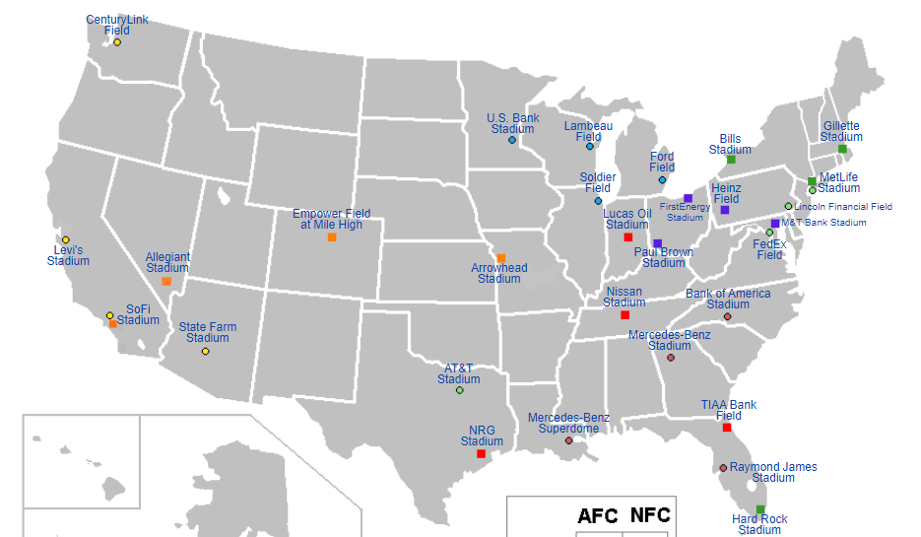

Slide 2
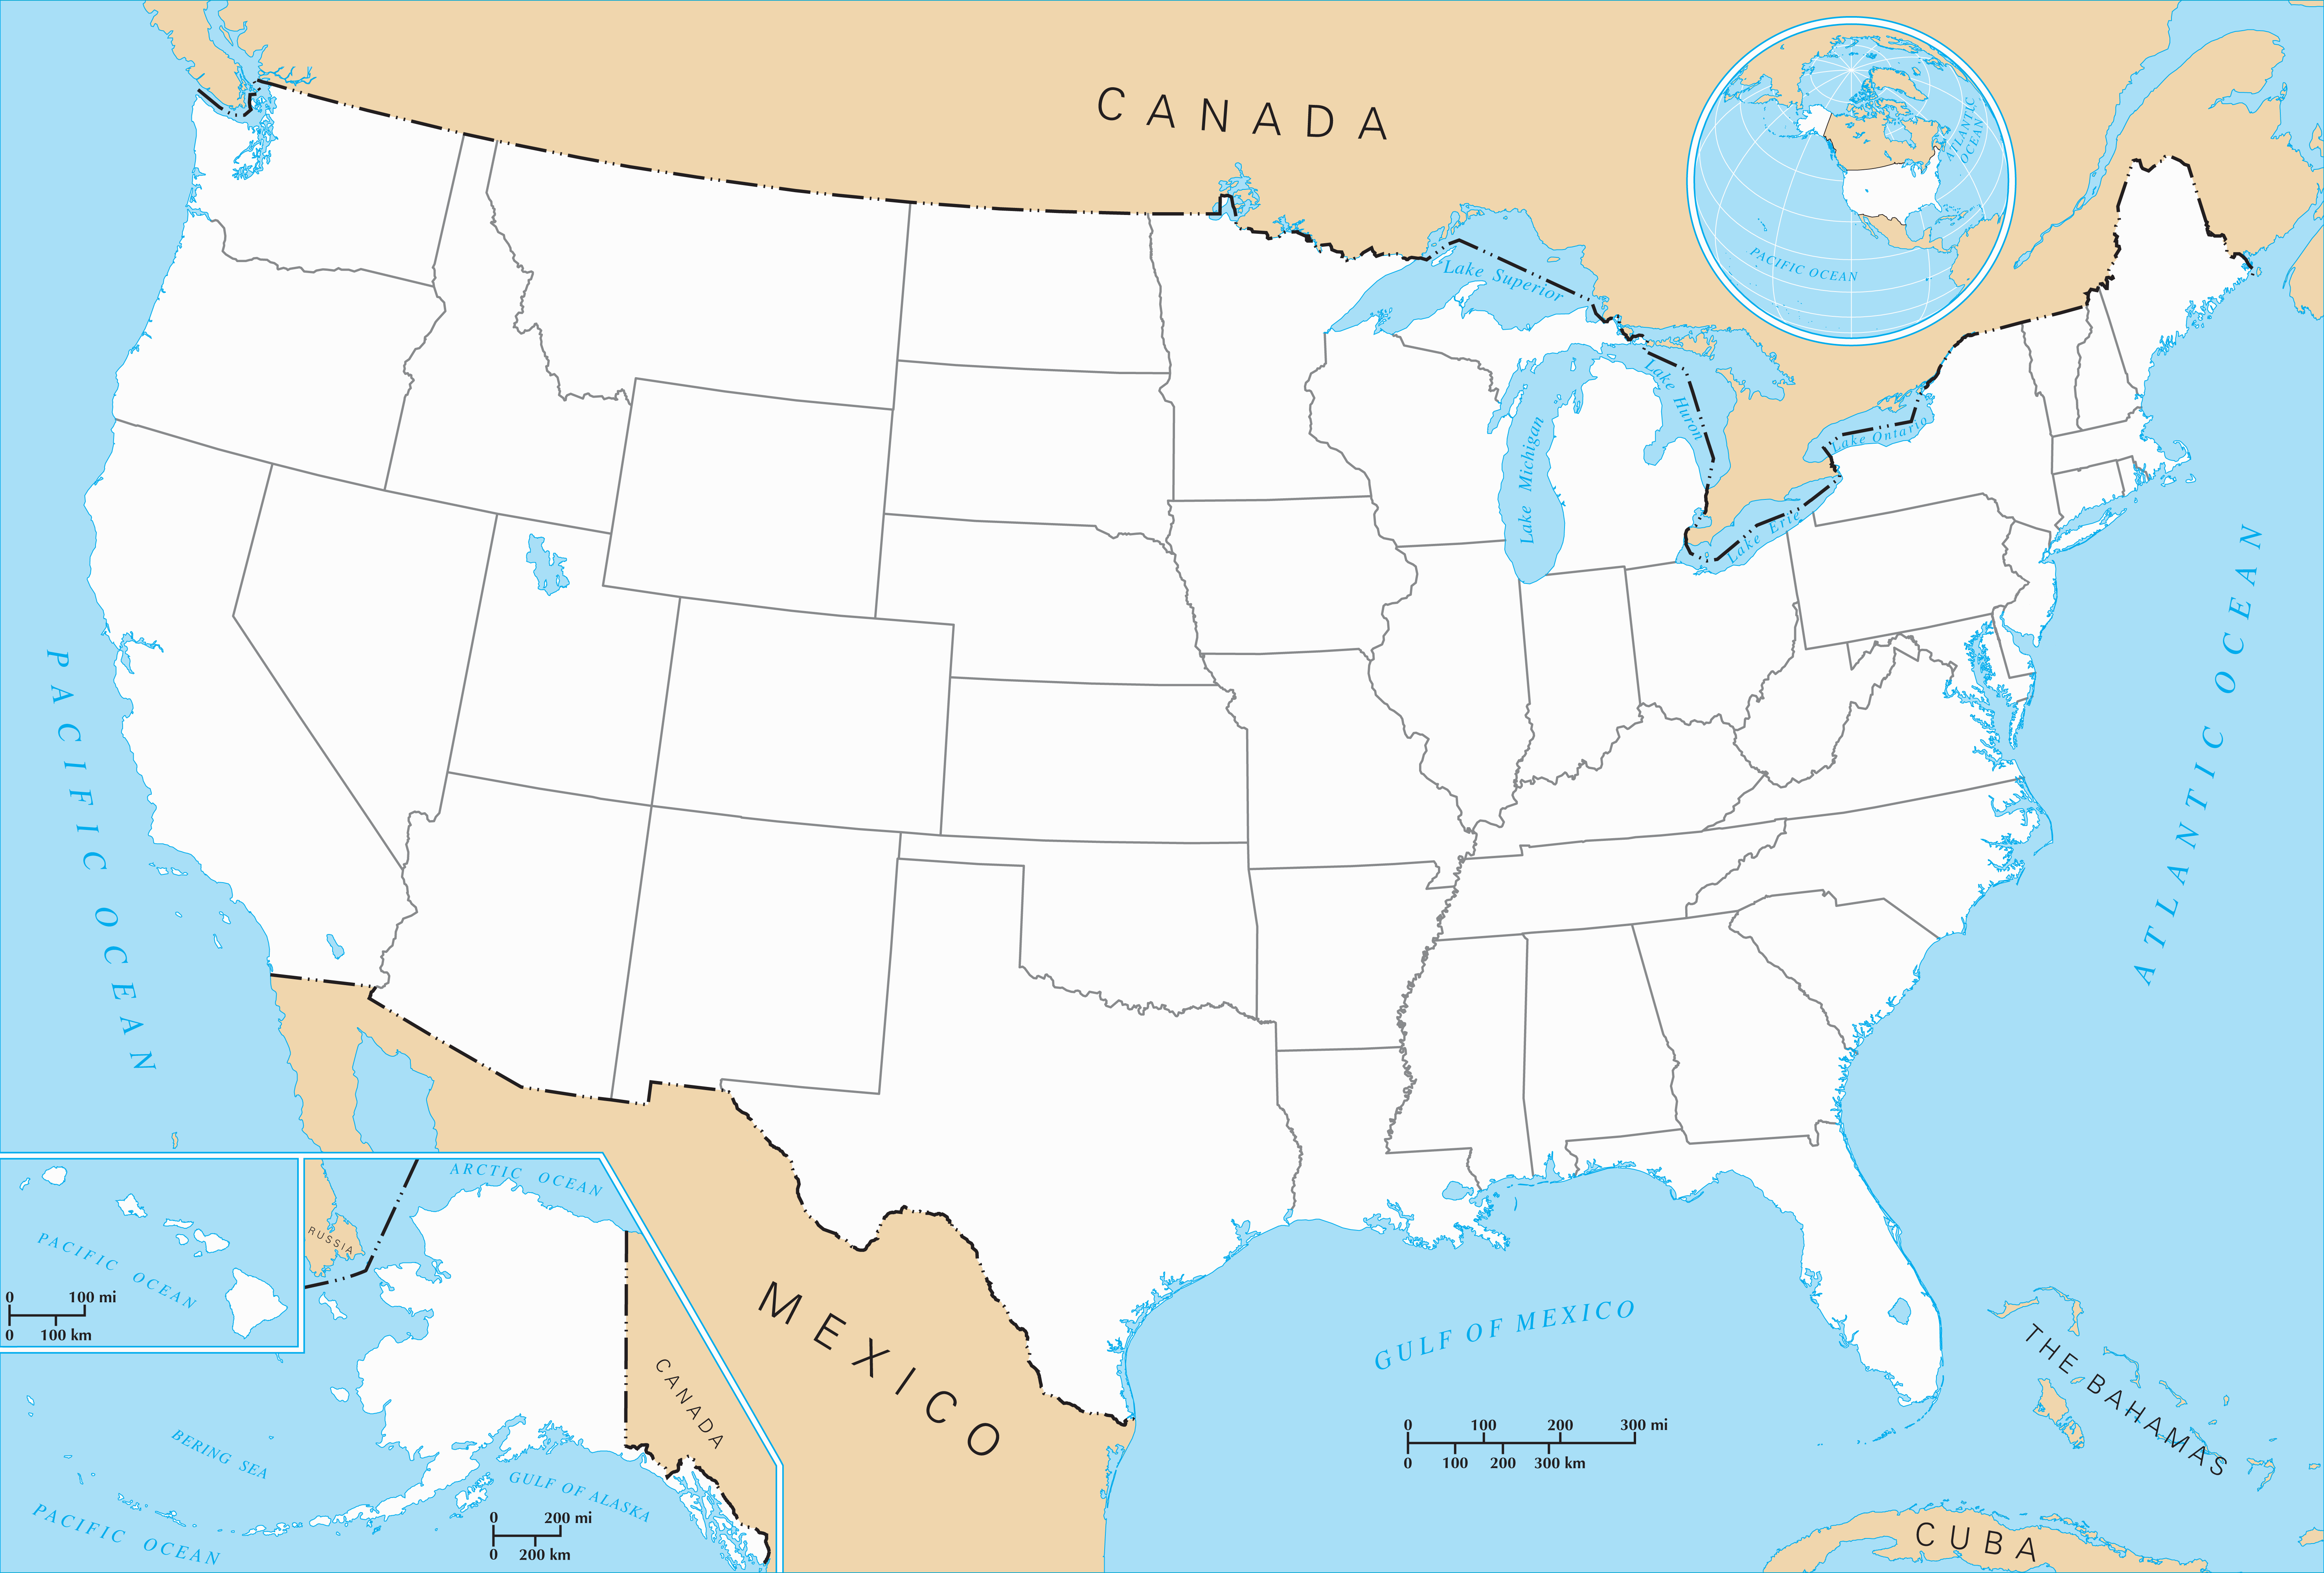
Century Link Field
2070
1390
U.S. Bank Stadium
1270
300
Bills Stadium
429
Gillette Stadium
Lambeau Field
430
Lincoln Financial
Field
210
195
80
Ford Field
225
315
80
50
1500
Soldier Field
240
90
50
FirstEnergy Stadium
115
M&T Bank Stadium
Metlife Stadium
Empower Stadium at Mile High
225
Heinz Field
90
930
Lucas Oil Stadium
250
Levi’s Stadium
560
415
260
700
FedEx Field
200
1015
Paul Brown Stadium
340
Arrowhead Stadium
470
240
365
SOFI Stadium
650
270
Allegiant Stadium
580
650
460
375
Bank of America Stadium
372
Nissan Stadium
225
1255
State Farm Stadium
870
740
Mercedes-Benz Stadium
342
AT&T Stadium
670
425
600
1115
230
TIAA Bank Field
320
480
170
Mercedes-Benz
Superdome
315
Stadium locations approximate
NRG Stadium
Raymond James Stadium
210
965
Hard Rock Stadium
Drawn by:
Cole Eastlund
CS1D Fall 2016

