Slide 1


Machine Learning Hackathon
Team Name- Machine_Overfit
Team Leader Name- Dhananjay Kumar
Team Leader Email Address- djsingh00@gmail.com

Slide 2
Brief Description of the Problem at hand:
The ad server logs contain valuable information such as browser details, IP addresses, geographic locations, search patterns, site urls, and other relevant data. The objective of the hackathon is to build a robust model that can accurately predict whether a user belongs to the HCP category and its specialization id/taxonomy.
Input: Ad server logs containing information on user behavior and other features
Output: Given a userid(userplatformuid) and ad server log, classify if the user is an HCP and its specialization (taxonomy). The output is divided into two parts:

Slide 3
Solution proposed and description:
HPC Classification : HPC classification problem mapped as binary classification problem
TAXONOMY Classification: The problem is mapped as multi class problem
For both the problem fine tune the pretrained classification BERT model

Slide 4
Classification Approach:
Concatenated the available data columns "KEYWORDS", "USERCITY", "DEVICETYPE", "CHANNELTYPE", "USERAGENT", "URL", "PLATFORMTYPE"
Tokenize the concatenated text using the BERT tokenizer
Created the torch dataset after tokenizing the concatenated text data and split the train data into train and validation dataset
Trained the pretrained BERT classification model with train dataset and validated the model over validation dataset
Finally, obtained test data instances score, whether instance belonging to HPC or Not HPC class and similarly for multi-class classification problem.

Slide 5
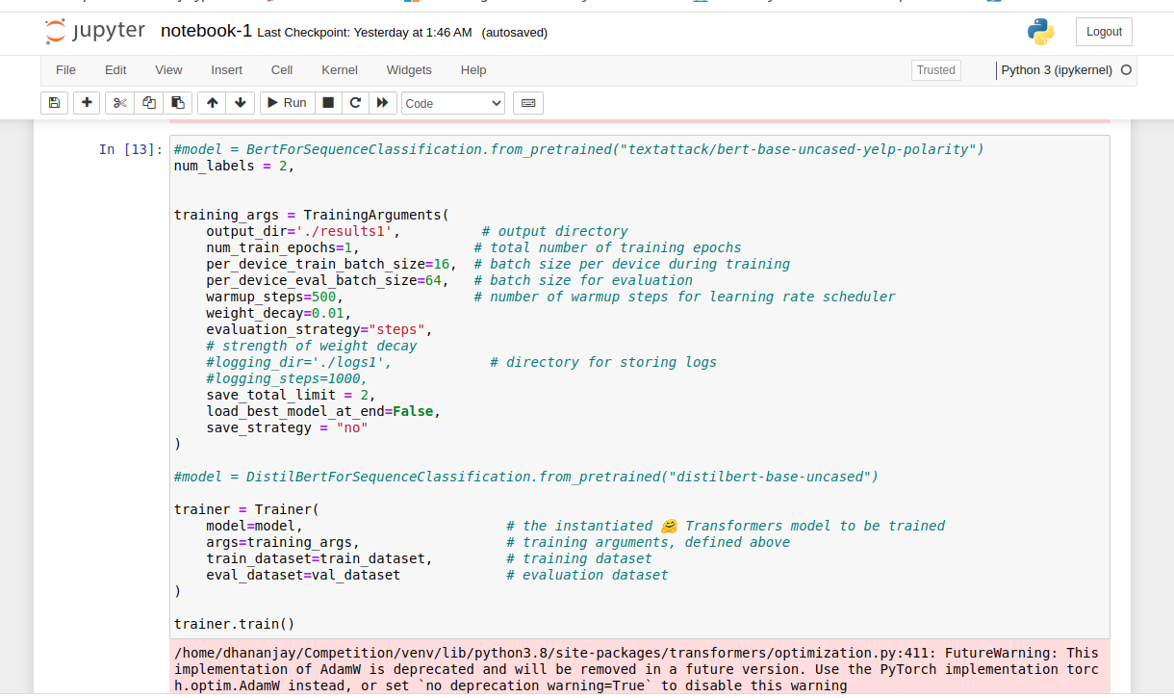
Screenshots of the Binary classification solution:

Slide 6
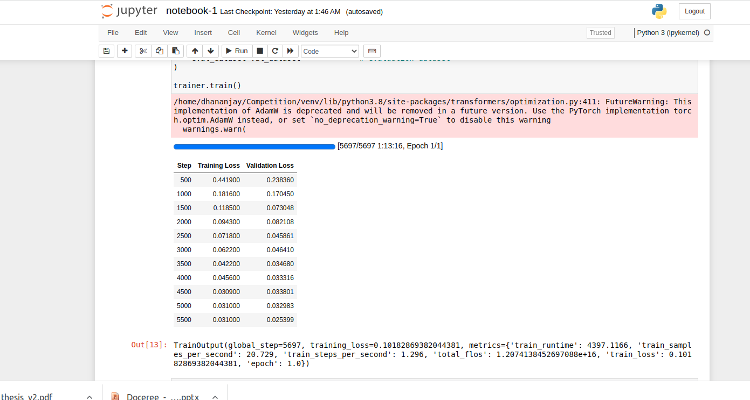
Screenshots of the Binary classification solution:

Slide 7
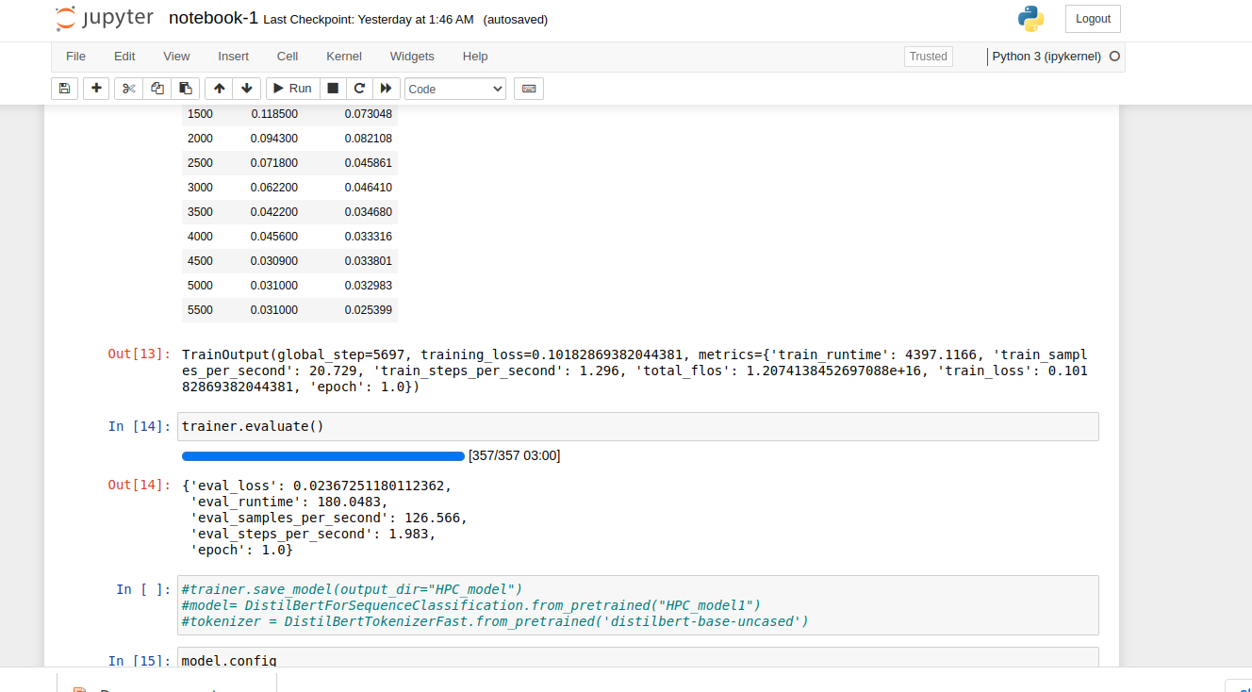
Screenshots of the Binary classification solution:

Slide 8
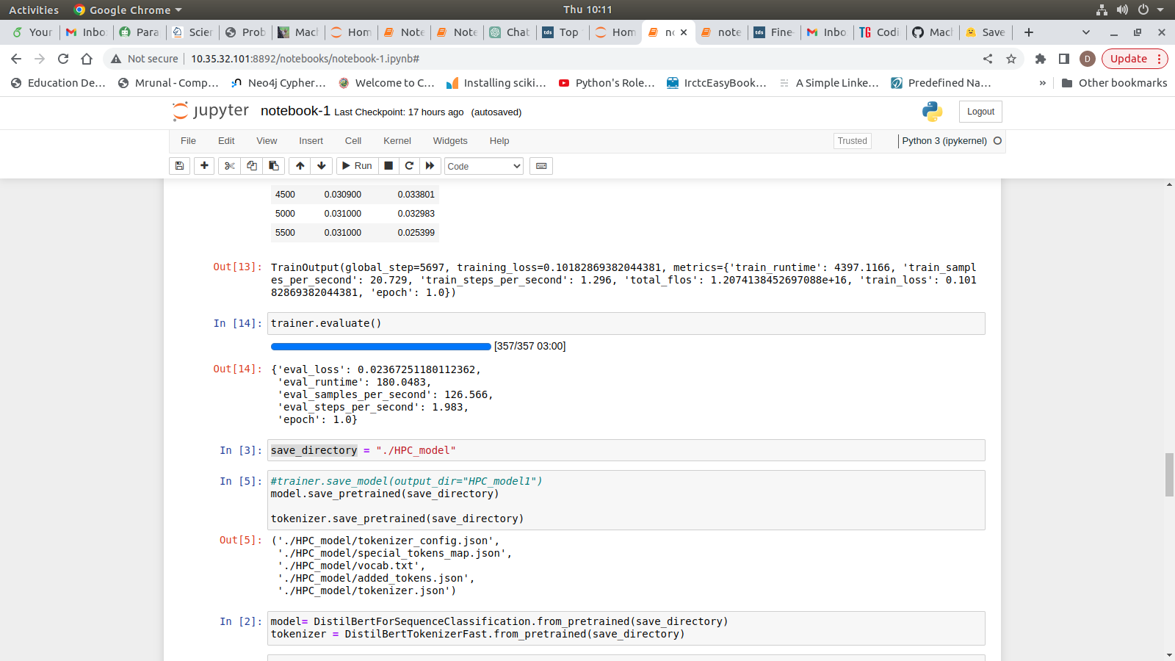
Screenshots of the HPC classification solution:

Slide 9
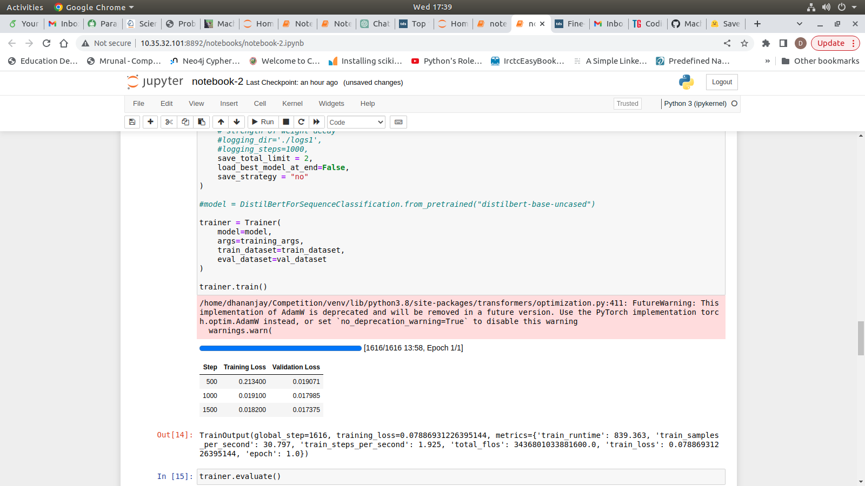
Screenshots of the Taxonomy classification solution:

Slide 10
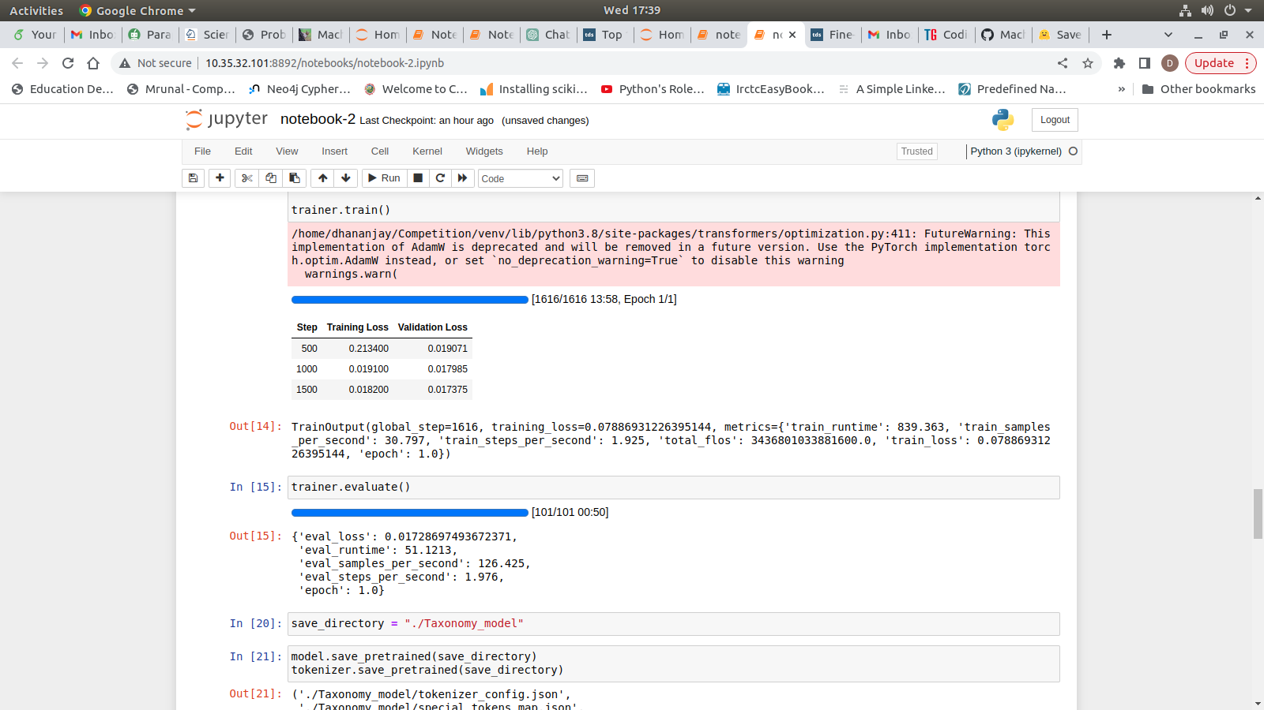
Screenshots of the Taxonomy classification solution:

Slide 11
THANK YOU!

